Slide 1
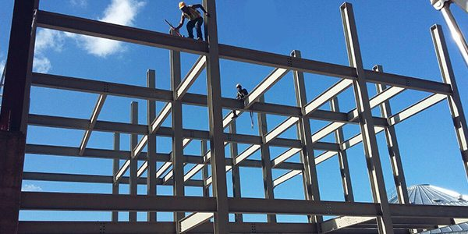
COLLEGE OF ENGINEERING AND TECHNOLOGY UNIVERSITY OF SARGODHA STEEL STRUCTURES (CT-313) (B.S TECHNOLOGY)
LECTURE-1,2&3
INTRODUCTION
Engr. Aqeel Ahmed
Lecturer, CET, UOS, Sargodha
16-Oct-2020

Slide 2
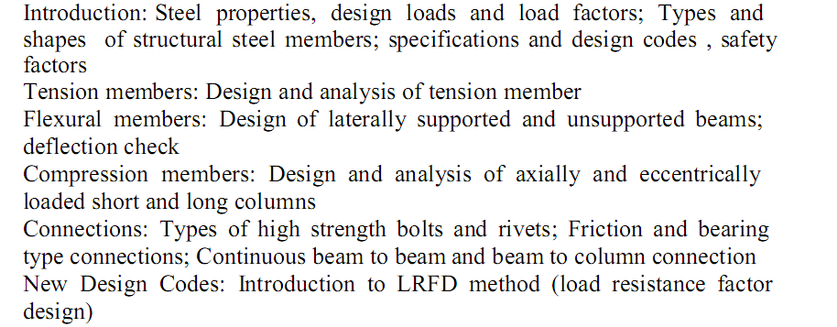
COURSE OUTLINES

Slide 3
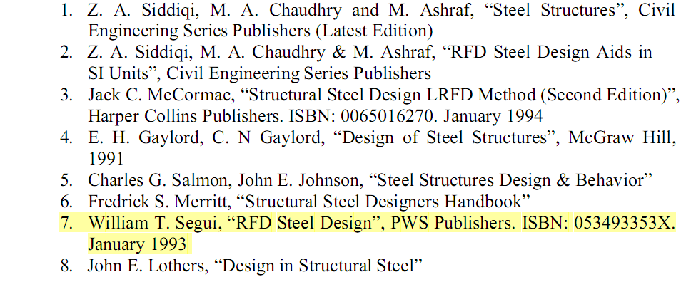
RECOMMENDED BOOKS

Slide 14
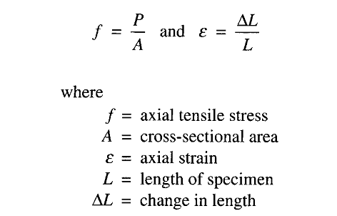

Slide 16
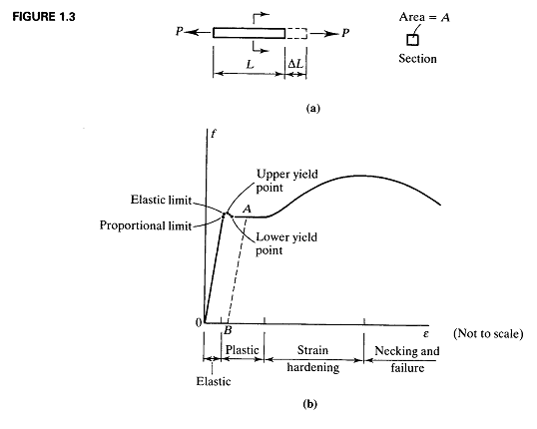

Slide 17
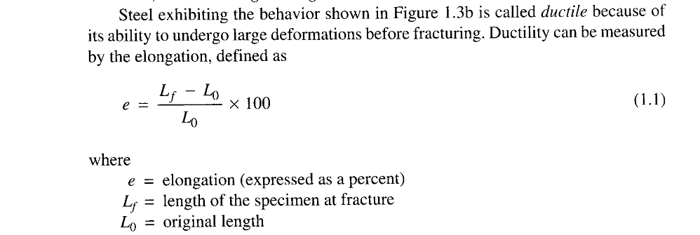
Ductility

Slide 18
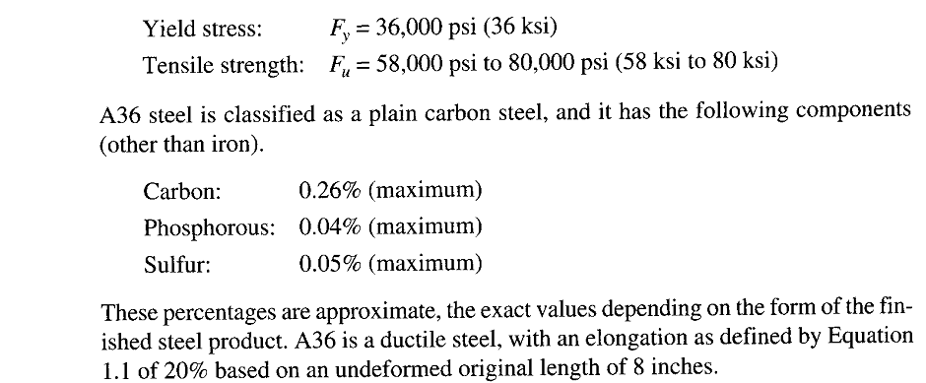
One of the most commonly used structural steels is mild steel designated as ASTM A36, or A36 for short and has the following tensile properties.

Slide 19
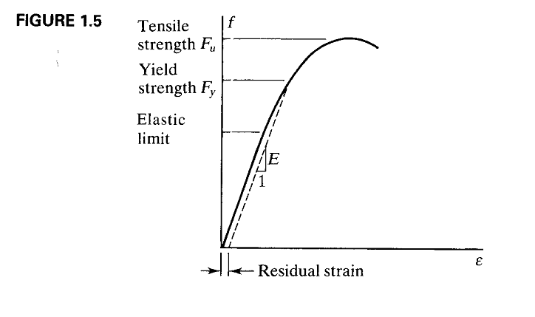

Slide 28
Lets Practice some problems for enhancing understanding of Stress and strain aspects

Slide 29
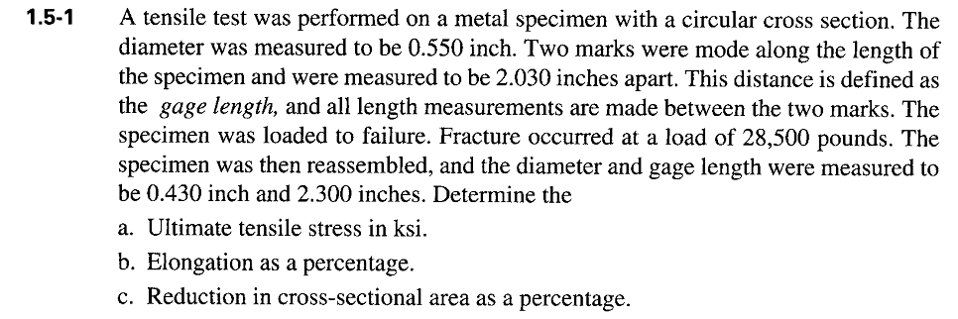

Slide 30
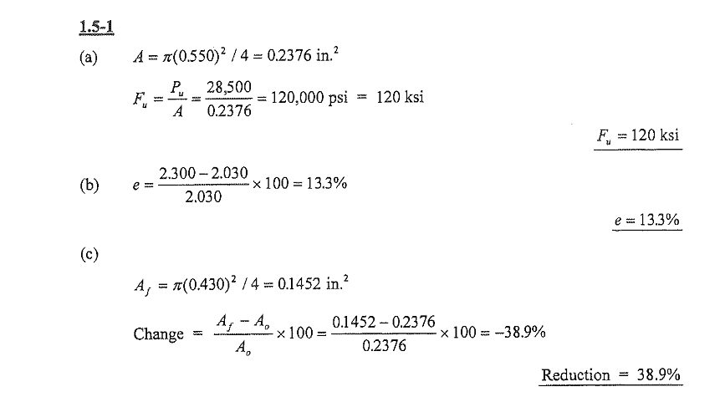
SOLUTION

Slide 32
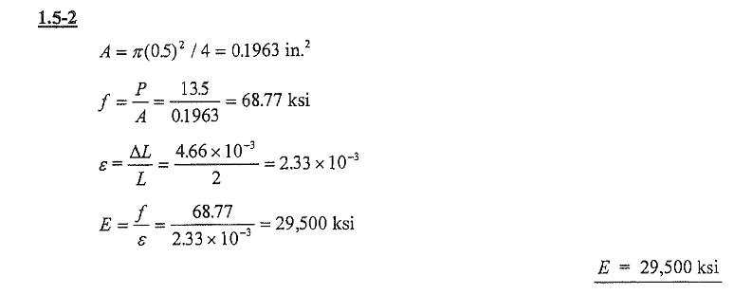
SOLUTION

Slide 33
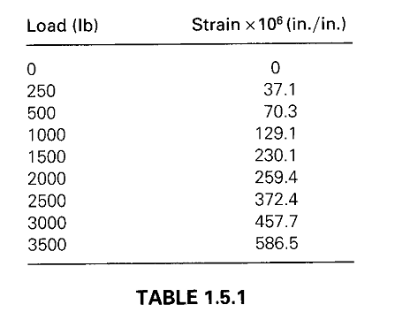

Slide 34
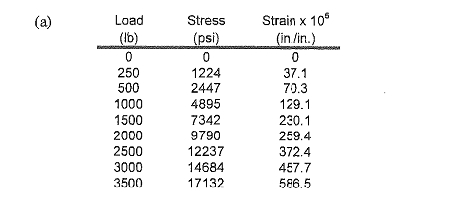
SOLUTION

Slide 35
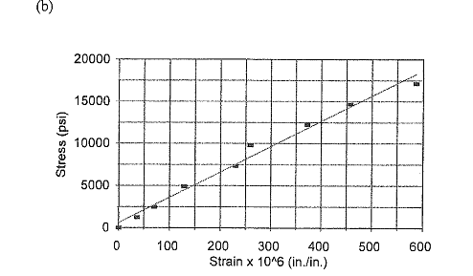
SOLUTION

Slide 36
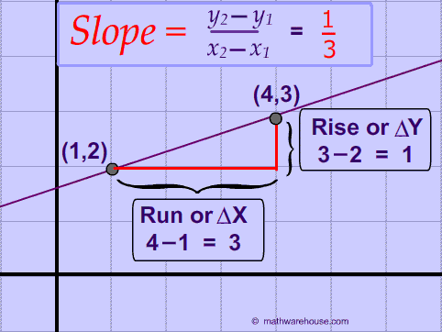

Slide 37
Assignment
Develop the previous problem stress strain curve on MS Excel

