Slide 1
CLASSIFICATION OF CARBOHYDRATES

Slide 2
A - Methods of Classification:
Several methods are used to classify carbohydrates.
1-One method of classification is based on whether the carbohydrate can be broken down into smaller units.
• Monosaccharides
cannot be broken down into smaller units by hydrolysis. Sometimes called simple sugars.
• Disaccharides
can be broken down (hydrolyzed) into two monosaccharide units.

Slide 3
• Oligosaccharides
can be broken into three to six monosaccharide units.
• Polysaccharides
composed of 7 or more mono-saccharide units

Slide 4
2-Another method is based on the number of carbons found in a simple sugar.
• If it has carbons it is called 3 a triose.
• If it has carbons it is called 4 a tetrose
• If it has carbons it is called 5 a pentose
• If it has carbons it is called 6 a hexose

Slide 5
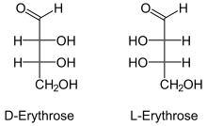
3-Another method uses the kind of carbonyl group.
A- Aldose:
A monosaccharide with an aldehyde group.

Slide 6
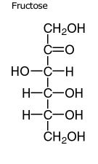
B- Ketose
A monosaccharide with a ketone group..

Slide 7
B- Stereoconfigurations of simple sugars.
Carbohydrates contain many stereocenters.
1- If the OH group is found on the right side of the carbon chain, the sugar is designated as a
D sugar.
2-If the OH group is found on the left side of the chain of carbons, the sugar is designated as an L sugar

Slide 10
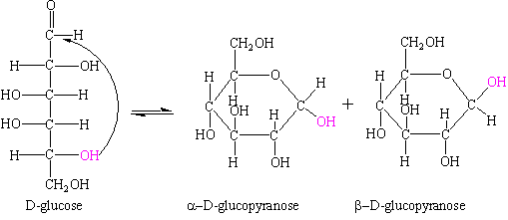
Cyclic Structures:
• Six membered sugar rings are known as
Pyranose rings.

Slide 11
Carbohydrate Anomers:
• Formation of either of the cyclic form has created a new
stereocenter.
• These stereoisomeric ring forms of carbohydrates are called Anomers
.Anomers:
are carbohydrates that differ by the stereo-configuration of the carbon involved in ring formation.
• The greek letters a and ß are used to describe the configuration about the ring forming carbon.
• The a anomer always has the OH group oriented in a
downward fashion on the anomeric carbon of a D-sugar.
• The ß anomer always has the OH group oriented in an upward
fashion on the anomeric carbon of a D-sugar.

Slide 12
Important Carbohydrates
Monosaccharides
composed of three to seven carbon atoms.
1- Glucose
• The most abundant hexose in our diet.
• The building block of complex carbohydrates.
• Component of the disaccharides: sucrose, maltose and lactose.
• Found in the polysaccharides: starch, cellulose and glycogen.

Slide 14
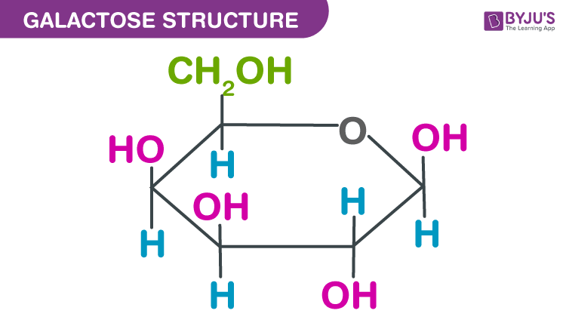
2. Galactose
Found in the disaccharide, lactose.
Found in the cellular membranes of the brain and nervous system.
•Galactose is the C-4 epimer of glucose.

Slide 15
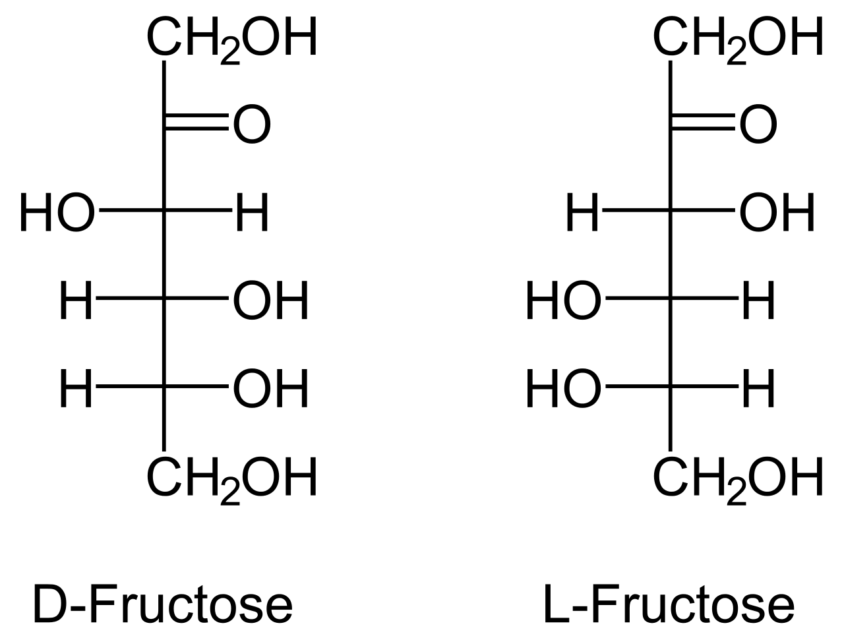
3. Fructose
• Sweetest of the carbohydrates.
• Component of the disaccharide sucrose.
• Fructose is a keto sugar

Slide 16
Important Carbohydrates
* Disaccharides
composed of 2 monosaccharide units.
1. Maltose - malt sugar.
• Used in cereals, candies and the brewing of beverages.
• Composed of two D-glucose sugars joined by an a-1,4 linkage.

Slide 18
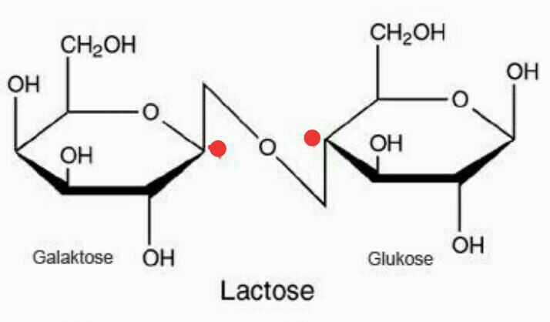
2. Lactose - milk sugar.
Found in milk and milk products.
Composed of one galactose and one glucose unit
joined by a ß-1,4 linkage.

Slide 19
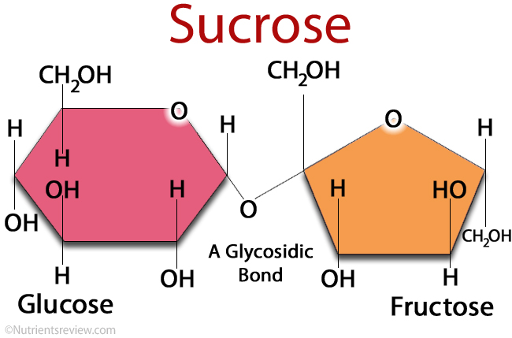
3. Sucrose - table sugar.
• Product of sugar cane and sugar beets.
• Composed of one glucose and one fructose unit.
• Linkage is at both anomeric carbons.

Slide 20
Important Carbohydrates
Polysaccharides
composed of many (more than 10) monosaccharide units.
1- Cellulose:
• Major structural material of plant cells.
• Consists of many glucose units joined by ß-1,4
linkages.

Slide 21
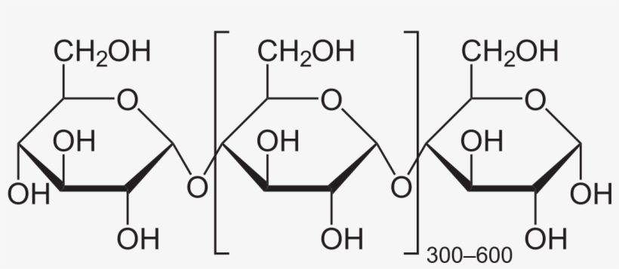
2. Starch:
Storage form of glucose found in rice wheat, potatoes, grains and cereals.
Consists of many glucose units joined by a-1,4 linkages.
Maltose is the disaccharide starting material.

Slide 22
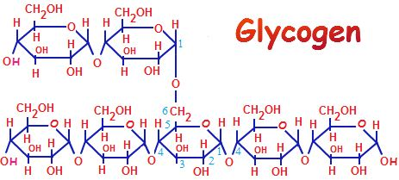
3. Glycogen:
Animal starch. Storage form of glucose found in the liver
and muscle of animals.
Contains many highly branched glucose units.
Joined by a-1,4 linkages and branched by a-1,6 linkages.

Slide 23
4. Dextrin:
• Mixture of branched and un-branched soluble
polysaccharides produced by partial hydrolysis of
starch by acids or amylases.
Reducing sugars
• Any sugar that contains either:
1- a free aldehyde group.
2-An a-hydroxy ketone group.
3-A hemiacetal linkage
• The presence of any of these groups allows the
carbohydrate to undergo easy oxidation.
• If the sugar gets oxidized it causes reduction. Thus the name “reducing sugar”.

