Slide 1
Maintaining Data

Slide 2
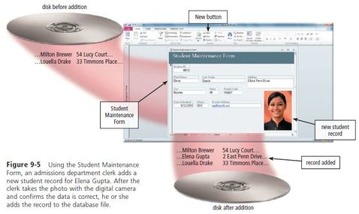
File maintenance refers to the procedures that keep data current. File maintenance procedures include adding records to, modifying records in, and deleting records from a file. Adding Records Users add new records to a file when they obtain new data. If a new student is admitted to the school, an admissions department clerk adds a new record to the Student file. The process required to add this record to the file might include the following steps: 1. An admissions department clerk uses the database management system (DBMS) to display a Student Maintenance Form that gives him or her access to the Student file.
2. The clerk fills in the fields of the student record with data (except for the Student ID, which automatically is assigned by the DBMS). 3. The clerk takes a picture of the student using a digital camera. 4. The admissions department clerk verifies the data on the screen and then instructs the DBMS to add the new student record to the Student file.

Slide 3
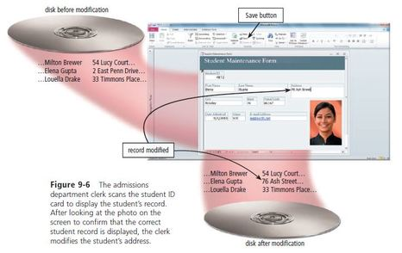
3. The clerk takes a picture of the student using a digital camera. 4. The admissions department clerk verifies the data on the screen and then instructs the DBMS to add the new student record to the Student file.
Modifying Records Generally, users modify a record in a file for two reasons: (1) to correct inaccurate data or (2) to update old data with new data. Suppose, for example, that Samantha Gastanes moves from 2 East Penn Drive to 212 F. Ramos Street. The process to change the address and update Elena Gupta’s record might include the following steps:
1. The admissions department clerk displays the Student Maintenance Form. 2. Assuming Elena Gupta is present, the clerk inserts Elena’s student ID card in a card reader to display her student record on the screen. If Elena did not have her ID card or was not present, the clerk could enter Elena’s student ID number — if Elena knew it. Otherwise, the clerk could enter Gupta in the Last Name field, which would retrieve all students with that same last name. The clerk then would scroll through all of the retrieved records to determine which one is Elena’s.

Slide 4
3. The DBMS displays data about Elena Gupta so that the clerk can confirm the correct student record is displayed. 4. The clerk enters the new street address, 76 Ash Street. 5. The admissions department clerk verifies the data on the screen and then, if required, clicks the save button to modify the record in the Student file. The DBMS modifies the record on the disk.
Deleting Records When a record no longer is needed, a user deletes it from a file. Assume a student named Kate Mendiola is moving out of the country. The process required to delete a record from a file includes the following steps: 1. The admissions department clerk displays the Student Maintenance Form. 2. The clerk displays Benjamin Tu’s student record on the screen. 3. The clerk confirms the correct student record is displayed. Then, the clerk clicks the Delete button to delete the record from the Student file and then, if required, clicks the Save button to save the modified file.

Slide 5
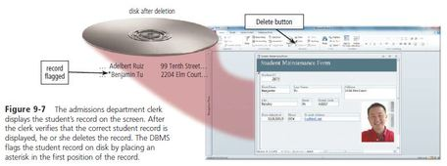
DBMSs use a variety of techniques to manage deleted records. Sometimes, the DBMS removes the record from the file immediately, which means the deleted record cannot be restored. Other times, the record is flagged, or marked, so the DBMS will not process it again. In this case, the DBMS places an asterisk (*) or some other character at the beginning of the record.
DBMSs that maintain inactive data for an extended period commonly flag records. For example, a school might flag inactive students. When a DBMS flags a deleted record, the record remains physically on the disk. The record, however, is deleted logically because the DBMS will not process it

Slide 6
Validating Data Validation is the process of comparing data with a set of rules or values to find out if the data is correct. Many programs perform a validity check that analyzes data, either as you enter it or after you enter it, to help ensure that it is correct. Validity checks reduce data entry errors. Various types of validity checks include alphabetic checks, numeric checks, range checks, consistency checks, and completeness checks. Check digits also validate data accuracy.
Alphabetic/Numeric Check An alphabetic check ensures that users enter only alphabetic data into a field. A numeric check ensures that users enter only numeric data into a field. Range Check A range check determines whether a number is within a specified range. Consistency Check A consistency check tests the data in two or more associated fields to ensure that the relationship is logical and their data is in the correct format.

Slide 7
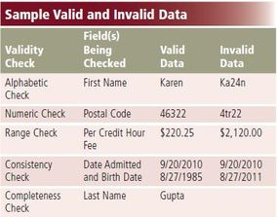
Completeness Check A completeness check verifies that a required field contains data. Check Digit A check digit is a number(s) or character(s) that is appended to or inserted in a primary key value. It often confirms the accuracy of a primary key value. Bank account, credit card, and other identification numbers often include one or more check digits.
Other Checks DBMSs that include hyperlink and attachment data types can perform validity checks on data entered in those fields. Hyperlink entries can be tested to ensure that the Web address follows the correct format and that the link works. Similarly, an attachment entry can be validated by confirming that the file exists.

