Slide 1
Role of textile designer

Slide 2
Textile Design
Textile design is the process of creating designs and structures for knitted, woven, non-woven or embellishments of fabrics. Textile designing involves producing patterns for cloth used in clothing, household textiles (such as towels) and decorative textiles such as carpets.

Slide 3
In other word, Textile design generally refers to the process of creating designs for knitted, woven, printed and mixed-media fabrics. The textile designer needs to be able to understand how to produce a design for a particular fabric type. In addition to this, they also need to be able to develop a textile design that is suitable for a given purpose – usually for the body, or for a particular space. Designers also require a good understanding of current trends, colour awareness and contemporary design issues, in order that their designs are up-to-date and relevant for their end purpose.

Slide 4
Textile design is an extensive subject that covers a wealth of design contexts, from wallpaper to clothing. Due to this breadth, textile design overlaps, links, and drives and innovates many other areas of design practice, including fashion, jewellery and architecture

Slide 5
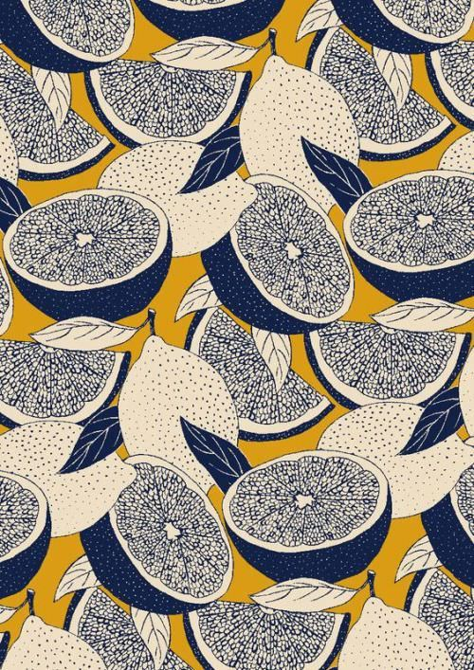

Slide 6
ROLES OF THE TEXTILE DESIGNER:
Textile designers have a wide range of roles and are often required to make decisions throughout the design process. For most, design practice begins with discussions with potential clients. Through presenting visual mood boards, portfolio work and verbal presentations, the designer discusses potential concepts and shows examples of previous design work in order to demonstrate their suitability for the project. This process is applicable to both freelance and in-house designers where they may have to pitch ideas to senior management within their design team and with their external clients. This also often involves trend forecasting themes and factors related to costs, sourcing materials, marketing and branding.

Slide 7
In short, the role of the designer is multifaceted and design is only one aspect of their role. Traditionally, the textile designer’s major role was within colour, pattern and fabric aesthetics. This role is now evolving. Through the development of new technologies and social media, consumers and clients today can be involved in the design process from the start. Known as customization, the designer is not only designing but also working as a facilitator or co-participant with end users. The role of the textile designer becomes ever more complex and exciting.

Slide 8
RESPONSIBILITIES OF A TEXTILE DESIGNER:
Technological advances and changes in consumer lifestyles, together with sustainability and environmental issues, are increasingly becoming major factors for the designer to consider throughout the design process. An awareness of sustainability issues is imperative for designers.

Slide 9
Designers are now required to consider where their materials originate from. Were they ethically sourced? Where did they come from? What processes were used in their production? Can waste be reduced? What is the life cycle of the product and can it be recycled? What are the long-term implications of your design? Is it biodegradable? These are just some of the questions that textile designers are now being asked to consider.

Slide 10
Ethical and environmental considerations challenge designers in new ways. Many designers today recognize their responsibilities in reducing waste and their impact on the environment. Design companies are increasingly using their environmental and ethical policies as part of their marketing and branding strategies to encourage consumers to buy.

