Slide 1
Plant genetic resources
Genetic resources and conservation
BS Biotechnology (6th Semester)
University of Sargodha

Slide 2
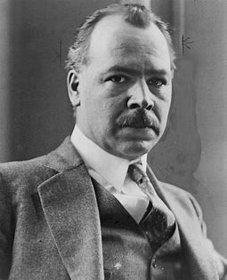
Plant genetic resources (PGR)
PGR is a repository of all genes of beneficial characters
N.I. Vavilov is considered as father of plant genetic resources. He identified center of origin also know a center of diversity in 1924.
Vavilov (1887-1943) was a Russian scientist who headed the Lenin All-Union Academy of Agricultural Sciences (later named the Vavilov All-Union Institute of Plant Industry in his honor) from 1920 to 1940. He established 400 research institutes that employed up to 20,000 people. He planned to collect all of the useful germplasm that had potential in the Soviet Union, to classify it, and to use it in a national plant breeding effort.
Vavilov said that “The theories of source material and origin of cultivated plants must be fundamental for scientific plant breeding”

Slide 3
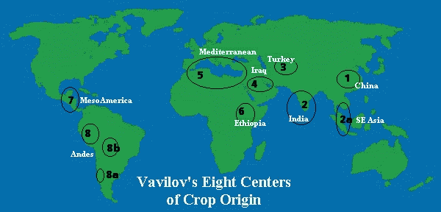
Center of origin
A centre of origin (or centre of diversity) is a geographical area where a group of organisms, either domesticated or wild, first developed its distinctive properties.
A Vavilov Centre (of Diversity) is a region of the world first indicated by Vavilov to be an original centre for the domestication of plants
Vavilov argued that plants were not domesticated somewhere in the world at random, but that there were regions where domestication started. Vavilov centres are regions where a high diversity of crop wild relative can be found, representing the natural relatives of domesticated crop plants

Slide 4
Types of center of origin
Primary center of origin
Wide genetic diversity
More wild characters
Less crossing over
Natural selection operates
More number of dominant genes
Secondary center of origin
Lesser genetic diversity
More desirable characters
More crossing over
Natural and artificial selection operates
More number of recessive genes

Slide 5
Meaning of Plant genetic resources
Genetic information encoded by genome
Biological mechanisms for translating genetic information into phenotypes
Form nd level of biological organization whereby the genes and phenotypes perpetuate

Slide 6
Importance of Plant genetic resources
Vicious cycle of cultivated crops
Narrow genetic base
Value of local landraces in plant breeding
Landrace: it is domesticated, locally adapted traditional variety, which has adaptation to its natural and cultural environment of agriculture
Cultivar: it is shorter form of Cultivated variety. It is selectively bred to conform to a particular standard of characteristics.

Slide 7
Role of plant genetic resources
Keystone of natural and manmade ecosystem
Human economics and subsitence
Improvement of the traditional agriculture systems
Improvement of crop cultivars

Slide 8
Sustainable use of plant genetic resources
It was bottleneck of Green revolution varieties. Inclusion of Plant genetic resources offers a way forward to sustainability of high yielding varieties.
Tapping/use of landrace potential
Yield maximization through the use of plant genetic resources
Stress breeding

