Slide 1
Auscultation

Slide 2
Definition
Medical term for using a stethoscope to listen to the sounds inside of your body
No risk or side effects
Used to detect sound connected with lungs , heart and abdomen
Robert Hooke(1635-1703) included in his writings
“There may also be a possibility of discovering the internal motions and actions of bodies by the sound they make”

Slide 3
Types of Auscultation
Immediate Auscultation
Mediate Auscultation
Doppler Auscultation

Slide 4
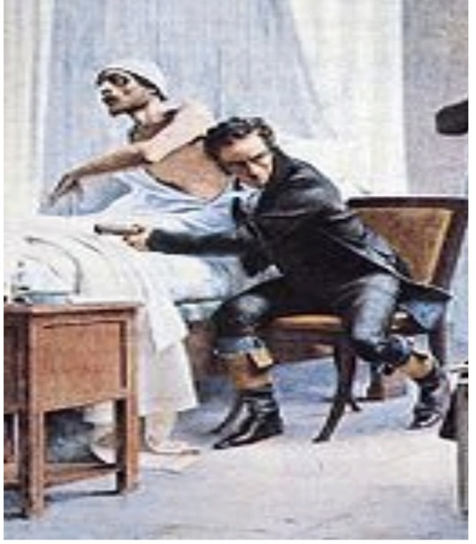
Immediate Auscultation
It is a medical term used for listening to the internal sounds of the body , directly placing the ear on the body

Slide 5
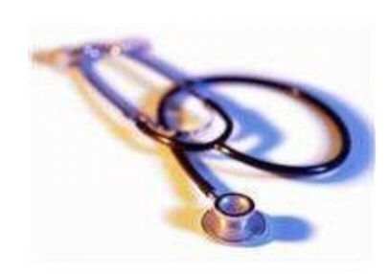
Mediate Auscultation
It is a medical term used for listening to the internal sounds of the body using an instrument , usually a stethoscope

Slide 6
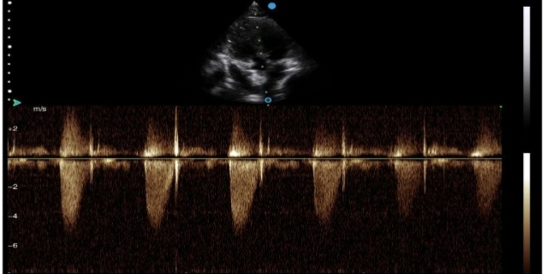
Doppler Auscultation
In this type of auscultation a device called doppler is used to listen sounds in the body
It is similar to ultrasound

Slide 7
Uses
Abnormal sound may indicate problems in lungs, abdomen , heart, blood vessels
Potential issues can include ;
Irregular heart rate
Crohn’s disease
phlegm

Slide 8
Crohn’s disease;
Inflammatory bowel disease causes inflamation of digestive tract lead to abdominal pain , diarrhea, fatigue and weight loss
Phlegm;
Thick mucus secreted in respiratory passages and discharged through mouth ;as during cold

Slide 9
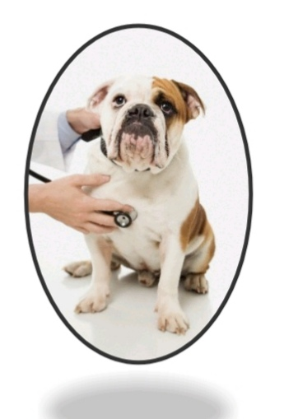
Methods
Heart
Doctor listens to the region where heart valve sounds are loudest
Doctor listens for;
What your heard sounds like
How often each sound occur
How loud the sound is

Slide 10
The first sound is heard best over cardiac apex while second sound is over the base of the heart
It is necessary to move the stethoscope to three or four positions over the area of heart in order to determine abnormal sounds(intensity, rate, rhythm)

Slide 11
Heart rate
Heart rate is the indication of the metabolic rate animal
Toxemia , pain and various forms of anoxia are the common cause of increased heart rate
Toxemia : condition in pregnency characterized by hypertention , leakage of large amount of protein albumin into urine , and swelling of hands , feet and face
Anoxia : reduced oxygen level

Slide 12
Cardiac rhythm
Is an indication of the state of the impulse conduction mechanism of the heart
In many cases abnormilities in rhythm require use of an Electrocardiogram (ECG) for positive diagnosis

Slide 13
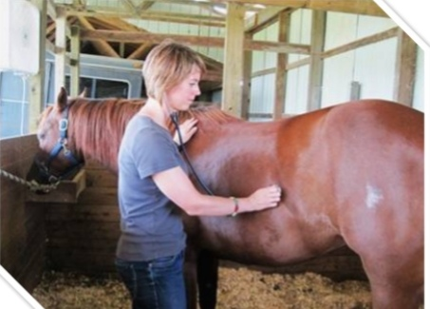
Sinus Arrhythmia
Is observed commonly in domestic animals
It is characterized by quickening of heart during inspiration and slowing during expiration

Slide 14
Heart Block
This condition may occur in any of three degrees
1) ECG diagnosis
2) dropping of odd ventricular beat
3)slow heart rate
Now a days phonocardiology used in diagnostic medicine to diffentiate various murmurs
Murmurs;
Heart sound produced when blood is pumped across heart valve.

Slide 15
Abdomen
Doctor listens to one ormore regions of animal’s abdomen separately to listen to bowel sounds
They may hear swishing, gurgling or nothing at all
Sound informs what happeing in your intestine

Slide 16
Lungs
Doctor compare one side with the other
Airflow sounds differently when airways are blocked , narrowed, or filled with fluid
Also listens abnormal sound such as wheezing
Sound in lungs are numerous types;
1)bronchial tones
2)vesicular murmurs
3)rales

Slide 17
Alternatives
Palpation
doctor can perform a palpation simply by placing their fingers on artries to measure systolic pressure
Percussion
It involves doctor taping their fingers on various parts of your abdomen

Slide 18
Importance
Auscultation gives your doctor a basic idea about what’s occuring in your body
Your heart,lungs,and other organs in your abdomen can all be tested using auscultation and other similar methods
You might need additional tests for a diagnosis depending on the sound, doctor hears

Slide 19
Feces
Feces (or faeces) are the solid or semisolid remains of food that could not be digested in the small intestine.
Bacteria in the large intestine further break down the material.
Feces contain a relatively small amount of metabolic waste products such as bacterially altered bilirubin, and the dead epithelial cells from the lining of the gut.

Slide 20
Feces are discharged through the anus or cloaca during defecation

Slide 21
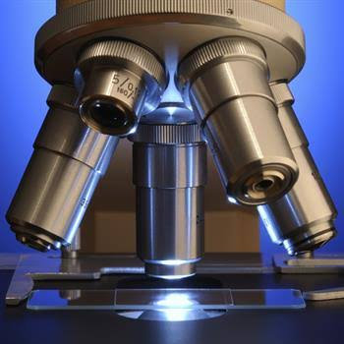
Microscopic Examination

Slide 22
What is Fecal Examination
Fecal examination is the microscopic evaluation of feces.
The test is indicated for pets With diaherra,lack of apitite,vomiting.
Annual fecal examinations are recommended on all animals as a part of yearly health exam.
Fecal examination are also recommended on all puppies and kittens.

Slide 23
Materials and Supplies
To examine your animals for worms, eggs and coccidia you will need a microscope and some basic supplies. You do not need an elaborate microscope.
Other supplies that you will need are plain microscope slides, cover slips, cheesecloth or a strainer, test tubes (or 12cc syringe covers), a stirring rod

Slide 24
Materials and Supplies
fecal flotation solution (sugar or salt can be used) and a test tube holding rack.
For the rack, you can punch holes in a cardboard box or a styrofoam block or use any device that will hold the test tubes in a vertical position.

Slide 25
Collection
When collecting fecal samples, first make certain that the feces is from the animal in question. Secondly, secure a fresh sample that is free from rocks, soil, bedding, and other foreign materials. Place the fecal sample in a plastic vial, glass jar, waxed cup, or plastic bag. If the examination does not follow closely after collection, preserve the sample in a refrigerator.

Slide 26
Gross Examination
The gross examination method involves visual observation of the fecal material. Consider these characteristics in gross examinations of feces: color and consistency of the feces and the presence of mucus, blood, undigested food, and parasites.

Slide 27
Physical Examination
The physical examination of urine includes quantity, specific gravity, color, odor, and consistency. The quantity measurement refers to the amount urinated in a 24-hour period.

Slide 28
Chemical Examination
Chemical examination of urine includes tests for pH (acidity or alkalinity), albumin, sugar, bile, acetone, calcium, bilirubin.Simple test kits are available for urinalysis.
The assistant will learn and conduct all tests and procedures under the direct supervision of a veterinarian.

Slide 29
Microscopic Examination
Perform microscopic examination of urinary sediment after centrifugation of a urine sample. Classify the sediments in the urine as organized and unorganized. Organized sediments include epithelial cells, blood cells, mucous threads, and microorganisms, such as bacteria, yeasts, and fungi

Slide 30
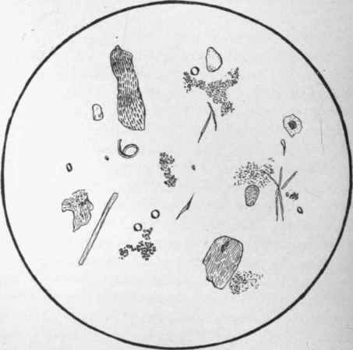

Slide 31
Fecal Analysis Methods
Mix up the flotation solution. It should be saturated. This means that you dissolve as much solid in the water as it will hold. You can use a variety of chemicals including salt or sugar.

Slide 32
Fecal Analysis Methods
Collect fresh feces. Use an old pill bottle or a small jar for each animal. Be sure to label the container with the date, time and animal that provided the specimen.
Place 3 or 4 fresh goat pellets (one to three grams) into a test tube and pour in just enough flotation solution to cover them.

Slide 33
Mash them up in the liquid with your stirring rod. Add more of the solution and pour it through the strainer or cheesecloth to remove the large particles. Now, pour the strained liquid into a clean test tube.

Slide 34
Next, fill up the test tube to the very top with more liquid. Place a microscope cover slip over the top. There should be no air between the cover slip and the liquid. Over time (20-30 minutes) the eggs will float up to the top and adhere to the glass plate.

Slide 35
Carefully remove the cover slip and lower it at an angle over a microscope slide with the sample sandwiched between both pieces of glass.
Start with the lowest power (40x) on your microscope and carefully move up to 100x and even 400x
Note, you will also be looking at other debris. Do not confuse it with parasites.

Slide 36
You should be able to see coccidia oocysts, nematode eggs, and some tapeworm eggs. Nematode eggs are shed by a large number of nematodes (worms), most of which cannot be easily distinguished from each other with this type of procedure.

Slide 37
Why we do This?
Fecal examinations are primarily performed to detect Microscopic gastrointestinal parasites,such as :
Roundworm
Hookworm
Whipworm
Coccidia
Tapeworm

Slide 38
Some abnormal parasites known as spirochetes or flagellates can also be detected
A positive result indicates gastrointestinal parasitic disease.
Negative result from one fecal sample may be misleading.
Some parasites do not shed eggs consistently so some sample may be negative even though the animal actually has a parasitic infection.
Repeated fecal examination may be necessary to detect some elusive parasites.

Slide 39
Spirochetea
Spirochetes can be found in large numbers in the colonic crypts of normal dogs.
In dogs with diarrhea, spirochetes can appear in the feces in large numbers.
Pilosicoli can be isolated from dogs with diarrhea and intestinal spirochetosis, whereas B. canis were commonly isolated from healthy dogs.
This disese usually occur rarely in dogs.

Slide 40
Spirochetea

Slide 41
Coccidiosis
Coccidiosis is a parasitic disease of the intestinal tract of animals caused by coccidian protozoa.
The disease spreads from one animal to another by contact with infected feces or ingestion of infected tissue.
can be one of the most economically devastating in many livestock species.
Coccidiosis is a parasitic disease of the intestinal tract of animals caused by coccidian protozoa.

Slide 42
The disease spreads from one animal to another by contact with infected feces or ingestion of infected tissue.
Diarrhea, which may become bloody in severe cases, is the primary symptom.
Most animals infected with coccidia are asymptomatic, but young or immunocompromised animals may suffer severe symptoms and death.

Slide 43
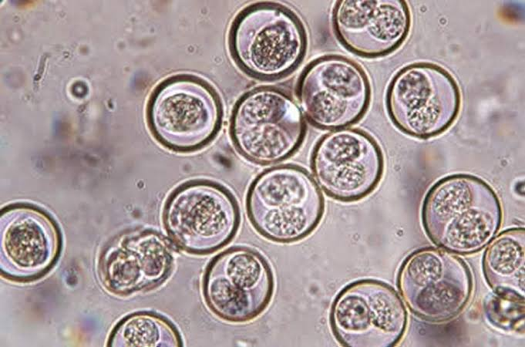

Slide 44
Roundworms
Roundworms are the most common of the parasitic worms found inside a dog.
Almost all dogs become infected with them at some time in their lives, usually as puppies.
Roundworms may be contracted in different ways, making them easy to spread and hard to control.
Dog may be infected with roundworms from the time it is born because often the mother passes the worms to the puppy while it is still in her body.

Slide 45
Adult roundworms live in the affected dog's intestines.
Many dogs do not have signs of infection; however, dogs with major roundworm infections, especially puppies, show diarrhea, vomiting, weight loss, dull hair, and a potbellied appearance.
The dog may cough if the roundworms move into the lungs.

Slide 46
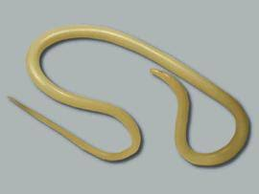

Slide 47
Hookworms
Hookworms are intestinal parasites that live in the digestive system of your dog (or cat).
The hookworm attaches to the lining of the intestinal wall and feeds on your dog’s blood.
Its eggs are ejected into the digestive tract and pass into the environment through your dog’s feces.
Larvae (young hookworms) that hatch from hookworm eggs live in the soil.
These larvae can infect your dog simply through contact and penetration of the skin and through the dog eating the larvae when they ingest dirt or during their routine licking (cleaning).

Slide 48
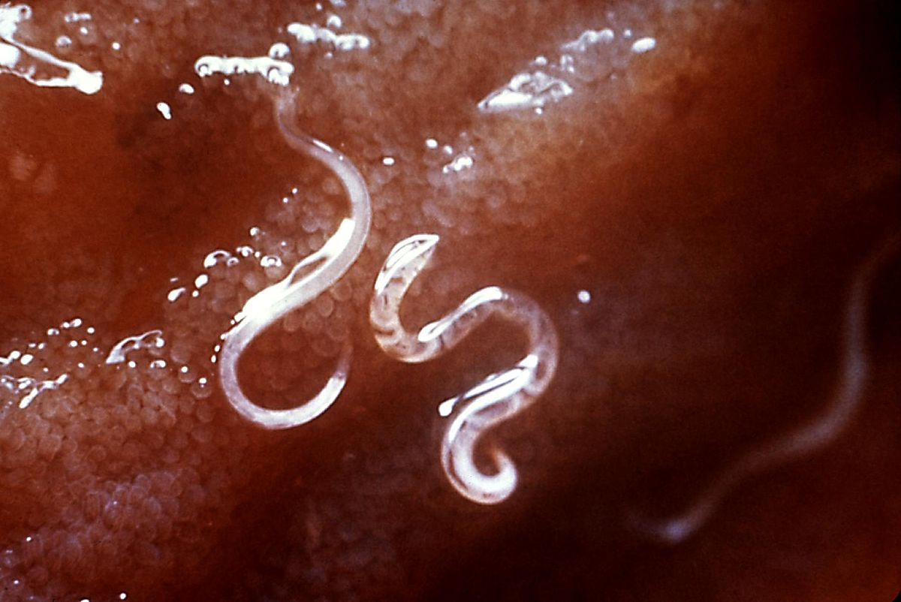

Slide 49
Tapeworms
Tapeworms are an intestinal parasite.
Along with roundworm, hookworm, and whipworm, this flat, segmented worm is found in dogs, cats, humans, and many other species around the world.
The most common tapeworm species is Dipylidium Caninum.
The medical term for a tapeworm infestation is Cestodiasis.

Slide 50
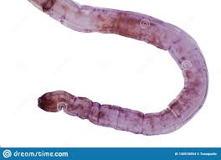

Slide 51
CONTENTS
.palpation
.Type of palpation
. Method of palpation
. Condition of palpation

Slide 52
PALPATION
Palpation is the assessment technique health providers use during a physical exam to detect certain characteristic of body
It's the technique of using the sense of touch to assess parts of the body
By using different parts of their hands, different characteristic about the patient body such as swelling size and movement can be identified.

Slide 53
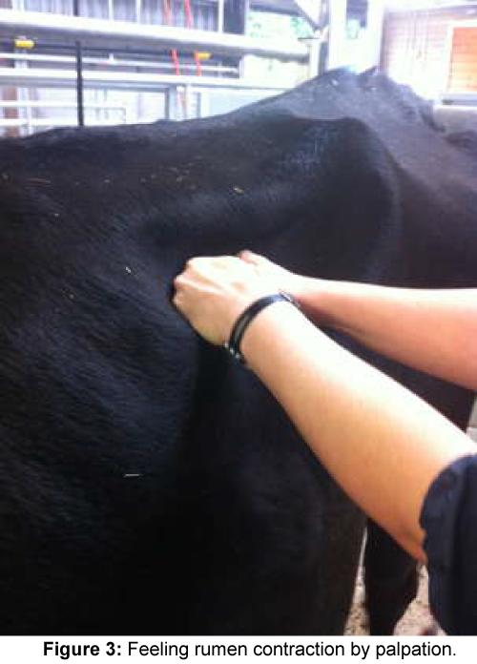
Sense of touch is just as important in this examination as the sense of physicians
Usually performed by the a health care practitioner

Slide 54
Equipment use for palpation
LUBRICANT
It is the applied to cover hand and arm to facilitate entry to cow rectum
Obstetrical lubricant are available at farm and ranch supply store
Liquid soap also use as a lubricant

Slide 55
CHUTE
A holding chute will allow the cow to stand on the ground in the normal position
Protect any unnecessary physical stress
A gate or bar in front of the cow will prevent het forward movement

Slide 56
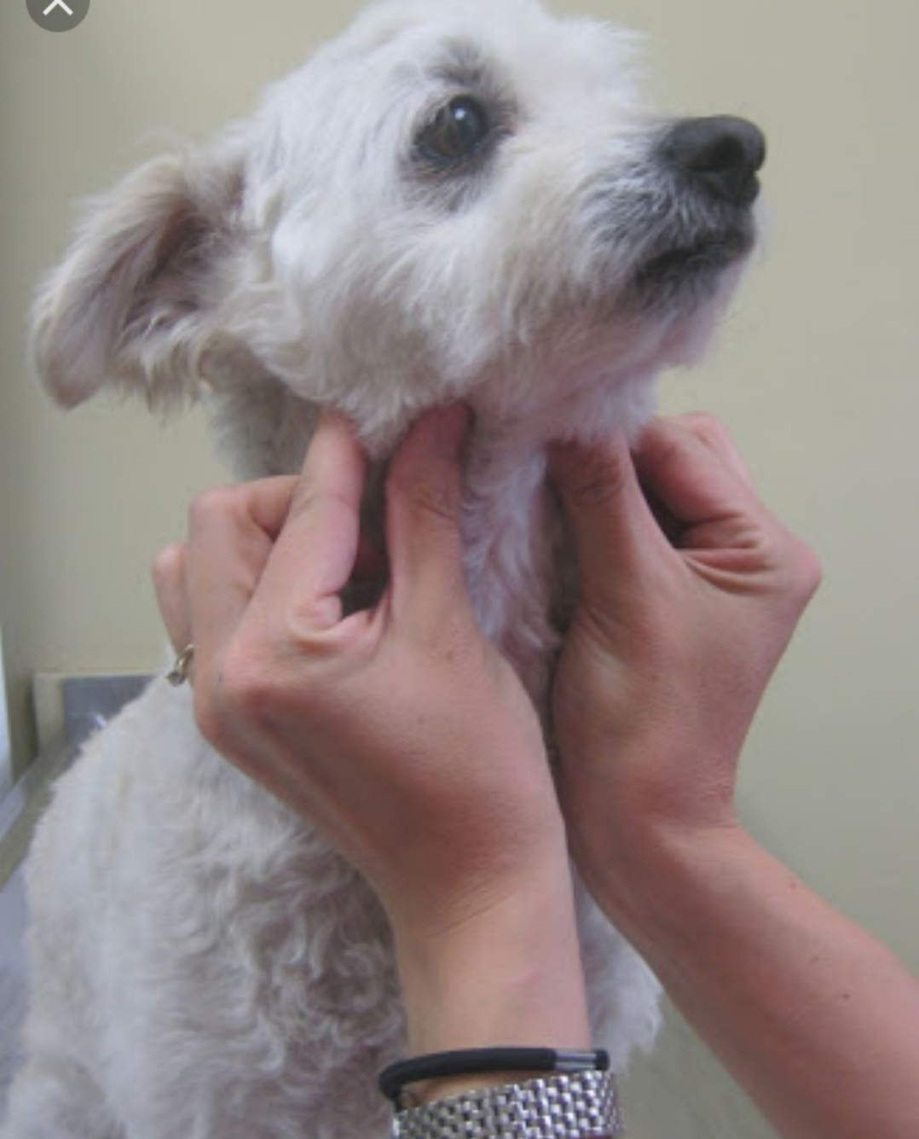
PALPATION OF DOG

Slide 57
USES OF PALPATION
Palpation is commonly used for abdominal or thoracic exams
It can be applied to any part of the body including the mouth vagina and anu

Slide 58
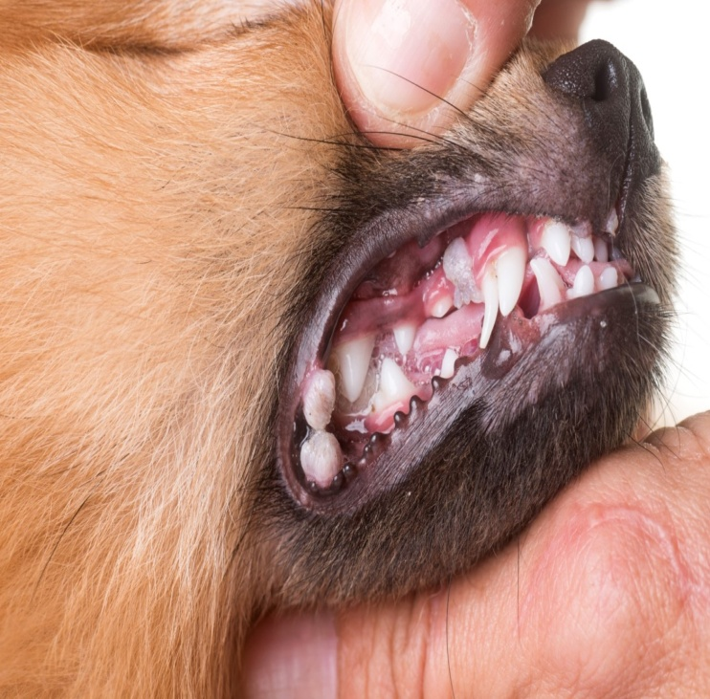
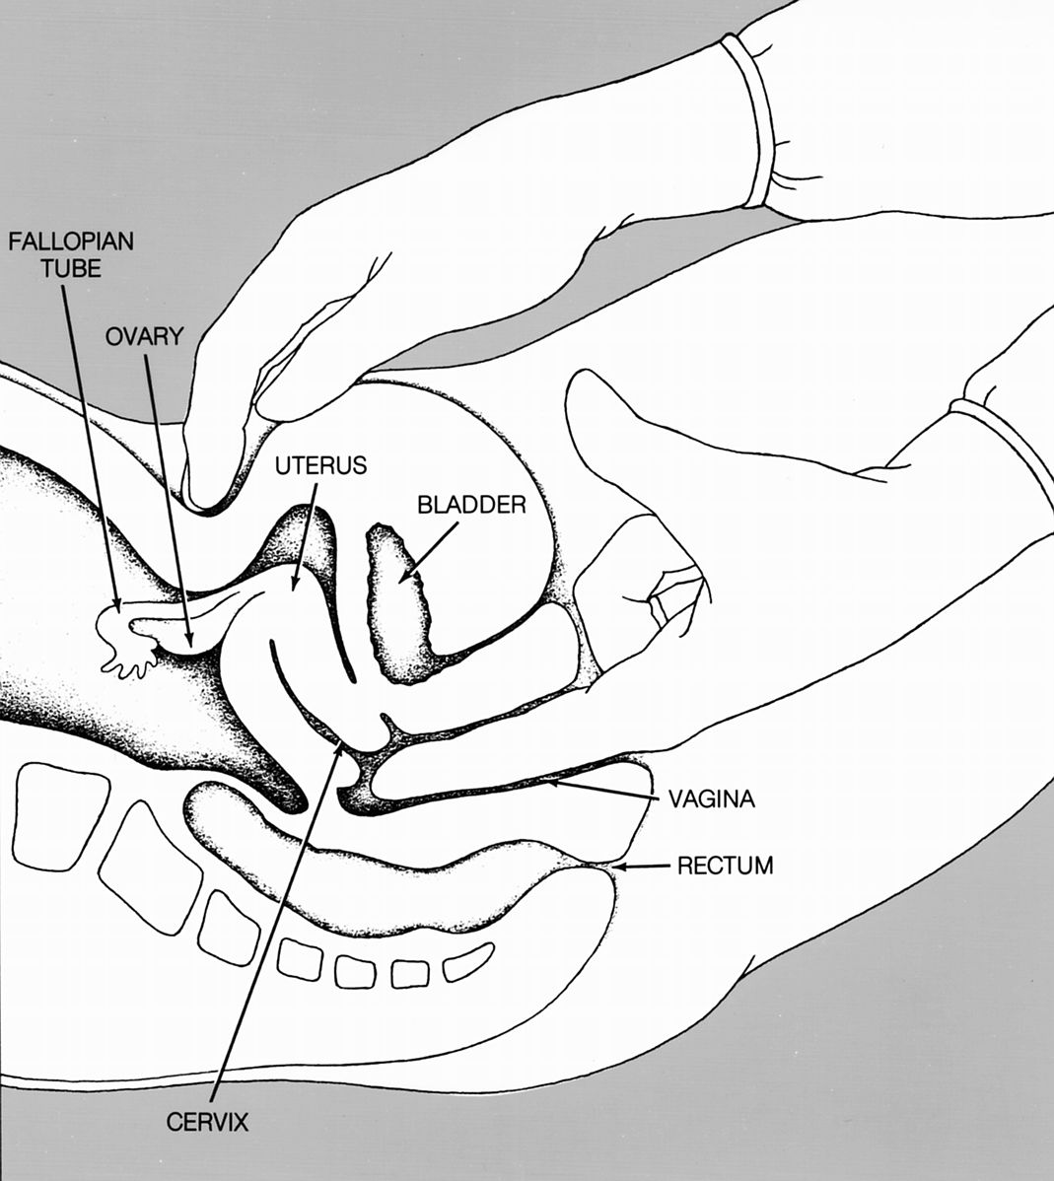

Slide 59
TYPE OF PALPATION
LIGHT PALPATION
It is use to feel abnormalities that are on the surface
You use the front of your fingers to gently press down into the area of the body about 1 to 2 centimeters
Then lift of the finger of the body and move to the next near by area

Slide 60
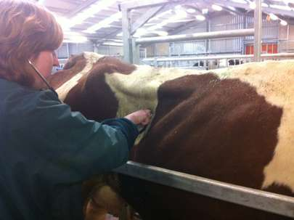

Slide 61
This help identify the texture, tenderness, temperature, moisture, elasticity, palpation and masses
DEEP PALPATION
It is use to feel internal organ and masses
You use the front of your finger to firmly press down into the area of the body about 4-5 centimeters

Slide 62
Then lift your fingers and move to the next near by area
This help us identify the size, shape, tenderness, symmetry, and mobility
It can be uncomfortable for the patient, especially when assessing the abdomen or painful area

Slide 63
ABDOMNAL PALPATION
Deep palpation of the abdomen is performed by placing the flat of the hand of the abdomen wall and appling firm steady pressure, two handed palpation used to exert pressure
The lower hand is used to feel is often useful in evaluation an abdominal mass

Slide 64
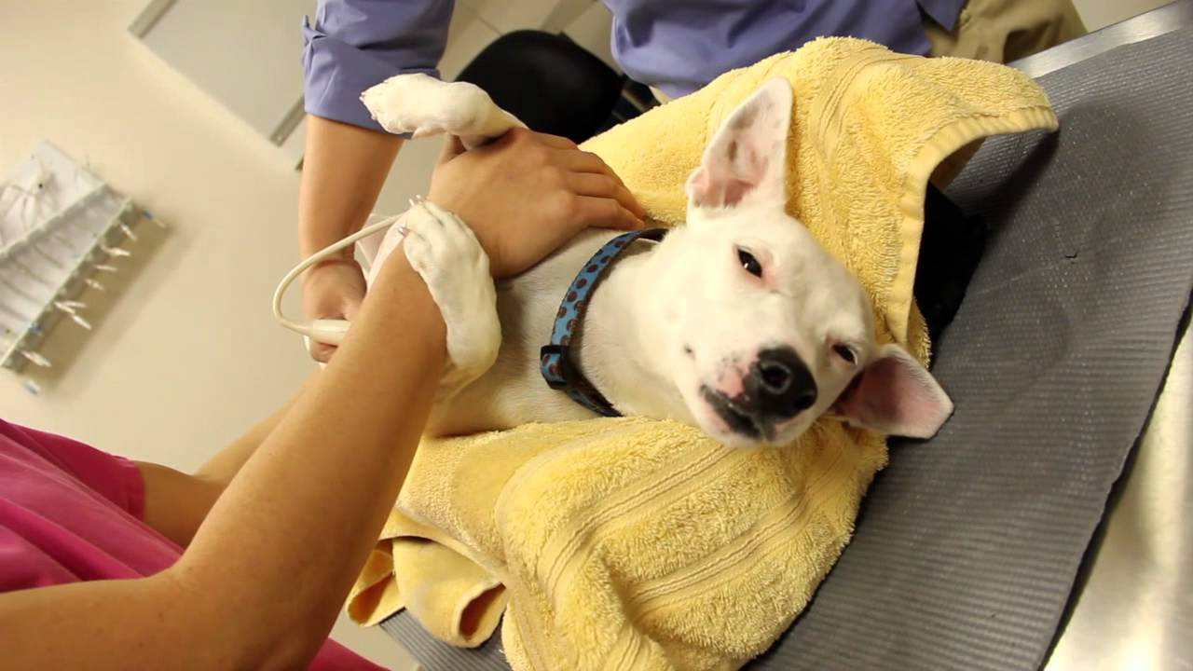
Abdominal palpation

Slide 65
UTERINE PALPATION
Another two handed procedure is the biamanual pelvic exam also known as manual uterine palpation
It involve the comparison of the lower abdomen with one hand and the palpation of tissues inside the vagina with the fingers of the other hand

Slide 66
METHOD OF PALPATION
Palpation is typically used for thoracic and abdominal examination
It is also used to diagnose edema
Palpation is also a simple method of examining the pulse
It is used by veterinarians to check animals for pregnancy

Slide 67
Palpation is the method of feeling with the fingers or hands during physical examination
The health care provide touches and feels your body to examine the size, consistency, texture, location, and tenderness organ of body part

Slide 68
ULTRASOUND
Detection of pregnancy through the use of ultrasound may be beneficial during the later stage of pregnancy
A prob is pass over the cow abdomen wall on into the rectum to transmit two dimensional images to a monitor that can be viewed by a a technician

Slide 69
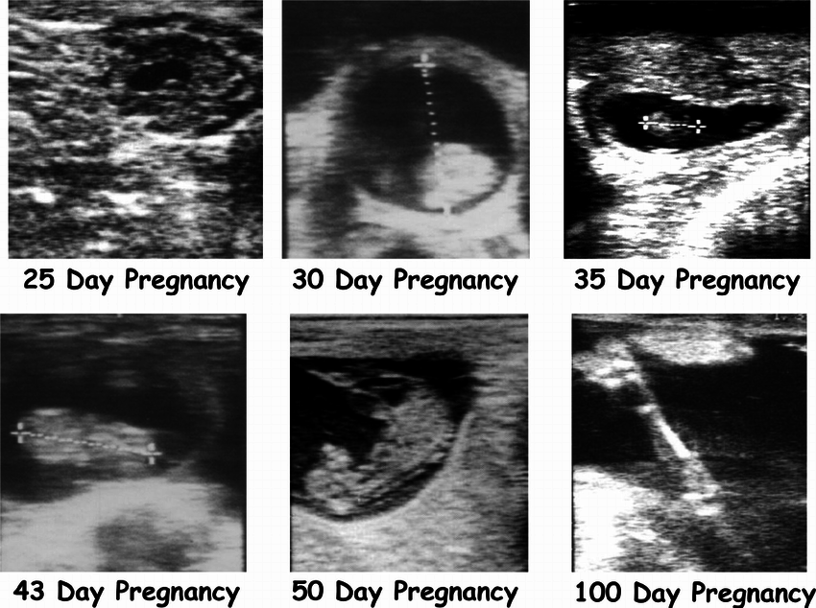
Organ or the reproductive tract as well as a developing fetus, can be viewed using ultrasound technology

Slide 70
BIOCHEMICAL TEST
One -farm test kits are available to producers to pregnancy check their cow. Some test kits are easy to use and give the producer immediate result
Example
Milk progesterone test

Slide 71
This kits allows a producer to test the level of progesterone in a milk sample
The colour change in the sample indicates the pregnant or non-pregnant status of the cow

