Slide 1
DAS
Introduction to Animal Husbandry
2019
Notes:
Experimental—deceleration, disability, supine, mice
Theory—mites, honeybees, identity, probit
Lifespan—primates, etc
Human—self reinforcing, wasp, NBA
Thank
Background
Invasive/Greece/Hawaii
CDFA Medfly panel
Aging research
LBAM
Workshop
Zalom et al
Retreat/Workshop
LMAM see that little changes
New day in science/policy

Slide 2
What is Animal Breeding. . . . . .
Several definitions of animal breeding in the scientific literature,
Jay Lush in 1945: "the means available for improving the heredity of farm animals“
Animal breeding may be seen as the optimal exploitation of the species' biological variation
The term genetic improvement, often considered as synonymous to breeding, also implies that something better is being looked for man's welfare
Notes:
Experimental—deceleration, disability, supine, mice
Theory—mites, honeybees, identity, probit
Lifespan—primates, etc
Human—self reinforcing, wasp, NBA
Thank
Background
Invasive/Greece/Hawaii
CDFA Medfly panel
Aging research
LBAM
Workshop
Zalom et al
Retreat/Workshop
LMAM see that little changes
New day in science/policy

Slide 3
Conti…
Breeding Vs Reproduction
Reproduction? "to produce offspring“
Breeding “reproduce for better production”
Notes:
Experimental—deceleration, disability, supine, mice
Theory—mites, honeybees, identity, probit
Lifespan—primates, etc
Human—self reinforcing, wasp, NBA
Thank
Background
Invasive/Greece/Hawaii
CDFA Medfly panel
Aging research
LBAM
Workshop
Zalom et al
Retreat/Workshop
LMAM see that little changes
New day in science/policy

Slide 4
Conti…
Application of scientific (genetic) knowledge to the genetic improvement of animals for different productive and reproductive traits of cattle, buffalo, sheep, goat, camel and poultry etc.
Changes to traditional / natural animal breeding
The science of genetics provides founding principles for the science of Animal Breeding
Notes:
Experimental—deceleration, disability, supine, mice
Theory—mites, honeybees, identity, probit
Lifespan—primates, etc
Human—self reinforcing, wasp, NBA
Thank
Background
Invasive/Greece/Hawaii
CDFA Medfly panel
Aging research
LBAM
Workshop
Zalom et al
Retreat/Workshop
LMAM see that little changes
New day in science/policy

Slide 5
Animal Breeding Tasks
To select the most desirable animals based on the prediction of genetic merit
To produce superior genotypes by the combination of genetics through breeding plans and system of mating
Notes:
Experimental—deceleration, disability, supine, mice
Theory—mites, honeybees, identity, probit
Lifespan—primates, etc
Human—self reinforcing, wasp, NBA
Thank
Background
Invasive/Greece/Hawaii
CDFA Medfly panel
Aging research
LBAM
Workshop
Zalom et al
Retreat/Workshop
LMAM see that little changes
New day in science/policy

Slide 6
Breeding objective
The basic objective of animals breeding is;
i. To enhance the efficiency of production
ii. The quality of the product for the ultimate consumer through planned genetic change
Notes:
Experimental—deceleration, disability, supine, mice
Theory—mites, honeybees, identity, probit
Lifespan—primates, etc
Human—self reinforcing, wasp, NBA
Thank
Background
Invasive/Greece/Hawaii
CDFA Medfly panel
Aging research
LBAM
Workshop
Zalom et al
Retreat/Workshop
LMAM see that little changes
New day in science/policy

Slide 7
Genetics Vs. Environment
Any performance of the animal is the combination of two things
Genetics
Environment
Genetics play role in the exposure of the traits as 60-80%
Genetic improvement is usually slower and often less dramatic, yet it is more permanent
Notes:
Experimental—deceleration, disability, supine, mice
Theory—mites, honeybees, identity, probit
Lifespan—primates, etc
Human—self reinforcing, wasp, NBA
Thank
Background
Invasive/Greece/Hawaii
CDFA Medfly panel
Aging research
LBAM
Workshop
Zalom et al
Retreat/Workshop
LMAM see that little changes
New day in science/policy

Slide 8
Important
The genes do not express themselves in vacuum
Environmental influences such as improved nutrition, disease prevention, or housing have immediate effect on production…..but these are temporary
Environmental factors have 20-40 % contribution in the overall performance of the animals
The final expression of a trait represents the joint action of both heredity of the animal and environment provided for its expression
Notes:
Experimental—deceleration, disability, supine, mice
Theory—mites, honeybees, identity, probit
Lifespan—primates, etc
Human—self reinforcing, wasp, NBA
Thank
Background
Invasive/Greece/Hawaii
CDFA Medfly panel
Aging research
LBAM
Workshop
Zalom et al
Retreat/Workshop
LMAM see that little changes
New day in science/policy

Slide 9
Contribution of Animal Breeding
Animal breeding has contributed much to the total improvement of livestock production
Where performance records have been available to direct selection and to assess changes in results have been dramatic
In other areas, combined environmental and genetic advances have led to remarkable success
e.g., increase in milk yield over the past 60 years
Notes:
Experimental—deceleration, disability, supine, mice
Theory—mites, honeybees, identity, probit
Lifespan—primates, etc
Human—self reinforcing, wasp, NBA
Thank
Background
Invasive/Greece/Hawaii
CDFA Medfly panel
Aging research
LBAM
Workshop
Zalom et al
Retreat/Workshop
LMAM see that little changes
New day in science/policy

Slide 10
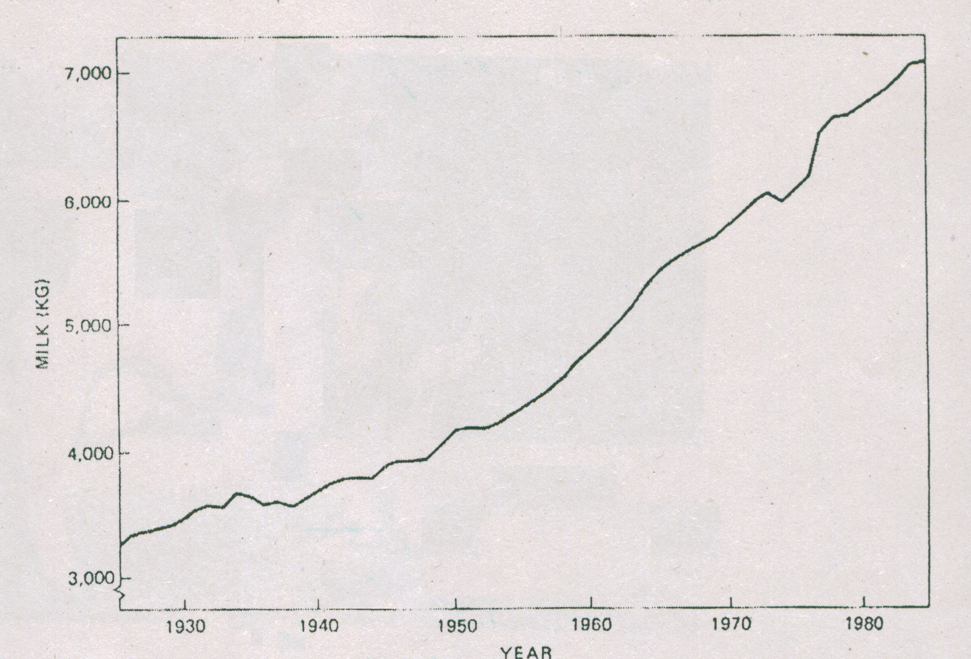
Increase in average milk yield per cow from 1925 to 1985 for all cows on Dairy Herd Improvement test in the US
Notes:
Experimental—deceleration, disability, supine, mice
Theory—mites, honeybees, identity, probit
Lifespan—primates, etc
Human—self reinforcing, wasp, NBA
Thank
Background
Invasive/Greece/Hawaii
CDFA Medfly panel
Aging research
LBAM
Workshop
Zalom et al
Retreat/Workshop
LMAM see that little changes
New day in science/policy

Slide 11
Milk Production
The rate of increase in milk yield has been, about 1 percent of the mean yield per year
Analyses indicate that approximately half of this is due to genetic improvements
The highest production by an individual cow is now 25,248 kg of milk in 365 days, milked twice daily
Holstein Cow, Beecher Arlinda Ellen, excellent at 91 points. She is the world record leader for milk yield with 365 day, twice daily milking
In one year Ellen produced enough milk to provide a liter a day for one person for 69 years and 2 months
Notes:
Experimental—deceleration, disability, supine, mice
Theory—mites, honeybees, identity, probit
Lifespan—primates, etc
Human—self reinforcing, wasp, NBA
Thank
Background
Invasive/Greece/Hawaii
CDFA Medfly panel
Aging research
LBAM
Workshop
Zalom et al
Retreat/Workshop
LMAM see that little changes
New day in science/policy

Slide 12
Reproductive Biotechnology
National programs of sire and cow evaluation provide computerized listings of sires for use in artificial insemination and cows to be mated as dams of young males in planned progeny-testing programs
Frozen semen has markedly extended the use of outstanding sires, some of which have sired over 200,000 offspring that is very large as compared to the natural breeding
Embryo transfer has been perfected to the point where outstanding females may now leave 100 or more progeny
Notes:
Experimental—deceleration, disability, supine, mice
Theory—mites, honeybees, identity, probit
Lifespan—primates, etc
Human—self reinforcing, wasp, NBA
Thank
Background
Invasive/Greece/Hawaii
CDFA Medfly panel
Aging research
LBAM
Workshop
Zalom et al
Retreat/Workshop
LMAM see that little changes
New day in science/policy

Slide 13
Meat Production
Beef
Sheep
Goat
Fish
Broiler chicken
Notes:
Experimental—deceleration, disability, supine, mice
Theory—mites, honeybees, identity, probit
Lifespan—primates, etc
Human—self reinforcing, wasp, NBA
Thank
Background
Invasive/Greece/Hawaii
CDFA Medfly panel
Aging research
LBAM
Workshop
Zalom et al
Retreat/Workshop
LMAM see that little changes
New day in science/policy

Slide 14
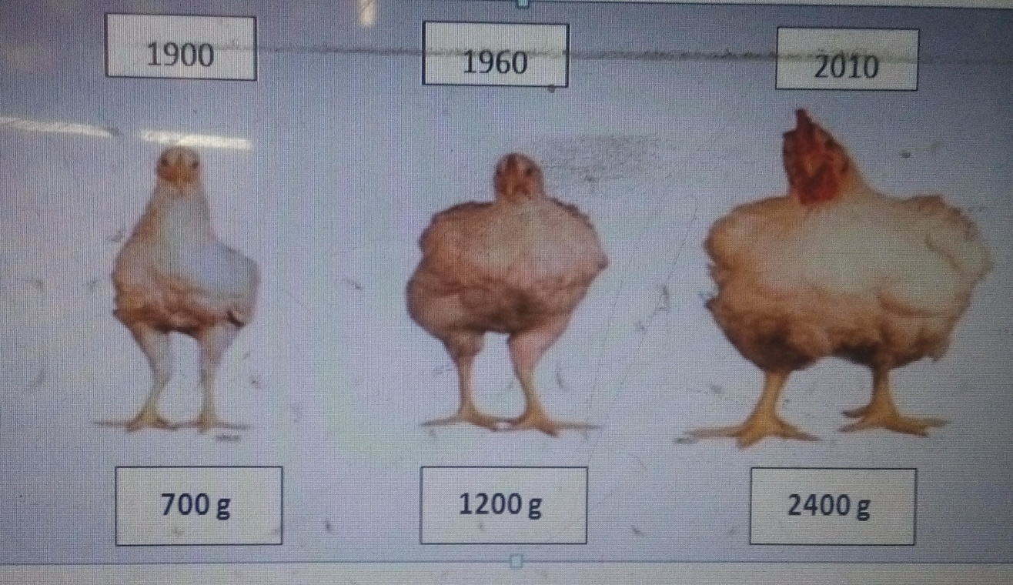
Genetic Improvement in Broilers
In the 1900s it took about 12 weeks to develop a broiler weighing 1.6 kilos; whereas, today a more than 2-kilo broiler can be developed in only 6 weeks
Feed requirements per kilo of gain have been reduced from 3.5 to 1.7 kilos

Slide 15
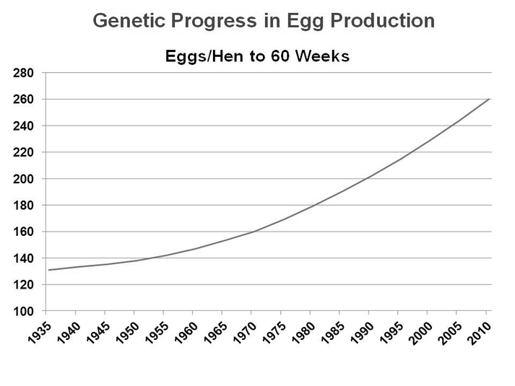
The egg production was increased from 130 egg in 1935 to 260 eggs in 2010 during 60 weeks of production

