Slide 1
Citrus Slow Decline Prevalent (Disease present) in all citrus growing areas

Slide 2
History and Importance:
1st reported from California (USA) in 1912.
5% losses overall.

Slide 3
Etiology
Nematode Disease.
Tylenchulus semipenetrans

Slide 4
Symptoms
Encrusted root system.
Twigs dieback.
Yellowing of leaves, defoliation, premature shedding of fruits, reduction in number and size of fruits.

Slide 5
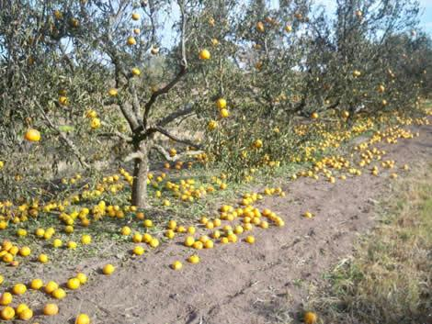
Symptoms
Decline tree

Slide 6
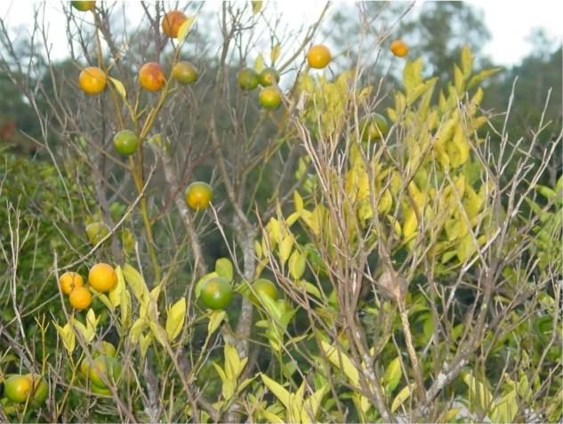
Symptoms
Decline symptoms

Slide 7
Disease cycle
Live on alternate host (olive grapevine)
Females lay eggs in gelatinous substance, remain safer for long time.
In soil may occur as deep as 4 meters.
Planting material is secondary source of spread.

Slide 8
Management:
Hot water (45°C for 25 min)
Treat nursery with nematicide (nemacur).
Pre and post plant soil fumigation (Nemagon, D-D mixture, Vapam).

