Slide 1
Aims of Education and Curriculum
Ms Sameen

Slide 2
Curriculum
'Curriculum' is a term frequently used in a variety of ways by those involved in education and its meaning is often taken for granted. Hayes (2006) suggests that it is in fact difficult to find agreement on this apart from perhaps 'the sum total of what pupils need to learn' (p. 57).
However, even here it is unlikely that a consensus can be reached over what pupils do actually need to learn. Sometimes the term 'curriculum' is used to refer to the content taught on a course. However, this is more properly called a syllabus.

Slide 3
Definition
According to Jenkins and Shipman: A curriculum is the formation and implementation of an educational proposal to be taught and learned within the school or other institution and for which that institution accepts responsibility at three levels: its rationale, its actual implementation and its effects (1976, p. 26).
The curriculum is often referred to as though it were a collection of subjects that appear on the timetable of education institutions such as schools.
Kelly(2004) suggests that this is very limiting and that a broader way of looking at the curriculum is in terms of all the experiences that the school provides.

Slide 4
Difference between Curriculum and Syllabus

Slide 5
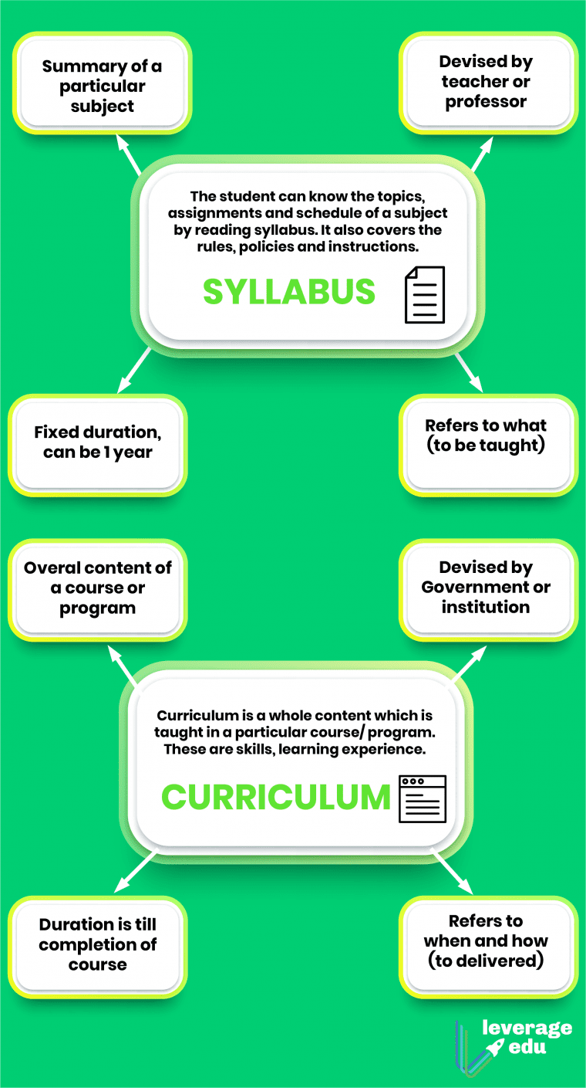

Slide 6
Cont…
Curriculum remains prescriptive in nature as its structure needs to be followed in the specified manner while syllabus is more descriptive and flexible in nature and can be covered in a non-prescriptive manner.
Curriculum is meticulously designed by the school or college administration while syllabus gets created by teachers by the educational board.
Curriculum stays the same for every teacher while syllabus can differ and it can be covered in a distinctive manner as per their own individual teaching style.

Slide 7
Cont…
Curriculum encompasses more extensive scope than syllabus. This is because syllabus remains confined to a particular subject while curriculum provides the structure for the whole course.
Syllabus is only provided for a year while the curriculum covers the whole course.
Curriculum contains all the subjects and outlines how they will be studied during the course while syllabus is more detailed version for each subject under the course.

Slide 8
Components of Curriculum
Thus there are four elements of curriculum, which are essential and interrelated to each other:
1) Curriculum Aims and Objectives
2) Curriculum Content or Subject Matter
3) Curriculum Experience
4) Curriculum Evaluation

Slide 9
Cont…
Curriculum Aims and Objectives:
Aims and objectives are decided at all the levels central, state, and local considering philosophy, sociological and psychological foundations.
Aims and objectives can be simplified as “what is to be done”.
The subject’s content structure, levels of students, and type of examination components are considered in the identification of objectives of teaching and learning.
These objectives are specific and written in behavioral terms so as to develop learning structures and conditions.

Slide 10
Cont…
Curriculum Content or Subject Matter:
It clearly defines the purpose and what the curriculum is to be acted upon and try what to drive at.
In the same manner, Curriculum has a frame work guideline. Here, it contains information about all the aspects to be learned in school.
It is an element or a medium through which the objectives are accomplished.

Slide 11
Cont…
Curriculum Experience:
Curriculum experience means what Instructional strategies, resources and activities will be employed in teaching- learning.
The specific objectives of teaching are attained with the help of appropriate teaching strategy.
These instructional strategies and methods will put into action the goals and use of the content in order to produce and outcome.
These would convert the written curriculum to instruction.
The behavioral objectives provides the awareness and insight about the specific learning conditions.

Slide 12
Cont…
Curriculum Evaluation:
For the fourth elements, the curriculum evaluation is an element of an effective curriculum.
Curriculum evaluation means what methods and instruments will be used to assess the results of the curriculum.
It identifies the quality, effectiveness of the program, process and product of the curriculum.

Slide 13
Cont…
The level of students attainment is evaluated by employing criteria referenced test.
It shows the effectiveness of strategy of teaching and other components.
The interpretation of evaluation provides the feedback to the curriculum and its components.
Curriculum evaluation is also important so that one could assess whether the objectives and aims have been meet or if not, he could employ another strategy which will really work out.
Curriculum evaluation is an empirical basis for the ‘curriculum development’

Slide 14
Characteristics of good curriculum
A good quality curriculum Values all children as individuals
Is based on a clear understanding of modern, broadly accepted concepts /understandings
about how children learn Promotes teaching practices that reflect these concepts of learning
Reflects that decisions and choices made during the curriculum development process are made in the interests of learners.

