Slide 1
TOPIC: EDUCATION AND ITS TYPES
BY FARHEEN MALIK

Slide 2
DEFINITIONS OF EDUCATION
The word “Educate” comes from a Latin word “Educere”, which means to Lead out or Bring out
Education is the process of bringing desirable changes into the behavior of the human beings.
It can also be defines as the process of imparting or acquiring knowledge or habits through instruction or study.

Slide 3
CONTINUE
Webster defines education as the process of teaching to develop the knowledge, skills and character of the students.
According to John Dewey “education is the developments of all those capacities in the individual which enable him to control his environment and fulfill his possibilities.”

Slide 4
Aristotle
“ Education is the creation of sound mind and sound body”.
Socrates
“Education refers to discover the universal principles of truth, beauty and goodness which govern human conduct”.

Slide 5
TYPES OF EDUCATION
Formal education
Non formal education
Informal education

Slide 6
FORMAL EDUCATION
Formal education is intentional, organized and structured for of learning, imparted in educational institutions like school, college and university in order to modify the behavior of an individual.

Slide 7
CHARACTERISTICS OF FORMAL EDUCATION
Full time education.
Technical and professional training.
A variety of specialized programmes.
Running from primary school through the university.
Leading to certificates degrees and diplomas
Long-term and general.

Slide 8
Non- Formal education
Non-formal education as any organized educational activity outside the established formal system.
Learning Resulting from daily activities related to work ,family and leisure. It is not organized or structured in terms of objective, time or learning support.

Slide 9
CHARACTERISTICS OF NON-FORMAL EDUCATION
It is flexible
It is built on learner-participation.
It is non-authoritarian.
It is life, environment and learner oriented.
It is diversified in content and methods.
Short-term and specific.

Slide 10
INFORMAL EDUCATION
Learning that goes in daily life and can be received through daily experiences such as from family, peer group, the media and other influences in a person’s environment.

Slide 11
CHARACTERISTICS OF INFORMAL EDUCATION
Never organized.
No formal curriculum.
Learner is highly motivated.
Often Spontaneous.
Life long education.
Take place every location.
Anywhere and Anytime.

Slide 12
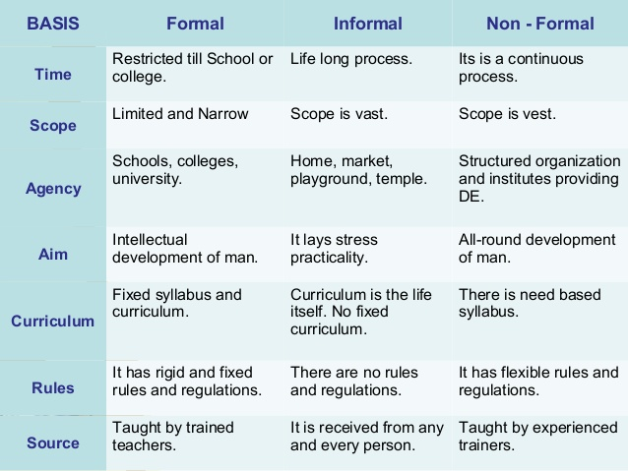

Slide 13
Thanks you.

