Slide 3
EX 27

Slide 4
Sol 27

Slide 5
EX 28

Slide 6
Sol 28

Slide 7
EX 29

Slide 8
Sol 29

Slide 9
Ex 29

Slide 11
Ex 30

Slide 12
Sol 30

Slide 13
Ex 31

Slide 14
Sol 31

Slide 15
Ex 32
A particle has a speed of 0.990cin a labortary reference frame. What are the kinetic energy, its total energy and its momentum if the particles (a) proton (b) electron?

Slide 16
Sol 32

Slide 17
Ex 34

Slide 18
Sol 34

Slide 19
Ex 37

Slide 20
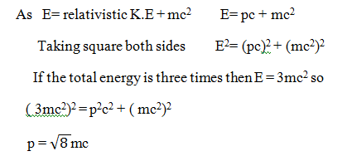
Sol 37

Slide 21
Assignment Problems

Slide 22
1. Verify the law of conservation of momentum and law of conservation of K.E are invarient under Galilean transformation

Slide 23
2. How fast should a rocket ship move for its length to be contracted to 99% of its rest length

Slide 24
3. A clock keep the correct time. With what speed should it move relative to the observer so that it may seem to lose 4 min in 24 hour?

Slide 25
4. A particle with proper life time of 1μs moves through the laboratory at 2.7 x 10 m/s. what is the life time of the particle as measured in the laboratory frame.

Slide 26
5. What is the momentum of the electron moving at the speed of v = 0.86c?

Slide 27
6. Find the speed of electron as a fraction of c if the electrons have K.E of 50 GeV?

Slide 28
7. Write down the expression for momentum of photon. How much is the rest mass of the photon?

Slide 29
8. Calculate the momentum of the photon whose energy is 1.00 x 10⁻²⁹joules.

