Slide 1
Computer Networks – A Systems Approach
Internetworking
Fourth Edition
Larrie Peterson and Bruce Davie

Slide 2
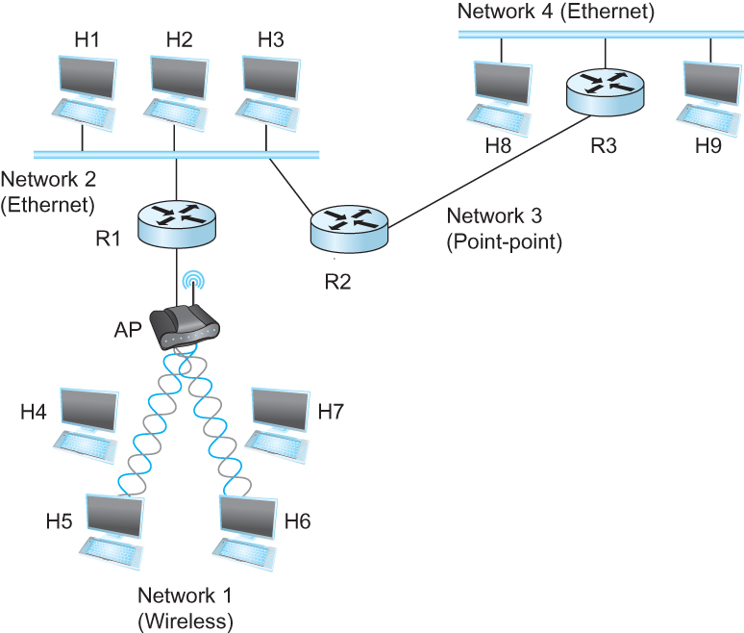
Internetworking
What is internetwork
An arbitrary collection of networks interconnected to provide some sort of host-host to packet delivery service

Slide 3
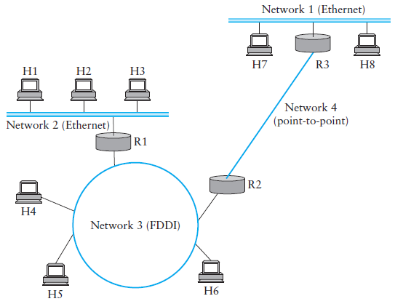
A Simple Internetwork

Slide 4
A Simple Internetwork

Slide 5
IP Service Model
Packet Delivery Model
Connectionless model for data delivery
Best-effort delivery (unreliable service)
packets are lost
packets are delivered out of order
duplicate copies of a packet are delivered
packets can be delayed for a long time
if something goes wrong and the packet gets lost, corrupted, misdelivered, or in any way fails to reach its intended destination, the network does nothing

Slide 6
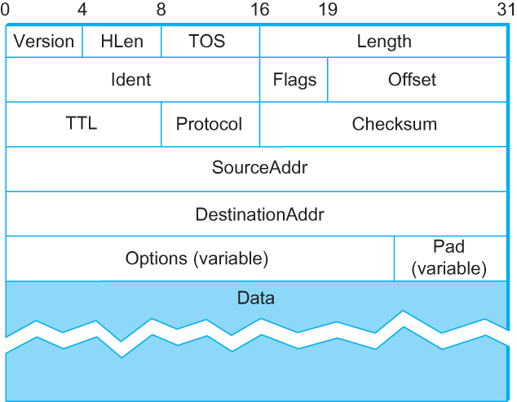
Packet Format
Version (4): currently 4
Hlen (4): number of 32-bit words in header
TOS (8): type of service (not widely used)
Length (16): number of bytes in this datagram
Ident (16): used by fragmentation
Flags/Offset (16): used by fragmentation
TTL (8): number of hops this datagram has traveled
Protocol (8): demux key (TCP=6, UDP=17)
Checksum (16): of the header only
DestAddr & SrcAddr (32)

Slide 7
Fragmentation and Reassembly
Each network technology tends to have its own idea of how large a packet can be
Ethernet can accept packets up to 1500 bytes long
FDDI packets may be 4500 bytes long
ATM (asynchronous transfer mode) has a fixed MTU of 48 bytes
PPP (point-to-point protocol) has a negotiated MTU that is usually between 500 and 2000 bytes.

Slide 8
Fragmentation and Reassembly
Two choices for the IP service model:
Make sure that all IP datagrams are small enough to fit inside one packet on any network technology
Provide a means by which packets can be fragmented and reassembled when they are too big to go over a given network technology

Slide 9
Fragmentation and Reassembly
Maximum Transmission Unit (MTU)
The largest IP datagram that it can carry in a frame
Reasonable Choice of MTU
MTU of the network to which the host is directly attached

Slide 10
Fragmentation Related Fields
Length
Length of IP fragment
Identification
To match up with other fragments
Flags
Don’t fragment flag(0)
More fragments flag(1)
Fragment offset
Where this fragment lies in entire IP datagram
Measured in 8 octet units (13 bit field)

Slide 11
Fragmentation and Reassembly

Slide 12
Fragmentation and Reassembly

Slide 13
Fragmentation and Reassembly
Suppose a TCP message that contains 2048 bytes of data and 20 bytes of TCP header is passed to IP for delivery across two networks of the Internet (i.e., from the source host to a router to the destination host). The first network uses 14-byte headers and has an MTU of 1024 bytes; the second uses 8-byte headers with an MTU of 512 bytes. Each network’s MTU gives the size of the largest IP datagram that can be carried in a link-layer frame. Give the sizes and offsets of the sequence of fragments delivered to the network layer at the destination host. Assume all IP headers are 20 bytes.

Slide 14
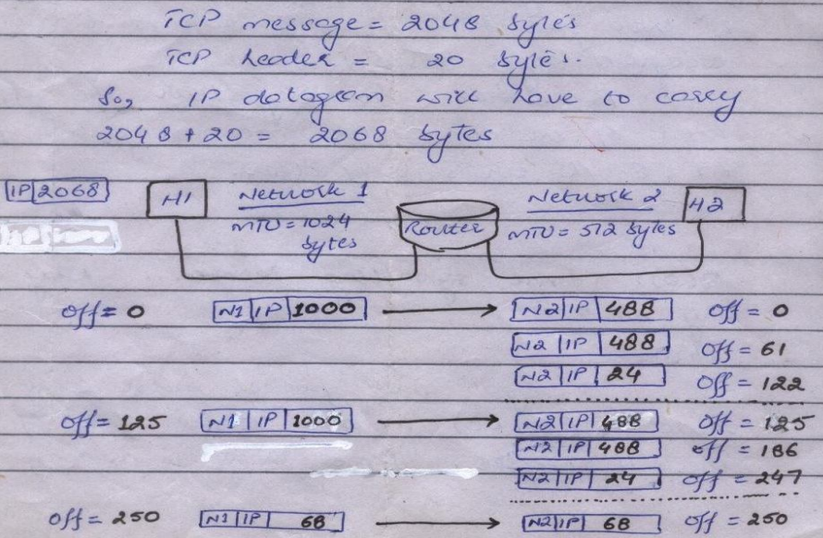
Fragmentation and Reassembly

Slide 15
Routing
Forwarding versus Routing
Forwarding
to select an output port based on destination address and routing table
Routing
process by which routing table is built
Forwarding table VS Routing table
Forwarding table
Used when a packet is being forwarded and so must contain enough information to accomplish the forwarding function
A row in the forwarding table contains the mapping from a network number to an outgoing interface and some MAC information, such as Ethernet Address of the next hop
Routing table
Built by the routing algorithm as a precursor to build the forwarding table
Generally contains mapping from network numbers to next hops

Slide 16
Routing Table / Forwarding Table

Slide 17
Routing Protocols
Dynamic Routing
Intradomain
(IGP)
Interdomain
(EGP)
Link State
Distance Vector
RIP
IGRP
OSPF
BGP
Routing
Static Routing
Hybrid
EIGRP

Slide 18
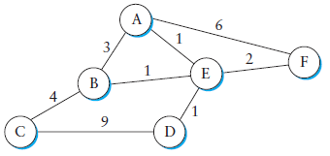
Network as a Graph
The basic problem of routing is to find the lowest-cost path between any two nodes
Where the cost of a path equals the sum of the costs of all the edges that make up the path

Slide 19
Network as a Graph
For a simple network, we can calculate all shortest paths and load them into some nonvolatile storage on each node.
Such a static approach has several shortcomings
It does not deal with node or link failures
It does not consider the addition of new nodes or links
It implies that edge costs cannot change
What is the solution?
Need a distributed and dynamic protocol
Two main classes of protocols
Distance Vector
Link State

Slide 20
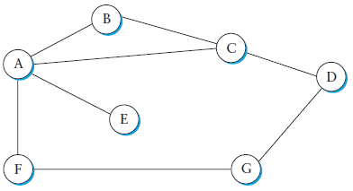
Distance Vector
Also known as Bellman-Ford Algorithm
Each node constructs a one dimensional array (a vector) containing the “distances” (costs) to all other nodes and distributes that vector to its immediate neighbors
Starting assumption is that each node knows the cost of the link to each of its directly connected neighbors

Slide 21
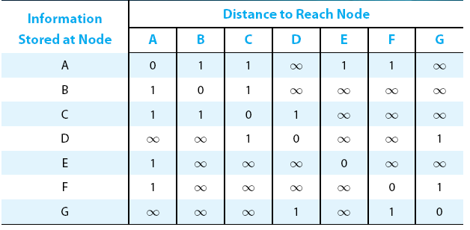
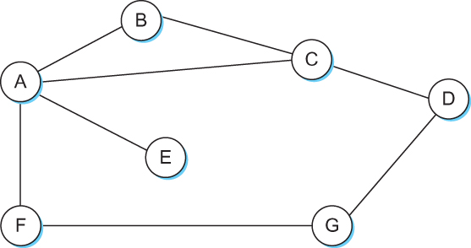
Distance Vector
Initial distances stored at each node (global view)

Slide 22
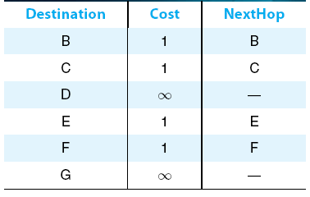
Distance Vector
Initial routing table at node A

Slide 23
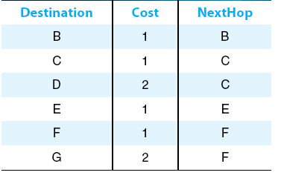
Distance Vector
Final routing table at node A

Slide 24
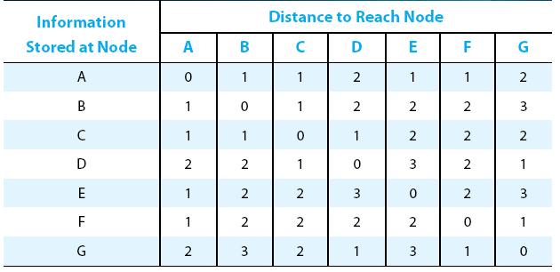
Distance Vector
Final distances stored at each node (global view)

Slide 25
Distance Vector
Convergence
The process of getting consistent routing information to all the nodes
Two different circumstances under which a given node decides to send a routing update to its neighbors
Periodic Update
each node automatically sends an update message after some time
serves to let the other nodes know that this node is still running
frequency of these periodic updates varies from protocol to protocol
Triggered Update
node receives an update from one of its neighbors that causes it to change one of the routes in its routing table

Slide 26
Distance Vector
When a node detects a link failure
F detects that link to G has failed
F sets distance to G to infinity and sends update to A
A sets distance to G to infinity since it uses F to reach G
A receives periodic update from C with 2-hop path to G
A sets distance to G to 3 and sends update to F
F decides it can reach G in 4 hops via A

Slide 27
Distance Vector
Slightly different circumstances can prevent the network from stabilizing
Suppose the link from A to E goes down
In the next round of updates, A advertises a distance of infinity to E, but B and C advertise a distance of 2 to E

Slide 28
Distance Vector
Depending on the exact timing of events, the following might happen
Node B, upon hearing that E can be reached in 2 hops from C, concludes that it can reach E in 3 hops and advertises this to A
Node A concludes that it can reach E in 4 hops and advertises this to C
Node C concludes that it can
reach E in 5 hops; and so on.
This cycle stops only when the
distances reach some number
that is large enough to be considered
infinite
Count-to-Infinity Problem

Slide 29
Count-to-infinity Problem
Use some relatively small number as an approximation of infinity
For example, the maximum number of hops to get across a certain network is never going to be more than 16
Split horizon
When a node sends a routing update to its neighbors, it does not send those routes it learned from each neighbor back to that neighbor
For example, if B has the route (E, 2, A) in its table, then it knows it must have learned this route from A, and so whenever B sends a routing update to A, it does not include the route (E, 2) in that update

Slide 30
Count-to-infinity Problem
Split horizon with poison reverse
B actually sends that back route to A, but it puts negative information in the route to ensure that A will not eventually use B to get to E
For example, B sends the route (E, ∞) to A

