Slide 1
Hetroploidy
Saeed Rauf

Slide 2
Hetroploidy
Change in chromosome number
Two types
Exact multiple of basic set or not
Euploidy vs. Aneuploidy
Euploidy leads towards the polyploidy
2n vs. 2x

Slide 3
Polyploidy
Polyploidy is the heritable condition of possessing more than two complete sets of chromosomes.
Even number of sets of chromosomes, with four being the most common (tetraploidy).
Common among plants, fish and amphibians, and are usually fit and well adapted.
Many sequenced genomes display the signature of polyploidy ancestry.
Polyploidy can bestow long-term evolutionary flexibility enforced by gene redundancy.

Slide 4
Polyploidy
NEOPOLYPLOID
A polyploid that has been produced by artificially inducing chromosome doubling.
DIPLOIDIZATION
Gradual conversion from polyploidy to diploidy through genetic changes that differentiate duplicated loci.
SUBFUNCTIONALIZATION
Retention by duplicated genes of different components of the original common function.
NEOFUNCTIONALIZATION
Acquisition of novel function by a duplicated gene.

Slide 5
Polyploidy
EPIGENETIC
A mitotically stable change in gene expression that depends not on a change in DNA sequence, but on covalent modifications of DNA or chromatin proteins such as histones.
HETEROSIS
The increase in performance displayed by hybrids compared with their inbred parents.
A more precise definition is non-additive inheritance in which a trait in the F1transgresses both parental values.

Slide 6
Poplyploid
DYSGENESIS
Sterility or other deleterious trait of an F1 hybrid that results from incompatibilities between parental genomes.

Slide 7
Polyploidy
Diploid gametes, which arise infrequently, typically fuse with haploid ones and produce triploid zygotes.
The fusion of diploid gametes leads to tetraploid zygotes, which are potentially stable.
The total number of chromosome sets is indicated by the prefix; for example, tri- (3), tetra- (4),penta- (5), hexa- (6) and octa- (8).
Meiotic pairing arrangements vary between ploidy types .
The increased complexity of pairing can cause the deletion or addition of chromosomes.
The chromosome sets of allopolyploids differ proportionally to the divergence of the parental genomes.
Segmental allopolyploidy.

Slide 8
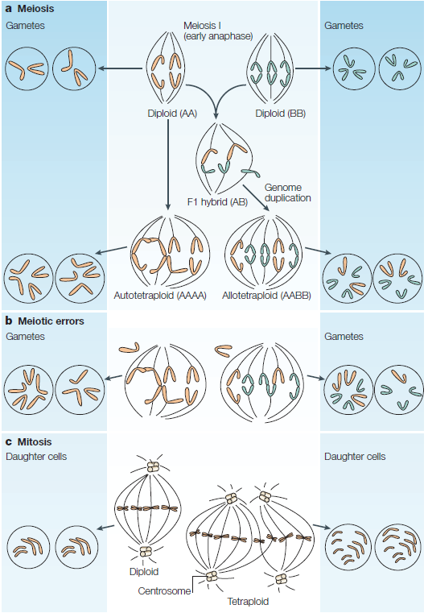
Figure 1. Formation of polyploid due to meiotic irregularities

Slide 9
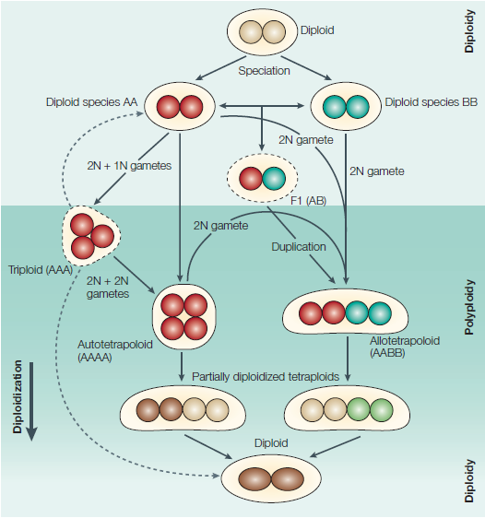

Slide 10
Advantages of polyploidy
Three documented or obvious advantages of becoming polyploid.
Heterosis
Gene redundancy
Asexual reproduction.

Slide 11
Heterosis
Heterosis
Fixing of divergent parental genomes.
Covering of lethal alleles at haploid stages of polyploid plants.
Autopolyploid show stronger heterosis than the corresponding diploid hybrids.
Autopolyploid inbreds show stronger INBREEDING DEPRESSION than diploid inbreds.

Slide 12
Gene redundancy
The masking of recessive alleles by dominant wild-type alleles at two stages of plant cycle.
Polyploidy can reduce the incidence of homozygous recessives.
Diploid Aa heterozygotes produce 1/4 aa homozygotes, AAaa autopolyploids produce between 1/36 and 1/22 aaaa homozygotes, and AaAa allopolyploids produce 1/16 aaaa homozygotes.
Diversify gene function by altering redundant copies of important or essential genes

Slide 13
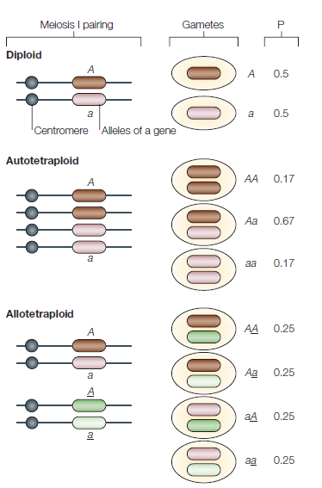

Slide 14
Loss of self-incompatibility and gain of asexual reproduction
Disrupting certain self-incompatibility systems, allowing self fertilization.
In the autopolyploid, Petunia hybrida, it could result from interallelic interactions in the 2X pollen.
Onset of asexual reproduction
Notes:
The molecular basis of this response is
unclear. In allopolyploids of A. thaliana it might result
from interactions between the parental genomes10,46. In
the autopolyploid, Petunia hybrida, it could result from
interallelic interactions in the 2X pollen (where X is
the normal chromosome number)47.

Slide 15
Disadvantages of polyploidy
Changes in cellular architecture, and regulatory implications.
Difficulties in meiosis: autopolyploids.
Difficulties in meiosis: allotetraploids.
Regulatory changes in gene expression.

Slide 16
Changes in cellular architecture, and regulatory implications.
Increasing the genomic content of an organism usually increases cell volume
Chromatin and nuclear envelope interaction changes due to change in surface area /volume ratio
1.6 SA/2 volume
Cell volume compensate for cell number

Slide 17
Difficulties in meiosis: autopolyploids.
Resolution of a tetravalent at anaphase I is more difficult
Tetravelent lead toward abnormal segregation
Neoautotetraploids frequently produce aneuploids
Auto-triploids and pentaploids are seedless

Slide 18
Difficulties in meiosis: allotetraploids
Formation of bivalent is necessary to maintain the parental genomic stability
A gene homeologous 1 is required for the avoidance of homeologous pairing
Similar system is also present in the Brassica

Slide 19
Regulatory changes in gene expression.
Increase in gene expression is not always the rule
Gene expression may be controlled through alternative regulatory or epigenetic changes
mRNA levels per genome for 18 genes in 1X, 2X, 3X and 4X maize
Some genes showed un expected reduction in gene expression
Sucrose synthtase gene expression was 3 and 6 times higher in 1x and 3x than 2x and 4x
Saccharomyces cerevisiae studied 17 gene expression in 1X, 2X, 3X and 4X using micro-arrays showing suppression of 9 genes

Slide 20
Epigenetic instability
Transgene (R) was subject to silencing in polyploids and the silenced epigenetic state was stably inherited.
DNA transposon of the Spm/CACTA family was activated after polyploidy

Slide 21
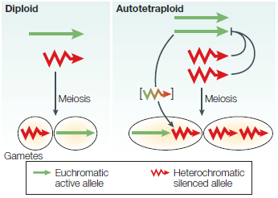

Slide 22
