Slide 1
Social Interaction

Slide 2
Introduction Of Social Interaction:
It refers to a relationship between two, three or more individuals.
Social interaction is an exchange between two or more individual and is a building block of society. Social interaction can be studied between groups of two, three or large social group.
By interacting with one or other people design rules, institutions and Systems within which they seek to live. Symbols are used to communicate the expectations of a given society to those new to it.

Slide 3
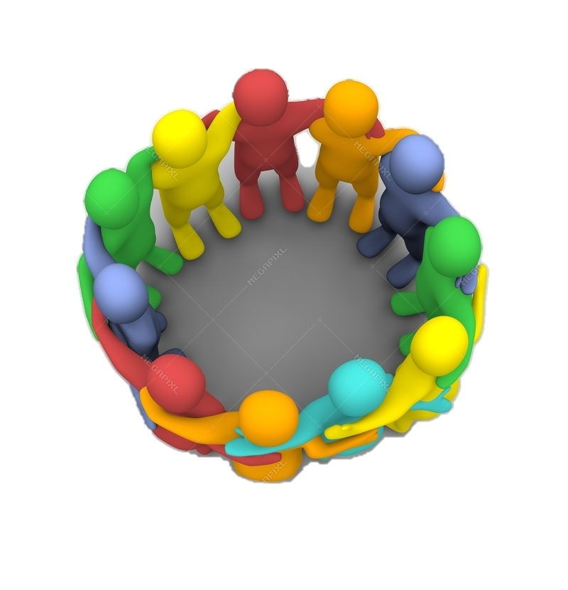
Social Group:
A collection of humans or animals that share certain characteristics, interact with one another, accept expectations and obligations has member of the group and share a common identity.
A social group exhibits some degree of social cohesion and is more than a simple collection or aggregate of individuals.
Social cohesion can be formed through shared interests, values, representations, ethnics or social background and kinship ties, among other factors.

Slide 4
Social Processes:
Social processes are the ways in which individuals and groups interact, adjust and readjust and establish relationships and pattern of behavior which are again modified through social interactions.
According to Horton and Hunt, “The term social process refers to the repetitive form of behavior which are commonly found in social life”.

Slide 5
Classifications Of Social Processes:
Social process may be classified in three ways as under:
By the number of person involved
By the degree of intimacy of the individual and groups in interaction.
By the nature or types of the processes.

Slide 6
Types of social processes:
These processes may be grouped into two main categories:
Associative Processes:
associative processes are also called the integrative or conjunctive social processes which are essential for the integration and progress of the society. There are two types of associative processes.
Co-operation
Accommodation

Slide 7
Co-operation:
It involves two or more persons joining their intelligence, efforts talents and resources together to attain a goal which can be shared. It is a kind of conjoint action or a alliance of person or groups seeking some common goal or reward.
Merrill and Eldrege:
“Co-operation is a form of social interaction where in two or more more persons work together to gain a common end”.

Slide 8
Accommodation:
Although accommodation has its origin in conflict situation, still it is radically different type of interaction.
According to Gillin and Gillin,
“ Accommodation is the term used by sociologists to describe a process by which competing and conflicting individuals and groups adjust their relationships to each other in order to overcome the difficulties which arise in completion, contravention or conflict.

Slide 9
Dissociative Processes:
Dissociative social processes are also called the disintegrative or disjunctive social processes. Although these processes hinder the growth and development of society, their absence results in stagnation of society. There are two types of dissociative processes are:
Competition
Conflict

Slide 10
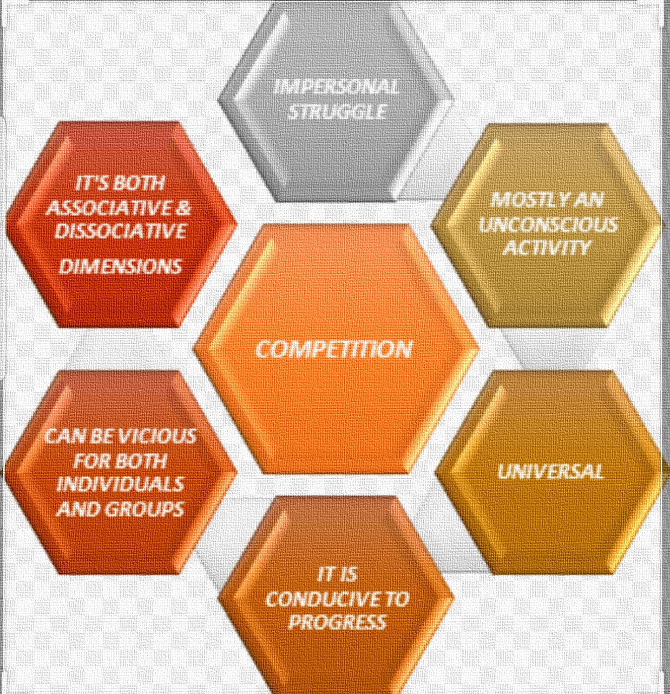
Competition

Slide 11
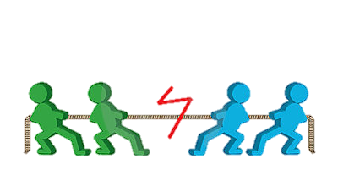
Competition:
Competition is one of the dissociative form of social processes. It is actually the most fundamental form of social struggle.
It occurs whenever there is an insufficient supply of anything that human being desires.
Competition is a process by which two or more people attempt to achieve a goal that only one can attain.
Competition is found in every society and in every age. It is found in every group. It is one aspect of struggle which is universal not only in human society but also in the plant and animal worlds. It is the natural result of the universal struggle for existence.
COMPETITION

Slide 12
Example of competition:
In any society, for example there are normally more people who want jobs than there are jobs available; hence there is a competition for them. Among those who are already employed, there is likewise competition for better jobs.

Slide 13
Characteristics of competition:
Competition is impersonal.
Competition is unconscious.
Competition is universal.
Competition is culturally patterned process.
Competition is continuous.

Slide 14
Forms of competition:
Racial competition
Economic competition
Political competition
Cultural competition
Social competition

Slide 15
1. Economic competition:
This type of competition is found in the process of production, consumption and distribution of goods. Economic competition can be observed at the individual as well as group level.
2. Social competition:
People always compete to achieve higher status and position. It is mostly observed in open societies.
3. Racial competition:
Racial competition is found among the different races of the world. The competition between the white and black in south Africa provides a very bright example of racial competition.

Slide 16
4. Cultural competition:
cultural competition takes place between two or more cultural groups. This kind of competition depends upon cultural differences.
5. Political competition:
political competition takes place in the political field. Political parties are always engaged in competition to capture power.

Slide 17
Conflict:
According to Gillin and Gillin
“Conflict is the social process in which individuals or groups seek their end by directly challenging the antagonist by violence or threat of violence.”
As a process, it is the anti-thesis of cooperation. Almost any human action is likely to toward the hopes or interferes with the plans of someone else. Such action becomes conflict.

Slide 19
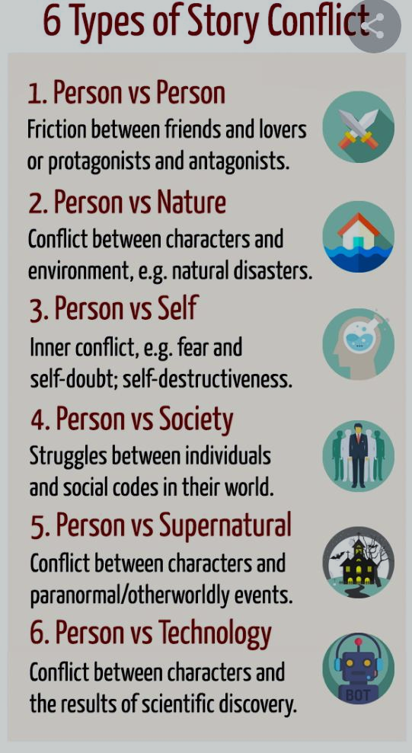
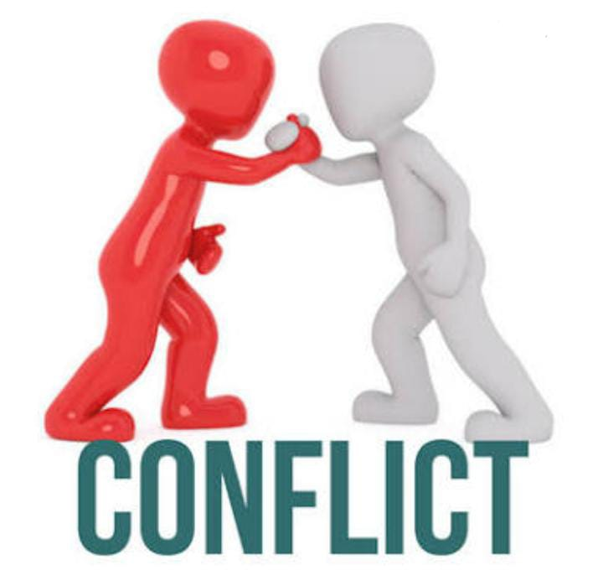

Slide 20
Difference between Competition and conflict:
Competition Competition is a continuous process and it is never ending. It is impersonal. It is unconscious and the individuals and groups are not aware of it. It encourages hard work. It is based on non-violence. | Conflict It is non continuous process. At some stage it must come to an end. It is personal. It is conscious and the individual and groups are aware and know each other. It discourages hard work for law in conflict. Violent methods may be used in conflict.

Slide 21
Elements of social interaction

Slide 22
Status:
Social status refers to the honor or prestige attached to ones position in society
in sociology a status is a persons rank or position in a particular context.
A social position that a person holds in every day use the world status.

Slide 23
Examples of status:
generally means: as when we say that a college president has a more status then a newly hide assistant professor but sociologically speaking both president and professor are statuses or postion with in the collegiate organization.
Middle class is an example of persons financial status. Being in a position of power is a example of having status.

Slide 24
Types of status:
Ascribed status:
Involuntary positions.
In born status
Example: gender and race
Achieved status:
Voluntary positions.
Earned statuses
Achieved status are those that results from our actions.
Often the two types work together, what we are ascribed often helps us achieve other statuses.

Slide 25
Status Master
A status that has exceptional importance for social identity, often shaping a person’s entire life. In Sociology, master status is the social position which is the primary identifying characteristic of an individual.
Example:
As a student your master status is your most important status and people tend to interact with you on its basis. Apart from student, some other statuses that you might hold are daughter/son , worker, athlete and so on..

Slide 26
Role:
A second important social structure is role behavior expected of someone who holds a particular status.
A position containing a set of socially defined attributes and expectations that determine appropriate behavior for an individual or group based on their status in relation to other people or groups.
Social interaction based on roles are usually very automatic and we often perform our roles without thinking about them. This in fact is why social interaction is indeed possible.
Example of role:
An individual in the role of parent is expected to care for there children and protect them from harm.
A high school football player carries the roles of student, athlete, classmate, etc.

Slide 27
Categories of social role:
Cultural roles:
Roles given by culture( for example, priest)
Social differentiation : (example: teacher, taxi driver)
Situation specific roles: (example eye witness)
Bio sociological roles: (example as human in a natural system)
Gender roles: as a man women mother father etc.

Slide 28
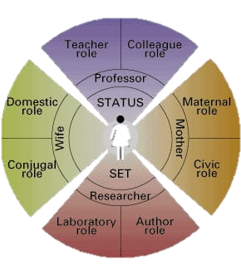
Role set:
Role set is the term used to describe the variety of roles and relationships you have as a result of your status in society
For example, a high school student interacts with a variety of different people as he goes through the school year, including teachers, the principal and administration.
His role set includes the different behaviors, or roles, he uses to meet the demands of this one social status of ‘student’.

Slide 29
Role strain:
Role strain occurs when we have trouble meeting the social roles expected of us..
The stress or strain experienced by an individual when incompatible behavior, expectations, or obligations are associated with a single social role.
Example of Role strain:
A college professor may enjoy being friendly with students. At the same time, however, the professor must maintain the personal distance needed in order to evaluate students fairly.

Slide 30
Role conflict:
Role conflict occurs when one playing two roles at the time that are governed by incompatible norms. People experience role conflict when they find themselves pulled in a various directions as they try to respond to many statuses they hold.
Role conflicts happens when there are contradictions between different roles that a person takes on or plays in their everyday life.
Examples of Role conflict:
If you are a police officer and you pull over your wife for speeding, your role of husband and lawman are in conflict.

Slide 32
Role exit:
Role exit describes the process of disengagement from a role that is central to one’s self-identity and re-establishment of an identity in a new role.
When a individual stops engaging in a role previously central to their identity and begin the process of establishing new identity.
Example of role exit:
When an individual retires from a job after a long career and must transition from the role of worker with deadlines and responsibilities to a leisurely life.

Slide 33
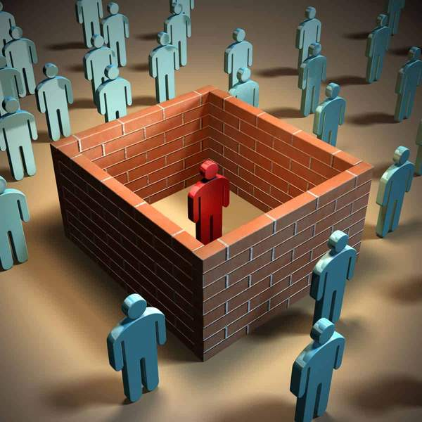
Social isolation:
Isolated can be defined as the state of being isolated, the complete separation from others of a person suffering from contagious disease
Fro example: people are isolated at homes and hospital because of COVID-19 if he or she is suffering from corona virus.
Social isolation is a state of complete or near complete lack of contact between an individual and society. It can also be defined structurally as the absence of social interactions, contacts and relationships with family and friends, or an individual level.

Slide 34
THANK YOU…

