Slide 1
Letter Writing
Communication Skills

Slide 2
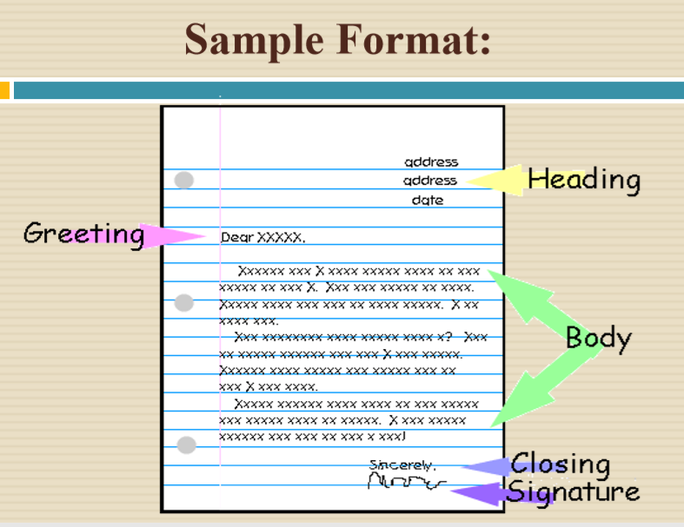
What is letter?
“A written or printed communication directed to a person or organization.”

Slide 3
Types of Letters
Personal Letters:
Personal Letters / Social Letters / Informal Letters written to Relatives & Friends . E.g.: Invitations etc.
Business Letters:
Business Letters/Formal Letters written by the traders, firms, companies etc. for business purposes . E.g. : Leave Letter, Ordering Letter etc.
Official Letters:
Letter of application, Letter to Government Officials, Letter to Newspapers, Job Applications, Recommendation Letter, Reference Letter, Termination letter etc.

Slide 4
Letter Components
The Writers Address
The Date
An Inside Address for the Recipient.
A Salutation
The Body of the Letter
A Complementary Close
The Writers Signed
Typed Names.

Slide 5
Letter Formats

Slide 6
Start with a salutation
The salutation you use will depend on your relationship with the recipient of the letter, as well as the formality of the letter.
Start the letter
If you're writing a personal letter, start by asking after the recipient's well-being. This can be "I hope you are well" or "How's it going?".
If you're writing a business or other formal letter, get straight to the point.
Proofread your letter
Before you send the letter, read over it a few times to make sure it conveys what you wanted to say, and that it's free of spelling or grammatical errors.

Slide 7
Use a complimentary close
A complimentary close ends your letter on a good note. Make two hard returns after the last paragraph of the letter, then write the complimentary close.
"Sincerely yours,“
"Kindest regards,“
"Best wishes."

Slide 8
Minutes of Meetings Writing
,

Slide 9
WHAT ARE MEETING MINUTES?
Minutes of Meeting describe specify what was discussed and decided in a meeting.
permanent record of the meeting for future reference.
Include an overview of the structure of the meeting
Note down in a concise way the matters that are being dealt with and decided on during a meeting and to produce the minutes of the meeting to every one..

Slide 10
FORMAT OF MINUTES
Generally, minutes begin with the organization name, place, date, list of people present, absent and the time.
All the agenda for the said meeting.
All official decisions must be included.
The reports given and the person involve
The vote tally may also be included
The date, time and place of the next meeting.
Assignments and the person responsible.
The minutes may end with a note of the time that the meeting was adjourned.

Slide 11
IMPORTANCE OF MEETING MINUTES?
Confirm any decisions made
Record of any agreed actions to be taken
Record of who has been allocated any tasks or responsibilities
Provide details of the meeting to anyone unable to attend
Serve as a record of the meeting's procedure and outcome

Slide 12
Types of minutes of meeting
There are basically three types:
Verbatim
These are used primarily in court reporting, where everything needs to be recorded word for word.
Minutes of resolution
These record only the main resolutions are reached. They are common in AGMs and other statutory meetings.
E.g. Purchase of new printer: The Secretary submitted a report on a purchase of new LaserJet printer. It was resolved that a LaserJet Printer 2055 be purchased at a cost of SR1500.
Minutes of narration
These are a concise summary of all the discussion that took place, reports received, decisions made and actions to be taken.

Slide 13
Features of minutes of meeting
Name of organization
Title of meeting: AGM, Directors’ meeting etc.
Date, time, venue
Attendance: Present
Apologies for absence
Minutes of last meeting
Matters arising from last minutes
Opening new branches
Disciplinary issues
Any other business (AOB)
Adjournment/Date of next meeting
Signature

