Slide 1
Human Physiology,
Motor System
Dr. Shahid Javed
MBBS; PhD

Slide 2
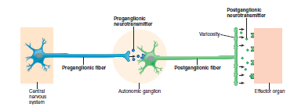
ANS

Slide 3
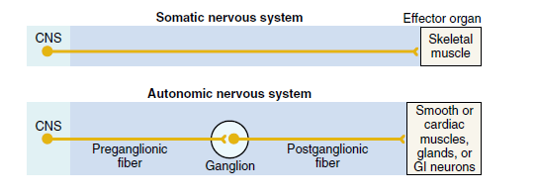

Slide 6
SYMPATHETIC NERVOUS SYSTEM
Origin: Spinal origin T₁ – L₂
Sympathetic neurons:
Sympathetic nerves differ from skeletal motor nerves in the following ways:
Sympathetic nerves
- Preganglionic neuron
- Postganglionic neuron

Slide 8
Segmental distribution of sympathetic nerve fibers
Depends up on the locus in the embryo from which the organ originated
T-1 → terminate in the head
T-2 → terminate in the neck
T-3,4,5,6 → terminate in the thorax
T-7,8,9,10,11 → in the abdomen
T-12,L-1,2 → in to the legs

Slide 9
PARASYMPATHETIC NERVOUS SYSTEM
Origin: Cranial nerves 3rd, 7th, 9th, 10th
Spinal origin → Sacral S₂, S₃ (occasionally from S₁, S₂)
Parasympathetic neurons:
- Preganglionic (long)
- Postganglionic (short)
Except in case of few cranial nerves mostly cell bodies lie in the viscera supplying

Slide 11
Basic characteristics of sympathetic nervous system
Neurotransmitter → all preganglionic neurons are cholinergic,most of the post ganglionic neurons are adrenergic but to sweat glands,piloerector muscles and to very few blood vessels are cholinergic
Structure of the junction btw.post ganglionic neuron and effector cell → have bulbous enlargement called varicosities containing secretory vesicles and mitochondria
Parasypyhetic postganglionic fibers release Ach, sympathetic ones norepinephrine

Slide 12
Nor epinephrine
Synthesis → starts in axoplasm of adrenergic nerve terminal but is completed inside the vesicle
1. Tyrosine→ dopa (hydroxylation)
2. Dopa→dopamine (decarboxylation)
3. Transport of dopamine in to the vesicles
4. Topamine→norepinephrine (hydroxilation)
In adrenal medulla
Norepinephrine→epinephrine (methylation) 80%
Removal from the secretory site in three ways
1. Reuptake by active transport process (50-80%)
2. Destruction of small amounts by monoamine oxidase, catechol–o-methyl transferase
Duration of action
→ remains active only for a few seconds
→ secreted by adrenal medulla in to blood remain active until diffuse into some tissue

Slide 13
Basic characteristics of parasympathetic system
Neurotransmitter →all preganglionic neurons are cholinergic → all postganglionic neurons are also cholinergic
Structure of the junction between postganglionic neuron and effector cells
→ a few postganglionic parasympathetic fiber endings are similar to skeletal neuromuscular junctions
→ many are similar to sympathetic varicosities

Slide 14
Acetylcholine
Sites of release
Synthesis
Acetyl-co A+choline → acetylcholine
(choline acetyl transferase)
Duration of action
For a few seconds
Destruction
Acetylcholine esterase

Slide 15
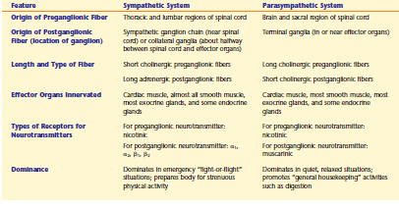

Slide 16
Effect of sympathetic and parasympathetic stimulation on specific organs: Eyes
Pupillary opening
→ sympathetic stimulation-dilates the pupil
→ parasympathetic stimulation-constrict pupil
Focus of lens → is controlled by parasympathetic nervous system-contracts ciliary muscles-lens becomes more convex-causing the eye to focus on the objects near at hand

Slide 17
Glands of the body
Nasal, Lacrimal, Salivary and many GI glands-stimulated by parasympathetic nervous system-increase quantity of watery secretions
GI glands-by sympathetic stimulation
1- formation of a concentrated secretion
2- also causes vasoconstriction so reducing the rate of secretion

Slide 18
Sweat glands→ sympathetic stimulation-increase sweating while parasympathetic stimulation-no effect
But sweating could be called a parasympathetic function because
1- sympathetic fibres to most sweat glands are cholinergic
2- sweat glands are stimulated primarily by centers in hypothalamus
Apocrine glands→in axilla–increase secretion by sympathetic stimulation and do not respond to parasympathetic stimulation
They differ from sweat glands in that sympathetic fibres are adrenergic

Slide 19
Heart
Sympathetic stimulation
→increase heart rate
→increase force of contraction
Parasympathetic stimulation
→decrease heart rate
→decrease force of contraction

Slide 20
Systemic blood vessels
Sympathetic stimulation
→causes vasoconstriction
→causes vascular dilatation
Parasympathetic stimulation
→has almost no effect but causes vasodilatation in certain areas such as blush areas of face

Slide 21
Arterial pressure
Sympathetic stimulation
→acute increase-by increasing cardiac out put and peripheral resistance
→long term increase-by stimulating kidneys to retain salt and water
Parasympathetic stimulation
→slightly decreases arterial pressure through vagus nerve

Slide 22
Sympathetic stimulation has multiple metabolic effects
Release of glucose from the liver
Increase in blood glucose concentration
Increase glycogenolysis in liver and muscles
Increase skeletal muscle strength
Increase basal metabolic rate

Slide 23
Functions of adrenal medulla
The adrenal medulla is a mdified part of sympathetic nervous system
Sympathetic stimulation causes release of epinephrine and nor epinephrine
80% epinephrine and 20% nor epinephrine
Have almost the same effects as by direct sympathetic stimulation but difference is in duration of action
Effects lasts 5-10 times as long because both of the hormones release from blood slowly

Slide 24
Sympathetic and parasympathetic tone
Normally, the sympathetic and parasympathetic systems are continually active and the basal rates of activity are known as sympathetic and parasympathetic tone
The tone of stimulated organ may be increased or decreased
Times of sympathetic dominance
Times of parasympathetic dominance
Advantages of dual autonomic innervation

Slide 25
Example of sympathetic tone
Sympathetic tone normally keeps almost all the systemic arterioles constricted
By increasing the degree of sympathetic stimulation, the vessels can be constricted even more
By decreasing the degree of sympathetic stimulation, the vessels can be dilated
Example of parasympathetic tone
Parasympathetic tone in the GI tract
Surgical removal of this tone cause GI atony-causing constipation

Slide 26
Receptors
Several different receptor types are available for each autonomic neurotransmitter
Cholinergic receptors
Muscarinic receptors (Muscarine, a poison from mushroom, activates only muscarinic receptors
Nicotinic receptors (activated by tobacco plant derivative nicotine)
Muscarinic receptors are found on all effector cells that are stimulated by post ganglionc cholinergic neurons either sympathetic or parasympathetic
Nicotinic receptors are found in the autonomic ganglia at the synapses btw. Pre and post ganglionic neurons of both sympathetic and parasympathetic system

Slide 27
Adrenergic receptors
Alpha receptors
alpha-1 and alpha-2
Beta receptors
beta-1 and beta-2
Epinephrine excites both receptors equally
Nor epinephrine excites mainly alpha receptors and to some extent beta receptors
Mechanism of action

Slide 28
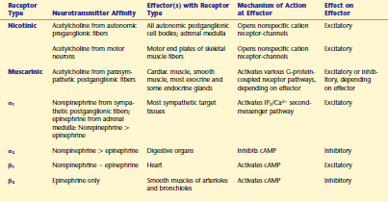

Slide 29
Autonomic agonists and antagonists
Atropine
Salbutamol
Metoprolol
Propanolol

Slide 30
Autonomic reflexes
Cardiovascular autonomic reflexes
→ baroreceptor reflex
Gastrointestinal autonomic reflexes
→ salivary reflex
→ defecation reflex
Micturation reflex

