Slide 1
Evidence Based Physical Therapy
What constitutes evidence

Slide 2
Clinical Observation
More good > effective
Some times clinical observation are overlapped by extraneous factors
natural recovery
Polite patients
Statistical Regression
Hawthorne effect
Placebo effect
Notes:
spontaneous resolution of episodic disease

Slide 3
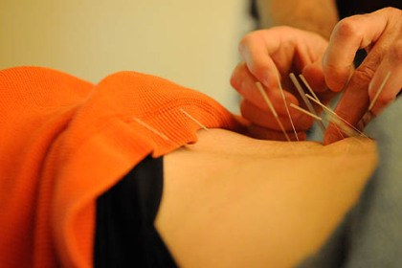
Theory about mechanism
Justification of practice is provided by theory rather observation.
Theory isn’t about effectiveness rather mechanism leads us to believe that intervention is effective.
Size of treatment effect is important …and theory fails in this aspect.
Developing & refining intervention but poor source about effect of intervention.
Status of working hypothesis rather c&a representation

Slide 4
People stretch after sport because they have been told that stretching reduces muscle spasm which causes delayed onset muscle soreness
(de Vries 1961).

Slide 5
Clinical research
Better source of info about effects of intervention.
Good control regarding bias & good estimate about size of treatment.
High quality clinical research

Slide 6
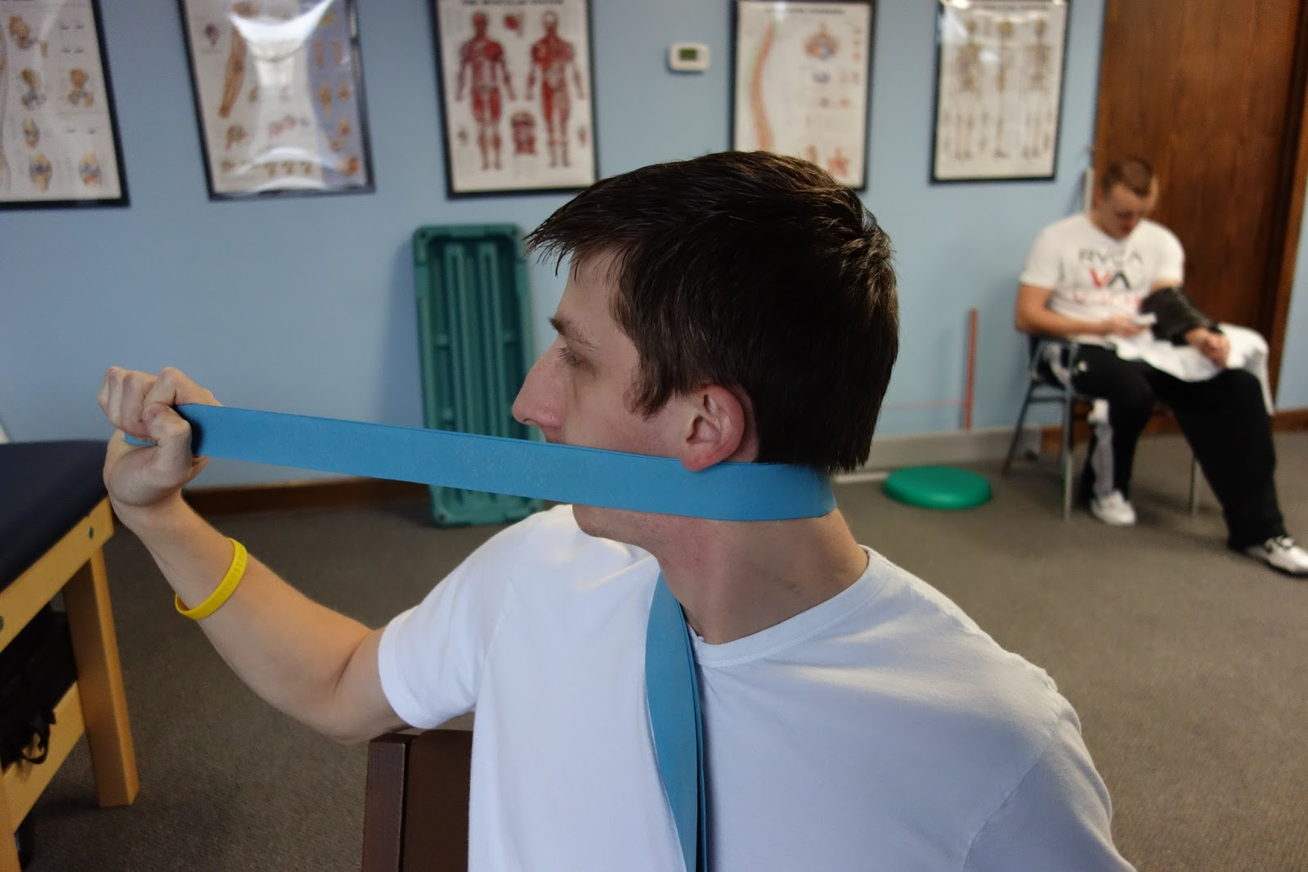
Research designs
Case Series & control trials
Notes:
Allocation bias

