Slide 1
Estimating the Schedule of Work
By: Saba Ashraf
Noon Business School, University of Sargodha

Slide 2
What is Scheduling when it comes to Project Management?
It is the listing of activities, deliverables, and milestones within a project.
A schedule also usually includes the planned start and finish date, duration, and resources assigned to each activity.
Effective project scheduling is a critical component of successful time management.
Scheduling should be accurate, realistic, and workable.

Slide 3
Steps in Creating a Schedule Sequentially
Establish the Scheduling Assumptions: It is important to specify scheduling assumptions before the schedule is completed. Answering the following question can ne helpful in this process.
Are there fixed number of resources or you can add them to meet schedule?
Is there an absolute date by which the project must be completed or the entire effort is lost?
Can you negotiate the completion date if you have resource constraint?
Will people work standard workdays or overtime would be allowed?
Are all resources currently trained and available?
Assumptions protects the project from severely affected by changes in plan.

Slide 4
Estimate the number of resources, the activity effort, and the work package duration based on the resources your have.
These estimates are constrained by your personnel and equipment resources.
Effort and duration are same sometimes.
Effort and duration could be different.
EFFORT: is the time it takes to work on an activity.
DURATION: is the time it takes to complete the activity.
In order to create both an accurate and detailed budget, it is important to know both effort and duration required to complete work package.
It is important to know if you can add resources to reduce duration
Determine calendar dates for each activity and create a master schedule.
You need to determine flexibility do you have to complete the various activities.
For that we measure float and slack time.

Slide 5
Adjust the individual resource assignment as necessary to optimize the schedule. (resource levelling process)
Chart the final schedule. Computer programs are really helpful for this.

Slide 6
Estimating the Duration of Activities
Estimating the duration is the most important and is like predicting the future. Following options can be availed to get the best estimate.
Get an objective expert’s opinion.
Recognize if the estimate is coming from a pessimist or optimist.
Analogous estimates.
Parametric estimates.
Make an educated guess.

Slide 7
A Compromise between best and worst case.
The results couldn’t be always extreme. (flawless execution or major disaster)
The best approach is to establish compromise between the two, where you estimate following
The optimistic estimates.
The most likely estimate.
The pessimist estimate.
PERT provides the mechanics for estimating all three.

Slide 8
PERT (Program Evaluation Review Technique)

Slide 9
What is PERT Chart?
A PERT chart, sometimes called a PERT diagram, is a project management tool used to schedule, organize and coordinate tasks within a project.
The PERT chart template uses nodes -- drawn as rectangles or circles -- to represent events and milestones throughout the project.
The nodes are connected by vectors -- drawn as lines -- which represent the various tasks that need to be completed.

Slide 10
How is it helpful for Project Manager
PERT charts provide project managers with an estimation of the minimum amount of time needed to complete a project.
Managers can also analyze the work breakdown and task connections as well as assess the risk associated with the project.

Slide 11
Terminologies used in PERT Chart
Nodes: are visual representations of milestones or events within the project. They are drawn as either numbered boxes or numbered circles
Arrows. are visual representations of the tasks that occur throughout the project. The direction of the arrow indicates the sequence of the task. Diverging arrows show that various tasks can be completed at the same time.
Fast Tracking. is when tasks and activities are performed simultaneously.
A PERT event is the point at which one or more tasks are started or completed.
A predecessor event occurs immediately before some events.
A successor event naturally occurs after events.

Slide 12
Terminologies used in PERT chart
Slack is the amount of time a single task can be delayed without harming other tasks or the project as a whole.
The critical path is the longest -- or most time consuming -- path from the start to the completion of an event or task.
Critical path activity refers to a task that does not experience slack.
Crashing critical path is when the completion time of a task is shortened.
Expected time is the best estimation of how long a task will take to complete, taking into consideration any problems or obstacles that might arise.

Slide 13
Terminologies
Optimistic time refers to the minimum amount of time it will take to complete a task.
Pessimistic time is the maximum amount of time it will take to finish a task.
Most likely time is the best guess of how long a task will take, assuming no problems arise.

Slide 14
How PERT chart works?

Slide 15
It could be as complex as this

Slide 16
How do we create it?
Let’s say you and your team members are designing an eBook with the intension of collecting client leads.
You want to understand exactly how long will it take to create eBook.
Additionally you want to understand how different tasks depend on one another.
Let’s build PERT chart

Slide 17
STEP 1
BREAK YOUR PROJECT INTO MILESTONES AND TASKS.
Milestones would be;
start date
Outline completed
First draft completed
Tech assets completed
Final version ready
EBook launched

Slide 18
STEP 1
Tasks would be;
Create outline
Draft copy
Design eBook
Identify target audience
Proofread copy
Proofread again
Create landing page
Launch eBook

Slide 19
STEP 2
SPOT ANY DEPENDENCIES;
What tasks cannot be completed without other tasks happening first.
For example, you cannot design the eBook until you have outline.
You cannot approve the final copy until you proofread it first

Slide 20
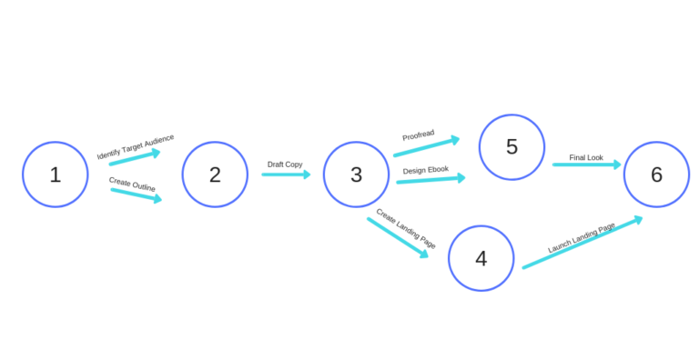
STEP 3
MAP OUT YOUR PERT CHART;
Start using the circles and arrows to plot out the best sequence.

Slide 21
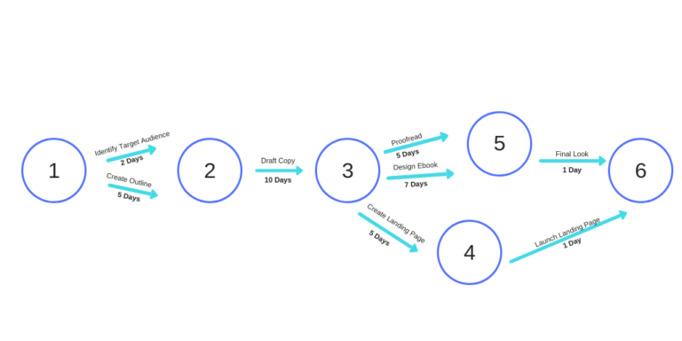
STEP 4
te = (o + 4m + p) ÷ 6
ADD TIME ESTIMATES TO EACH TASK

Slide 22
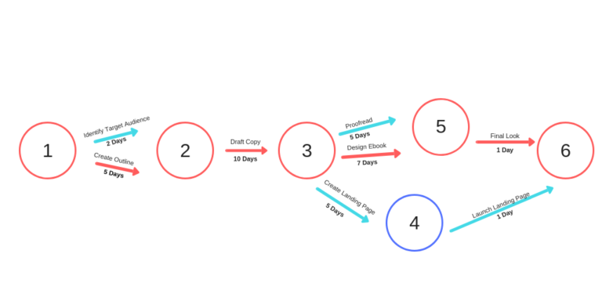
STEP 5
SPOT THE CRTICAL PATH:

Slide 23
Last words
Once you start understanding how things work, you can always update the estimated time.

