Slide 1
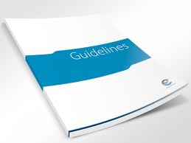

Slide 2
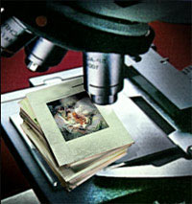

Slide 3
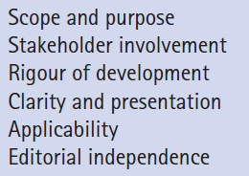
Domains of AGREE (Appraisal of Guidelines, REsearch and Evaluation (AGREE) Collaboration) instrument:
6 theoretical
quality Domains
Notes:
Stakeholder:a person, group, organization, member or system who affects or can be affected by an organization's actions
Rigour

Slide 4
RESULTS OF THE CRITICAL APPRAISAL MEANING IN PRACTICE?
Is the purpose of the guideline clear?
Is the patient population to which the guideline applies similar to your own patients?
Are the settings to which the guideline applies similar to the settings of your patients?
Has the development process been systematic and rigorous?
Is the guideline generally, and the recommendations in particular, clear?

Slide 5
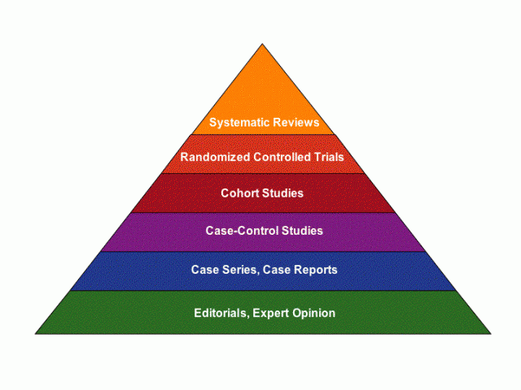

Slide 6
Quality of evidence & strength of recommendations
GUIDELINES
MAKE
RECOMMENDATIONS
FOR PRACTICE

Slide 7
Level of trust in guidelines depend upon strength of the recommendation.
The GRADE Working Group (2004) suggestion to consider:
Balance b/w benefits and harm
Quality of evidence
Translation of evidence in specific setting practice
* Relative risk / benefits of guidelines

Slide 8
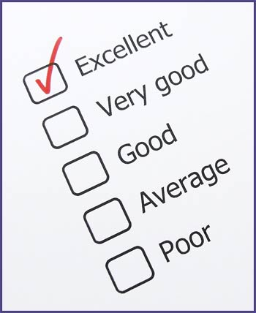
Notes:
Grade A: recommendation based on atleast one RCT, C : based on clinical experience /expert

Slide 9
LEGAL IMPLICATION
Increase in number of guidelines by the time.
Everything has certain effects/outcomes
To follow Clinical Guideline is necessary.
Guidelines may contradict with clinical experience
Autonomy
Concern:
With increase # of guideline , autonomy in professional judgement & make their own choice in Patient care may compromise
Notes:
A practitioner is someone who engages in an occupation, profession, religion, or way of life.

Slide 10
In case of available high quality evidence If Professional does not use it ,may be there are legal issues
There is little case law in relation to the use (or not) of clinical guidelines
In US where medical sues are more ,Clinical guidelines play pivotal/relevant role, in proof of negligence is ,in 7 % of cases.
Despite an explosion of clinical guideline development since the 1990s, it appears that the courts are more likely to focus on the facts of the case than refer to clinical guidelines (Samanta et al 2003).
Notes:
Case Law:Part of common law, consisting of judgments given by higher (appellate) courts in interpreting the statutes (or the provisions of a constitution) applicable in cases brought before them.

Slide 11
CAN THERE BE CONTRADICTION BETWEEN PROFESSIONAL JUDGEMENT of Practitioner regarding particular patient
AND RECOMMENDATIONS IN CLINICAL GUIDELINES
? ? ? ?

Slide 12
There has been no suggestion that the presence of a clinical guideline takes away the responsibility of the practitioner for using professional judgement in relation to a particular patient

Slide 13
the user of clinical guidelines will not accept recommendations at face value, but will first consider their relevance and acceptability for any individual patient (Mann 1996)

Slide 14
Courts seem to take the view that the status of clinical guidelines is secondary to the reasonableness of a group of respected health professionals

Slide 15
*‘Bolam test’
derived from a legal ruling in 1957,in the case of Bolam v. Friern Hospital Management Committee
‘a doctor will not be guilty of negligence if he has acted in accordance with a practice accepted as proper by a responsible body of medical men skilled in that particular art’

Slide 16
the test also recognizes that there can be more than one school of thought, so doctors can often defense a charge of negligence by claiming to conform to the practice of another body of responsible doctors (Hurwitz 1999)
Cont……………..

Slide 17
Notes:
Systematically developed statements that assist practitioner and patient decisions about appropriate health for specific circumstances

Slide 18
CLINICAL GUIDELINES
Systematically developed statements that assist practitioner and patient decisions about appropriate health for specific circumstances

Slide 19
Outline previous Lectures
LEGAL IMPLICATIONS
In US where medical sues are more ,Clinical guidelines play pivotal/relevant role, in proof of negligence is ,in 7 % of cases.
Despite an explosion of clinical guideline development since the 1990s, it appears that the courts are more likely to focus on the facts of the case than refer to clinical guidelines
(Samanta et al 2003).

Slide 20
Outline previous Lectures
Courts seem to take the view that the status of clinical guidelines is secondary to the reasonableness of a group of respected health professionals

Slide 21
Bolam Test
‘a doctor will not be guilty of negligence if he has acted in accordance with a practice accepted as proper by a responsible body of medical men
skilled in that particular art’

Slide 22
DOCUMENTATION

Slide 23
two issues in relation to Documentation
If a clinical guideline is available, but the recommendations are not followed, an explanation of the rationale for the variance should be documented.
Time Frame

Slide 25
REFLECTIONS ON THE FUTURE OF GUIDELINE DEVELOPMENT
Who should Develop Guidelines?
Grimshaw et al (1995) observed that the development of valid guidelines requires considerable Resources.
Notes:
They concluded that expertise was needed for conducting systematic reviews, synthesizing the evidence and developing valid guidelines.

Slide 26
They argued for greater co-ordination nationally on guideline development, to avoid duplication, and felt that national programmes would reduce the costs of local guideline development.
Expertise
Implementing
+ barrier to applicability issues at local level

Slide 27
Collaboration in Guideline development
Existing Systematic reviews
Collaboration b/w Systematic reviewers & guideline developers
sharing common methodologies, problems and solutions, and also to share actual reviews, to avoid duplication.

Slide 28
there should be a database of evidence tables available that both systematic reviewers and guideline developers
In the Netherlands, partnerships are already established between the Dutch Cochrane Centre and guideline centre and developers can access.

Slide 29
Collaboration in guideline development
International collaboration
a way of avoiding
Duplication and
utility of unnecessary resource.
Problem of generalized applicability…
Evidence reviews to be shared across countries
Netherland & UK…future collab on CG esp shar Evid Rew

Slide 30
High quality clinical guidelines provide a valuable resource for practice in the form of recommendations for practice based on a systematic evidence review integrated with information from a consensus process and expert judgement

Slide 31
Clinical guidelines are expensive and time-consuming to develop.
A real challenge for the years
ahead will be to set up international collaborations of organizations that will trust each others’ work sufficiently to avoid the current duplication of guidelines developed across countries.

Slide 32
A second challenge will be to
determine with more clarity whether clinical guidelines actually lead to health benefits for patients.
Finally, optimal mechanisms for facilitation
and implementation of guidelines need to be found and used.

