Slide 1
Pragmatism BS Education-III Philosophy of Education (EDU-203)
Department of Education University of Sargodha

Slide 3
BS Education (3) Presented By:
Self-Support 21 Aila Sarwar
Philosophy of Education 45 Aaiza Saeed
2019-2023 46 Tayyaba

Slide 4
Content:
pragmatism
John Dewey
Main form of pragmatism
Metaphysics
Epistemology
Axiology
Basic principle
Pragmatism in education
Curriculum
Method of teaching

Slide 5
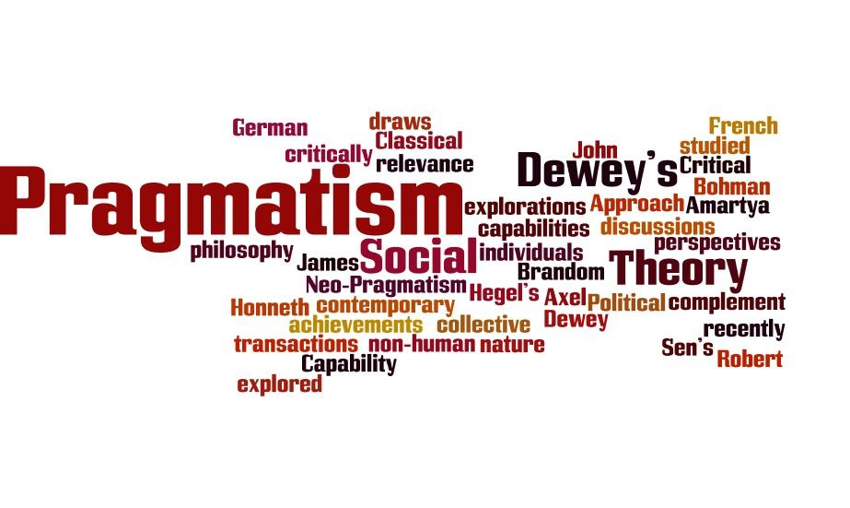
Pragmatism
Greek origin words –action or activity
According to pragmatism, it is necessary to create a atmosphere to present situation and it is necessary to divert t towards useful things
Humans are capable of fulfilling their minds on the basis of this truth
According to pragmatism education contains a important practical knowledge and useful activities which ,make self dependant and useful member of the society

Slide 6
John Dewey:
An American philosopher and educator
Rejected traditional method of teaching
Father of modern experiential education
Supporter of progressive education
“education is not affair of telling or being told but an active and constructive process”

Slide 7
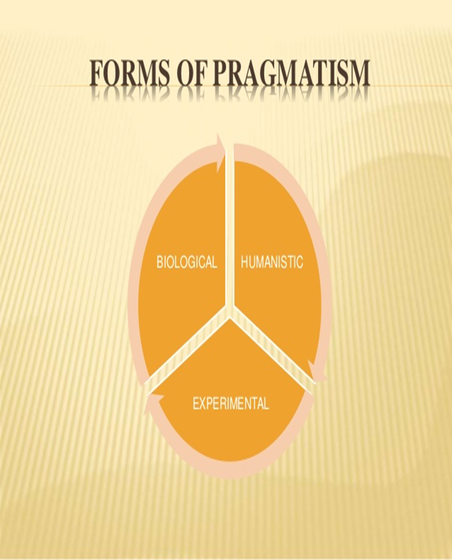
Main form of pragmatism
There are three form of pragmatism

Slide 8
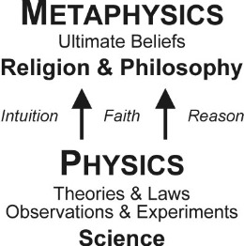
Metaphysics Of Pragmatism
According to William James “pragmatism is a temper of a mind ,an attitude , it is also a theory of the nature of ideas and truth and finally it is the theory reality”
Believe in knowledge which feel through sense of organ
No faith in ultimate reality
Truth is man made
No believe in spiritual values
Reality is still in making

Slide 9
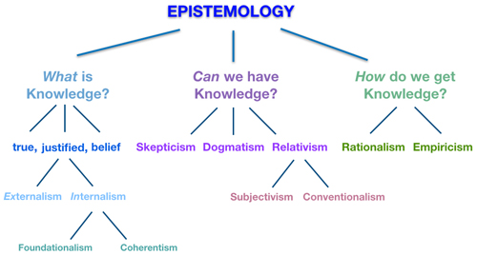
Epistemology
Knowledge is based on experience is true
Recreation of experience = knowledge
Sense of organ = base of knowledge
experience = knowledge
Axiology
Values is not stagnate
Values change according to space and time
Confidence in flexibility
Values of life is changeable

Slide 10
Basic Principal Of Pragmatism
Practicability and usefulness
Acceptance of the method science
Favour of giving education for social life
Mam is active being
Emphasis on change
emphasis on social aspects

Slide 11
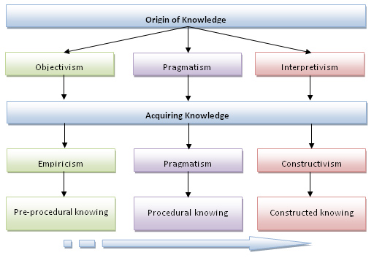
Pragmatism in education
According to foster “the basic of all teaching is the activity of world”
Not believe in pre- conceived aims of education
Education is a process of individual growth and development “Dewey”
Aims, nature, organization of education should be such it may do maximum good for man
Progressive education
Fulfil their needs
Material welfare, desire for enjoyment
Development of social skill

Slide 12
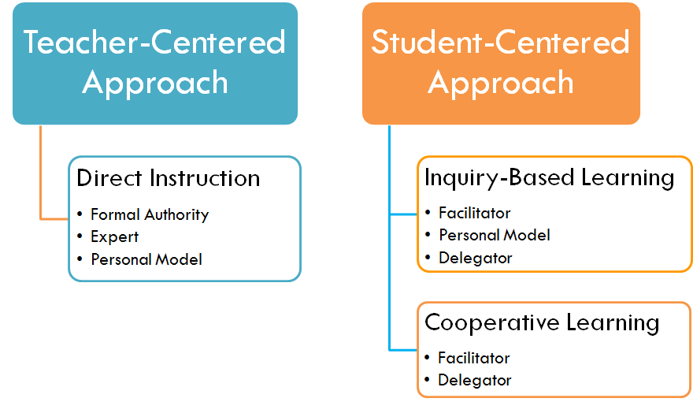
Method Of Teaching
Learning by doing experience
Purposeful activities
Project method
Problem solving

Slide 13
Contribution of pragmatism in education
Child centred education
Stress on social utility
Scientific method of teaching like - project method, problem solving method
Democratic way of learning
Teacher as a friend, philosopher and guide
Avoid traditional education ‘

Slide 14
References
Alexander, T. (1987). John Dewey’s theory of art, experience, and nature. SUNY Press
Bohac, P., (2001, February 6). Dewey's pragmatism. Chapter 4 Pragmatism and Education.RetrievedSeptember3,2009,from
http://www.brendawelch.com/uwf/pragmatism.pdf
Boisvert, R. D. (1988). John Dewey: Rethinking our time. Albany: State University of New York Press.
Ozmun, H.A. & Craver, S.M. (2008). Philosophical foundations of education (8th ed.). Columbus, Ohio: Prentice-
Hall Inc. Welch man, J. (1995). Dewey’s ethical thought. Ithaca: Cornell University Press.

