Slide 1
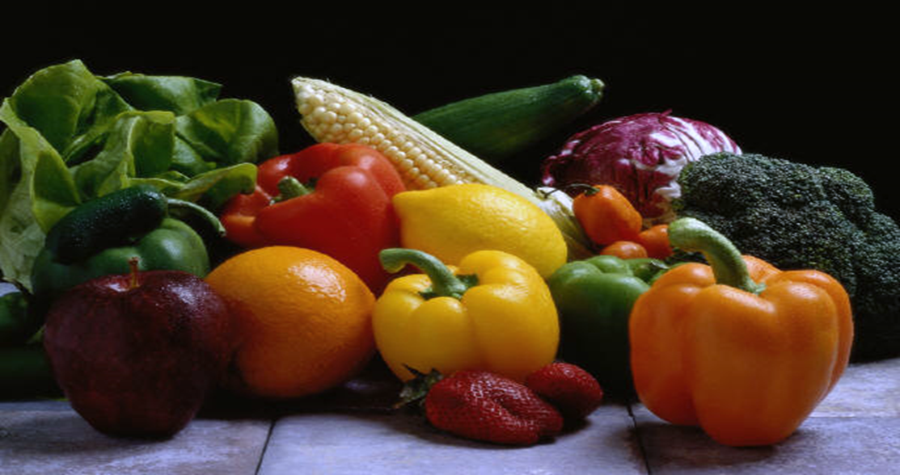
Wax coating
Prof. Dr. Sarfraz Hussain
FST 508

Slide 2
OUTLINES
Introduction
Fruits & Vegies benefited by waxing
Sources
Properties
Wax action
Advantages & Disadvantages
Conclusions
References

Slide 3
Wax coating
Waxing consist of applying a thin layer of edible wax to the outer surface of fresh fruits & vegetables.
It gives Shiny glossy appearance
Improve their cosmetic features ( surface shine, color ) of the product
Natural wax coating on fruits and vegetables is only recommended for good quality products

Slide 4
Fruits & Vegetables benefited by waxing

Slide 5
Sources

Slide 6
PROPERTIES OF WAX
Knead able at 20° C.
Easily emulsifiable.
Should not impart undesirable odor.
Should be economical.
Efficient drying performance.
Non-sticky or tacky.
Should never interfere with the quality of fresh fruit / vegetable.
Melts above 40° C without decomposition.
Has relatively low viscosity.
Capable of being polished by slight pressure.
Translucent to opaque form but not like glass.

Slide 7
HOW WAX COATING WORKS

Slide 8
Waxing methods
1.Liquid Paraffin wax method
2. Slab wax method
3. Spray method
4. Dipping or cold wax method

Slide 9
WAXING METHODS
Liquid Paraffin wax method: In this method fruits and vegetables are dipped in hot paraffin.
The main disadvantage of this method is too much of coating material is used.
2. Slab wax method (Roller Brushing) : In
this case the wax is pressed against rapidly revolving
brushes. But the efficiency is very less.

Slide 10
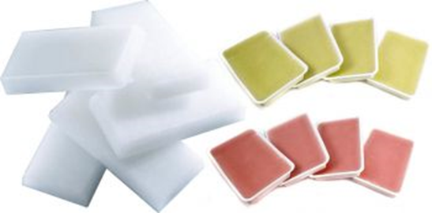
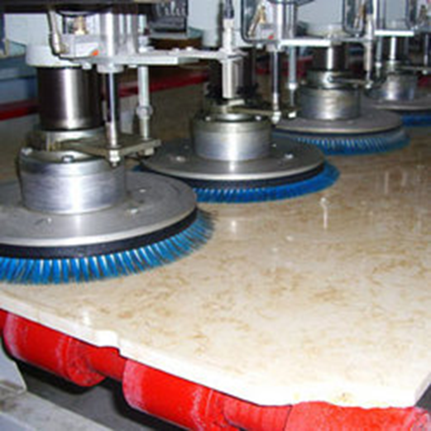
LIQUID PARAFFIN WAX
SLAB WAX METHOD
SLAB WAX METHOD

Slide 11
3. Spray method:
Spraying of melted wax on the fruit, which is subsequently brushed mechanically until a film of desired thickness is obtained.
The wax is dissolved in a suitable solvent. This depends on,
The pressure employed
Volume of wax used
Wax temperature
Distance of fruit from the spray
Number of spray nozzles.

Slide 12
Method of spraying wax

Slide 13
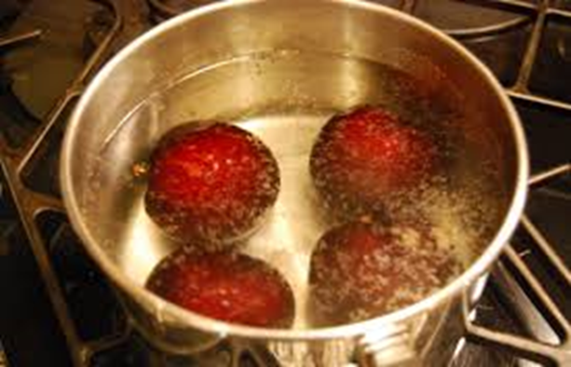
4. Dipping or cold wax method:
Fruits and vegetables are washed and then without being dried are dipped into a wax emulsion of proper concentration.
They are dried before packing. Purified wax is odour less, tasteless and nontoxic and it can be heat- sealed
DIPPING OR COLD WAX

Slide 14
ADVANTAGES vs DISADVANTAGES

Slide 15
CONCLUSIONS
Coating improves product appearance and color
coating is an effective method of value addition and preservation for the food product
Continuous Mechanization is not available for various coating operations. Till now, many of the coating operations are done by batch processing.
Safety of food product should be maintained in the coating operations

Slide 16
REFERENCES
Lisa Kitinoja and Adel A. Kader . Small-Scale Postharvest Handling Practices: A Manual for Horticultural Crops.UCDAVIS. Postharvest Horticulture Series No. 8E
WAXING FRUITS AND VEGETABLES. ( June 2004). Postharvest Handling Technical Bulletin No. 33. http://pdf.usaid.gov/pdf_docs/PNACY849.pdf Preservation of fruits and vegetables by wax coating.

