Slide 1
Quantiles
Quartiles
Deciles
Percentile

Slide 2
Definitions
Quartiles: The three values which divides the data into four equal parts, are called the Quartiles. These values are denoted by Q1,Q2 and Q3.
Deciles: The nine values which divides the data into 10 equal parts, are called Deciles. These values are denoted by D1,D2,…D9.
Percentiles: The ninety nine values dividing the data into one hundred equal parts, are called Percentile. These values are denoted by P1,P2…..P99.

Slide 3
Quartiles
Q₁, Q₂, Q₃
divides data into four equal parts
25%
25%
25%
25%
Q₁
Q₂
Q₃

Slide 4
Deciles
Decile Divides data into ten equal parts
It is denoted by D₁, D₂, D₃, D₄, D₅, D₆, D₇, D₈, D₉
10%
10%
10%
10%
10%
10%
10%
10%
10%
10%
D₁ D₂ D₃ D₄ D₅ D₆ D₇ D₈ D₉

Slide 5
Percentiles
Divide the data into one hundred equal parts are called percentiles.

Slide 6
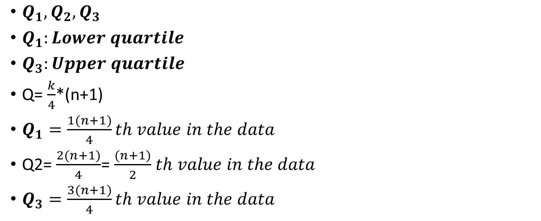
Quartiles Formulas for ungrouped data
$Q_{1}, Q_{2}, Q_{3}$
$Q_{1}:Lower quartile$
$Q_{3}:Upper quartile$
Q= $\frac{k}{4}$*(n+1)
$Q_{1}=\frac{1(n+1)}{4}th value in the data$
Q2= $\frac{2(n+1)}{4}$= $\frac{(n+1)}{2}$ $th value in the data$
$Q_{3}=\frac{3(n+1)}{4}th value in the data$

Slide 7
Deciles Formulas for Ungrouped data
D= $\frac{k}{10}$*(n+1)
D1=$\frac{1}{10}$*(n+1)
D2=$\frac{2}{10}$*(n+1)
.
.
.
D9=$\frac{9}{10}$*(n+1)

Slide 8

Percentile formulas for ungrouped data
P= $\frac{k}{100}$*(n+1)
P1=$\frac{1}{100}$*(n+1)
P2=$\frac{2}{100}$*(n+1)=$\frac{1}{50}$*(n+1)
.
.
.
P99=$\frac{99}{100}$*(n+1)

Slide 9
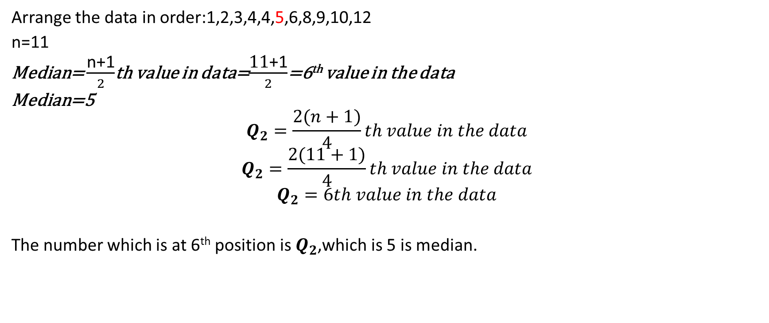
Example for ungroup data for the following data 3,4,8,5,10,9,1,4,6,12,2 Find median ,Q2,Q1, Q3, D5, D7, P12, P50. and prove that Median = Q2 = D5 = P50
Arrange the data in order:1,2,3,4,4,5,6,8,9,10,12
n=11
Median= $\frac{\text{n}\text{+1}}{2}$th value in data=$\frac{\text{11}\text{+1}}{2}$=6th value in the data
Median=5
$$Q_{2}=\frac{2(n+1)}{4}th value in the data$$
$$Q_{2}=\frac{2(11+1)}{4}th value in the data$$
$$Q_{2}=6th value in the data$$
The number which is at 6th position is $Q_{2}$,which is 5 is median.

Slide 10
Arrange the data in order: Q₁
1,2,3,4,4,5,6,8,9,10,12
$$Q_{1}=\frac{n+1}{4}th value in the data$$
$$Q_{1}=\frac{11+1}{4}th value in the data$$
$$Q_{1}=3$$
The number which is at 3rd position is $Q_{1}$ ,which is 3.
$$Q_{3}=\frac{3(n+1)}{4}th value in the data$$
$$Q_{3}=\frac{3(11+1)}{4}th value in the data$$
The number which is at 9th position is $Q_{3}$ ,which is 9.

Slide 11

Formula:D= $\frac{k}{10}$*(n+1)
$${\begin{aligned}\begin{aligned}D_{5}=\frac{5}{10}\text{∗(11+1)= }\frac{60}{10} \\ \begin{aligned}D_{5}\text{= }\text{6} \\ { D}_{5} \text{is} \text{the}\text{ 6}\text{th} \text{element}\text{ ,}\text{which} \text{is}\text{ 5 }\end{aligned}\end{aligned} \\ \end{aligned}}_{}$$

Slide 12

$P_{6}=\frac{6}{100}$*(11+1)= $\frac{72}{100}$
$P_{6}$= 7.2 approximately equal to 7
$P_{6}$ is the 7th element ,which is 6
$P_{50}=\frac{50}{100}$*(11+1)= $\frac{1}{2}\left(12\right)=6$
$P_{50}$ is the 6th element ,which is 5

Slide 13

Formulas for Group Data
Quartiles
$Q_{1}=l_{b}+\frac{h}{f}\left(\frac{n}{4}−c\right)$
$Q_{3}=l_{b}+\frac{h}{f}\left(\frac{3n}{4}−c\right)$
Deciles
$D_{1, }D_{2}, ……..D_{9}$
$D_{1}=l_{b}+\frac{h}{f}\left(\frac{n}{10}−c\right)$
$D_{9}=l_{b}+\frac{h}{f}\left(\frac{9n}{10}−c\right)$

Slide 14

Percentiles
$P_{1}, P_{2}, ……..P_{99}$
$P_{1}=l_{b}+\frac{h}{f}\left(\frac{n}{100}−c\right)$
$P_{99}=l_{b}+\frac{h}{f}\left(\frac{99n}{100}−c\right)$

Slide 15
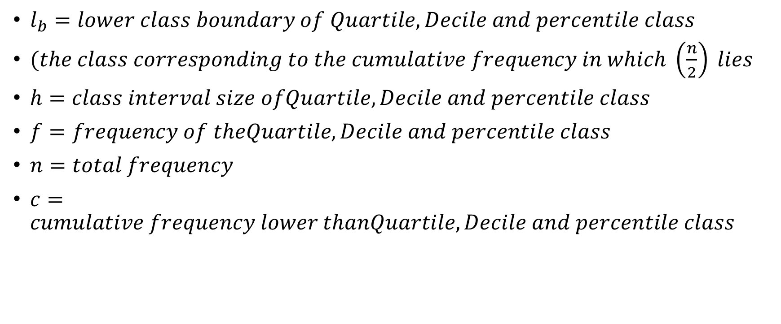
$l_{b}=lower class boundary of Quartile,Decile and percentile class$
$(the class corresponding to the cumulative frequency in which \left(\frac{n}{2}\right) lies$
$h=class interval size ofQuartile,Decile and percentile class$
$f=frequency of theQuartile,Decile and percentile class$
$n=total frequency$
$c=cumulative frequency lower thanQuartile,Decile and percentile class$

Slide 16
Example for Groupe Data
Find the Q1,D5 and P40 for the distribution of examination marks given below: Marks No. of students 30-39 8 40-49 87 50-59 190 60-69 304 70-79 211 80-89 85 90-99 20

Slide 17
Marks | Class boundries | Frequency | Cumulative frequency
30-39 | 29.5-39.5 | 8 | 8
40-49 50-59 | 39.5-49.5 49.5-59.5 | 87 190 | 8+87=95 95+190=285
60-69 | 59.5-69.5 | 304 | 285+304=589
70-79 | 69.5-79.5 | 211 | 589+211=800
80-89 | 79.5-89.5 | 85 | 800+85=885
90-99 Total | 89.5-99.5 | 15 900 | 885+15=900

Slide 18

$Q_{1}=l_{b}+\frac{h}{f}\left(\frac{n}{4}−c\right)$
Q1 class= $\frac{n}{4}$= $\frac{900}{4}$=225
lb= 49.5, h= 10, $\frac{n}{4}$=225, C= 95
$Q_{1}=49.5+\frac{10}{190}\left(225−95\right)$=49.5+6.84=56.34

Slide 19
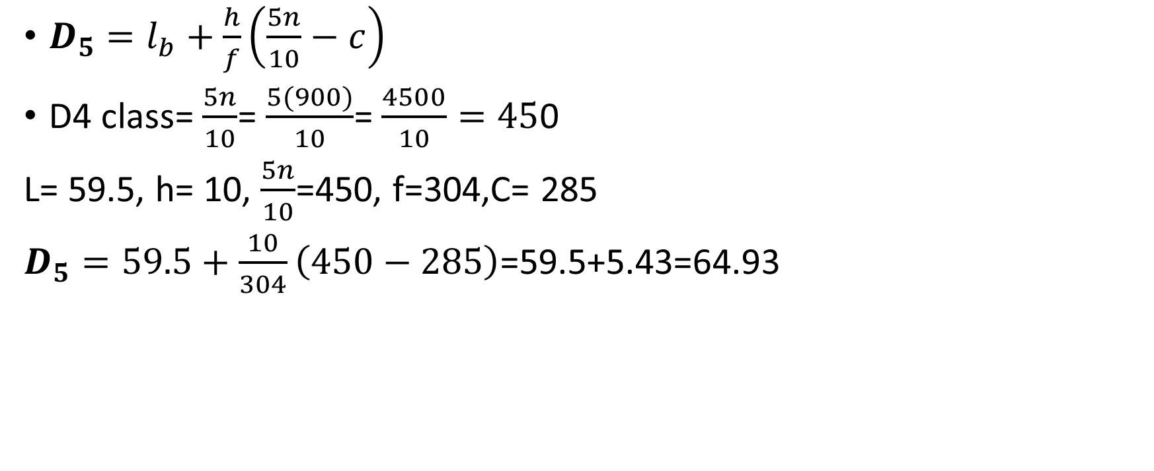
$D_{5}=l_{b}+\frac{h}{f}\left(\frac{5n}{10}−c\right)$
D4 class= $\frac{5n}{10}$= $\frac{5(900)}{10}$= $\frac{4500}{10}=45$0
L= 59.5, h= 10, $\frac{5n}{10}$=450, f=304,C= 285
$D_{5}=59.5+\frac{10}{304}\left(450−285\right)$=59.5+5.43=64.93

Slide 20
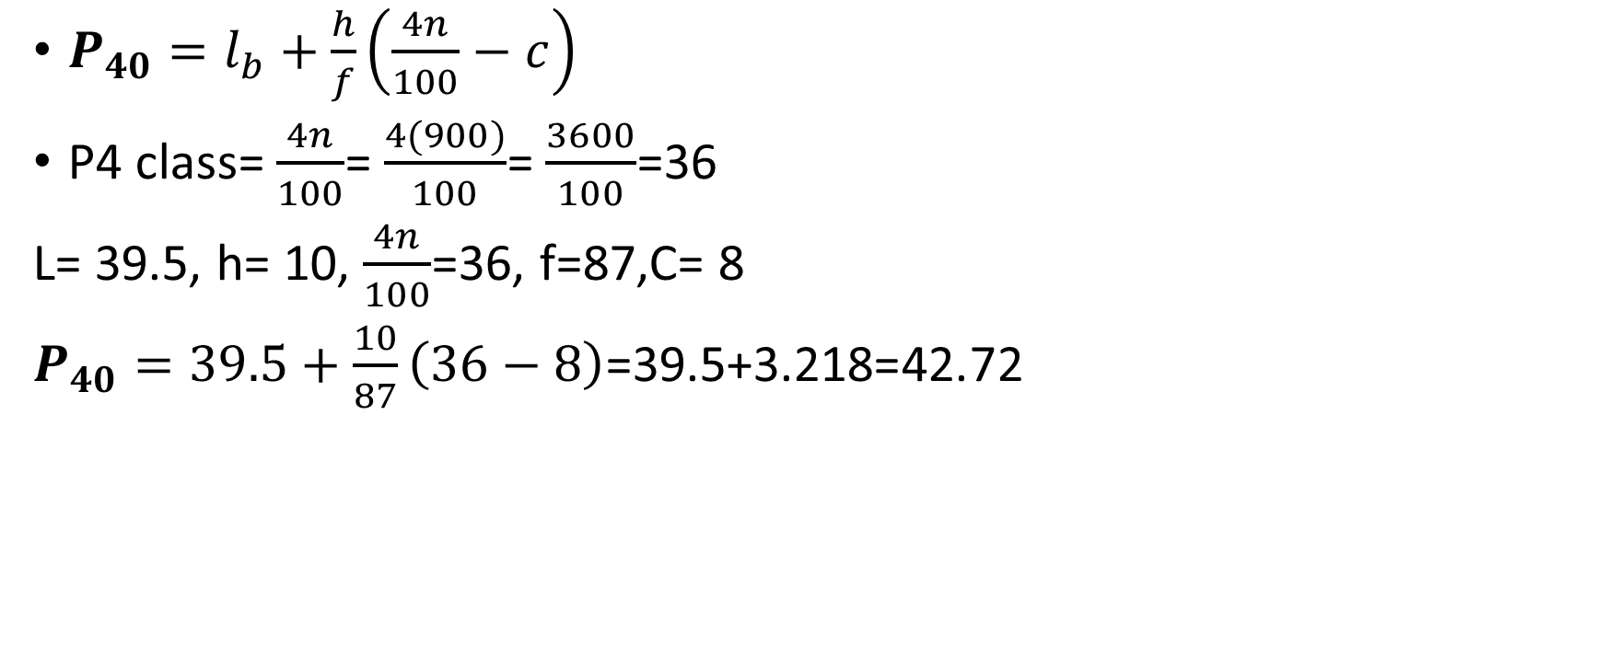
$P_{40}=l_{b}+\frac{h}{f}\left(\frac{4n}{100}−c\right)$
P4 class= $\frac{4n}{100}$= $\frac{4(900)}{100}$= $\frac{3600}{100}$=36
L= 39.5, h= 10, $\frac{4n}{100}$=36, f=87,C= 8
$P_{40}=39.5+\frac{10}{87}\left(36−8\right)$=39.5+3.218=42.72

Slide 21
Assignment
Question #1:Find the median,Q1,D4 and P2 for the given data 34, 50,72,80,92,99, 51,60,65,32,20, 43,49, 60,22,39,81.

Slide 22
Question #2
Find Q2,Q3,D6,P75 of the following data.
Hourly wages No. of persons
30-39 5 40-49 9 50-59 8 60-69 16 70-79 8 80-89 4

