Slide 1
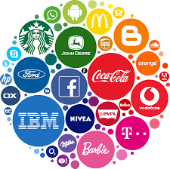
What is branding in simple words?
Branding has been around since 350 A.D and is derived from the word “Brandr”, meaning “to burn” in Ancient Norse language. By the 1500s, it had come to mean the mark that ranchers burned on cattle to signify ownership—a precursor of the modern logo.
Yet branding today is so much more than just a look or a logo. It has come to signify the emotional “gut feeling” reaction a company can elicit from its customers.

Slide 2
What is branding in simple words?
A brand is a name, term, design, symbol or any other feature that identifies one seller's good or service as distinct from those of other sellers.
Branding is the process of creating a strong, positive perception of your company, and it’s product in your customer's mind.

Slide 3
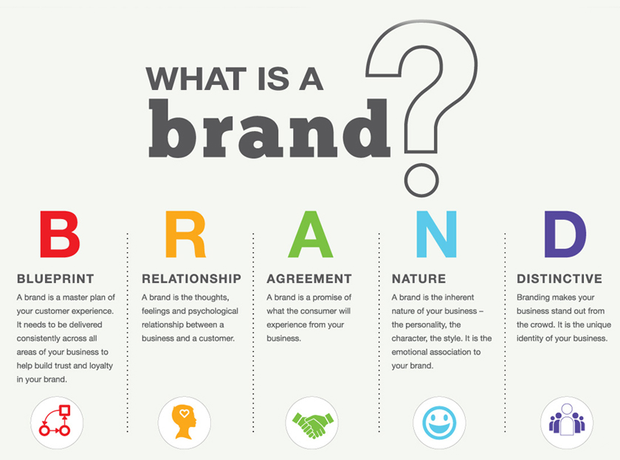

Slide 4
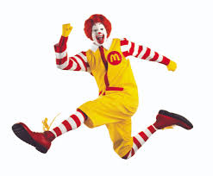
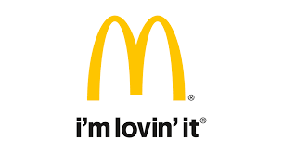
What is branding and examples?
Branding is the process of communicating a unique selling proposition, or differential, that sets a product or service apart from the competition. Examples of branding techniques include the use of logos, taglines, jingles “I'm lovin' it.” or mascots “Ronald McDonald is a clown character”.

Slide 5
why is it important?
Branding is important because not only is it what makes a memorable impression on consumers but it allows your customers and clients to know what to expect from your company. It is a way of distinguishing yourself from the competitors and clarifying what it is you offer that makes you the better choice.

Slide 6
Who does it affect?
Consumers: As discussed above, a brand provides consumers with a decision-making-shortcut when feeling indecisive about the same product from different companies.
Employees/shareholders/third-parties: Besides helping consumers to distinguish similar products, successful branding strategies are also adding to a company’s reputation. This asset can affect a range of people, from consumers to employees, investors, shareholders, providers, and distributors. As an example, if you don’t like or don’t feel connected to a brand, you would probably not want to work for it. However, if you feel like the brand understands you and offers products that inspire you, you would probably desire to work for it and be part of its world.

Slide 7
What are the elements of branding?
Companies tend to use different tools to create and shape a brand. For example, branding can be achieved through:
Brand definition: purpose, values, promise
Brand positioning statement
Brand identity: name, tone of voice, visual identity design (which includes the logo design, color palette, typographies…)
Advertising and communications: TV, radio, magazines, outdoor ads, website, mobile apps…
Sponsoring and partnerships
Product and packaging design
In-store experience
Workspace experience and management style
Customer service
Pricing strategy

