Slide 1
Components of Computer
Lecture 3

Slide 2
Main Components of Computer
Five basic components of computer system
Input Unit.
Output Unit.
Storage Unit.
Central Processing Unit (CPU)
Main Memory

Slide 3
Block Diagram

Slide 4
PROCESSOR
The processor, also called the central processing unit (CPU), interprets and carries out the basic instructions that operate a computer
Contain a control unit and an arithmetic logic unit (ALU)
Multi-core processor
Dual-core processor
Quad-core processor

Slide 5
TYPES OF PROCESSORS
A processor core, or simply core, contains the circuitry necessary to execute instructions. The operating system views each processor core as a separate processor.
A multi-core processor is a single chip with two or more separate processor cores. Two common multi-core processors are dual-core and quad-core.
A dual-core processor is a chip that contains two separate processor cores.
A quad-core processor is a chip with four separate processor cores.

Slide 6
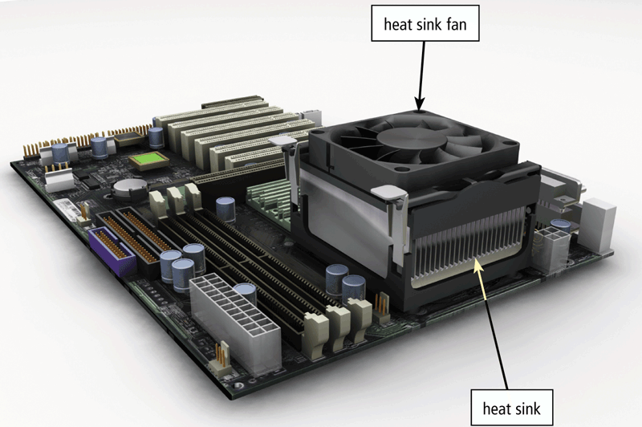
A processor chip generates heat that could cause the chip to burn up
Require additional cooling
Heat sinks
Liquid cooling technology

Slide 7
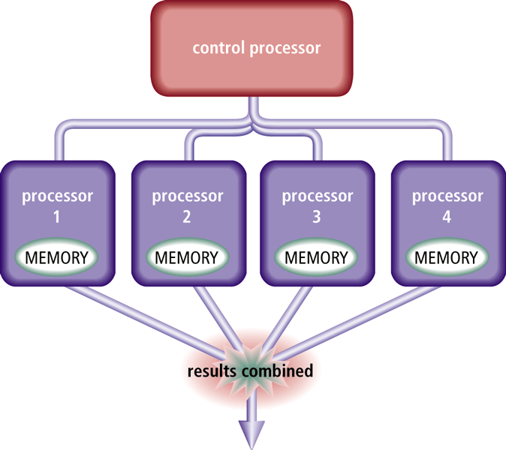
Parallel Processing
Parallel processing uses multiple processors simultaneously to execute a single program or task
Massively parallel processing involves hundreds or thousands of processors

Slide 8
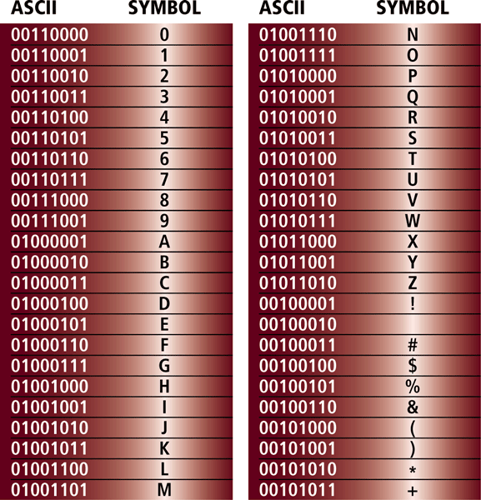
DATA REPRESENTATION
ASCII (American Standard Code for Information Interchange) is the most widely used coding scheme to represent data

Slide 9
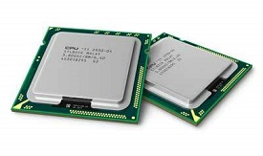
Central Processing Unit (CPU)
Central Processing Unit (CPU) consists of the following features :
CPU is considered as the brain of the computer.
CPU performs all types of data processing operations.
It stores data, intermediate results, and instructions (program).
It controls the operation of all parts of the computer.
CPU itself has following two components.
Control Unit CU
ALU(Arithmetic Logic Unit)
Central Processing Unit (CPU)

Slide 10
CONTROL UNIT (CU)
This unit controls the operations of all parts of the computer but does not carry out any actual data processing operations.
It is responsible for controlling the transfer of data and instructions among other units of a computer.
It communicates with Input/Output devices for transfer of data or results from storage.
It does not process or store data.

Slide 11
ALU (Arithmetic Logic Unit)
This unit consists of two subsections namely,
Arithmetic Section
Logic Section
Arithmetic Section
Function of arithmetic section is to perform arithmetic operations like addition, subtraction, multiplication, and division. All complex operations are done by making repetitive use of the above operations.
Example:
2+2
3-1

Slide 12
Continue…
Logical Unit
Function of logic section is to perform logic operations such as comparing, selecting, matching, and merging of data.
Greater than >
Less than <
Equal to ==
Less than or equal to <=
Greater than or equal to>=

Slide 13
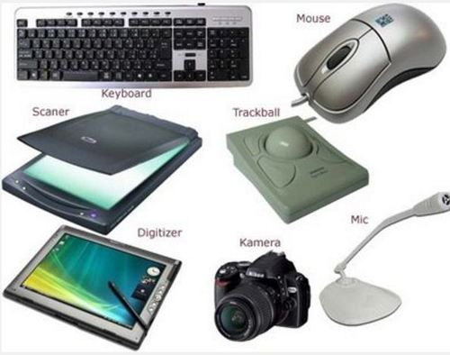
What is Input?
An input is data that a computer receives
An input device is something you connect to a computer that sends information into the computer.

Slide 14
INPUT DEVICES
Following are some of the important input devices which are used in a computer −
Keyboard
Mouse
Joy Stick
Light pen
Track Ball
Scanner
Graphic Tablet
Microphone
Magnetic Ink Card Recognition(MICR)
Optical Character Reader(OCR)
Bar Code Reader
Optical Mark Reader(OMR)

Slide 15
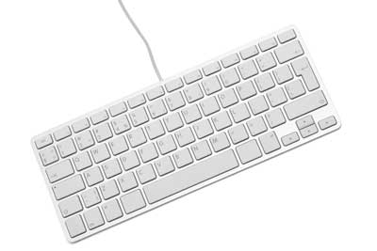
Continue…
Keyboard
Keyboard is the most common and very popular input device which helps to input data to the computer. The layout of the keyboard is like that of traditional typewriter, although there are some additional keys provided for performing additional functions.
Keyboards are of two sizes 84 keys or 101/102 keys
Standard Layout for Keyboard is QWERTY
The insertion point, also known as the cursor, is a symbol on the screen that indicates where the next character you type will appear

Slide 16
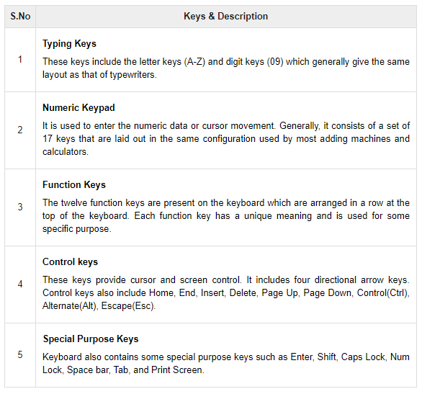

Slide 17
CONTINUE…
Wired Keyboards
USB port
Wireless Keyboards
Bluetooth

Slide 18
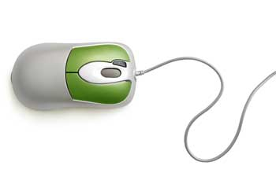
MOUSE
A computer mouse is an input device that is used with a computer. Moving a mouse along a flat surface can move the cursor to different items on the screen.
Generally, it has two buttons called the left and the right button and a wheel is present between the buttons.

Slide 19
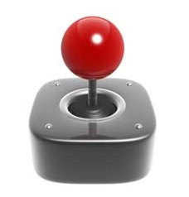
JOYSTICK
A joystick is an input device commonly used to control video games. Joysticks consist of a base and a stick that can be moved in any direction. The stick can be moved slowly or quickly and in different amounts.
The function of the joystick is similar to that of a mouse. It is mainly used in Computer Aided Designing (CAD) and playing computer games.

Slide 20
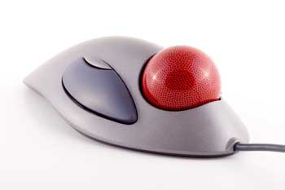
Track Ball
Track ball is an input device that is mostly used in notebook or laptop computer, instead of a mouse. This is a ball which is half inserted and by moving fingers on the ball, the pointer can be moved.
Since the whole device is not moved, a track ball requires less space than a mouse. A track ball comes in various shapes like a ball, a button, or a square.

Slide 21
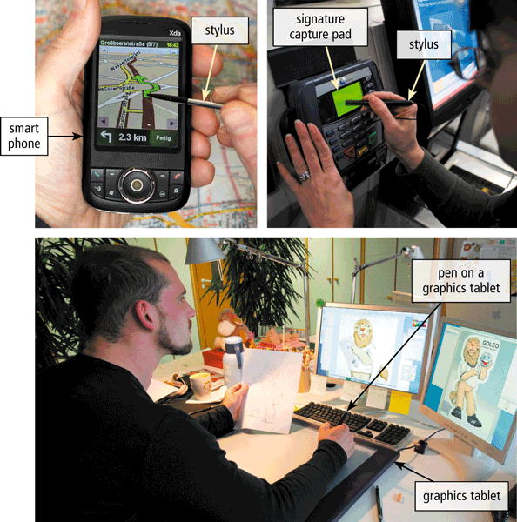
DIGITAL PEN
With pen input, you touch a stylus or digital pen on a flat surface to write, draw, or make selections

Slide 22
VOICE INPUT
Voice input is the process of entering input by speaking into a microphone
Music production software allows users to record, compose, mix, and edit music and sounds
Voice recognition is the computer’s capability of distinguishing spoken words

Slide 23
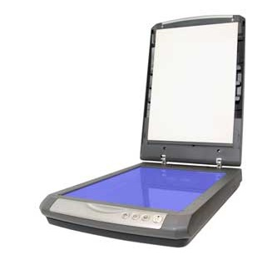
SCANNER
Scanner is an input device, which works more like a photocopy machine. It is used when some information is available on paper and it is to be transferred to the hard disk of the computer for further manipulation.
Scanner captures images from the source which are then converted into a digital form that can be stored on the disk. These images can be edited before they are printed.

Slide 24
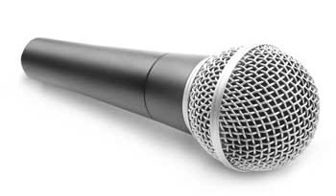
MICROPHONE
Microphone is an input device to input sound that is then stored in a digital form.
The microphone is used for various applications such as adding sound to a multimedia presentation or for mixing music.

Slide 25
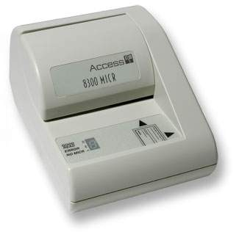
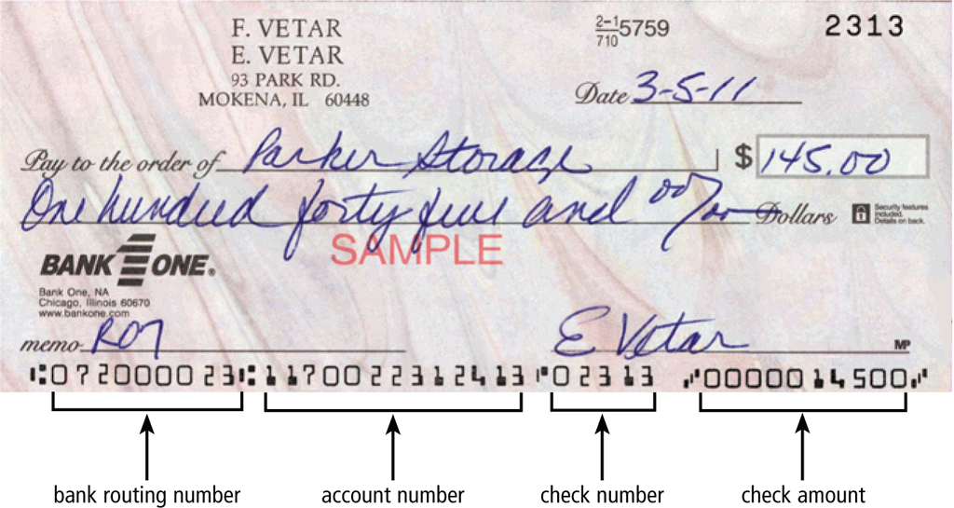
MICR
MICR input device is generally used in banks as there are large number of cheques to be processed every day.

Slide 26
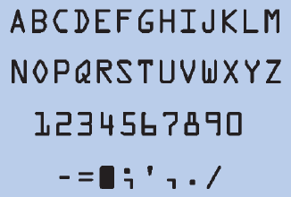
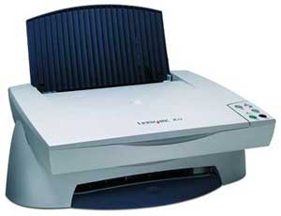
OCR
OCR is an input device used to read a printed text.
Reads Character by character

Slide 27
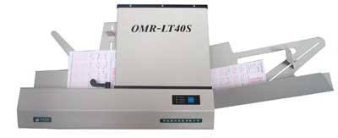
OMR
OMR is a special type of optical scanner used to recognize the type of mark made by pen or pencil. It is used where one out of a few alternatives is to be selected and marked.
It is specially used for checking the answer sheets of examinations having multiple choice questions.

Slide 28
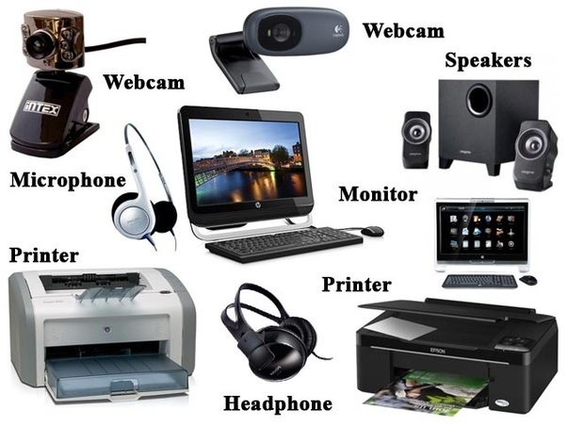
What is Output Device
An output device is any hardware device used to send data from a computer to another device or user.

Slide 29
Types of Output Devices
Following are some of the important output devices used in a computer.
Monitors
Graphic Plotter
Printer

Slide 30
Monitor
Monitors, commonly called as Visual Display Unit (VDU), are the main output device of a computer. It forms images from tiny dots, called pixels that are arranged in a rectangular form. The sharpness of the image depends upon the number of pixels i.e. Resolution.
There are two kinds of viewing screen used for monitors.
Cathode-Ray Tube (CRT)
Flat-Panel Display

Slide 31
Factors
The quality of an LCD monitor or LCD screen depends primarily on:
Resolution
Response time
Brightness
Dot pitch
Contrast ratio

Slide 32
Resolution
Resolution is the number of horizontal and vertical pixels in a display device
A higher resolution uses a greater number of pixels

Slide 33
Types of Monitor
Cathode ray monitor
Flat Panel Display
LCD(Liquid Crystal Display)
LED(Light Emitting Diode)
GAS PLASMA
There are some disadvantages of CRT −
Large in Size
High power consumption

Slide 34
PRINTER
Printer is an output device, which is used to print information on paper.
There are two types of printers −
Impact Printers
Character printers
Dot Matrix Printer(DMP)
Daisy Wheel
Line printers
Drum Printer
Chain Printer

Slide 35
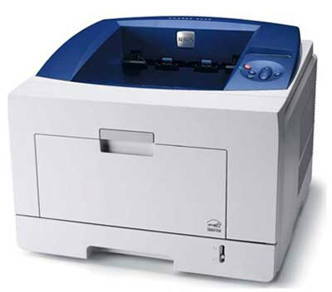
CONTINUE…
Non-Impact Printer
These printers are of two types −
Laser Printers
Inkjet Printers

Slide 36
MEMORY
A memory is just like a human brain. It is used to store data and instructions. Computer memory is the storage space in the computer, where data is to be processed and instructions required for processing are stored. The memory is divided into large number of small parts called cells. Each location or cell has a unique address, which varies from zero to memory size minus one.
The address of these locations varies from 0 to 65535.
Memory is primarily of three types −
Cache Memory
Primary Memory/Main Memory
Secondary Memory

Slide 37
CONTINUE...
Memory size is measured in kilobytes (KB or K), megabytes (MB), gigabytes (GB), or terabytes (TB)

Slide 38
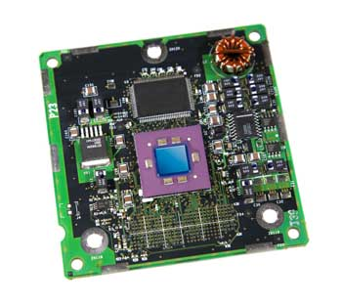
Cache Memory
Cache memory is a very high speed semiconductor memory which can speed up the CPU. It is used to hold those parts of data and program which are most frequently used by the CPU
Cache memory is faster than main memory.
It consumes less access time as compared to main memory.
It stores the program that can be executed within a short period of time.
It stores data for temporary use.

Slide 39
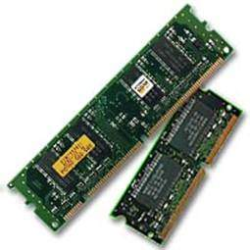
Primary Memory (Main Memory)
Primary memory holds only those data and instructions on which the computer is currently working. It has a limited capacity and data is lost when power is switched off. It is generally made up of semiconductor device
It is divided into two subcategories RAM and ROM.
Characteristics of Main Memory
These are semiconductor memories.
It is known as the main memory.
Usually volatile memory.
Data is lost in case power is switched off.
It is the working memory of the computer.
Faster than secondary memories.
A computer cannot run without the primary memory.

Slide 40
Secondary Memory
This type of memory is also known as external memory or non-volatile. It is slower than the main memory. These are used for storing data/information permanently. CPU directly does not access these memories, The contents of secondary memories are first transferred to the main memory, and then the CPU can access it. For example, disk, CD-ROM, DVD, etc.
Characteristics of Secondary Memory
These are magnetic and optical memories.
It is known as the backup memory.
It is a non-volatile memory.
Data is permanently stored even if power is switched off.
It is used for storage of data in a computer.
Computer may run without the secondary memory.
Slower than primary memories.

Slide 41
RAM (Random Access Memory)
RAM (Random Access Memory) is the internal memory of the CPU for storing data, program, and program result. It is a read/write memory which stores data until the machine is working. As soon as the machine is switched off, data is erased.
RAM is volatile, i.e. data stored in it is lost when we switch off the computer or if there is a power failure.
RAM is of two types −
Static RAM (SRAM)
Dynamic RAM (DRAM)

Slide 42
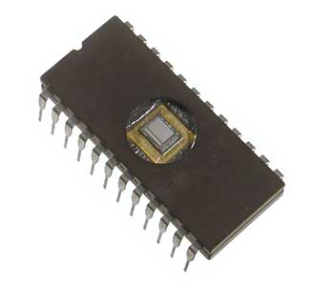
ROM (Read Only Memory)
ROM stands for Read Only Memory. The memory from which we can only read but cannot write on it. This type of memory is non-volatile. The information is stored permanently in such memories during manufacture. A ROM stores such instructions that are required to start a computer. This operation is referred to as bootstrap. ROM chips are not only used in the computer but also in other electronic items like washing machine and microwave oven.
Types of ROM
MROM (Masked ROM)
PROM (Programmable Read Only Memory)
EPROM (Erasable and Programmable Read Only Memory)
EEPROM (Electrically Erasable and Programmable Read Only Memory)

Slide 43
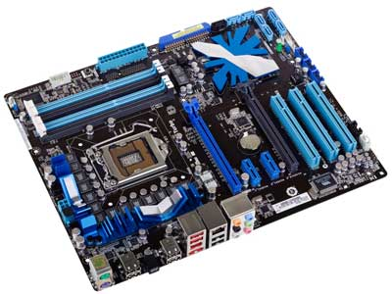
Mother Board
The motherboard serves as a single platform to connect all of the parts of a computer together. It connects the CPU, memory, hard drives, optical drives, video card, sound card, and other ports and expansion cards directly or via cables. It can be considered as the backbone of a computer.

Slide 44
Expansion Slots and Adapter Cards
An expansion slot is a socket on the motherboard that can hold an adapter card
An adapter card enhances functions of a component of the system unit and/or provides connections to peripherals
Sound card and video card

Slide 45
Ports and Connectors
A port is the point at which a peripheral attaches to or communicates with a system unit (sometimes referred to as a jack)
A connector joins a cable to a port

Slide 46
USB PORT
A USB port can connect up to 127 different peripherals together with a single connector
You can attach multiple peripherals using a single USB port with a USB hub

Slide 47
BUSES
A bus allows the various devices both inside and attached to the system unit to communicate with each other
Data bus
Address bus
Control Bus
Word size is the number of bits the processor can interpret and execute at a given time

Slide 48
POWER SUPPLY
The power supply converts the wall outlet AC power into DC power
Some external peripherals have an AC adapter, which is an external power supply

