Slide 1
DESIGN FOR Quality 1. Innovation 2. quality function deployment 3. the House of quality
TQM
Lecture 4

Slide 2
Design Quality
Design quality is the value of a design to customers.
Design is the root of all quality including the quality of products, services, experiences, systems and processes.
For example, a product with a poor design will be low quality even if quality control and quality assurance succeed in producing the design accurately.

Slide 3
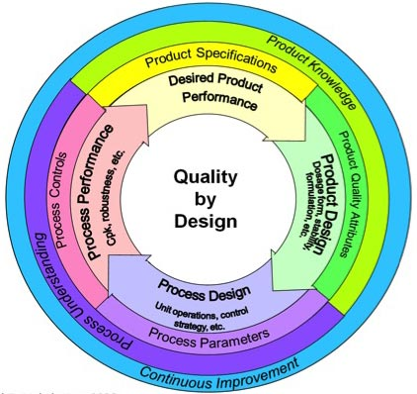
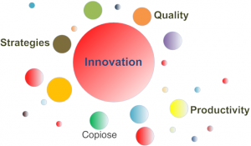
Innovation

Slide 5
What is Innovation
It is an idea, practice or object that is perceived a new by an individual or other unit of adoption .
It is a use of new knowledge to offer a new product or service that customer want. Thus it is
Invention + Commercialization
“ Invention / Creation is the search for and the discovery, developed, improvement, adoption and commercialization of new process, new products and new organization structures and procedures”

Slide 6
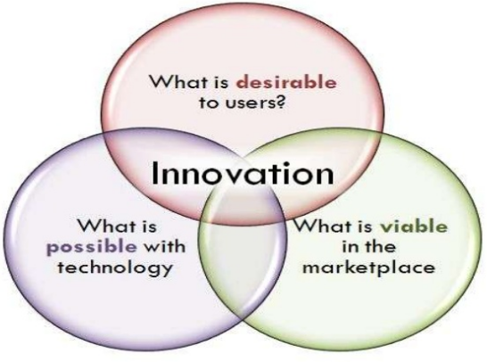

Slide 7
Characteristics of Innovation

Slide 8
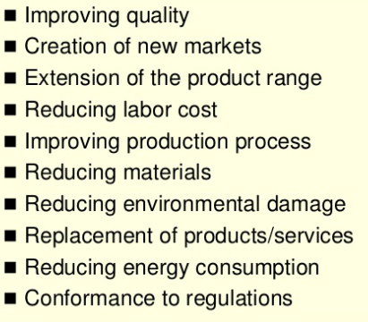
Goals of Invention

Slide 11
Types of Innovation

Slide 16
Quality Function Deployment
Quality Function Deployment (QFD) is a structured approach to defining customer needs or requirements and translating them into specific plans to produce products to meet those needs.
The “voice of the customer” is the term to describe these stated and unstated customer needs or requirements.
Quality Function Deployment provides documentation for the decision-making process.
QFD helps you to: Translate customer requirements into specific offering specifications

Slide 17
Quality Function Deployment
Quality Function Deployment (QFD) is a process and set of tools used to effectively define customer requirements and convert them into detailed engineering specifications and plans to produce the products that fulfill those requirements.
QFD is used to translate customer requirements (or VOC) into measureable design targets and drive them from the assembly level down through the sub-assembly, component and production process levels.
QFD methodology provides a defined set of matrices utilized to facilitate this progression.

Slide 18
Why Implement Quality Function Deployment (QFD)
Effective communication is one of the most important and impactful aspects of any organization’s success.
QFD methodology effectively communicates customer needs to multiple business operations throughout the organization including design, quality, manufacturing, production, marketing and sales.
This effective communication of the Voice of the Customer allows the entire organization to work together and produce products with high levels of customer perceived value.

Slide 20
How to Implement QFD
The Quality Function Deployment methodology is a 4-phase process that include activities throughout the product development cycle.
A series of matrices are utilized at each phase to translate the Voice of the Customer to design requirements for each system, sub-system and component. The four phases of QFD are:
Product Definition
Product Development
Process Development
Process Quality Control

Slide 21
1. Product Definition
The Product Definition Phase begins with collection of VOC and translating the customer wants and needs into product specifications.
It may also involve a competitive analysis to evaluate how effectively the competitor’s product fulfills the customer wants and needs.
The initial design concept is based on the particular product performance requirements and specifications.

Slide 22
2. Product Development
During the Product Development Phase, the critical parts and assemblies are identified.
The critical product characteristics are cascaded down and translated to critical or key part and assembly characteristics or specifications.
The functional requirements or specifications are then defined for each functional level.

Slide 23
3. Process Development
During the Process Development Phase, the manufacturing and assembly processes are designed based on product and component specifications.
The process flow is developed and the critical process characteristics are identified.

Slide 24
4. Process Quality Control
Prior to production launch, the QFD process identifies critical part and process characteristics. Process parameters are determined and appropriate process controls are developed and implemented.
In addition, any inspection and test specifications are developed.
Full production begins upon completion of process capability studies during the pilot build.

Slide 25
The House of Quality
House of Quality refers to a well-known process for product development that is inspired by customer desires for product or process development and secure by the capabilities and resources of the organization seeking to meet those desires.
House of Quality or HOQ is a tool used in QFD to do the same. It is the most convenient and simple tool used to convert the customer needs into technical descriptors. House of quality is actually a matrix also called Quality Matrix

Slide 26
House of Quality Steps are as follows:
House of Quality Steps are as follows:
Identify what customer wants (VOC)
Identify how the product will satisfy the customer.
Identify relationships between how's.
Develop importance ratings.
Evaluate competing products or services.
Determine the desirable technical attributes.

Slide 28
Primary Purposes of QFD & House of Quality
We’ll now cover some primary purposes of QFD / House of Quality:
Understand Customer Desires
Many times, customers need outside perspective to discover what they really need to build their product or process.
The goal is to understand customers perhaps even better that they understand themselves so as to open their eyes to ideal solutions.

Slide 29
Understand Customer Priorities
During the interview stage, get to know customer needs, but then break those needs down into prioritized parts.
For example, if a customer is building drones for media production, how important is battery life compared to camera quality.
How important is imaginative compared to quality of the drone body.
Weights are assigned to each quality based on what is most important to the customer.
How well each need is met is ultimately how the customer will judge your solution’s value.

