Slide 2
Department of Botany
Plant ecology

Slide 3
Plant Ecology
Nature and properties of soil

Slide 4
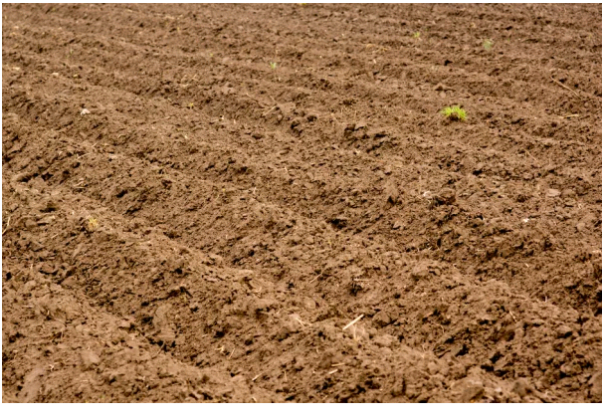
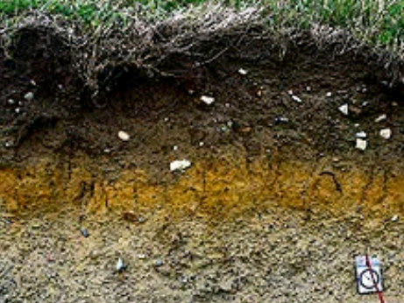

Slide 5
What is soil?
Soil is a mixture of organic matter ,minerals ,gases,liquids and
that together supports life.

Slide 9
Composition of soil
Soil is made up of minerals matter ,organic matter,water and air .
The solid minerals matter and organic matter made up of 50% of the soil.
The average soil contain about 45% minerals matter and 5 percent organic matter.
The solids are not tightly packed .Instead ,there are between solids particles that are called pore spaces.

Slide 10
Composition of soil
Pores spaces are either filled with water or air .In good soil water makes up about 25 percent of soil .
While the air also makes up about 25 percent of soil .

Slide 11
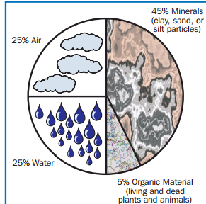

Slide 12
Mineral matter
Mineral matter is inorganic material.
Mineral matter began as rock. Soil generally have minerals matter of different sizes.
These particles are labeled as sand ,silt or clay.
Sand is the largest soil particle.
Silt is mid-size soil particle.
Clay is the smallest soil particle.

Slide 13
Organic matter
Organic matter which accounts for 5 percent of the soil , is partially decomposed plant and animal matter.
Most organic matter is from plants leaves, roots, and stems.
Organic matter gives the soil black colour.organic matter improves aeration and water-holding capacity and contributes to soil fertility.

Slide 14
Pores spaces

Slide 16
Biological nature of soil
Abundant life can be found in soil.
Forms of life in soil include ;
Earthworm.
Insects.
Bacteria.
Fungi.
Other organisms.
Bacteria and fungi have an important role in soil. They break down organic matter and release nutrients
.

Slide 17
Earthworms , ants, crawfish, moles and other organisms improve the soil tilth, the ease at which soil can be worked. These organisms create openings in the soil as they tunnel. This enhances drainage and improves air exchange.

Slide 18
Formation of Soil
Weathering breaks down rocks and minerals into fragments.
Plants and animals add organic material to the soil.
May take thousands of years to form.
May range in thickness from a few centimeters to 60 meters thick.

Slide 19
Formation of Soil What effect formation of soil and soil type?
Glaciation
Climate
Type of parent rock
Slope
Time

Slide 20
Glacial Deposits
Unsorted mass of clay, silt , sand, and boulders.
Creates very fertile soil.

Slide 21
Desert soils
Contain little organic material.
Thinner than soils in wet climates.
Prairie soils
Thick, dark A horizons due to the large number of grasses.

Slide 22
Temperate Forest soils
Thinner A and B horizons enriched in minerals due to leaching.
Parent rock
Affects the type of soil that develops.
Can also effect the vegetation that grows in the area.

Slide 23
Steep slopes
Soil horizons are often poorly developed.
Bottomland
Soils are often thick, dark, and full of organic material.

Slide 25
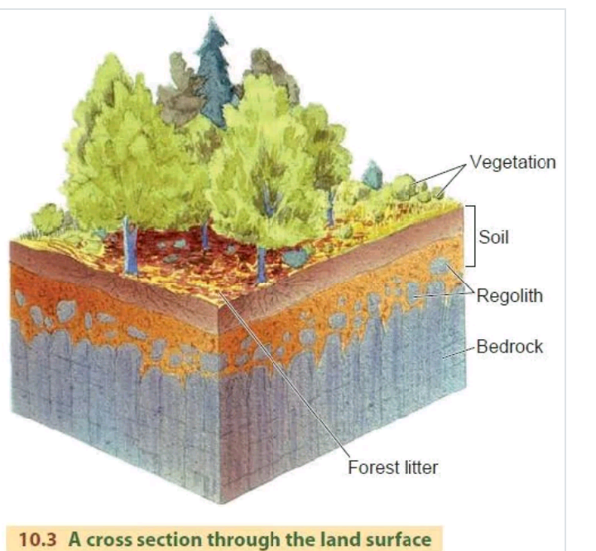
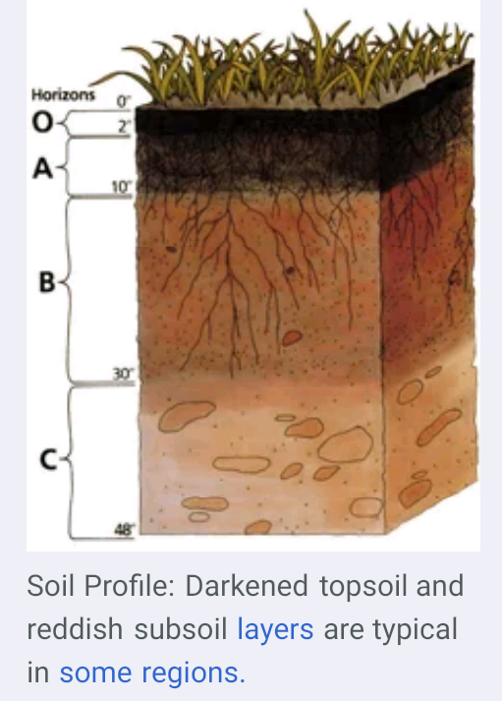

Slide 30
Properties of soil
A soil properties are largely determined by its parent material and weathering during its formation.Topography,age,and agricultural practices effect a soils properties.
Three types of soil properties include following;
Physical properties.
Chemical properties.
Biological properties.

Slide 31
The properties of soil effect;
Plant growth responses.
Fertilizers requirements.
The soils response to management.
Land use capability (i.e. suitability for different land uses such as grazing versus cultivation)
Drainage and water runoff.
Nutrient loss and leaching.
Soil erosion.

Slide 32
Physical properties
Physical properties include the following:
Soil texture
Soil Structure
Soil porosity
Soil colour
Consistence
Partiole density
Bulk density

Slide 33
Soil Texture
Soil texture refers to the size of the particles that make up the soil and depends on the portion of sand, silt and clay sized particles and organic matter in the soil.
Soils that are mixture of sand ,slit and clay are called loams. The name of the soil often identifies the dominant particle, for example, Timaru slit loam describes a soil that has a predominance of slit.
Sand particles are quite big. The pore spaces between the particles in sandy soils are also quite large. This allows water to drain quickly and air to enter the soil.
Slit particles are too small for us to see with our eyes.
Clay particles are smaller than 0.002mm in diameter. Clay soils are poorly drained and hold on the water in their pore spaces for much longer.

Slide 34
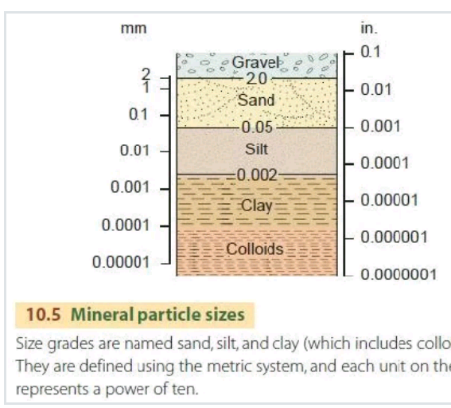

Slide 35
Soil Structure
Soil structure describes the way the sand, slit, and clay particles are clumped together.
Organic matter and soil organisms like earthworms and bacteria influence soil structure.
Soil structure is important for plant growth, regulating the movement of air and water, influencing root development and affecting nutrient availability.
Good quality soils are friable and have fine aggregates so the soil breaks up easily if you squeeze it.
Poor soil structure has coarse, very firm clods or no structure at all.

Slide 37
Soil Porosity
Soil porosity refers to the pores in the soil.
Porosity influences the movement of air and water.
Healthy soils have many pores between and within the aggregates.
Poor quality soils have few visible pores, cracks or holes.
The way in which a soil is managed can affect its porosity.

Slide 38
Consistence
It is the resistance of soil to deformation or rupture and is determined by the cohesive and adhesive properties of the soil mass.
This is a term used to designate the manifestation of the cohesive and adhesive properties of soil at various moisture contents.

Slide 39
Partiole Density
Partiole density of the soil is the mass per unit volume of soil particles(soil solid phase)-expressed in g/c.c. Most soils have particle density of about 2.6g/cc.
Presence of organic matter decrease the density and iron compounds increase the density.

Slide 40
Bulk density
It is the mass of soil per unit volume of soil (volume includes both soil and pores)-expressed in g/c.c.
Soil colour
Soil colour gives an indication of the various processes going on in the soil as well as the type of minerals in the soil.
Soil colour is described by the parameters called hue, value and chroma.
Hue represents the dominant wavelength of light, value refers to the lightness of the colour; chroma, relative purity or strength of the colour.

Slide 41
Soil permeability
It is the ability of the soil to transmit water and air.
Permeability is measured in terms of permeability rate or coefficient of permeability.
Permeability rate or coefficient of permeability is determined in the laboratory by measuring the rate of flow of water from a constant head of water through a colomn of soil at specific moisture content and other conditions.

Slide 42
Chemical properties of Soil
The chemistry of soil determines its ability to supply available plant nutrients and affects its physical properties and health of its microbial population.
In addition, a soil’s chemistry also determines its corrosivity, stability, and ability to absorb pollutants and to filter water.
It is the surface chemistry of mineral and organic colloids that determines soil’s chemical properties.

Slide 43
Reactivity(pH)
Soil reactivity is expressed in terms of pH and is a measure of the acidity or alkalinity of the soil.
More precisely, it is a measure of hydrogen ion concentration in an aqueous solution and ranges in values from 0 to 14 bur practically speaking for soils, pH ranges from 3.5 to 9.5, as pH values beyond those extremes are toxic to life forms.
Soils with high acidity tend to have toxic amounts of aluminium and manganese.
Plants which need calcium need moderate alkalinity, but most minerals are more soluble in acid soils.

Slide 44
Base saturation percentage
There are acid forming cations and there are base forming cations. The fraction of the base forming cations that occupy positions on the soil colloids is called the base saturation percentage.
When the soil pH is 7, base saturation is 100% and there are no hydrogen ions stored on the colloids.
Base saturation is almost in direct proportion to pH . It is of use in calculating the amount of lime needed to neutralize an acid soil.

Slide 45
Buffering
The resistance of soil to change in pH, as a result of the addition of acid or basic material, is a measure of the buffering capacity of a soil and increases as CEC increases.
Hence pure sand has almost no buffering ability, while soils high in colloids have high buffering capacity.
Buffering occurs by cation exchange and neutralization.
The general principle is that an increase in particular cation in the soil water solution will cause that cation to be fixed to colloids and a decrease in solution of that cation will cause it be withdrawn from the colloid and moved into solution.

Slide 46
Salinity
The water within a soil, combined with the nutrients in solution within it, affects the salinity of the soil. If moisture levels in the soil are low, particles of sodium , calcium, increases, meaning the soil becomes more saline.

Slide 47
This can be exacerbated if, due to lack of moisture at the surface, plants draw up moisture from the groundwater that, in turn, evaporates, leaving the salts behind.
If the salinity of the soil increases too much at the surface, it will negatively affect the growth of plants within it.
Ensuring soil receives and retains sufficient moisture ensures salinity does not become a problem.

Slide 48
Cations
Cations are positively charged ions of nutrients that are in solution.
Basically, for plants to access nutrients in the soil, those nutrients need to be in soluble form, mixed with water.
The positive charge allows the cations to adhere to soil particles from where plant roots can access them.

Slide 49
Nutrients
Sixteen elements or nutrients are essential for plant growth and reproduction.
These are carbon C ,hydrogen H ,oxygen O ,nitrogen N ,phosphorus P ,potassium K , Sulphur S ,calcium Ca , magnesium Mg , iron Fe , boron B , manganese Mn , copper Cu , zinc Zn ,molybdenum Mo , nickel Ni ,and chlorine Cl.

Slide 50
Essential nutrients;
Nutrients that are essential for plants to complete their life cycle are considered as essential nutrient.
Non-essential nutrients;
Nutrients that enhance the growth of plant and are not necessary to complete their life cycle.

Slide 51
Sodicity
The sodicity of soil is refers to the amount of exchangeable sodium cations compared to others cations adsorbed on to the soil.
A soil with 6% or more of its exchangeable sodium cations as sodium is called as sodic soil.

Slide 52
Biological properties
Biological properties of soil include following;
Living organism
Organic matter

Slide 53
Living organism
Many organisms are found in healthy soil. Such as earthworm ,to the smallest bacteria.
Soil organism help to decompose organic matter.
The burrowing habit of these organism incorporates the organic matter into the soil and creates larger pore spaces that aerate the soil and allow faster water infiltration.
The small organisms such as bacteria ,fungi and protozoa ,further decompose the organic matter ,which release the nutrients in the form that plant can use.

Slide 54
Organic matter
Organic matter is any thing that is living or the remains of living thing.
However ,in case of soil composition ,organic matter is build-up in the soil of decayed plants and animal residues.

Slide 55
Organic soils , such as peats , contain from 20% to as much as 95% of organic matter.
Mineral soil contain anywhere from a trace to 15% or 20% organic matter.
Organic matter is composed of about 57% organic carbon.

