Slide 1
Development of Model Lesson Plans BS Education-V Teaching Mathematics (EDU-511)
Department of Education University of Sargodha

Slide 2
Development of model lesson plans
Ayesha Ashraf (BEUF18M027)
Teaching of Mathematics (EDU-511)
BS Education (Semester 5)
Department of Education
University of Sargodha, 40100 Sargodha, Pakistan
October 2020

Slide 3
What is a lesson plan?
A lesson plan is a guide which helps execute a mission that is to be accomplished in the classrooms with the child.
A lesson plan can also be defined as a creative process which provides a frame work for purposeful learning.

Slide 4
What is model lesson plan?
The model based lesson plan is an instructional model based on the constructivist approach to learning, which says that learners build or construct new ideas on the top of their old ideas.
Student should become mentally engaged in the concept, process or skill to be learned.

Slide 5
Parts of lesson plan
Objectives
Subject matter( topic, reference, materials)
Procedure( motivation, activity , routines, lesson proper)
Consolidation
Evaluation
Assignment

Slide 6
Models
5-E model lesson plan
The 5E are an instructional model encompassing the phases Engage, Explore, Explain, Elaborate, and Evaluate.
When planning a lesson each of these areas should be completed.
Often times these lessons may take a few days to complete.

Slide 7
Teacher: ABC
Time:45 minutes
subject: Mathematics
Topic: Profit and loss
Date:
General objectives: Know the terms profit, loss, cost price and selling price. Understands relationship of cost price and sell price with profit and loss. Apply concept of profit and loss to solve problems.
Method: Demonstration and problem solving
Engage: student ‘A’ and ‘B’ are engaged to demonstrate in selling an item with price tag of Rs 10. student ‘A’ as seller and ‘B’ as buyer. other students are asked to observe.
Explore: also students in the class are provided with some more items with price tags in it and asked to anticipate their selling price.
Explain: teacher explains about the price tag indicated in the items and assume some price at which the item may be brought by the seller.
Elaborate: teacher may ask some questions about topic and based on the answers he will elaborate the topic.
Evaluate: students responses and answers are checked.

Slide 8
Herbartian lesson plan model
Herbart’s pedagogical method was divided into discrete steps:
Preparation
Presentation
Association
Generalization
application

Slide 9
Date……. Class……. Subject…… Topic….. Time……
General objectives: Specific objects: Introduction:
Teaching aids: Previous knowledge:
6. Statement of aim: 7. presentation:
8. Explanation: 9. Summary :
10. Review questions:

Slide 10
Madeline Hunter lesson plan model
In 1976, Madeline Hunter wrote a book in which she detailed specific criteria teachers should plan for when developing lessons.
Madeline Hunter lesson plan model consist of seven steps.

Slide 11
1. Anticipatory set.
2. objectives.
3. Instructional input.
4. Modeling.
5. Checking for understanding.
6. Guided Practice.
7. Independent practice.

Slide 12
7E’s lesson plan model
The 7E’s stand for the following:
Elicit
Engage
Explore
Explain
Extend
Evaluate
7E’s model lesson plan has been adapted from 5E’s model lesson plan.

Slide 13
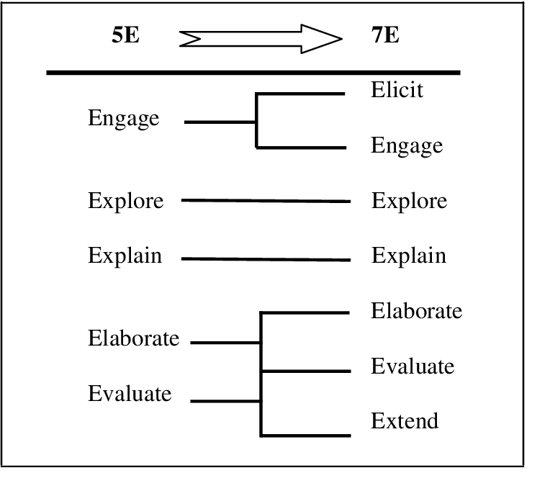

Slide 14
MCQ’S
What information does the objectives in lesson plan contain?
The topic of lesson plan
Material used in lesson plan
The skills and knowledge children will learn.
Which of following is center of lesson plan?
Student
Teacher
None

Slide 15
MCQ’S
3. Which of the following is not phase of 5E’s lesson plan model?
Elicit
Explore
Explain
4. Madeline hunter model lesson plan consist of……steps.
Four
Two
seven

Slide 16
MCQ’s
5. Herbartian pedagogical method was divided into …….discrete steps.
Five
Four
Seven
key of mcq’s
1.C
2. a
3.A
4.C
5. a

Slide 17
references
http://images.app.goo.gl/FNV7Qxj4nRqc8Zug7
http://www.slideshare.net/mobile/rinumol2017/model-of-lesson-plan
http://www.slideshare.net/mobile/DammarSaud/model-lesson-plan-72644754

