Slide 1
Subject: Statistics
Class: MA 3rd (Social Work)
Lecture: 2nd week
Topic: Simple Linear Regression

Slide 2
Scatter Diagram
A first step in finding whether or not a relationship between two variable exist, is to plot each pair of independent-dependent variable as a point on graph paper, using the X-axis for the regression variable and the Y-axis for the dependent variable. Such a diagram is called a scatter diagram or scatter plot.
If a relationship between the variables exist, then the points in the scatter diagram will show a tendency to cluster around a straight line or some curve. Such a line or curve around which the points cluster, is called the regression line or curve.
https://asq.org/quality-resources/scatter-diagram
https://www.youtube.com/watch?v=PE_BpXTyKCE

Slide 3
Types of scatter plot
1. Positive and Linear Relation
As one variable increases so does the other. Height and shoe size are an example; as one's height increases so does the shoe size.
2. Negative and Linear Relation
As one variable increases, the other decreases. Time spent studying and time spent on video games are negatively correlated; as your time studying increases, time spent on video games decreases.
3. Curvilinear Relation
If the regression line is not linear than there a curvilinear relation will exist between two variables.
4. No Relation
There is no apparent relationship between the variables. Video game scores and shoe size appear to have no correlation; as one increases, the other one is not affected.
The graphs are shown in the next slide.

Slide 4
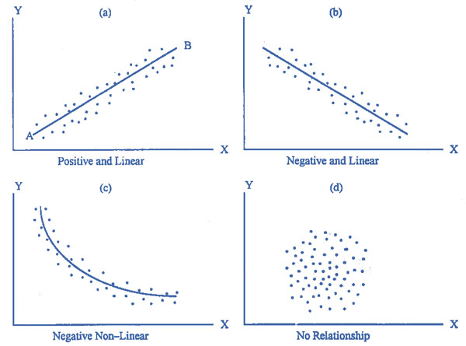

Slide 5
Fitting a Regression line
The above we see that what is a scatter diagram and some types of scatter plot. Now the question is how we can draw a scatter plot?
So to answer this question we need to fit a line of regression i.e. $\hat{Y}=a+bX$ by putting the values of X variable in the above equation.
By putting the values of X variable in the above equation we got different values of $\hat{Y}$ (which is the estimated variable). This $\hat{Y}=a+bX$ is known as the line of regression or regression line which indicates a relationship between independent and dependent variable. This procedure of putting the values of X in the above equation is known as fitting of a regression line.
Let us consider the following example to fit a regression line and draw a scatter plot.

Slide 6
Numerical example
In an experiment to measure the stiffness of a spring, the length of the spring under different loads was as follows:
X=Loads (lb) | 3 | 5 | 6 | 9 | 10 | 12 | 15 | 20 | 22 | 28
Y=length (in) | 10 | 12 | 15 | 18 | 20 | 22 | 27 | 30 | 32 | 34
Find the regression equations appropriate for predicting the length, given the weight on the spring. Also fit a regression line and draw a scatter plot for the above data.

Slide 7
Solution
The first thing to do for the solution of this question is to find the regression line which we’ve already found in the previous lecture. Now to fit the regression line we proceed as follows.
As the regression line was
$$\hat{Y}=8.74+1.02X$$
So now what we have to do is simply put the values of X variable in the above equation to fit a regression line.
For example the first value of X is 3 so if we put 3 in the equation we got
$$\hat{Y}=8.74+1.02\left(3\right)=11.8$$
So put all values of X in this equation.

Slide 8
X | Y | $$\hat{Y}=8.74+1.02X$$
3 5 6 9 10 12 15 20 22 28 | 10 12 15 18 20 22 27 30 32 34 | =8.74+1.02(3)=11.8 13.84 14.86 17.92 18.94 20.98 24.04 29.14 31.18 37.3

Slide 9
Interpretation
From the above table we can see that when we put the values of X in the regression equation, so due to the positive value of b the effect of X variable on Y is also positive i.e. as the values of X increases the value of Y are also increasing. So the scatter plot will also show an upward trend on the graph.

Slide 10
Scatter plot
To make a scatter plot
Draw a raw graph on paper which have Y axis and X-axis
Adjust the scale of Y and X-axis
Draw a dot on the graph according to the values of X and Y (one dot represent one value of both X and Y)
After completing all the points look at the shape of the graph i.e. it is either positive, negative, curvy or has no pattern.
Then draw a straight line between the dots by using the values of $\hat{Y}$

Slide 11
Scatter Plot
This graph shows a positive relation between loads and lengths which means as loads increase the lengths also increases.

