Slide 2
CONTENTS
Plant cleaning
Definition
Difference between cleaning and sanitizing
Types of deposits/soils
Cleaning
Dry cleaning
Wet cleaning
Introduction to detergents

Slide 3
PLANT CLEANING
Cleaning
Cleaning is designed to remove all visible dirt, soil, chemical residues and allergens from equipment, utensils and work surfaces.
Sanitizing
Sanitizing is removing number of microorganisms to safe level. It is done after cleaning. All surface that come in direct contact with food must be sanitized. It is also known as cleansing.
Sterilizing
Sterilizing removes all microorganisms from the equipment.

Slide 4
PLANT CLEANING…
IMPORTANCE OF CLEANING AND SANITIZING
Cleaning and sanitizing helps to prevent pest infestations
Cleaning and sanitizing helps food business stay complaint with food safety laws and regulations
Cleaning and sanitizing helps to protect customers and employees from health risks like food poisoning and allergic reaction

Slide 5
PLANT CLEANING…
SOIL/DEPOSITS:
Any unwanted matter that need to be removed from food plant is generally known as soil/deposits
There are three major types of deposits
1)Mineral deposit
2)Organic deposit
3) Microbial deposit

Slide 6
PLANT CLEANING…
TYPES OF DEPOSITS
1) Mineral deposits
It arises from food processing spills and are formed by deposition of insoluble hardness ions on equipment such as in boilers and water softening plants
If not removed, can reduce heat transfer efficiency of boilers, heat exchangers, evaporators and pasteurizers

Slide 7
PLANT CLEANING…
2)Organic Deposits
It arise from food processing spills and include remain of food particles composed of carbohydrates, proteins and edible fats and oils
They are potential port for microorganisms on plant surfaces which can contaminate food on proliferation

Slide 8
PLANT CLEANING…
3)Microbial deposits
This type of soil arise from food spoilage and pathogenic microorganisms that gain entry at different stages of processing
These sources of microorganism entry mainly include
Raw material
Water and air
Equipment
Food handler

Slide 9
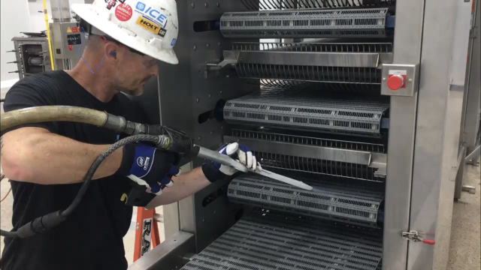
PLANT CLEANING…
TYPES OF CLEANING
Dry cleaning
Dry cleaning of equipment can only be practiced when soil can be removed by brushing, scrapping or scrubbing
Sometimes soil are often dry and can be easily removed by such techniques

Slide 10
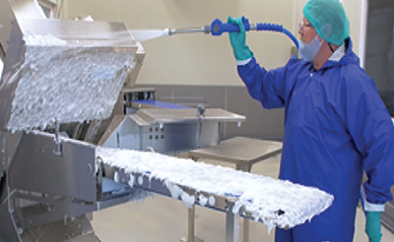
PLANT CLEANING…
2) Wet cleaning
Wet cleaning is the process of using water and eco friendly detergent or chemical to remove unwanted matter from the equipment
Water alone cannot remove the dirt and is an inefficient cleaner

Slide 11
PLANT CLEANING…
DETERGENTS
A detergent alters the condition of water surface, reduces the tension and allow the water to spread and wet the soil
Apart from this, two main important function of detergents are
Dislodge dirt/soil
Disperse soil particles

Slide 12
PLANT CLEANING…
Properties of good detergent
Solubility
The selected detergent must be readily soluble in water to avoid the possibility of depositing unwanted soils
Wetability
It should adequately wet the surface interface thus dislodging the soil. It should also be able dissolve or disperse the food materials released

Slide 13
PLANT CLEANING…
Emulsification
The detergent solution must be able to emulsify or disperse fats and oils
Rinseability
The detergent should easily be rinseable to avoid residues remaining on the equipment
Corrosiveness
The detergent solution must not attack the contact surfaces. Corrosion must be avoided by correct selection of detergent

Slide 14
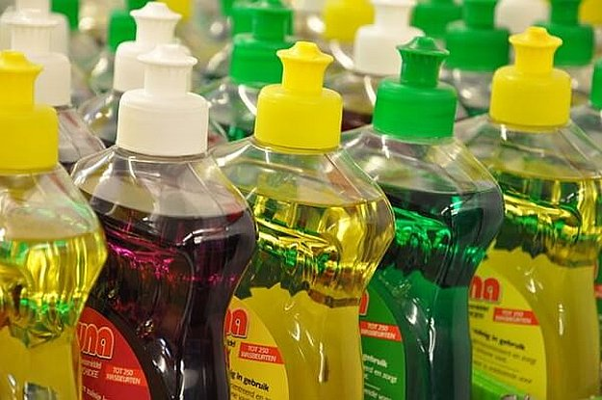
PLANT CLEANING…
TYPES OF DTEREGENTS
Basically there are three types of detergents
Acid detergents
Alkaline detergents
Surfactants

Slide 15
PLANT CLEANING…
Acid Detergents
Acid detergent have pH value below 3
Inorganic soils are best removed with these detergents
Acid detergents that are acceptable include
Hydrochloric acid
Nitric acid
Phosphoric acid
Gluconic acid
Citric and tartaric acid

Slide 16
PLANT CLEANING…
2. Alkaline detergents
Alkaline detergents have pH above 11 while the weaker one may have in the range of 8 and 11
organic soils are best removed with these detergents
The common example includes
Sodium and calcium hydroxide
Sodium metasilicate
Trisodium phosphate
Sodium carbonate or soda ash

Slide 17
PLANT CLEANING…
3. Surfactants
A surfactant is a substance that, when dissolved in water gives a product ability to remove dirt from surfaces such as glassware and equipments
They perform three major functions
They enable the cleaning solution to fully wet the surface being cleaned so that dirt can be easily loosened
They clean greasy,oily and protein,carbohydrates based stains
They are instrumental in removing dirts and in keeping them emulsified, suspended and dispersed

Slide 18
PLANT CLEANING…
Surfactants are classified as
Anionic surfactants
They are negatively charged ions in an aqueous solution
They have excellent wetting and dispersing power
They are poor bactericides
Particularly used for removing fatty acids
Examples include soaps, alkylaryl sulphonates and alcohol sulphates

Slide 19
PLANT CLEANING…
2. Cationic Surfactants
They are positively charged in an aqueous solution
They are powerful sterilants
They are principally used for their germicidal, fungicidal and algaecide properties
Example is of quats(ammonium compounds)

Slide 20
PLANT CLEANING…
3. Non-Ionic Surfactants
They are neutral in aqueous solution and are not dissociated in solution
They are powerful emulsifiers
They have pronounced foaming action that can lead to difficulties especially in the disposal of detergent

Slide 21
PLANT CLEANING…
4. Amphoteric Surfactants
They have both negative and positive charges in water
These are mainly used in electroplating, shampoo and cosmetic industry

Slide 22
PLANT CLEANING…
EVALUATING DETERGENTS
Following parameters are consider while choosing detergent
The nature of surface to be cleaned or soil to be removed
Solubility of detergent in water
Buffering power and pH
Stability in dry and solution form

Slide 23
Thank You ☺

