Slide 1
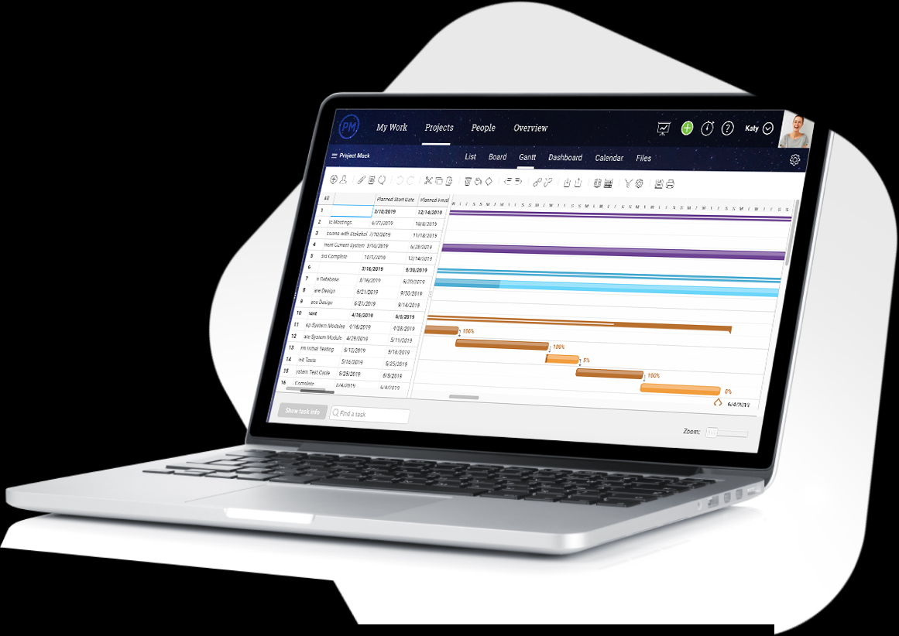
GANTT CHARTS
By: Saba Ashraf
Noon Business School, University of Sargodha.

Slide 2
What is Gantt Chart?
A Gantt chart is a visual view of tasks scheduled over time.
It is a horizontal bar chart developed as a production control tool in 1917 by Henry L. Gantt, an American engineer and social scientist.
Frequently used in project management, a Gantt chart provides a graphical illustration of a schedule that helps to plan, coordinate, and track specific tasks in a project.
This is also useful to keep tasks on track when there is a large team and multiple stakeholders when the scope changes

Slide 3
How Does it Work?
On the left of the chart is a list of the activities and along the top is a suitable time scale.
Each activity is represented by a bar; the position and length of the bar reflects the start date, duration and end date of the activity.

Slide 4
GANTT CHART

Slide 5
GANTT CHART
In the previous image you can easily see;
The start date of the project
What the project tasks are
Who is working on each task
When tasks start and finish
How long each task will take
How tasks group together, overlap and link with each other
The finish date of the project

Slide 6
Detailed Gantt Chart

Slide 7
Detailed Gantt Chart
The left side of the generic chart shows five labeled columns, WBS (Task Number), Task Name, Duration, Start Date and Finish Date.
The right of the chart shows Gantt chart bars and symbols showing the timing of tasks.
This right part of the chart has timescale headings and vertical grid lines. These heading lines have labels for the year at the top line, months on the second line, and weeks from the plan start.
There are six boxes that contain text annotation explaining elements of the Chart with arrows pointing to the related Gantt element.

Slide 8
Activities You Can Perform Using Gantt Chart
Establish the initial project schedule - who is going to do what, when and how long will it take.
Allocate resources - ensure everyone knows who is responsible for what.
Make project adjustments - the initial plan will need many adjustments.
Monitor and report progress - helps you stay on schedule.
Control and communicate the schedule - clear visuals for stakeholders and participants.
Display milestones - shows key events.
Identify and report problems - As everything is depicted visually you can immediately see what should have been achieved by a certain date and, if the project is behind schedule, you can take action to bring it back on course.

Slide 9
Gantt Chart vs. PERT Chart
Gantt Chart
PERT chart
Represented with Bar Chart
Used for Small Projects
Provide Accurate Time Duration and Percent Complete
Cannot Display Interconnecting Tasks that Depend on Each Other
Represented with Flowchart (or Network Diagram)
Used for Large and Complex Projects
Need to Predict the Time
Has Numerous Interconnecting Networks of Independent Tasks

