Slide 1
Subject: Engineering Probability and Statistics
Class: BS 4th
Lecture: 6th week
Topic: Normal Distribution

Slide 2
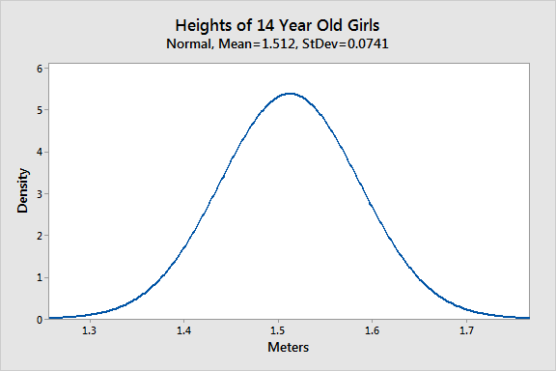
Normal Distribution
Definition
A normal distribution is an arrangement of a data set in which most values cluster in the middle of the range and the rest taper off symmetrically toward either extreme.
A normal distribution, sometimes called the bell curve, is a distribution that occurs naturally in many situations. For example, heights, blood pressure, measurement error, and IQ scores follow the normal distribution.
Height data are normally distributed. The distribution in this example fits real data that I collected from 14-year-old girls during a study.

Slide 3
Historical Background
The normal distribution is the most important of the continuous probability distribution. It has long occupied a central place in the theory of statistics and in applications of this theory.
It was first discovered by Abraham DeMoivre (1667-1754) who derived the distribution as the limiting form of the binomial distribution.
It was independently rediscovered by K.F Gauss (1777-1855) and P.S Laplace (1749-1827) in the early years of 19th century.
Gauss derived the normal probability function in connection with work in evaluating errors in repeated measurement of the same quantity. Therefore it is also referred as Gaussian distribution in the honor of K.F Gauss.

Slide 4
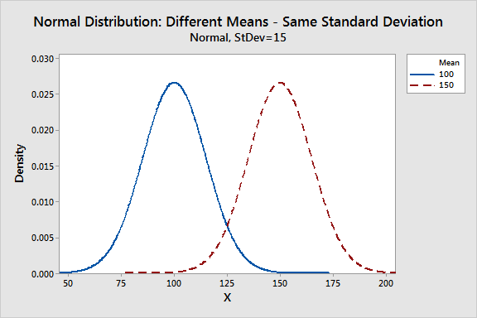
Parameters of the Normal Distribution
As with any probability distribution, the parameters for the normal distribution define its shape and probabilities entirely. The normal distribution has two parameters, the mean and standard deviation. The normal distribution does not have just one form. Instead, the shape changes based on the parameter values, as shown in the graphs below.
1. Mean
The mean is the central tendency of the distribution. It defines the location of the peak for normal distributions. Most values cluster around the mean. On a graph, changing the mean shifts the entire curve left or right on the X-axis.

Slide 5
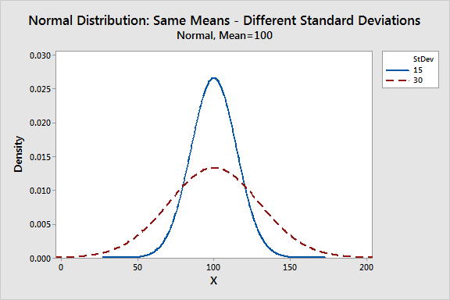
2. Standard deviation
The standard deviation is a measure of variability. It defines the width of the normal distribution. The standard deviation determines how far away from the mean the values tend to fall. It represents the typical distance between the observations and the average.
On a graph, changing the standard deviation either tightens or spreads out the width of the distribution along the X-axis. Larger standard deviations produce distributions that are more spread out.
When you have narrow distributions, the probabilities are higher that values won’t fall far from the mean. As you increase the spread of the distribution, the likelihood that observations will be further away from the mean also increases.

Slide 6
Probability Density Function of Normal Distribution
The density of the normal distribution (the height for a given value on the x axis) is shown below. The parameters μ and σ are the mean and standard deviation, respectively, and define the normal distribution
$$f\left(x\right)=\frac{1}{σ\sqrt{2π}}e^{−\frac{1}{2}{(\frac{x−μ}{σ})}^{2}}$$
The probability of a random variable falling within any given range of values is equal to the proportion of the area enclosed under the function’s graph between the given values and above the x-axis.

Slide 7
Common Properties for All Forms of the Normal Distribution
Despite the different shapes, all forms of the normal distribution have the following characteristic properties.
Normal distributions are symmetric around their mean.
The mean, median, and mode of a normal distribution are equal.
The area under the normal curve is equal to 1.0.
Normal distributions are denser in the center and less dense in the tails.
Normal distributions are defined by two parameters, the mean (μ) and the standard deviation (σ).
68% of the area of a normal distribution is within one standard deviation of the mean.
Approximately 95% of the area of a normal distribution is within two standard deviations of the mean.
Approximately 99% of the area of a normal distribution is within three standard deviations of the mean.

Slide 8
The Empirical Rule for the Normal Distribution
When you have normally distributed data, the standard deviation becomes particularly valuable. You can use it to determine the proportion of the values that fall within a specified number of standard deviations from the mean. For example, in a normal distribution, 68% of the observations fall within +/- 1 standard deviation from the mean. This property is part of the Empirical Rule, which describes the percentage of the data that fall within specific numbers of standard deviations from the mean for bell-shaped curves.
Mean +/- standard deviations $$μ±σ$$ | Percentage of data contained
1 ($μ±1σ)$ | 68%
2 $(μ±2σ)$ | 95%
3 $(μ±3σ)$ | 99.7%

Slide 9
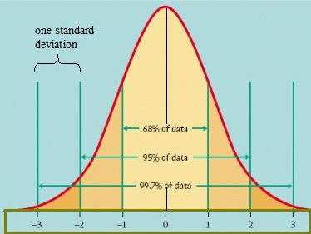

Slide 10
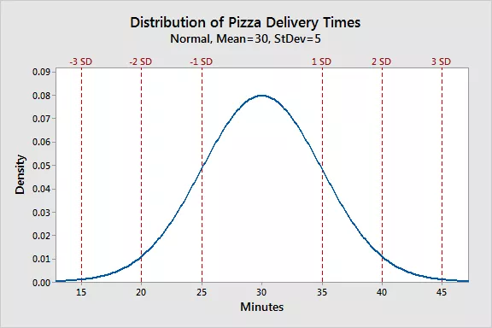
Example
Let’s look at a pizza delivery example. Assume that a pizza restaurant has a mean delivery time of 30 minutes and a standard deviation of 5 minutes. Using the Empirical Rule, we can determine that 68% of the delivery times are between 25-35 minutes (30 +/- 5), 95% are between 20-40 minutes (30 +/- 2*5), and 99.7% are between 15-45 minutes (30 +/-3*5). The chart below illustrates this property graphically.

Slide 11
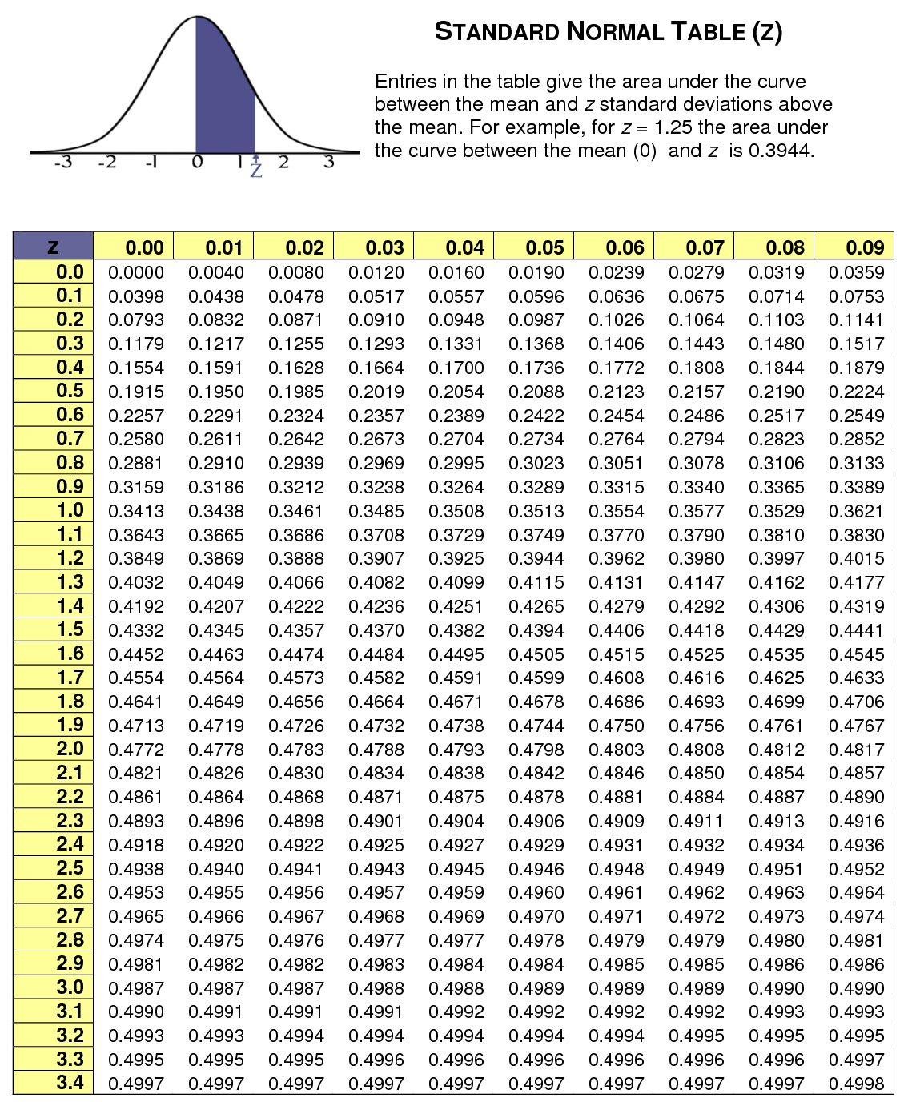

Slide 12
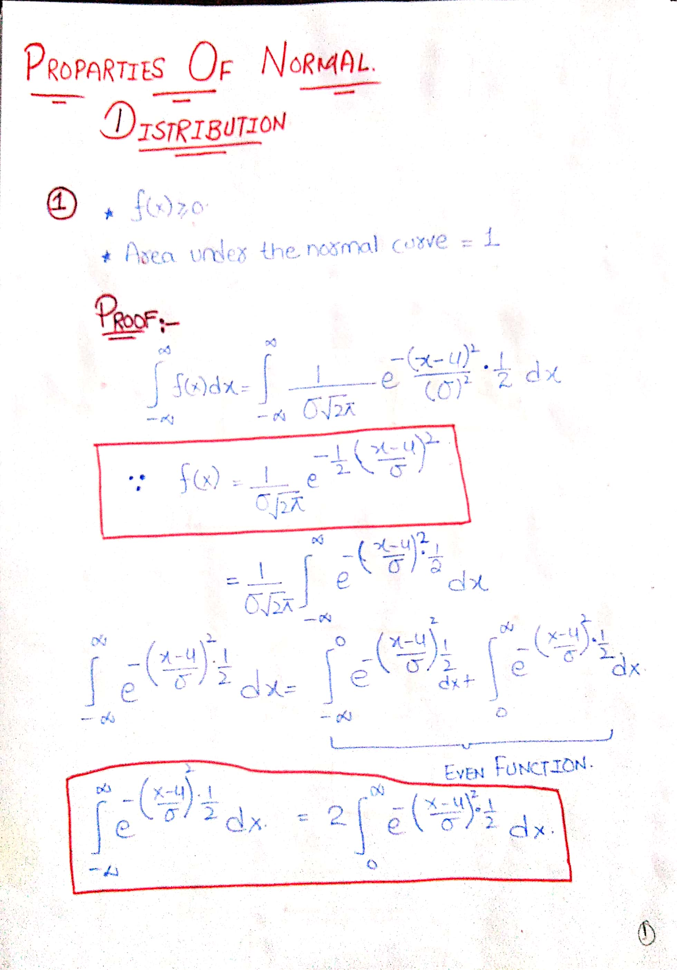

Slide 13
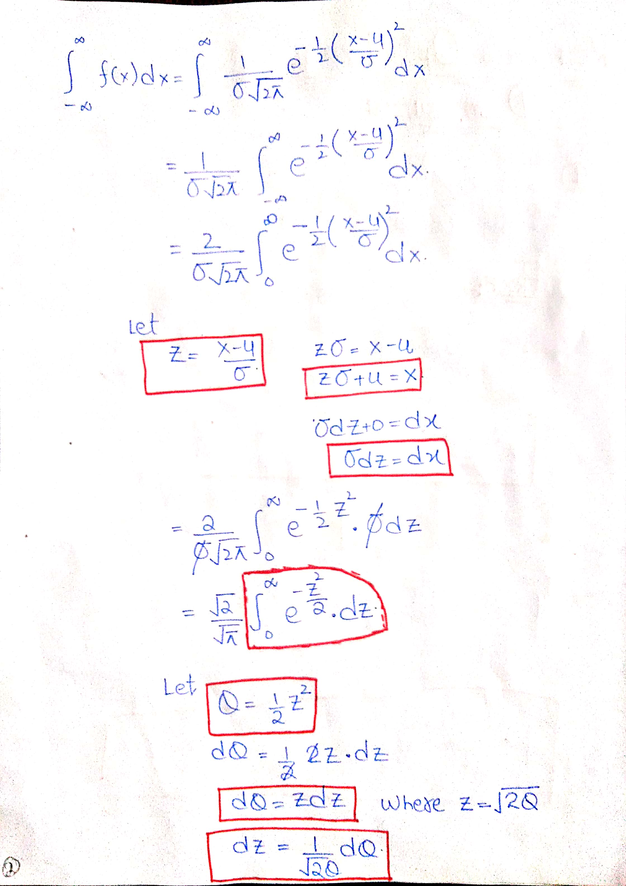

Slide 15
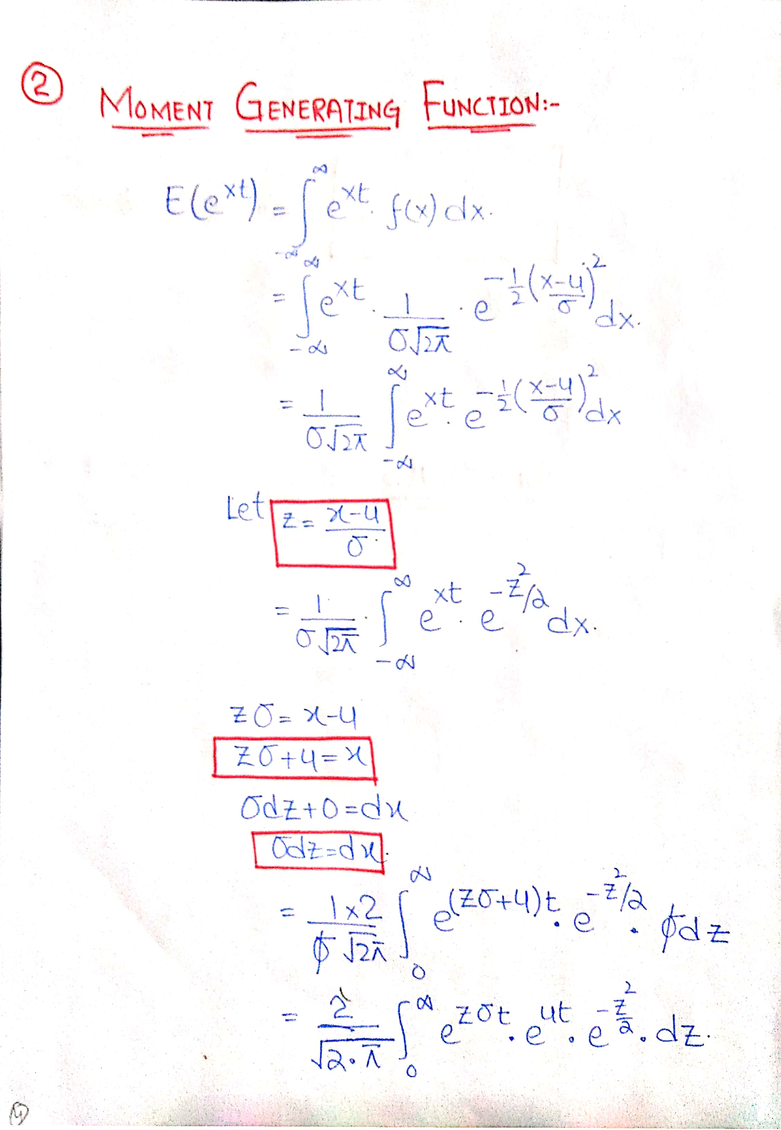

Slide 16
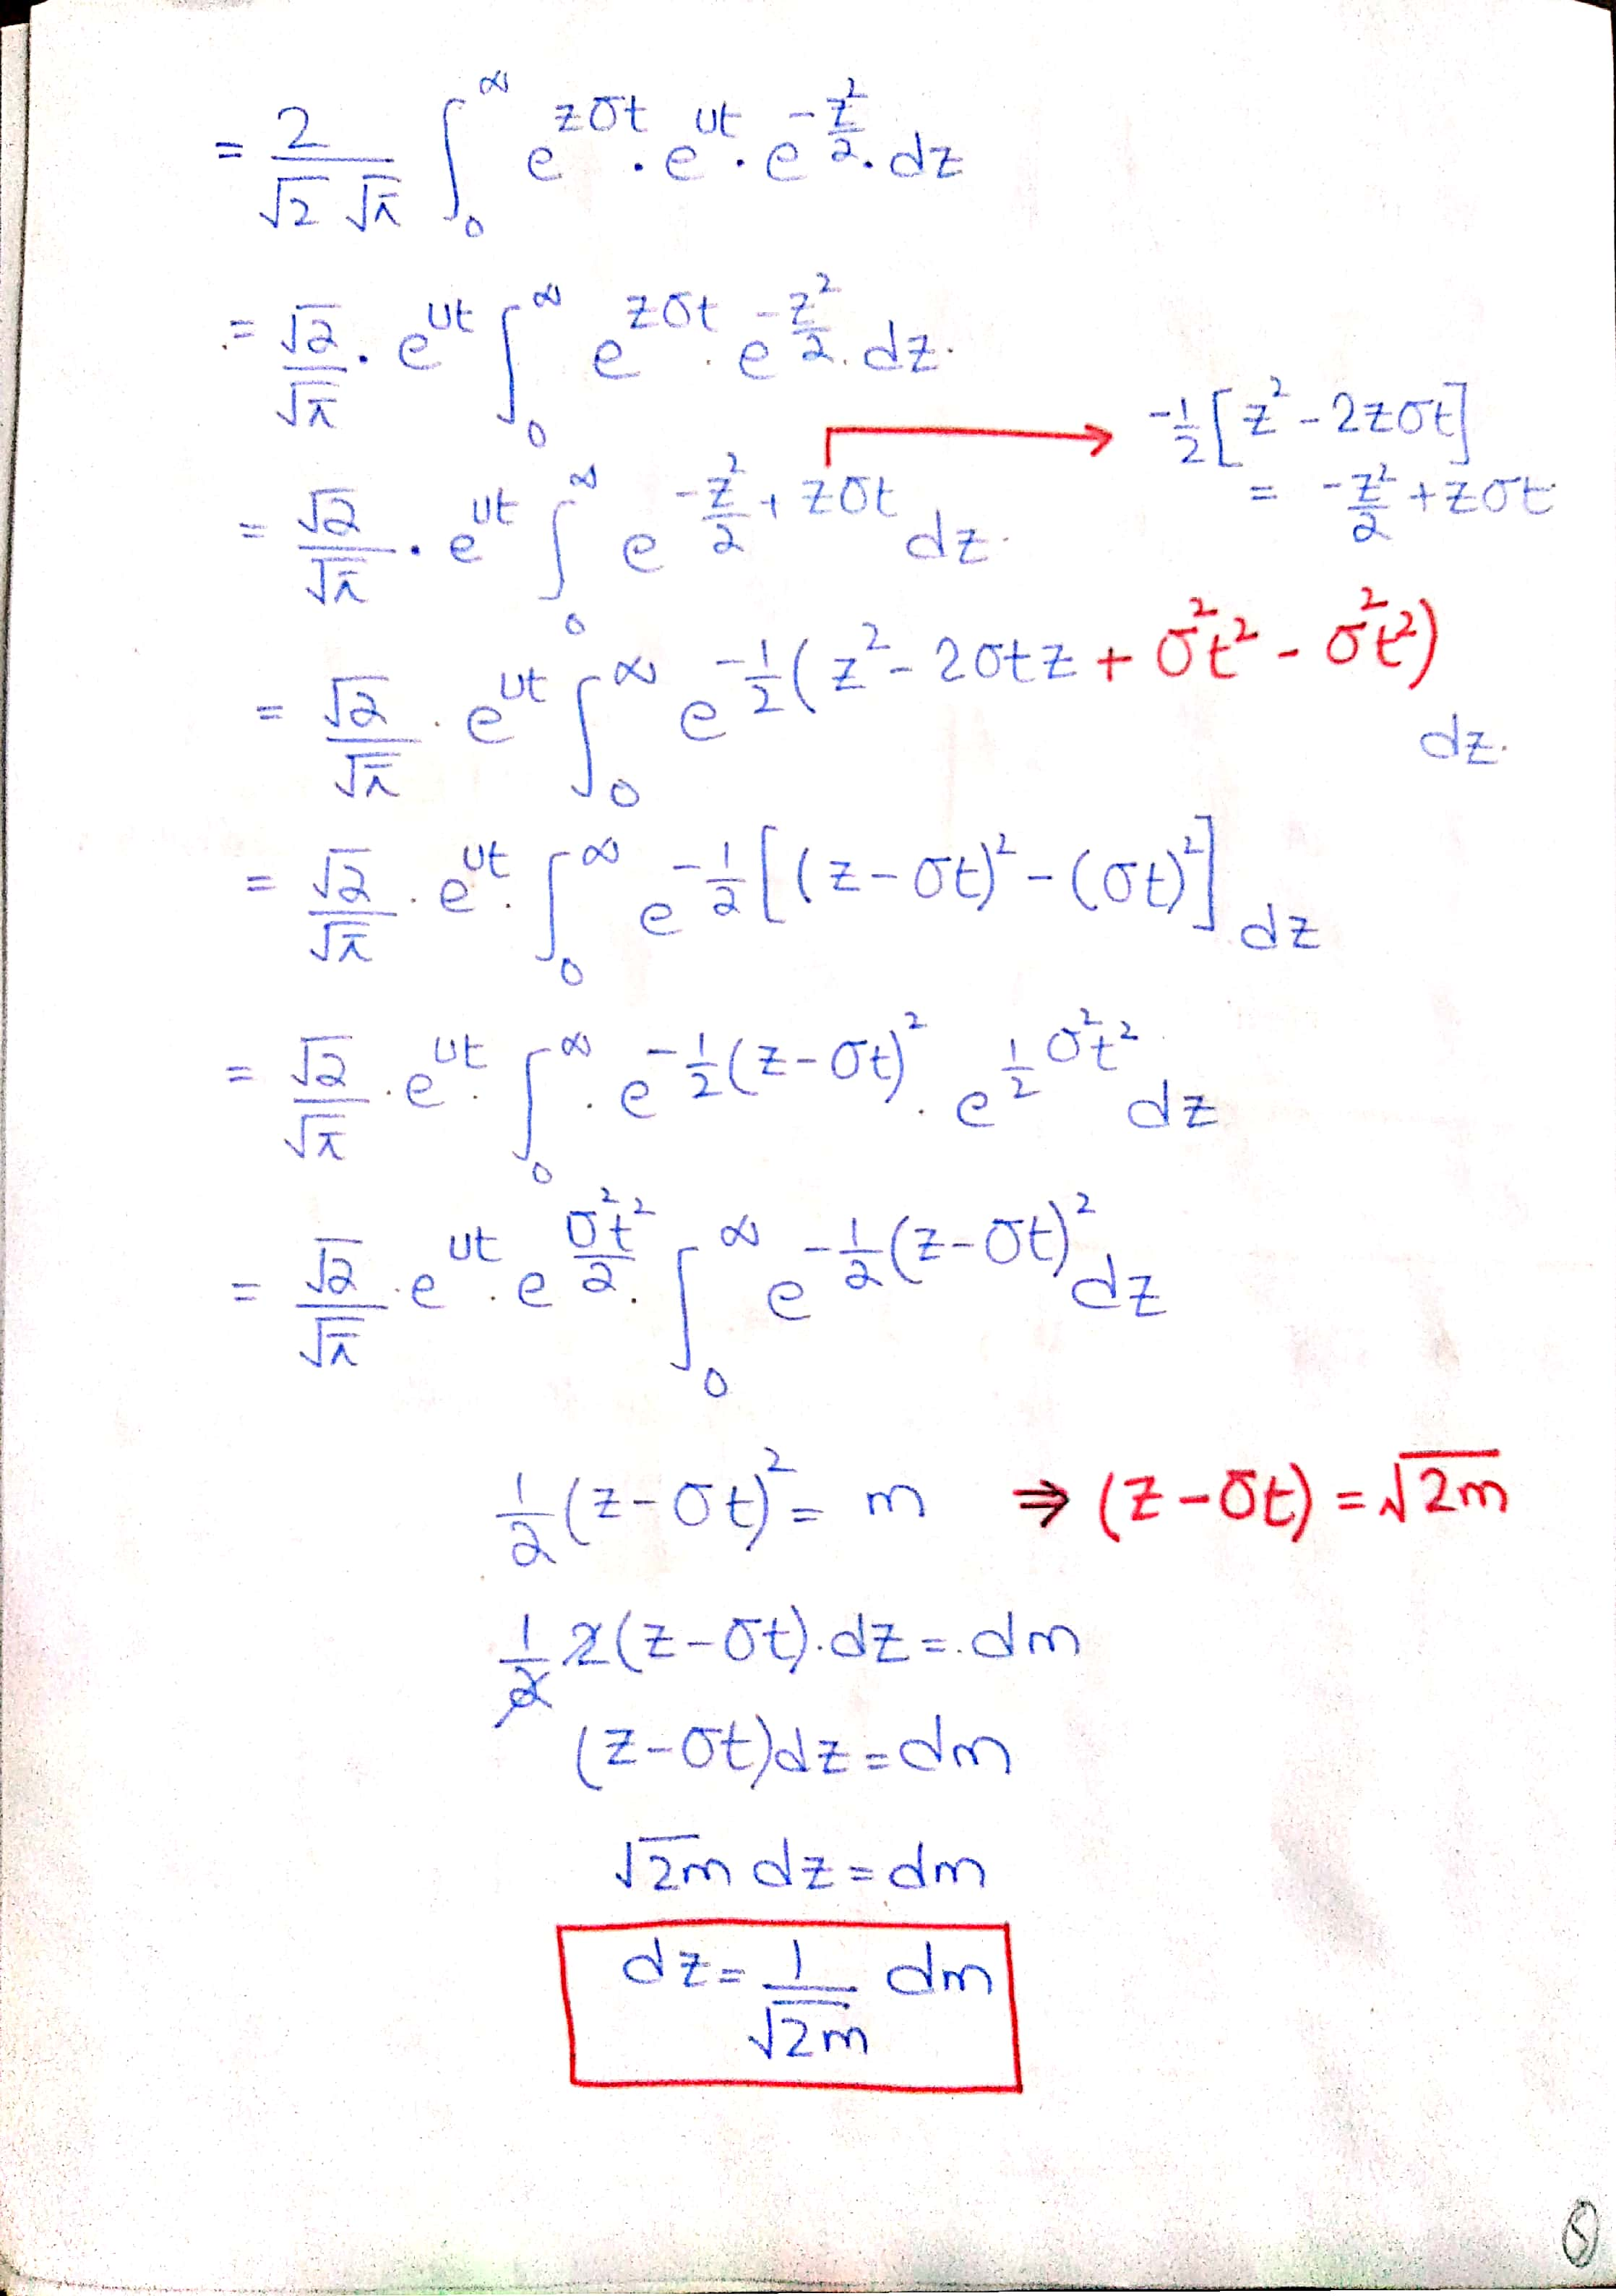

Slide 19
https://statisticsbyjim.com/basics/normal-distribution/
https://www.statlect.com/probability-distributions/exponential-distribution
https://www.statisticshowto.com/probability-and-statistics/normal-distributions/
http://onlinestatbook.com/2/normal_distribution/intro.html

