Slide 1
ELECTRICAL REACTIONS

Slide 2
Changes in Electrical Reactions
When there is a disease or injury to the motor nerves or muscles, ALTERATIONS ARE LIABLE TO OCCUR IN THEIR RESPONSE TO ELECTRICAL STIMULATION.
the altered electrical reactions may be of considerable assistance in diagnosis of type and extent of the lesion.
Reduction or loss of voluntary action of muscle may be due to a lesion of
UMN
LMN
The muscle itself
A neuromuscular junction fault
Functional
Which part of motor pathway is accessible to electrical stimulation

Slide 3
1. Upper Motor Neuron Lesion
No changes in lower motor neurons or muscle i.e. accessible part of motor pathways.
Normal type of response.
Only when nerve and muscles are hyper excitable, react on lower intensity of current than that normally required.

Slide 4
2. Lower Motor Neuron Lesion
Damage to lower motor neuron may involve
Anterior horn cells.
Fibers of nerve roots
Peripheral nerve
Lesions involving the nerve fibers can be divided into three groups
Neurapraxia
Axonotmesis
Neurotmesis

Slide 5
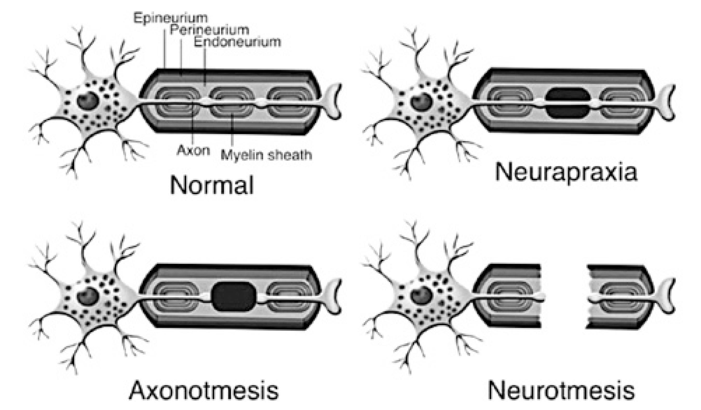

Slide 6
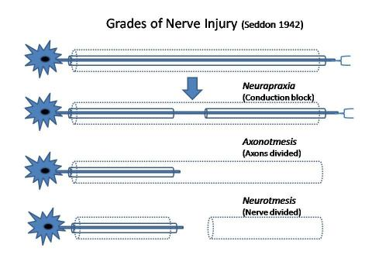

Slide 7
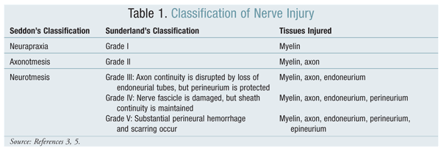

Slide 8
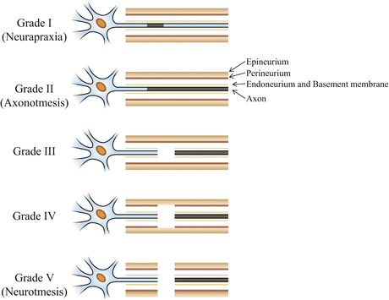

Slide 9
Neuraparaxia
1ST DEGREE INJURY
“Bruising or pressure may render the nerve incapable of conducting impulses past the site of lesion, and yet not be severe enough to cause degeneration of the fibers.”
If the electric reactions are tested on the affected muscles a normal type of response is obtained.
But there is loss of response to a stimuli applied to the nerve trunk above the lesion

Slide 10
Axonotmesis
2ND DEGREE INJURY
If lesion is more severe.
Degeneration of the axons takes place, the sheath of nerve remain intact
Example; radial nerve palsy associated with fractured shaft of humerus.
Once the nerve fibers are degenerated, the alteration in electric reactions occurs

Slide 11
Neurotmesis
3RD DEGREE INJURY
Severity of nerve sheath and fibers.
The fibers degenerate below the site of the lesion, causing the same alteration in the electrical reactions as axonotmesis.
The condition is more severe as the suturing of nerve is necessary before satisfactory regeneration of nerve takes place.
Example; ulnar nerve severed by a cut on the front of the wrist.

Slide 12
All type of nerve lesion may be partial or complete, or there may be mixture of two of them, e.g. neuraparaxia or axonotomesis
If all the nerve fibers supplying a muscle degenerate, the reaction of complete denervation is observed.
While if only some of the fibers degenerate the reaction is that of partial denervation.
ANTERIOR HORN CELLS
Reaction depends on the extent of damage
If all the nerve cells supplying the muscles are damaged___ reaction is that of complete denervated
If only a proportion of the cells are involved ______ reaction is that of partial denervation.
In less severe lesions degeneration of the nerve fibers does not occur, the reactions are normal

Slide 13
3. Neuromuscular Junction
Abnormalities like;
Myesthenia gravis; reduction of voluntary power is due to reduction of neurotransmitter at neuro-muscular junction.
So electrical stimulations will not provide the satisfactory to diagnosis.

Slide 14
4. Muscle Lesion
If reduction of voluntary power is due to weakness or disease of the muscle, no degeneration of motor nerve, electrical reactions are of normal type, but are reduced in strength.
If the lesion is too severe that there is complete loss of muscle tissue, there can not be any response to electrical stimulation.
Examples are;
ischemic contractures
Advanced stages of myopathies
Fibrosis of muscles in long standing denervation

Slide 15
5. Functional Disorders
Hysterical paralysis
Electrical reactions are normal

Slide 16
Development of Reaction of Denervation
When a nerve is severed, Wallarian degeneration takes place below the site of lesion, and above it is, as far as the first node of Ranvier.
These changes take up to 14 days to complete.
If the nerve is stimulated below site of lesion, before degeneration has taken place, an impulse is initiated and a normal response of muscle produced.
Because of this, it may not be possible to make full assessment of the lesion until three weeks after a suspected nerve injury, by which time any nerve fibers that have been severed will have degenerated.
Theses test before this date can, however, provide useful information.

Slide 17
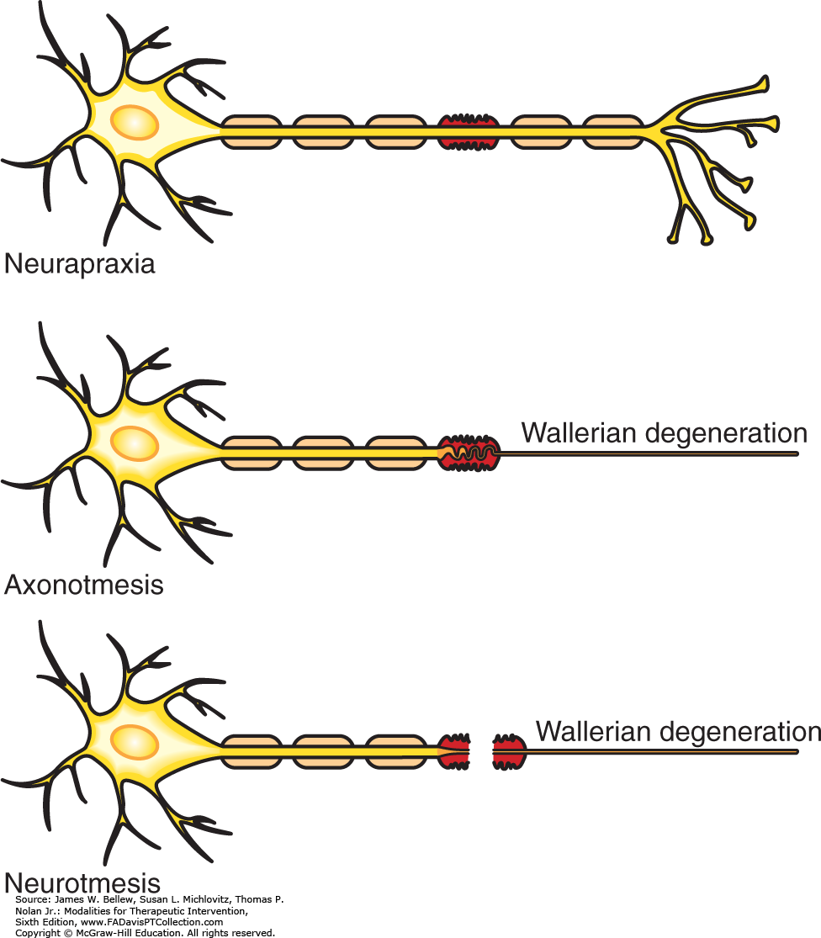

Slide 18
If a normal nerve trunk is stimulated with a current of adequate intensity, there is contraction of all the muscles it supplies beyond the point of stimulation.
If there is degeneration of nerve fibers this response is reduced or lost.
And changes become evident 3 OR 4 DAYS after the injury.
Changes in the reactions obtained on stimulation over the muscles may be observed before the END OF ONE WEEK, and indicate that nerve is degenerating. However at this stage ultimate extent of degeneration can ne assessed.
REACTION OF PARTIAL DENERVATION would show that some of the nerve fibers had degenerated, but would not indicate, how many more were still in the process of degeneration, or whether the denervation would ultimately become complete.
If, however, the reaction of complete denervation were obtained, the severity of the lesion would immediately be apparant

Slide 19
STRENGTH-DURATION CURVE

Slide 20
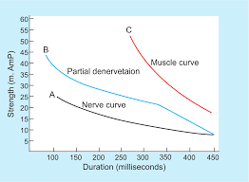

Slide 21
Strength duration curve:
“A graph is plotted of intensity of curve (effective voltage) against the duration of stimulus, such a graph is termed as strength duration curve”
A logarithmic scale is used as it magnifies the part of the curve showing the effects of the stimuli of shorter duration.
It is most satisfactory method for the routine testing of electrical reactions in peripheral nerve lesion

Slide 22
Apparatus
Form of impulses; RECTANGULAR
Duration; 0.01, 0.03, 0.1, 0.3. 1, 3, 10, 30, 100, MILLISECONDS
Both form and duration must be accurate.( check at regular intervals)
Type of stimulator;
CONSTANT CURRENT
( records intensity of current, more accurate result)
CONSTANT VOLTAGE TYPE
(records voltage, rather more comfortable)

Slide 23
Method
Before treatment: skin resistance should be removed, pt should be warm and fully supported and in good light.
Indifferent electrode: over some convenient area, on the midline of the body, or the origin of muscle.
Active electrode over the fleshy part of muscle.
Or two fixed electrodes are used over each end of the body.
In all cases active electrode must be of very small size as to isolate the each muscle.
Current is applied using longest impulse first, increase intensity until a minimal contraction is obtained
Intensity of current noted and impulse shortened.
This procedure is repeated with each stimulus in turn.
A minimal contraction is used as this makes it easy to detect any change in strength.
It is shape of curve that is the essential feature

Slide 25
Normal Innervation
When all the nerve fibers supplying the muscle are intact, the strength duration curve is that of normally innervated muscle.
The curve is of typical shape.
The impulses of longer duration all produce a response with the same strength of impulse irrespective of their duration.
While impulses of shorter duration require an increase in the strength of stimulus each time the duration is reduced.
The point where the curve begin to rise is variable but it usually the at a duration of 1 millisecond with constant current
And 0.1 millisecond with constant voltage stimulator.

Slide 27
Complete Denervation
When all the nerve fibers supplying the muscle are degenerated.
The strength duration curve is that of complete denervation.
When the duration of impulses is 100 millisecond or less, the strength of stimuli must be increased each time the duration is reduced
No response is obtained to the impulses of very short duration.
Curve rises steeply and is further to the right than that of normally innervated muscle.

Slide 28
Partial Denervation
When some of the nerve fibers supplying a muscle have degenerated, while others are intact, the curve obtained is that of partial denervation.
The impulses of longer duration can stimulate both innervated and denervated muscle fibers, so a contraction is obtained with a stimulus of low intensity.
As the impulses are shortened the denervated fibers respond less readily, as longer stimulus is required to produce a perceptible contraction and the curve rises steeply like that of denervated muscle.
With impulses of shorter duration the innervated fibers respond to a weaker stimulus than that required for the denervated fibers. So contraction of later( denervated) is not obtained and this part of curve is similar to that of innervated muscle.

Slide 29
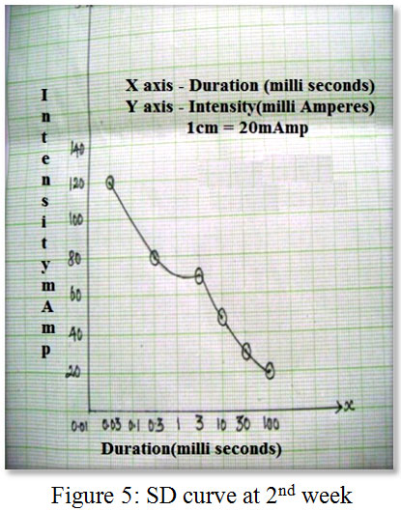

Slide 30
Thus the right hand part of curve resembles that of denervated muscle, the left hand part that of innervated muscle, and a klink is seen at the point where the two section meet.
The shape of curve indicate the proportion of denervation.
If a large number of fibers are denervated the curve rises steeplty and greater part of it resembels that of denervation.(fig.)
If the majority of the fibers are innervated, the curve is lower and flatter and bears a closer resemblance to that of full innervation.(fig.)

Slide 31
EARLY SIGNS OF RESTORATION
the early signs of restoration of nerve supply to a muscle may be change in the shape of the strength duration curve.
A klink appears in the curve and, as innervation progresses, the curve moves down to the left.
Progressive denervation is indicated by the appearance of a klink, increase in the slope and shift of the curve to the right.
ADVANTAGES
It is simple and reliable, indicates the proportion of denervation.
While series of tests shows changes in condition
DISADVANTAGES
Only a proportion of fibers may responds.
Full picture is not clearly shown, and that it does not indicate the site of the nerve lesion.
The later may be remedied by testing nerve conduction

Slide 32
NERVE CONDUCTION TESTS

Slide 33
Nerve Conductivity
Stimulation of a nerve trunk causes contraction of the muscles supplied by that nerve distal to the point of stimulation.
Testing of nerve conduction is commonly used in conjunction with the plotting of strength duration curves.
An impulse with a duration of 0.1 or 0.3 millisecond is applied at a point where the nerve trunk is superficial, and any contraction of the muscle supplied below this point indicates that at least some of the nerve fibers are intact.
Comparison with a strength of the stimulus required to produce a similar reaction on the unaffected side of the body gives some indication of the severity of the lesion.
Although it does not show whether the fault lies in the nerve or in the muscle itself.
When a nerve fiber is degenerating, conductivity is lost distal to the lesion within a few days, and this can give some indication of the stat of the lesion and possible prognosis at a date earlier than that at which the full test can accurately be performed.
in lesion in which degeneratiion does not occur, it may be possible to determine the level at which the impulses are blocked by testing at different points on the nerve trunk.
Stimulation below, but not the site of lesion, should elicit a response

Slide 34
Nerve Distribution
The distribution of different nerves is subject to some variation, which may prove misleading in the assessment of nerve lesions.
The distribution of a nerve can be determined by stimulating the nerve trunk and observing the resulting muscle contraction

Slide 35
Conduction Speed
The speed with which an impulse is transmitted along a nerve fiber can be measured with suitable equipment.
(Electromyography)

Slide 36
OTHER METHODS OF TESTING

Slide 37
RHEOBASE
Is the minimum intensity of current that will produce a response if the stimulus is of infinite duration.
A duration of 100 millisecond is used in poractice.
In denervation the rheobase may be less than that of innervated muscle, and often rises as re-innervation commences.
(Not sufficiently constant to be reliable)
The rheobase varies considerably
in different muscles
according to skin resistance
Temperature of the part
Rise may be due to fibrosis of the muscle.

Slide 38
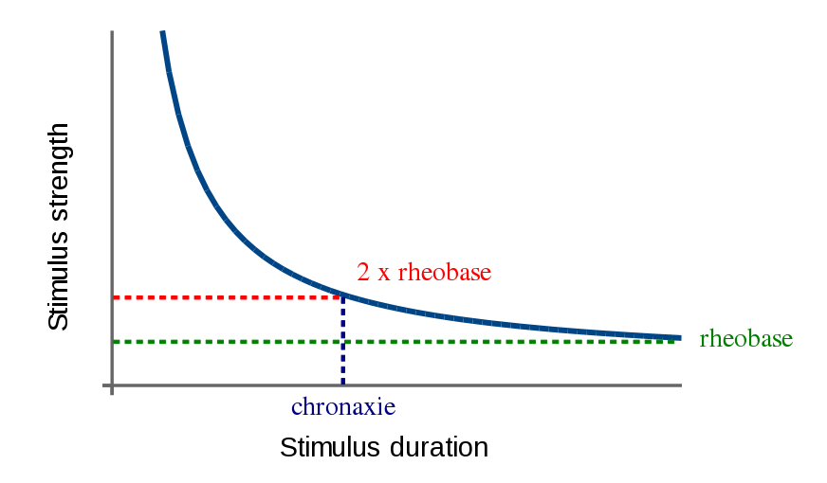

Slide 39
CHRONAXIE
Is duration of the shortest impulse that will produce a response with a current of double the rheobase.
The chronanxie of innervated muscles is appreciably less than that of denervated muscle,
The former being less and latter being more than 1 milliseconds if the constant voltage stimulator is used.
With constant current stimulator the values are higher but bear a similar relationship to each other.
Chronaxie is not a satisfactory method of testing electrical reactions, as partial denervation not clearly shown.
The chronaxie being that of the predominant fibers, e.g. the chronaxie of a muscle with 25% of its fibers innervated would be same as that of a completely denervated muscle

Slide 40
PULSE RATIO
This is the ratio of the current needed to produce a muscle contraction with an impulse of 1 millisecond to that required if the duration of the impulse is 100 milliseconds.
With innervated muscle little or no increase in the intensity of current is necessary when the impulse is shortened from 100 to 1 milliseconds, so the pulse ratio is low, less than2.2.
Denervated muscle required a greater increase in the intensity of current , so the pulse ratio is higher, usually more than 2.5.
DISADVANTAGES
Partial denervation is not clearly shown

Slide 41
FARADIC_I.D.C. TEST
FARADIC__ duration 0.1 to 1 ms, frequency 50-100/sec
Tetanic contraction of innervated muscles.
With faradic coil impossible to get contraction of denervated muscles(shorter duration)
With modren stimulator,a response of denervated muscle can usually be obtained with impulses of this duration, owing to the greater output and more comfortable current than that of old equipment
Inaccuracies arose with latter because the form and duration of the impulses varied with currents from different sources
THE INTERRUPTED DIRECT CURRENT__ duration 100 ms, repeats 30/min
Brisk contraction of innervated fibers
Sluggish contraction of denervated fibers
Innervated muscles may however responds sluggish if their temperature I below normal, also in myxoedema.
While contraction of denervated muscles becomes brisker as its temperature rises

Slide 42
THANKS!

