Slide 2
ALLERGY
By Hafiza Sara Afzal

Slide 3
CONTENT:
DEFINITION
DIAGNOSIS
TARGETS
PATHOPHYSIOLOGY
PREVALENCE
TREATMENT

Slide 4
ALLERGY
An allergy is an abnormal reaction to a normally harmless substance (allergen).
Depending on the allergy, reactions occur seasonally or throughout the year. If you are allergic, you produce too much IgE antibody in response to a foreign substance (allergen).
When IgE antibodies react with an allergen (substance to which you are allergic), your body releases chemicals that cause specific allergic symptoms.
Histamine is one of these chemicals.It causes the muscles in the airways and walls of the blood vessels to tighten. It also instructs the lining of the nose to produce more mucus.

Slide 5
HISTORY OF ALLERGY:
Allergies were discovered over 150 years ago, however despite historical developments mankind is still searching for a cure.
Though allergic reactions have been documented in ancient Greek and Roman history, the modern era of the study of allergies really began in the 1800's when hay fever was described by Dr. John Bostock in 1819.
In 1859, Charles Harrison Blackley sneezed. A doctor in Manchester, England, Blackley suffered from what were called summer colds, with seasonal sneezing, watery eyes, and a runny nose.
In 1948 corticosteroids were first used to treat asthma and allergic reactions.

Slide 6
ALLERGEN: An allergen is a usually harmless substance capable of triggering a response that starts in the immune system and results in an allergic reaction.
ANAPHYLAXIS:
Anaphylaxis is a serious allergic reaction that causes an itchy rash, throat or tongue swelling, shortness of breath, vomiting, lightheadedness, and low blood pressure.
ANGIOEDEMA:
Angioedema is swelling in the deep layers of the skin, often seen with urticaria (hives).
ATOPY: Atopy refers to the genetic tendency to develop allergic diseases such as allergic rhinitis, asthma and atopic dermatitis (eczema).
URTICARIA: Another name for hives. Raised, itchy areas of skin that are usually a sign of an allergic reaction. They reflect circumscribed dermal edema (local swelling of the skin).
.

Slide 7
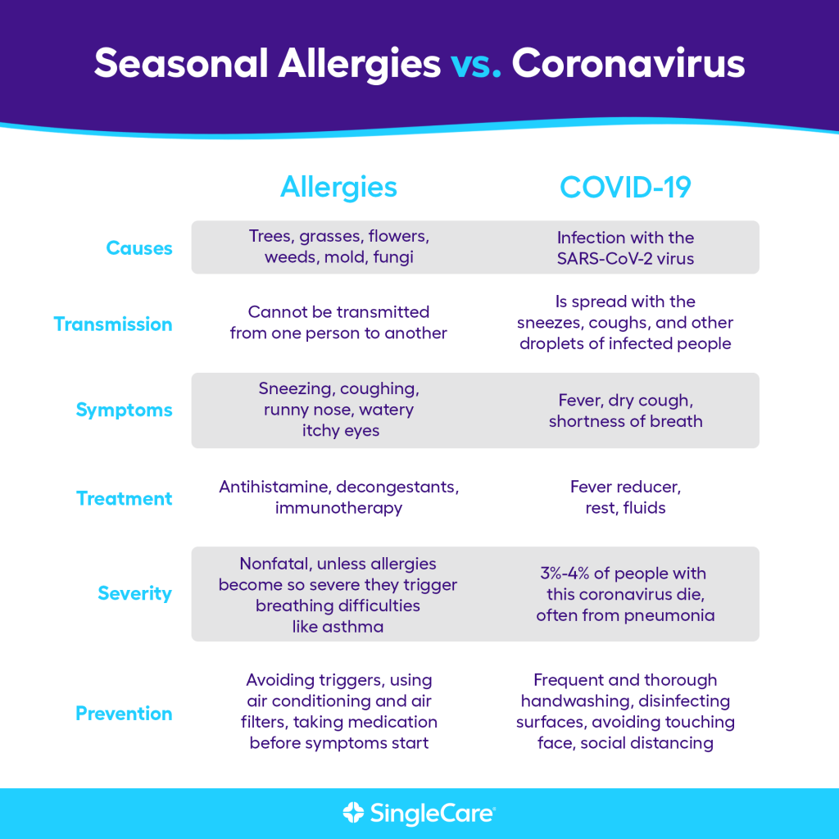

Slide 9
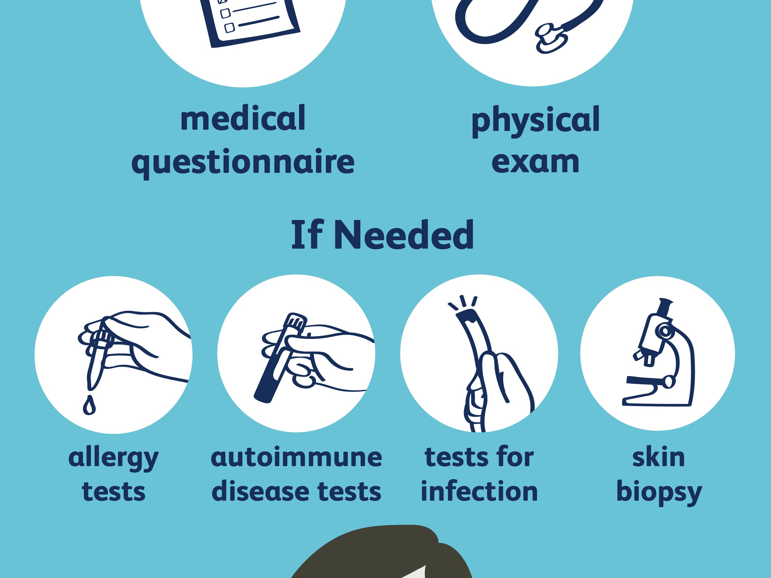
DIAGNSOIS:

Slide 10
Allergic reactions on drugs includes 4 types of hypersensitivity reactions:
Type I: IgE/Immediate Hypersensitivity (Anaphylactic Reaction) These allergic reactions are systemic or localized, as in allergic dermatitis (e.g., hives, wheal and erythema reactions).
Type II: IgG/Cytotoxic/cytolytic Reaction (Antibody-dependent) an antibody mediated process in which IgG and IgM antibodies are directed against antigens on cells (such as circulating red blood cells) or extracellular material (such as basement membrane).
Type III: Immune Complex Reaction/retarted reaction are characterized by tissue damage caused by the activation of complement in response to antigen-antibody (immune) complexes that are deposited in tissues.
Type IV: Cell-Mediated (Delayed Hypersensitivity) is mediated by effector T cells, macrophages and other leukocytes that infiltrate a site of antigen exposure and induce a delayed form of inflammatory tissue damage.

Slide 12
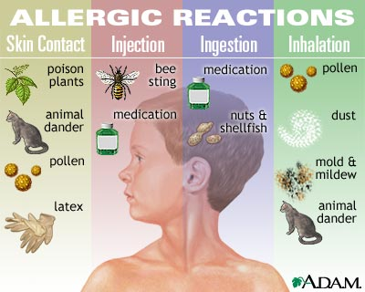
Immediate phase reaction (type 1 hypersensitivity)
Once the mast cells and/or basophils have released their chemicals, the allergic reaction occurs rather quickly.
This part of the reaction is called the immediate reaction
Late phase reaction (allergic inflammation)
About 50% of the time, the allergic reaction progresses into a "late phase." This late phase occurs about four to six hours after the exposure.
In the late phase reaction, there is tissues redness and swelling due to the arrival of other cells to the area, including the eosinophils, neutrophils, and lymphocytes.

Slide 13
PREVALENCE OF ALLERGIC DISEASE:
The prevalence of diseases associated with atopy has increased in many parts of the world over the past 20 to 30 years.
In the United Kingdom,Sweden, Switzerland, Norway, the United States, Australia, New Zealand and Taipei. the prevalence of diagnosed asthma and symptoms strongly suggestive of asthma in children has increased at a rate of about 5% a year.
Few reported serial surveys have examined the prevalence of asthma in adults, although the proportion of military enlist with asthma has increased in Finland, Sweden, and Israel.
In the United Kingdom, results from the three national birth cohorts (samples of people born in 1946, 1958, and 1970) have shown a marked increase (5.1%, 7.3%, and 12.2% respectively) in the prevalence of eczema as reported by the mother in children aged under 5.

Slide 14
ALLERGIC PREVALENCE IN PAKISTAN:
Overall prevalence in Pakistan, according to the study, is 24.6 % for allergic rhinitis,24.04% for urticaria, 19.4% for bronchial asthma and 8.4% for eczema in age group of 12-55 years.
When city and province data was analyzed it was found that allergic rhinitis was the main allergic disease of Islamabad, KPK (Khyber Pakhtunkhwa) and Sindh.
Similarly urticaria was the commonest allergic disease of Rawalpindi and Baluchistan.
Mixed cases of respiratory Diseases were common in Punjab and NWFP (Khyber Pakhtunkhwa).
KARACHI - Allergic Rhinitis or Hay Fever is the most common allergy in Pakistan, affecting 24.62 percent Pakistanis while Sindh being on top with 27.92 percent prevalence.

Slide 15
FREQUENCY OF VARIOUS TYPES OF ALLERGIES ON RISE:
The incidence of various types of allergies—including nasal, eye and skin—have been on increase by 30 to 40 per cent in the winter season every year, and there is no allergy test facility available in the government sector hospitals of the Sindh province.
Renowned ENT Surgeon, Dr Jawaid Akhtar Jamali, while talking to PPI, said due to the prevailing cold and dry weather conditions, the incidence of allergy due to air pollution, dust and dry weather in varied forms suffering from skin rashes, flu, cough, sneezing and asthma had risen increases by 30 to 40 percent in this season.
. When contacted, Another ENT Surgeon Pakistan Medical Association (PMA) leader, Dr SM Qaiser Sajjad, said allergy cases are on the rise in Karachi due to dry weather air pollution, dust, smoke and chemicals among the elderly and children.

Slide 16
ALLERGY AND IMMUNOLOGY:
Allergy and immunology involves the management of disorders related to the immune system. These conditions range from the very common to the very rare, spanning all ages and encompassing various organ systems. Diseases typically seen by an allergist/immunologist (often referred to simply as an "allergist") include:
Allergic diseases of the eye, such as allergic conjunctivitis
Respiratory tract-related conditions such as allergic rhinitis, sinusitis, asthma, hypersensitivity pneumonitis and occupational lung diseases
Gastrointestinal disorders caused by immune responses to foods, including gastroenteritis, and food protein-induced enteropathies
Skin-related allergic conditions such as atopic dermatitis, contact dermatitis, acute and chronic urticaria, or angioedema
Adverse reactions to foods, drugs, vaccines, stinging insects and other agents

Slide 17
Diseases primarily affecting the immune system, including primary immune deficiencies such as severe combined immune deficiency syndromes, antibody deficiencies, complement deficiency, phagocytic cell abnormalities, or other impairments in innate immunity and acquired immune deficiency
Systemic diseases including anaphylaxis and systemic diseases involving mast cells or eosinophils
Diseases associated with autoimmune responses to self-antigens, such as auto-inflammatory syndromes
Stem cell, bone marrow and/or organ transplantation
Allergies can affect anyone, regardless of age, gender, race, or socioeconomic status. Generally, allergies are more common in children due to weak immunity.

Slide 18
Emerging immune targets for the therapy of allergic disease:
1.The Study authors conclude that Tfh13 cells are responsible for directing antibody-producing B cells to create high-affinity IgE and that Tfh13 cells may be required for allergic disease, including anaphylaxis.
2.The most promising approaches might be those that selectively remove or inactivate TH2 cells through the targeting of cell surface molecules such as T1, chemokine (C-C) motif receptor 8 (CCR8) and CCR4.
People with allergies have large numbers of TH2A cells circulating in their bodies, people without allergies do not, Wambre says
3.GATA-binding protein 3 (GATA3); or CD4.In addition to these new molecules, new approaches to blocking them will be developed, including soluble receptors, immunotoxin antibodies and gene therapy.

Slide 19
4.Several potential immune targets seem to have limited therapeutic potential in allergic asthma include IL-5, the more widely shared cytokine-receptor signalling moieties, many transcription factors, including nuclear factor-κB (NF-κB) and most of the signal transducer and activator of transcription (STAT) factors, and the Janus-associated kinase (JAK) family of tyrosine kinases.
5.The keystone cytokines in type 2 immune response include interleukin (IL) 4, IL-5, IL-9, and IL-13
IL-5 and IL-9 are responsible for the activation and recruitment of eosinophils and mast cells, while IL-13 induces goblet cell hyperplasia, mucus hyper-secretion and airway hyper-responsiveness
6.Neuro-immune signaling may play a central role in the pathophysiology of allergic diseases including atopic dermatitis, asthma and food allergies

Slide 20
7.Immune cells release inflammatory mediators including histamine, cytokines or neurotrophins that directly activate sensory neurons to transmit itch in the skin, cough/sneezing and bronchoconstriction in the respiratory tract and motility in the GI tract.
8.Somatosensory and visceral afferent neurons release neuropeptides including calcitonin gene-related peptide, substance P and vasoactive intestinal peptide, which can act on type 2 immune cells to drive allergic inflammation.

Slide 23
PRESCRIPTION OPTIONS:
There are two types of allergy treatment:
MEDICATION:Decongestant and antihistamines are the most common.They help to reduce a stuffy nose,runny nose,sneezing and itching.Corticosteroids treat inflammation in the nose.Non-steroidal anti-inflammatory medications (NSAIDs) may also be used to help temporarily reduce pain, swelling, and cramping caused by allergies.
IMMUNOTHERAPY:A preventive treatment for allergic reactions that involves giving gradual increases doses of the allergen.The slow increase of the allergen allows the immune system to become less sensitive to the allergen.

Slide 25
NEW TARGETS FOR THE TREATMENT OF ALLERGY:
1.Researchers have identified several mast cell molecules which can be targets of new drugs.
These targets include, for example, serine proteinases tryptase, chymase, which are enzymes that break down proteins, as well as 5-lipoxygenase-activating protein , prostaglandin-D2, and proinflammatory cytokines such as TNF-alpha, IL-4, IL-6 and IL-17.
2.Monophosphoryl lipid, a TLR4 agonist and the latter contains, CpG motifs activating the TLR9 cascade.
Preseasonal subcutaneous injection of both of these allergy vaccines has been safe and efficacious in control of nasal symptoms of patients with allergic rhinitis.
.

Slide 26
3.Chemokines that target CCR3 in concert with Th2 cytokines appear to play a pathogenic role in allergy.
In contrast, chemokines that target CXCR3 in concert with Th1 cytokine appear to play a beneficial role.
Inhibiting CCR3/Th2 pathway using CCR3 antagonists is viewed as a potentially useful strategy for anti-allergy drug development.
In contrast, the idea of using CXCR3 agonists to inhibiting allergic response by promoting CXCR3/Th1 pathway faces serious concerns of their potential pro-inflammatory activities in vivo.
4.Researchers have identified an enzyme known as Cyp11a1, as a potential target for treatment of increasingly common and potentially deadly food allergy. e.g: peanuts
Blocking the enzyme's activity in sensitized mice prevented diarrhea and inflammation, and reduced levels of several proteins associated with allergies

Slide 27
5.Drug therapy for allergy is based on the use of non-sedative antihistamines, i.e. blocking of the histamine H1 receptors, but sometimes additional help is obtained from blockers of the cysteinyl leukotriene receptor-1.
3.Vitamin D is a potent immune modulator, increase the immune system to respond to allergic inflammation.
The vitamin D receptor is also expressed on airway smooth muscle where higher concentrations of vitamin D relax the smooth muscle and prevent its proliferation.
Vitamin D also upregulates the absorption of inhaled corticosteroid across the airway epithelium and also used in childhood asthma.

Slide 28
REFERENCES:
1.Ishizaka K, Ishizaka T, Hornbrook MM. Physico-chemical properties of human reaginic antibody. IV. Presence of a unique immunoglobulin as a carrier of reaginic activity. J Immunol 1966; 97(1): 75–85.
2. Chapter 4: The Extent and Burden of Allergy in the United Kingdom. House of Lords – Science and Technology. Report number: 6, 2007.
3. Abramson M, Puy R, Weiner J. Immunotherapy in asthma: an updated systematic review. Allergy 1999; 54(10): 1022-1041.
4. Creticos PS, Van Metre TE, Mardiney MR, Rosenberg GL, Norman PS, Adkinson NF Jr. Dose response of IgE and IgG antibodies during ragweed immunotherapy. J Allergy Clin Immunol 1984; 73(1 Pt 1): 94-104.
5. Schulten V, Westernberg L, Birrueta G, Sidney J, Paul S, Busse P, et al. . Allergen and epitope targets of mouse-specific T cell responses in allergy and asthma. Front Immunol. (2018)

