Slide 1
Professional Practice
Human resource Management

Slide 2
Human Resource Management
Human resource management is the strategic approach to the effective management of organization workers so that they help the business gain a competitive advantage
Commonly known as the HR Department, it is designed to maximize employee performance in service of an employer's strategic objectives.
HR is primarily concerned with the management of people within organizations, focusing on policies and systems.
HR departments are responsible for overseeing employee benefits design, employee recruitment, training and development, performance appraisal and rewarding.
Notes:
an act of assessing something or someone. : a formal assessment, typically in an interview

Slide 3
Model of human resource management
Model of human resource management constitutes a broad collection of features.
In this section we will discuss only some features salient for software engineering

Slide 4
Model of human resource management
Long term, strategic and proactive in style
HR planning is of great significance for managers responsible for locating and managing resources.
Their duties include
– Establishing number of staff – Maximum utilization of personnel – Development and education of employees – A projection of future staff needs
Notes:
Proactive behavior involves acting in advance of a future situation

Slide 5
Model of human resource management
Commitment to the organization
Two approaches
Complete control through reliance on the rules governing employment.
Empowering employees with status and responsibility for quality production.

Slide 6
Model of human resource management
Commitment to the organization
Real challenge is to shift employee attitudes from mere compliance with rules at work to commitment and self motivation.
Skill is now not much the technical qualifications of employees but their qualities in terms of attendance, flexibility, responsibility, discipline, identification with the company and work rate.

Slide 7
Model of human resource management
Self-management
Self management is a form of organizational management based on self-directed work processes on the part of an organization's workforce
There are two variations of self-management – All the workers manage the enterprise directly through assemblies – workers exercise management functions indirectly through the election of specialist managers.
Notes:
Self-Management is the organizational philosophy represented by individuals freely and autonomously performing the traditional functions of management without mechanistic hierarchy or arbitrary, unilateral command authority over others

Slide 8
Self-management
• The goals of self-management are to improve performance by granting workers greater autonomy in their day-to-day operations, boosting morale, reducing alienation, and when paired with employee ownership, eliminating exploitation.

Slide 9
Unitary Perspective
The unitary perspective is based on the assumption that the organization is an integrated group of people with single authority/ loyalty structure and a set of common values, interests and objectives shared by all members of the organization.
• Management’s prerogative is regarded as legitimate, rational and accepted and any opposition to it is seen as irrational.
Notes:
privilege exclusive to a particular individual or class.

Slide 10
Unitary Perspective
There is no conflict between the interests of those supplying capital to the enterprise and their managerial representatives, and those contributing their labor.
The underlying assumption of this view is that the organizational system is in basic harmony, and conflict is unnecessary and exceptional.

Slide 11
Unitary Perspective
Managements clings to this view because
It legitimizes its authority role by projecting the interests of management and employees as being the same and by emphasizing managements role of governing in the best interest of organization as a whole.
It reassures managers by confirming that conflict, where it exists, is largely the fault of the government rather than management.
Notes:
hold on tightly to::cling

Slide 12
Model of human resource management Flexible Work Roles
Idea behind flexible work roles is that rather than the organization being centralized , with job roles formally defined, the roles should be flexible with devolution of decision making and a fluid organizational structure.
Four main characteristics of the management structure of well established firms are – Motivate and retain technical talent – Decentralization – Looser authority structure – Matrix organization (A matrix organisation is a structure in which there is more than one line of reporting managers. Effectively, it means that the employees of the organisation have more than one boss!)
Notes:
You may have heard it said of a business owner that he "runs a tight ship." This means that manager uses tight coupling, in which employees work under close supervision, and supervisors continually justify their decisions and actions based on how they align with company objectives and policies. A loose coupling allows more independence and encourages teams or individuals to explore options without having to show how they fit in with company goals.
…………………….
Loose coupling gives individuals or teams the autonomy to experiment and explore. This frees up resources to exploit new markets, create new products or services and change management methods on a per-task basis. This is not unsupervised experimentation, but management does allow more decision-making at the lower levels of the hierarchy. Such an organization may reward novel ideas through bonuses.

Slide 13
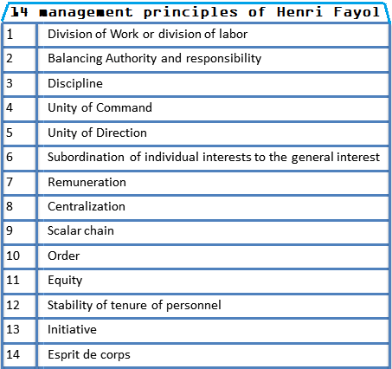
Model of human resource management Maximum utilization of human resources
Human resource utilization is the extent to which available human resources are deployed effectively for the maximum achievement of individual, collective and organizational goals and objectives. • Examples

Slide 14
Notes:
Just for your understanding

Slide 17
The Software Factory
A software factory is a structured collection of related software assets that aids in producing computer software applications or software components according to specific, externally defined end-user requirements through an assembly process.
A software factory applies manufacturing techniques and principles to software development to mimic the benefits of traditional manufacturing.
Software factories are generally involved with outsourced software creation.
Notes:
Mimmic: copy

Slide 18
The Software Factory
Managers can control the process of software development by setting out the three key elements of – Methods – Tools – procedures
Notes:
is that method is a process by which a task is completed; a way of doing something while procedure is a particular method for performing a task.

Slide 19
The Software Factory
Methods refer to the wide range of tasks in building software. These include
– Project planning and estimation – System and software requirement analysis – Design of data structure – Coding, testing and maintenance

Slide 20
The Software Factory
Tools provide automated support for methods.
They may be integrated so that the information created by one tool can be used by another, thus establishing a system for the support of software development.
CASE (Computer-aided software engineering).

Slide 21
The Software Factory
Procedures hold the methods and tools together and control timing by defining a sequence in which methods will be applied

