Slide 1
THE GLOBAL MEDIA MARKETPLACE

Slide 2
Objectives
Convergence of media
Synergies
Global trade in media products
Global news and information network
Global news agenda

Slide 3
Introduction
The deregulation and liberalization of the international communication sector in the 1990s were paralleled in the media industries and, in conjunction with the new communication technologies of satellite and cable, have created a global marketplace for media products.
The convergence of media and technologies

Slide 4
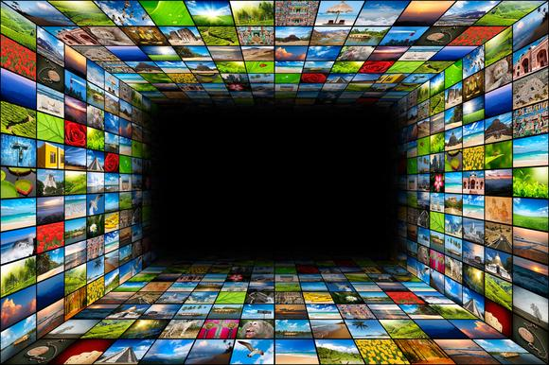
Convergence
Convergence means ‘coming together of two distinct entities or phenomena’.
Before globalization, most media corporations had distinct areas of business:

Slide 5
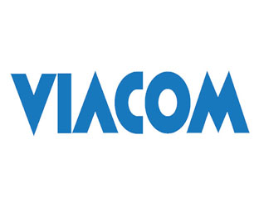
Cartoon films and theme parks
TV syndication and cable outfit
Publishing business
Newspapers
Privatization and new methods of delivering media and communication content:
Satellite
Cable
Internet

Slide 6
Deregulation and relaxation of cross media ownership restrictions
Mergers and acquisition in mid-1980s
Trend of media in the 21st century
Less than 10 corporations based in the US
TV corporations own multiple broadcast and cable networks and production facilities
Convergence of media industry

Slide 7
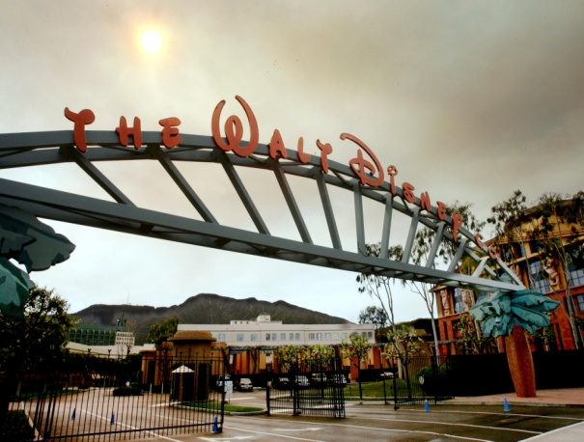
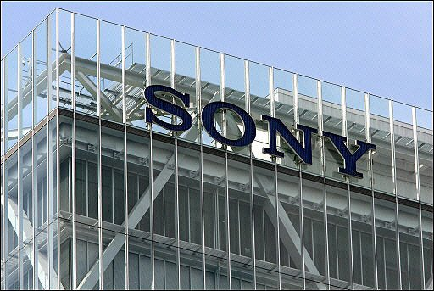
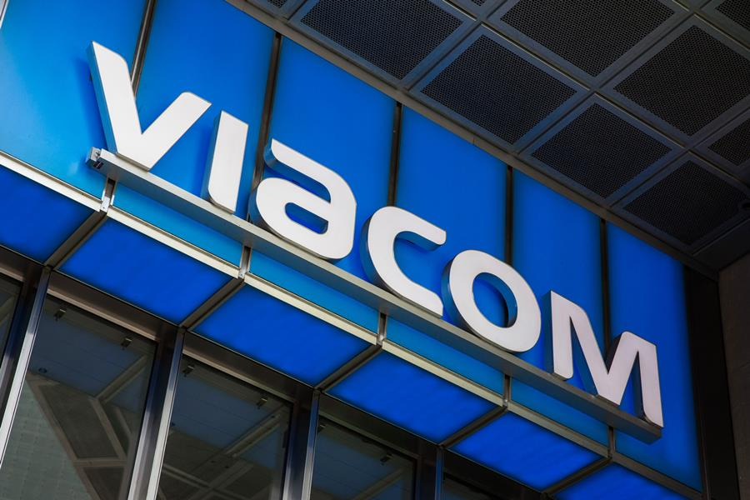
Popular Media
Time Warner
Bertelsmann
Viacom
The Walt Disney Company
Sony

Slide 8
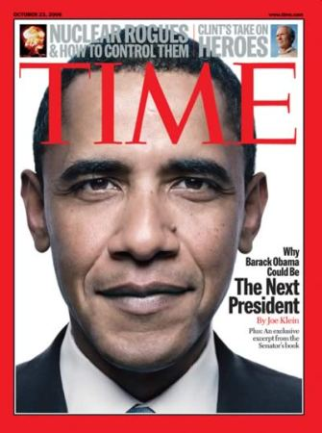
World’s largest entertainment and information company
Television channel/production: Turner Broadcasting, Warner Bros TV
Newspaper and magazine publication: Time Inc.
Book publication: Warner Books
Music: Warner Music Group
Time Warner-EMI merger, 2nd largest music company
Film: Warner Brothers
5700 feature films, 32000 TV programs, 13500 animated titles etc. Best-known film company evolving into global entertainment corporation
Hardware: TBS Superstation
Merger with AOL makes it most powerful media and entertainment corporation.

Slide 9
German media giant-World’s largest books and magazines publisher
Television channel/production: CLT-UFA 22 and RTL 2,4,7
Merger of Bertelsmann UFA with Luxembourg broadcaster CLT
Newspaper and magazine publication: Gruner + Jahr
Book publication: Random House Berlin
One million books a day
Music: Bertelsmann Music Group
Introduced new formats of DVD
Hardware: Sonopress
World’s 2nd largest manufacturer of CDs

Slide 10
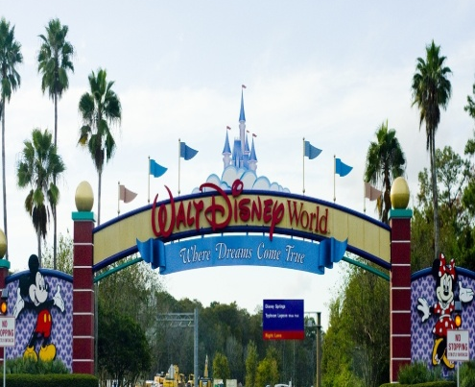
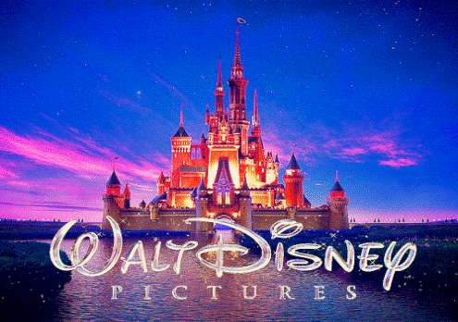
2nd largest media corporation after Time Warner
Television channel/production: Disney Channel, ESPN – Walt Disney TV
Newspaper and magazine publication: Disney, ESPN (+20)
Book publication: Walt Disney Book Publishing, Hyperion, Miramax
Music: Walt Disney Records, Buena Vista Music Group, Hollywood Records
Film: Walt Disney Pictures, Miramax Pictures, Touchstone Pictures
Theme parks/resorts: Walt Disney World, Disney’s Animal Kingdom, Magic Kingdom
14% revenue from merchandising and Disney stores.
earned $400.7 million in North America, and an estimated $873.5 million in other countries, for a worldwide total of $1.274 billion

Slide 11
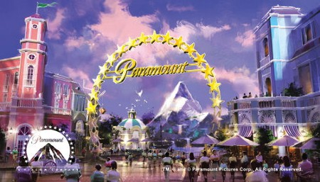
One of the world’s largest entertainment and information company merged with CBS
Television channel/production: CBS, MTV, NICK – Paramount TV
Book publication: Simon and Schuster
Film: Paramount Pictures
Theme parks: Paramount Parks
Viacom: ‘Cradle to grave advertising depot’ Catering to toddlers with children’s channel such as Nickelodeon, to youth, by way of MTV and to the older generation through CBS.

Slide 12
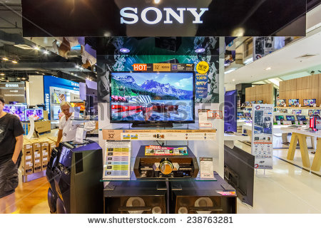
Tokyo based consumer electronics and multimedia entertainment giant, being the global producer of communication hardware
Television channel/production: Sony Entertainment Television (+25) – Columbia Tristar Int. TV, Game Show Network
Music: Sony Music
Film: Sony Pictures Classic, Screen Gems
Hardware: Electronic products
Global dominance in computer game market
Biggest market in Europe - 72% revenue

Slide 13
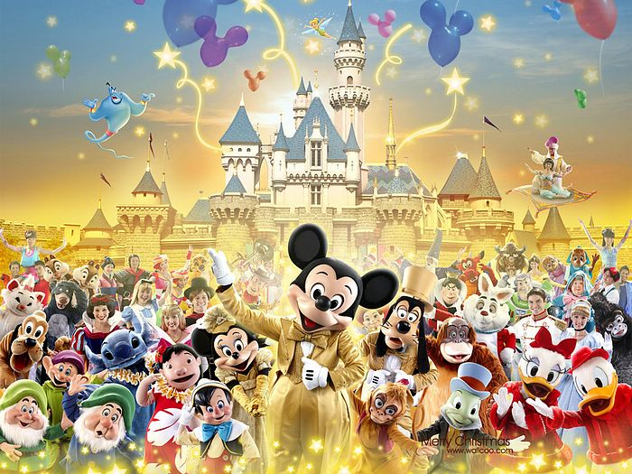
Synergies
Process by which one company subsidiary is used to complement and promote another
Develop, produce and distribute media products
Cross selling and cross promotion
Charging for the rights of characters
Examples:
CNN – TNT Films
MTV – MTV Books
Disney Parks and stores – Disney characters

Slide 14
Global Trade in Media Products
US is the leading exporter of cultural products Its entertainment industry is one of its largest export earners
The main media are:
Television
International Film Industry
International Book Publishing
International Print Media
International Advertising

Slide 15
Television
World’s entertainment output is transmitted by TV
Importance of satellite television
USA, the ‘world provider’ of TV programs
Types:
drama serials
wildlife programs
religious television
Sports
Popular music

Slide 16
ESPN
World leader in televising sports globally
Transmits live sports event
Sponsors and advertisers
Increased commercialization and ‘media-ization’ of sports
Services
ESPN Radio
ESPN Magazine
ESPN Real and Online Shops

Slide 17
European Market
BBC
Europe’s largest exporter of TV programs
BBC World, BBC Entertainment, BBC Animal Zone, BBC Urdu
KirchGrupp
Leading European program exporter (Film and TV libraries)
Bertelsmann’s CLT-UFA
Europe’s biggest broadcasting corporation
18 radio stations in ten countries
RTL in Netherlands, Poland, Britain
Canal France International
Exporter of French programs
Africa, Eastern Europe

Slide 18
International Film Industry
Hollywood Vs. Bollywood
Internationalization defines Hollywood
Distribution networks such as Viacom
Market of Hollywood
Structural links

Slide 19
International Book Publishing
The reach of the publishing giants is global: via networks of local affiliates, their books and journals are sold in virtually every country in the world.
Examples
USA leads world’s book export market such as that of Readers Digest Association
British based Miller Freeman in 49 countries
McGraw-Hill in 32 countries

Slide 20
International Print Media
The US-UK ‘duopoly’ seems to dominate global newspaper and magazine markets
Examples
International Herald Tribune to 186 countries
Newsweek and Time journalism
The Economist for decision makers
The Wall Street Journal for business elites

Slide 21
International Advertising
Advertising supports global expansion of media products
USA, the biggest advertising market
Transnational marketing service for conglomerates
Integrated Marketing Communication

Slide 22
News Agencies
Central role in setting international news agenda
Globalization and commodification of international information
Famous news agencies

Slide 23
Associated Press
World’s Largest news gathering organization
Digital photo network
AP’s services
Reuters
Second major actor
Business of information
Agence France Presse
Third global news agency
Strong coverage of news through MENA Network

Slide 24
Financial News Services
Televised financial news markets
Reuters
International electronic data company
64% of revenue from financial information products
Bloomberg
Real time financial information network
Bloomberg services

Slide 25
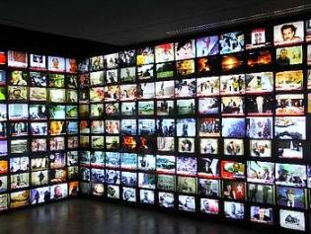
International Television News
Control global flow of audio-video news material
CNN
Global news network shaping international communication
World’s news leader
‘Blanket the globe’ through satellite technology
Covering live international news events
Integrating the media systems of former socialist countries

Slide 26
Monitor news events and disseminate timely information
Markets
‘Influentials’: government ministers, tops bureaucrats etc
‘CNNization’ of television news has become a model for expanding ‘American news values around the world’
AOL-Time Warner merger makes CNN the part of world’s biggest media and entertainment conglomerate
CNN Vs BBC, Sky News, Star News, Fox News

Slide 27
Global Radio
Voice of America
World Radio Network
Radio Moscow
Deutsche Welle
Radio France Internationale
Radio Bejing

Slide 28
Setting the Global Agenda
Who dominates the world’s entertainment and information network?
UNITED STATES OF AMERICA
News Agency AP
News Channel CNN
Radio VOA
Cinema Hollywood

Slide 29
Conclusion
Western control and its ability to set the agenda of international communication
Market-led global media system benefits TNCs
Media may become the mouthpiece of global corporations and their supporters in government

Slide 30
Thank you for your cooperation!

