Slide 1
Mathematical methods of physics-1
COURSE CODE: PHY 301

Slide 2
Complex variable function

Slide 3
Analytical Functions
Regular/ Holomorphic/ Monogenic Function

Slide 4
Course content
Some standard functions such as:

Slide 5
Entire Function

Slide 6
Analytical Functions

Slide 7
Analytical Functions

Slide 8
Analytical Functions

Slide 9
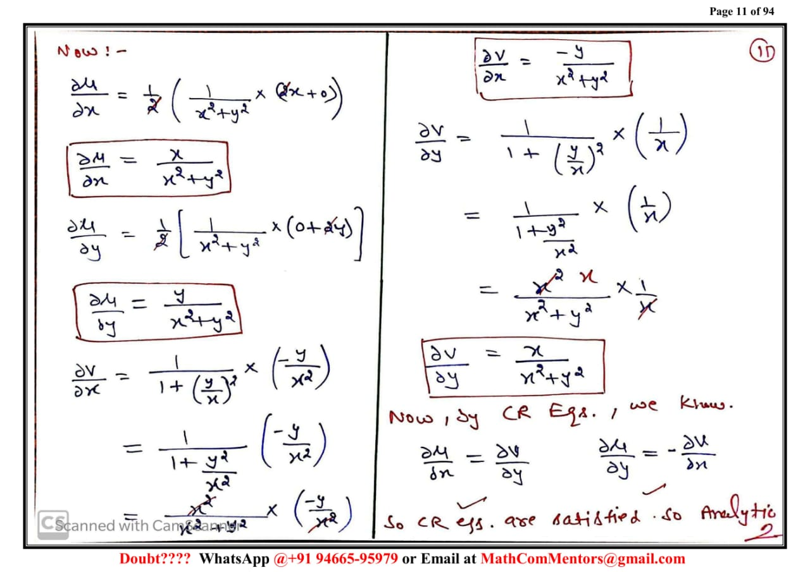
Analytical Functions

