Slide 2
A Preliminary Study Of Medicinal Plants With Anti-hypertensive Potential
Presented By Muhammad Fakher Abbas

Slide 3
ABSTRACT
Hypertension is most common diseases affecting humans throughout the world.
The aim of study to review the preliminary data of medicinal plant which possess anti- hypertensive potential, from available literature.
Medicinal plants offer potentials benefitTraditional Mexican medicine is one of the most important health systems in the world, among Chinese and Indian systems. Furthermore, medicinal plants play an important role in these systems. Investigation of medicinal plants allowed the isolation of several active compounds that have been used as leads for the developing of several therapeutic agents. In this context, from our continuous effort for the investigation of Mexican medicinal plants from different point of views,

Slide 4
ABSTRACT
in this opportunity we are reporting a preliminary ethnopharmacologic, chemical and pharmacological survey of 186 plant species used in Mexico for the treatment of hypertension. From these, it was registered a total of 163 genera and 76 families and is important to mention that the most abundant were Asteraceae (17), Lamiaceae (12), Solanaceae (11), Fabaceae (10) and Rutaceae (8). Moreover, 85 were wild type. To the best of our knowledge, 47% of the total was studied at least once from phytochemical point of view and 74% were subjected to investigation of in vitro and in vivo pharmacological assays. These last investigations were carried out in order to validate their medicinal uses as antihypertensive agents in the Mexican traditional medicine. Keywords: antihypertensive, ethnomedicinal knowledge, Mexican medicinal plants, vasorelaxant effect. s as compared to allopathic’.

Slide 5
INTRODUCTION
Hypertension is defined as arterial blood pressure that exceeds 140/90mm Hg at several determinations.
This is an arbitrary definition because a diastolic pressure of even 85 mm Hg may be associated with increased cardiovascular morbidity and mortality.
Hypertension is important modifiable risk factor for coronary heart disease, stroke, congestive heart failure, end-stage renal disease, and peripheral vascular disease.

Slide 6
INTRODUCTION…
Health care professionals not only identify and treat patients with hypertension
but promote a healthy lifestyle and preventive strategies to decrease the prevalence of hypertension in the general population.

Slide 9
What guidelines are used to categorize HTN?
The Joint Committee on Prevention, Evaluation, and Treatment of High Blood Pressure (JNC 7) guidelines provide the most current guidelines
http://www.nhlbi.nih.gov/hbp/detect/categ.htm

Slide 13
Prevalence
65 million Americans have hypertension (HTN)
Of those diagnosed with HTN < 50% have their blood pressure under control
Lack of treatment leads to serious complications

Slide 15
PATHOPHYSIOLOGY
Primary Hypertension 90% –Prevalence about 60% (age 60+) –Prevalence about 15-25% (age 25+) –Prevalence mean 35%
Secondary Hypertension 10% –but may normalize by special treatment (surgery, hormone treatment)

Slide 16
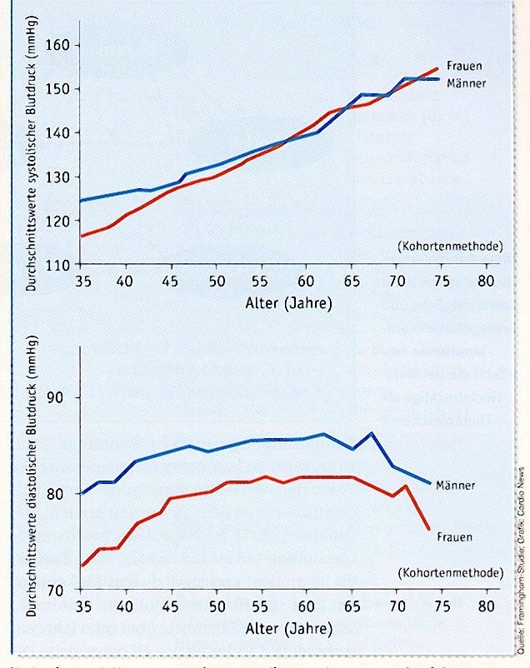
Mean SBP
Female
Male
Mean DBP
age
Male
Female
Age

Slide 17
MORPHOLOGICAL FEATURES OF HYPERTENTION
Large Blood Vessels – Macro-angiopathy.
( Atherosclerosis and complications)
Small Blood Vessels – Micro-angiopathy.
(Hyper-plastic arteriosclerosis)
Heart
(LVH, Hypertensive cardiomyopathy-IHD, MI

Slide 18
MORPHOLOGICAL FEATURES OF HYPERTENTION
Large Blood Vessels – Macro-angiopathy.
( Atherosclerosis and complications)
Small Blood Vessels – Micro-angiopathy.
(Hyper-plastic arteriosclerosis)
Heart
(LVH, Hypertensive cardiomyopathy-IHD, MI

Slide 19
MORPHOLOGICAL FEATURES OF HYPERTENTION
Kidney
Benign nephrosclerosis
Eyes
(Hypertensive retinopathy)
Brain
(Hemorrhage, infarction)
(Splinter hemorrhages & Lacunar infarcts)

Slide 20
CLINICAL FEATURES
Dangerous aspects of hypertension is that you may not know that you have it.
In fact, nearly one-third of people who have high blood pressure don't know it. The only way to know if your blood pressure is high is through regular check ups. This is important if you have a close relative who has high blood pressure.
If your blood pressure is extremely high, there may be certain symptoms

Slide 21
Clinical Symptoms
Severe headache
Fatigue or confusion
Vision problems
Chest pain
Difficulty breathing
Irregular heartbeat
Blood in the urine
Pounding in your chest, neck, or ears

Slide 22
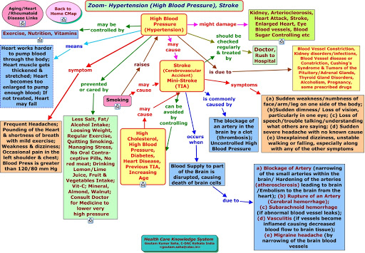

Slide 23
DRUG THERAPY

Slide 24
NEED FOR MEDICINAL PLANTS
Drug prescribed to treat the condition largely pose various side effects and illness which results in various side effects and reoccurrence of condition.
Drugs are expensive and difficult for many patients in developing countries to afford them.
Therefore it is continued search for less expensive and effective alternatives to conventional drugs for hypertension therapy.
Natural plants products constitute a vital and promising resource for identifying new therapeutic agent for hypertension.

Slide 25
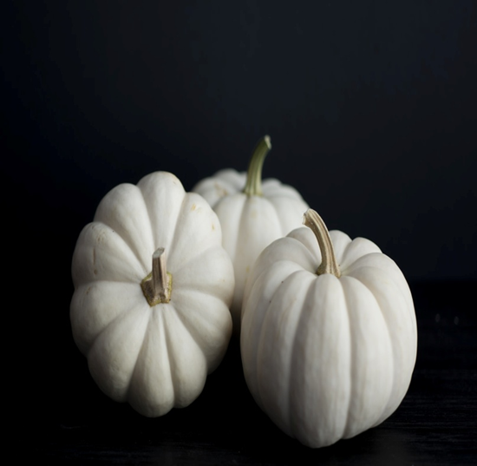
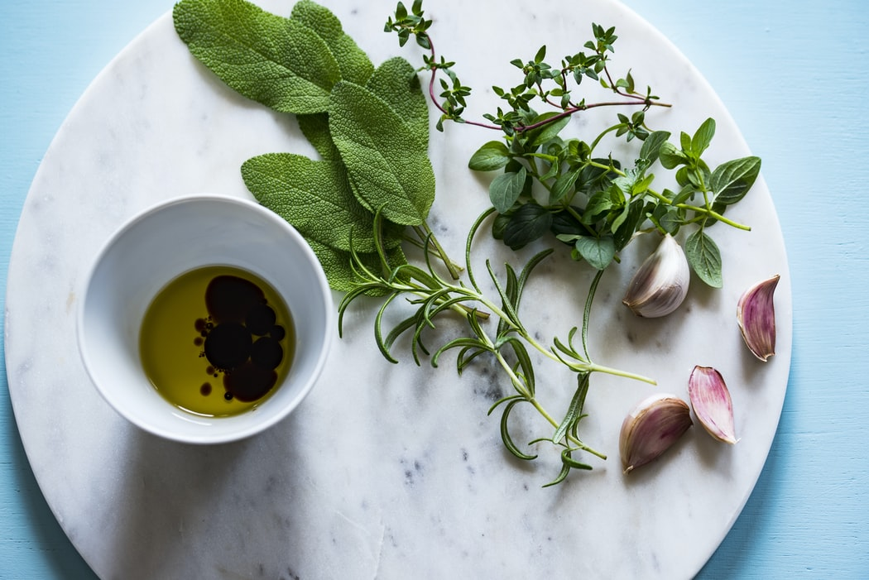
MEDICINAL PLANTS
Natural products from herbal remedy.
Medicinal plants, functional foods, and their constituents used for treatment of various disease including cancer from ancient time to recent days.
Increasing emphasis on traditional medicine many herbs and medicinal plants.

Slide 26
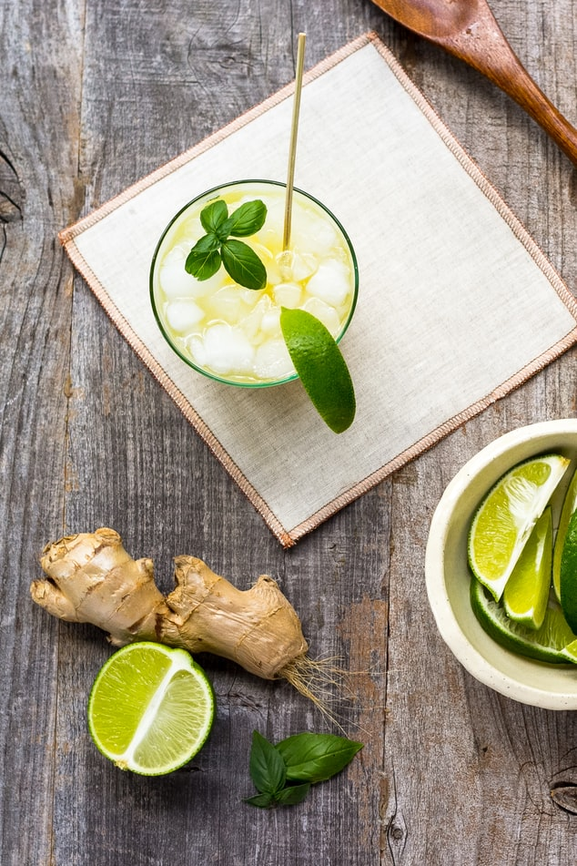
MEDICINAL PLANT
Several reasons to use herbal medicines
First herbal treatment provide other mechanism of action encompassing in many cases a single drug to treat single disease.
Second the utilization of unique traditional knowledge of herbal medicine has great positional to generate biocompatible, cost effective solutions and will hasten discovery of new medicine.

Slide 27
MEDICINAL PLANT
Generally safe when used according to traditional methods, some are inherently toxic.
Effective techniques that allow researchers to acquire more insight in to these components are lacking.
More research is required in this field so safety and efficacy of medicinal plants can be established and the use of natural medicines be promoted adequately

Slide 28
RESULTS & FINDINGS

Slide 29
RESULTS & FINDINGS

Slide 30
RESULTS & FINDINGS

Slide 31
RESULTS & FINDINGS

Slide 32
RESULTS & FINDINGS

Slide 33
RESULTS & FINDINGS

Slide 34
RESULTS & FINDINGS

Slide 35
RESULTS & FINDINGS

Slide 36
RESULTS & FINDINGS

Slide 37
CONCLUSION
Medicinal products with antihypertensive activity that has been recently researched.
It would aid the clinical researchers to start exploring the potential of natural products and discover new medicines or treatment with better safety and efficacy.
It is need of time to develop such products that would lead to improved patient health.
Outcomes with a decrease in mortality, possible complications and adverse effects that occurred due to medicines.

Slide 38
REFRENCES
Gurib-Fakim. Medicinal Plants: Traditions of yesterday and drugs of tomorrow. Mol Aspects Med 27:1-93 (2006).
S. Sardana, A.K. Madan. Topological models for prediction of antihypertensive activity of substituted benzylimidazoles. Mol Aspects Med 683: 41-9 (2003).
B.B. Hoffman. Therapy of hypertension. In: Goodman and Gilman’s. The Pharmacological Basis of Therapeutics. 11th ed.; 845-97 (2005).
INEGI/Secretaría de Salud, 2008. Dirección general de información en salud. CONAPO, Proyecciones de la población de México 2000–2050.
Secretaria de Salud, Dirección de Medicina Tradicional y Desarrollo Intercultural (2004); Fortalecimiento y desarrollo de la medicina tradicional mexicana y su relación intercultural con la medicina institucional. <http://www.salud.gob.mx/> [Acceded: September 10th 2007].

Slide 39
6. Aguilar, J.R. Camacho, S. Chino, P. Jacquez, M.E. López. Plantas medicinales del Herbario IMSS. Cuadros básicos por aparatos y sistemas del cuerpo humano. Primera edición 1994. Primera reimpresión 1996. IMSS. México, D. F. (1996).
7. Monroy-Ortiz, P. Castillo-España. Plantas Medicinales Utilizadas en el Estado de Morelos. Cuernavaca, Morelos, México, Centro de Investigaciones Biológicas, Universidad Autónoma del Estado de Morelos. 2nd Edition (2007).
8. L.G. Cabrera. Plantas curativas de México. Propiedades medicinales de las más conocidas plantas medicinales de México; su aplicación correcta y eficaz. Ed. Cicerón. 5th edition. México, D. F. (1958).
9. V.A. Argueta, A.L.M. Cano, M.E. Rodarte. Atlas de las Plantas de la Medicina Tradicional Mexicana. Tomo I, Tomo II y Tomo III. Ed. Instituto Nacional Indigenista. México, D.F. (1994).

Slide 40
10. O.F. Lara, A.C. Márquez. Plantas medicinales de México. Composición, usos y actividad biológica. 1th Edition, UNAM. México, D.F. (1996).
11. A.L.M. Cano. Flora Medicinal de Veracruz. I. Inventario Etnobotánico. 1th Edition. Universidad Veracruzana, México. (1997).
12. S.M.L. Arreguín, L.G. Cabrera, N.R. Fernández, L.C. Orozco, C.B. Rodríguez, B.M. Yépez. Introducción a la Flora del Estado de Querétaro. Ed. CONCYTEQ. (1997).
13. A.C. Márquez, O.F. Lara, R.B. Esquivel, E.R. Mata. Plantas medicinales de México II. Composición, usos y actividad biológica. Primera edición, UNAM. (1999).
14. C.V. Martínez. El Mundo de las plantas. www.botanical-online.com [Acceded: November 21th, 2005].
15. R.S. Del Amo. Plantas Medicinales del Estado de Veracruz. Catálogo Plantas Medicinales de Veracruz. Ed. Instituto Nacional de Investigaciones sobre Recursos Bióticos. Xalapa, Veracruz. (1979).

Slide 41
16.R.M. Mendieta, R.S. Del Amo. Plantas Medicinales del Estado de Yucatán. 1th Edition. Ed. Continental. México. (1981).
17.E.R. López, G.A. Hinojosa. Catálogo de plantas medicinales sonorenses. Jardín Botánico. Universidad de Sonora. (1988).
18.N.J.C. Soto, S.M.Sousa. Plantas Medicinales de la Cuenca del Río Balsas. Cuadernos 25. Universidad Nacional Autónoma de México. Instituto de Biología. México, D.F. (1995).
19.F.M.M. González. Plantas Medicinales del Noroeste de México. Monterrey, N.L. México. Ed. El sol. (1998).
20.Aguilar, J.R. Camacho, S. Chino, P. Jacquez, M.E. López. Plantas medicinales del Herbario IMSS. Cuadros básicos por aparatos y sistemas del cuerpo humano. IMSS. México, D. F. (1996).

Slide 42
21.A.Y. Betancourt, D.M.A. Gutierrez, A.I. Betancourt. Proyecto Mercados Verdes Herbolarios; FANCA. Red Mexicana de Plantas Medicinales (REDPLAM). Ecología y Desarrollo de Tlaxcala y Puebla A.C. Jardín Botánico Universitario. Secretaría de Investigación Científica-Universidad Autónoma de Tlaxcala. Tlaxcala, México. (2000).
22.P. Castillo, R. Monroy, G. Soria. Rescate del conocimiento tradicional de la flora de Felipe Neri, municipio de Tlalnepantla, Morelos. In, Resúmenes del X Congreso Mexicano de Botánica, p. 75, Sociedad Botánica de México. (1987).
23.S.L.M. Cervantes. Plantas medicinales del distrito de Ocotlán en la región de los valles centrales de Oaxaca. Facultad de Ciencias, Universidad Nacional Autónoma de México. México, D.F. (1979).
24.V.M.E. López. Contribución etnobotánica en plantas medicinales utilizadas por 2 grupos étnicos de Mecapalapa, Mpio. de Pantepec, Puebla. Tesis de Licenciatura. Escuela Nacional de Estudios Profesionales “Iztacala”, Universidad Nacional Autónoma de México. (1988).
25.J.M.L. Sánchez. Distribución de 10 plantas medicinales mexicanas. Su medio ecológico y cultural. Tesis. Facultad de Ciencias. Universidad Nacional Autónoma de México. (1989).

