Slide 1
PRESSURE REDISTRIBUTION: SEATING, POSITIONING AND SUPPORT SURFACES

Slide 2
INTRODUCTION
Multiple intervention strategies are needed to prevent and treat pressure ulcers.
Managing loads on the skin and associated soft tissue is one of these strategies.
A comprehensive care plan should include pressure redistribution strategies for individuals both while in bed and when seated.
Properly chosen support surfaces, adequate periodic pressure redistribution, protection of especially vulnerable bony prominences such as the heels, and consideration of special patient needs are all essential components of the care plan.
A support surface is a specialized device for pressure redistribution designed for management of tissue loads, microclimate, and other therapeutic functions.
Types of surfaces include mattresses, integrated bed systems
Achieving a good match between the patient’s needs and the performance capabilities of the support surface has a profound, positive impact on a patient’s health and well-being; conversely, a poor match has a negative impact.

Slide 3
SUPPORT SURFACE PERFORMANCE PARAMETERS
Nine parameters must be considered when evaluating the characteristics of a support surface for the patient with a wound:
Redistribution of pressure
Moisture control
Temperature control
Friction control (between patient and product)
Infection control
Flammability
Life expectancy
Fail safety
Product reputation

Slide 4
SOFT-TISSUE BIOMECHANICS
Human soft tissue consists of a variety of macrostructures, including skin, fat, muscle, vessels, nerves, ligaments, and tendons.
Connective tissues-fibroblast-extracellular matric(macromolecules)-two main classes of macromolecules
Polysaccharides(Glycosaminoglycans and proteoglycans form a highly hydrated, gel-like “ground substance”)
Fibrous proteins (for example, collagen
and elastin)
providing lubrication and shock-absorbing qualities.
resists compressive forces on the matrix
provide tensile strength and resilience.

Slide 5
TISSUE MECHANICAL PROPERTIES
SOFT TISSUE is an anisotropic, incompressible biosolid, biofluid mixture.
Because soft tissue is largely incompressible, it tends to move slowly from areas of greater pressure to areas of lesser pressure.
This slow movement of ground substance and interstitial fluid is responsible for the time-dependent (viscoelastic) behavior of the soft tissue manifested as four phenomena:
stress relaxation
creep
hysteresis
pseudoelasticity (preconditioning)

Slide 6
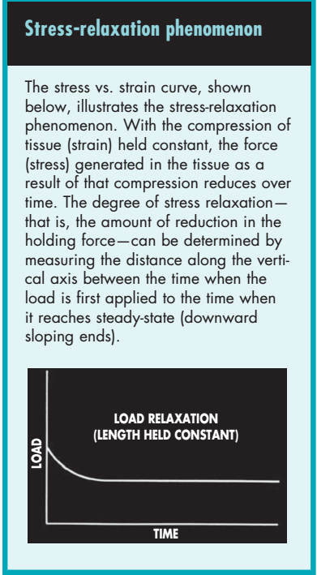
TISSUE MECHANICAL PROPERTIES
Stress is represented as the deforming force on the y axis and the tissue strain (deformation) is plotted on the x axis. When soft tissue is suddenly deformed (strained) and the strain is thereafter kept constant, the corresponding stress induced in the tissue decreases over time. This phenomenon is known as stress relaxation.

Slide 7
TISSUE MECHANICAL PROPERTIES
Creep describes the progressive tissue deformation that occurs over time when stress remains Constant.
During cyclic loading such as that produced by a dynamic, or alternating-pressure mattress, the stress-strain relationship demonstrated during the loading phase is different from that of the recovery, or unloaded, portion of the cycle. This effect is known as hysteresis.
Pseudoelasticity is the term associated with an increase in the repeatability and predictability of a tissue’s stress-strain relationship following a defined period of repetitive cyclic loading.

Slide 8
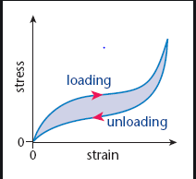
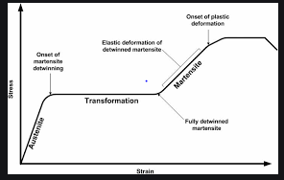

Slide 9
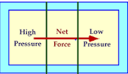
TISSUE LOADING AND PRESSURE ULCER FORMATION
Body weight resting on bony prominences, such as the scapula, sacrum, greater trochanters, ischial tuberosities, and heels, can cause significant concentrations of pressure at the skin’s surface and in the underlying soft tissue
The pressure peaks and the pressure gradients surrounding these peaks can put the soft tissue at risk for breakdown.
Damaging effects of pressure are related to both its magnitude and duration.

Slide 10
RISK FACTORS
At the cellular level, the three mechanisms most commonly cited describing how external forces result in tissue damage are
(1) ischemia resulting from tissue deformation,
(2) reperfusion injury following pressure relief
(3) mechanical damage to cells caused by excessive deformation
IN ADDITION
Clinical implications of aging
all of the well-known extrinsic pressure ulcer risk factors (pressure, shear, friction, temperature, and moisture) tend to influence the tissue’s ability to withstand loading
LIMITATIONS OF INTERFACE PRESSURE AS A PREDICTOR OF TISSUE DAMAGE
Tissue interface pressure is the force per unit area that acts perpendicularly between the patient’s body and the support surface

Slide 11
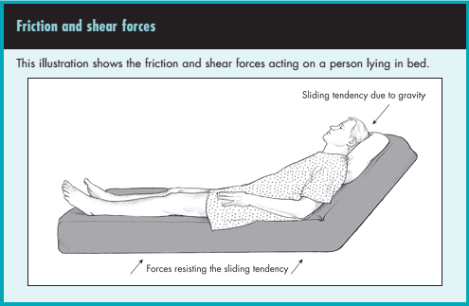
SUPPORT SURFACE CHARACTERISTICS
Pressure redistribution
Shear and friction reduction
Temperature control
Moisture control

Slide 12
MATERIALS AND COMPONENTS USED IN SUPPORT SURFACE SYSTEMS
Foam
Foam may be elastic or viscoelastic and may be comprised of open or closed cells.
Open-cell foam is defined as a permeable structure in which there’s no barrier between cells, and gases or liquids can pass through the foam.
Closed-cell foam is defined as a non-permeable structure in which there’s a barrier between cells, preventing gases or liquids from passing through the foam.
Fluid-filled bladders and compartments
Fluid-filled products may consist of small or large chambers filled with air, water, or other viscous fluid materials, such as silicon elastomer, silicon, or polyvinyl.
The “fluid” flows from chamber to chamber or within a single chamber in response to movement and requires no supplemental power. The term “air-flotation” is sometimes used to describe interconnected multi-chamber surfaces.

Slide 13
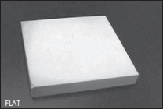
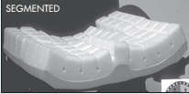
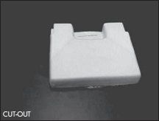
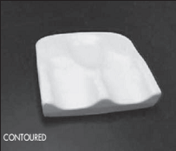

Slide 14
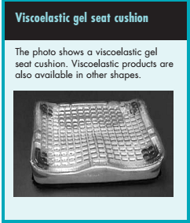

Slide 16
FEATURES OF SUPPORT SURFACES
Air-fluidized
Low-air-loss
Alternating pressure
Lateral rotation

Slide 17
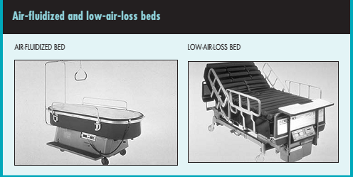
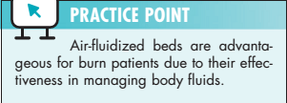

Slide 18
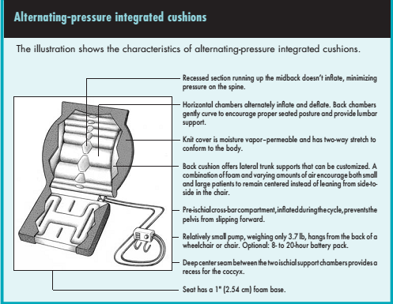

Slide 19
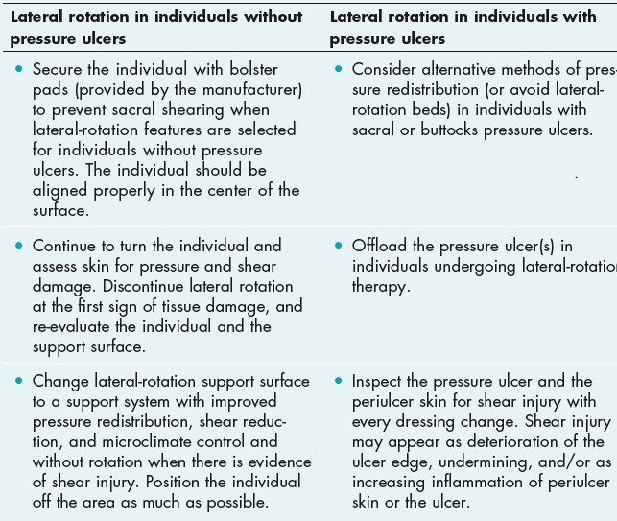

Slide 20
What are the patient’s specific load management needs?
Proper selection of mattress and wheel chair cushion
Prevention strategies
Product effectiveness
Treatment effectiveness
Proper positioning
Heel protection(Clinical recommendations for pressure reducing heel protection include:
• reducing pressure, friction, and shear
• separating and protecting the ankles
• suspending the heels
• permitting repositioning without increasing pressure in other areas
• preventing footdrop
• enhancing patient comfort
• reassessing at least daily)

Slide 21
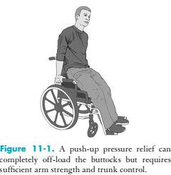
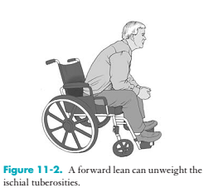
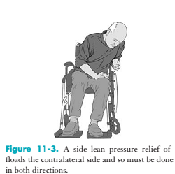

Slide 22
POSITIONING
The following positions are commonly used to reposition patients on horizontal surfaces:
• a prone position with rotation of 30 degrees to the right or left
• a supine position with 30 degrees of rotation to the right or left
• a supine position with slight right or left sacral relief
• a supine position with the head of the bed elevated 30 degrees or less and the feet blocked
• a supine position with the head of the bed elevated 30 degrees or less and the knees flexed with the bed.

Slide 23
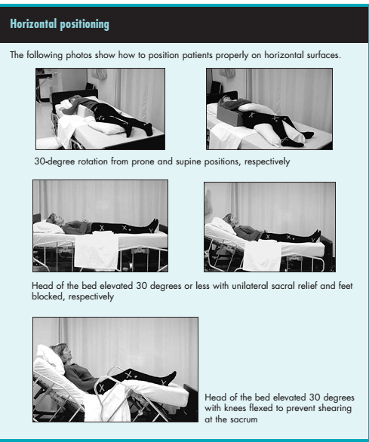

Slide 24
WHAT’S PRACTICAL?
Consider these patient factors before purchasing support surfaces:
• Ease of use
• Operational costs of the equipment
• Service contracts and backup service
• Alarm systems
• Daily maintenance
• Operating mechanisms and space requirements

