Slide 1
chapter 8 (part 1) SOCIAL INFLUENCE
Prepared by
Ms. Shahida Perveen
Department of Psychology
University of Sargodha

Slide 4
Conformity
Change attitude and behavior in order to adhere to social norms
Types of norms: (norms: rules for behavior)
Descriptive norms: what most people do
Injunctive norms: what should be done
Normative influence:
Conformity based on a person’s desire to fulfill other’s expectations, often to gain acceptance.
Example: going along with the crowd to avoid rejection
Informational influence:
Conformity occurring when people accept evidence about reality provided by other people
You conform to gain information

Slide 5
Sherif’s experiment
Muzafer Sherif was interested in knowing how many people would change their opinions to bring them in line with the opinion of a group.
In his experiment (1936), participants were placed in a dark room and asked to stare at a small dot of light 15 feet away.
They were then asked to estimate the amount it moved; however, there was no real movement.
Perceived motion was caused by the visual illusion known as the autokinetic effect.
On the first day, each person perceived different amounts of movement, as they participated in the experiment individually.
From the second through the fourth day of the study, estimates were agreed upon by the group.
Because there was no actual movement, the number that the group agreed on was a direct result of group conformity.
Sherif suggested this was a reflection of how social norms develop in larger society.

Slide 6
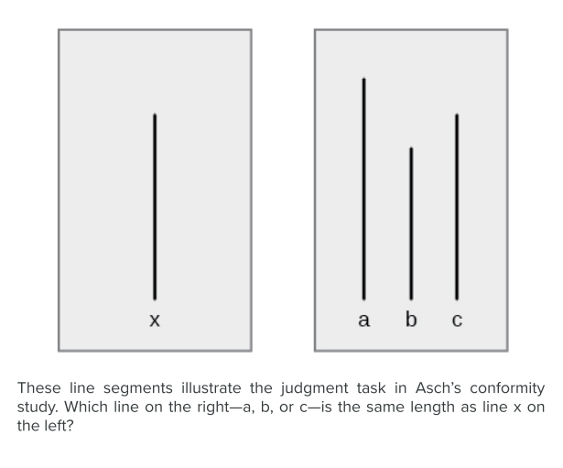
Asch’s experiment on conformity
Solomon Asch conducted several experiments in the 1950s to determine how people are affected by the thoughts and behaviors of other people.
In one study, a group of participants was shown a series of printed line segments of different lengths: a, b, and c.
Participants were then shown a fourth line segment: x.
They were asked to identify which line segment from the first group (a, b, or c) most closely resembled the fourth line segment in length.

Slide 7
Asch’s experiment cont..
Each group of participants had only one true, naïve subject.
The remaining members of the group were confederates of the researcher.
A confederate is a person who is aware of the experiment and works for the researcher.
Confederates are used to manipulate social situations as part of the research design, and the true, naïve participants believe that confederates are, like them, uninformed participants in the experiment.
In Asch’s study, the confederates identified a line segment that was obviously shorter than the target line—a wrong answer.
The naïve participant then had to identify aloud the line segment that best matched the target line segment.

Slide 8
Asch’s experiment cont..
How often do you think the true participant aligned with the confederates’ response? That is, how often do you think the group influenced the participant, and the participant gave the wrong answer?
Asch (1955) found that 76% of participants conformed to group pressure at least once by indicating the incorrect line.
Conformity is the change in a person’s behavior to go along with the group, even if he does not agree with the group.

Slide 9
Factors affecting conformity
Group size:
3 to 5 people elicit more conformity than 1 or 2
Unanimity:
individuals are more likely to conform to group decisions when the rest of the group’s response is unanimous.
Cohesion:
The more cohesive a group is, the more power it gains from its members
Status:
Higher status people tend to have more impact
Public response:
People conform more when they must respond in front of others
No prior commitment:
After giving a public answer, if asked to reconsider most people don’t.

Slide 10
Factors affecting conformity
Culture:
cultures that are collectivist exhibit a higher degree of conformity than individualistic cultures.
Gender:
women are more likely to conform than men in situations involving surveillance, but less likely when there is no surveillance. Societal norms establish gender differences that affect the ways in which men and women conform to social influence.
Age:
younger individuals are more likely to conform than older individuals, perhaps due to lack of experience and status.
Importance of stimuli:
individuals may conform less frequently when the task is considered important. This was suggested by a study where participants were told that their responses would be used in the design of aircraft safety signals, and conformity decreased.

Slide 11
End of part 1

