Slide 1
Plant variety Registration & seed certification
Variety procedure with seed development.

Slide 2
Your best quote that reflects your approach… “It’s one small step for man, one giant leap for mankind.”

Slide 3
Plant Variety Registration;
Requirements
1.Application for variety registration on form A.
2.Seed sample of the candidate variety.
3.Morphology description of the candidate of the candidate VARIETY .
4.Undertaking applicant not to use gene terminator technology in case of GMCs.
5.Approval for commercialization by the national bio-safety committee(NBC) in case of GMCs.
6.Data regarding agronomic value .

Slide 4
Criteria ;
To be listed ,varieties must meet standards on;
Distinctness
Uniformity
Stability
Value for cultivation and use –for agricultural crops
This value is based on ;
Yield
Response to the environment
Quality characteristics
Resistance to harmful organism

Slide 6
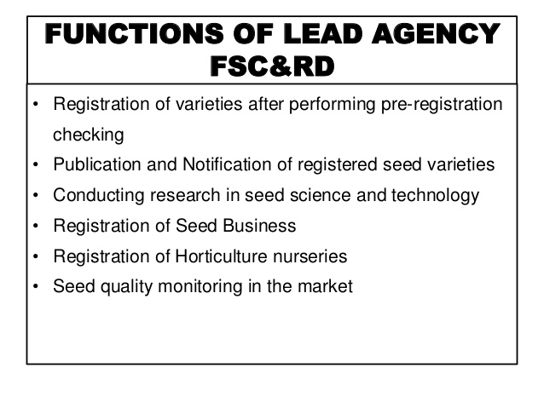

Slide 14
Thanks

