Slide 1
What Is IT Security?

Slide 2
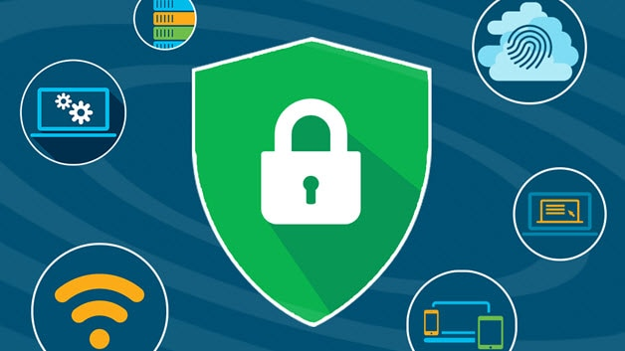
What Is IT Security?
IT security is a set of cybersecurity strategies that prevents unauthorized access to organizational assets such as computers, networks, and data. It maintains the integrity and confidentiality of sensitive information, blocking the access of sophisticated hackers.
IT security protects the integrity of information technologies like computer systems, networks, and data from attack, damage, or unauthorized access. A business trying to compete in a world of digital transformation needs to understand how to adopt security solutions that begin with design. This is what it means to "shift security left"—to make security a part of the infrastructure and product lifecycle as early as possible. This helps security be both proactive and reactive.
Continuous security is fed by a routine system of feedback and adaptation, often handled through the use of automatic checkpoints. Automation ensures fast and effective feedback that doesn’t slow the product lifecycle down. Integrating security in this way also means that updates and responses can be implemented quickly and holistically as the security landscape changes.

Slide 3
What are the threats to IT security?
Threats to IT security can come in different forms. A common threat is malware, or malicious software, which may come in different variations to infect network devices, including:
Ransom ware
Spyware
Viruses
These threats make it even more important to have reliable security practices in place.
How do I benefit from IT security?
IT security prevents malicious threats and potential security breaches that can have a huge impact on your organization. When you enter your internal company network, IT security helps ensure only authorized users can access and make changes to sensitive information that resides there. IT security works to ensure the confidentiality of your organization’s data.

Slide 4
What is the need for IT security?
As hackers get smarter, the need to protect your digital assets and network devices is even greater. While providing IT security can be expensive, a significant breach costs an organization far more. Large breaches can jeopardize the health of a small business. During or after an incident, IT security teams can follow an incident response plan as a risk management tool to gain control of the situation.
Traditionally IT security was focused on fortifying, maintaining, and policing the datacenter perimeter—but today that perimeter is dissolving. The way we develop, deploy, integrate, and manage IT is dramatically changing. Public and hybrid clouds are redistributing responsibility for regulatory compliance and security across multiple vendors. The adoption of containers at scale requires new methods of analyzing, securing, and updating the delivery of applications. Mobile apps are spread across a multitude of devices, and more and more infrastructure is moving from hardware to software. The traditional ways of managing security aren’t keeping up. Digital transformation demands a change in security programs—security must be continuous, integrated, and flexible in a digital world.
For some businesses, doing security right means hiring a Business Information Security Officer. BISOs are embedded in the business and involved in the product lifecycle from design to delivery and adoption. They report to the Chief Information Security Officer (CISO) to make sure that security concerns are thoughtfully managed and integrated at every stage, balancing security needs with risk to the business to ensure fast delivery that functions as it should.

Slide 5
Red Hat and IT security:
We want you to have confidence as you adopt a continuous security strategy. We do that by making open source ready for the enterprise. Our goal is to help your business remain competitive, flexible, and adaptable while maintaining security and regulatory compliance.
Red Hat's unique subscription model gives customers access to a dedicated team of experts who support our technology 24x7. Here are just a few of the things we can offer you as part of your open source security solution
What is the difference between IT security and information security (InfoSec)?
Although IT security and information security sound similar, they do refer to different types of security. Information security refers to the processes and tools designed to protect sensitive business information from invasion, whereas IT security refers to securing digital data, through computer network security.

Slide 6
Types of IT security
Network security:
Network security is used to prevent unauthorized or malicious users from getting inside your network. This ensures that usability, reliability, and integrity are uncompromised. This type of security is necessary to prevent a hacker from accessing data inside the network. It also prevents them from negatively affecting your users’ ability to access or use the network.
Network security has become increasingly challenging as businesses increase the number of endpoints and migrate services to public cloud.
Internet security:
Internet security involves the protection of information that is sent and received in browsers, as well as network security involving web-based applications. These protections are designed to monitor incoming internet traffic for malware as well as unwanted traffic. This protection may come in the form of firewalls, antimalware, and antispyware.

Slide 7
Endpoint security:
Endpoint security provides protection at the device level. Devices that may be secured by endpoint security include cell phones, tablets, laptops, and desktop computers. Endpoint security will prevent your devices from accessing malicious networks that may be a threat to your organization. Advance malware protection and device management software are examples of endpoint security.
Cloud security:
Applications, data, and identities are moving to the cloud, meaning users are connecting directly to the Internet and are not protected by the traditional security stack. Cloud security can help secure the usage of software-as-a-service (SaaS) applications and the public cloud. A cloud-access security broker (CASB), secure Internet gateway (SIG), and cloud-based unified threat management (UTM) can be used for cloud security.

Slide 8
Application security:
With application security, applications are specifically coded at the time of their creation to be as secure as possible, to help ensure they are not vulnerable to attacks. This added layer of security involves evaluating the code of an app and identifying the vulnerabilities that may exist within the software.

