Slide 1
Propagation

Slide 2
Propagation
Production of plants
Increase in number of the species by reproduction.

Slide 3
Propagation includes
Whole field of seed production
Growing of seedling plants
Production of bulb & bulb like structures
Growing of plants on their own roots
Layering
Cutting
Budding
Grafting

Slide 4
Types of propagation
Sexual propagation
A-sexual propagation

Slide 5
Sexual propagation
Reproduction through seed (union of male and female gametes) is called sexual propagation
Polyembryony
Some seeds produce more then one seedling
1. Zygotic
2. Nucellar ( produce by nucellus cells)

Slide 6
Merits of sexual propagation
Hardy seedling
Bear heavy crop
Long lived
Better root system
Easier to propagate
Some time chances of found superior characters
Most of seedling free from virus diseases
Can tolerate biotic and a-biotic stress

Slide 7
Drawbacks of sexual propagation
Cross pollinated seeds do not reproduce characters of parents.
Fruit tree seedling take a long time to bearing
Tendency to grow tall ( increase maintenance and harvesting cost)
Not uniform in growth, quality of fruit and yield characters.
Plants will not true to type
Transmission of seed-born diseases

Slide 8
Purpose of sexual propagation
Establishment of seed garden
Evolution of promising new varieties ( controlled cross planation)
Crop production
Vegetables
Flowers
Some fruits (coconut, Falsa, Papay)
Raising rootstock

Slide 9
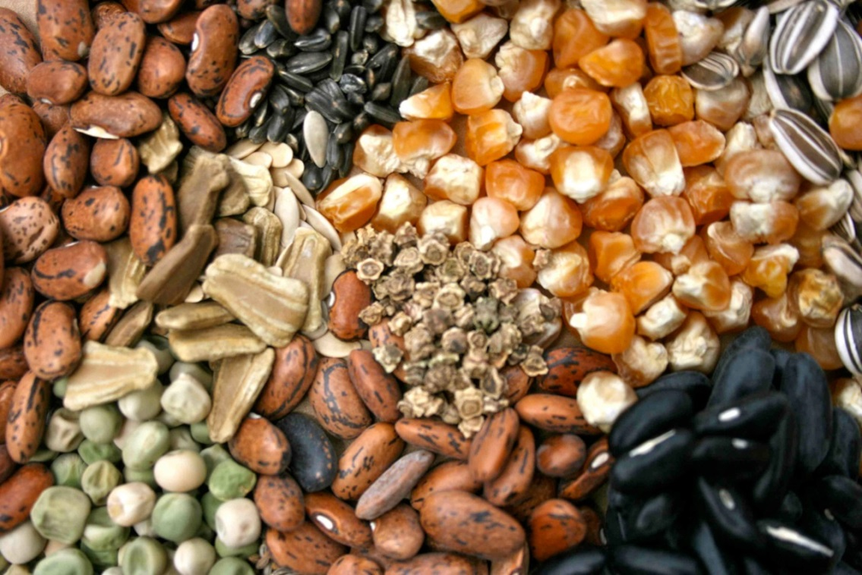
Seed
The fertilized, matured ovule of a flowering plant, containing an embryo

Slide 10
Important structure of seed
1 Embryo
Living plant
Growth restricted by the maturity of seed
2 Stored food
Accumulate in seed before detach from mother plant
Within embryo or in endosperm
3 Testa
Outside covering and protection coat of seed

Slide 11
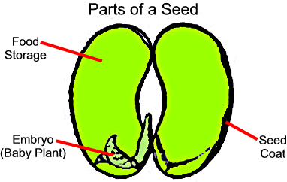

Slide 12
Process of seed germination
Water absorption
Movement and utilization of food
Seedling

Slide 13
A- water absorption
Seed subjected to favorable supply of water
For this purpose generally seed is place in a soil or others medium with a suitable moisture contents
Some impervious seed unable to uptake water without the aid of special treatment
Seed coat absorb water and become soft
Embryo push the seed coat off

Slide 14
B- Movement and utilization of food
Seed contain food in such insoluble form as starch, fat and protein.
Food convert into soluble compound by enzymes
Enzymes produce within cells

Slide 15
C- Seedling
Germination considered as complete when
Seed coat is broken
radical and plumule pass out from seed
That young plant is called seedling
This stage continue until plant manufacture its own food

Slide 16
Technique or method of sexual propagation

Slide 17
Method or Technique of sexual propagation
Selection of fruit and extraction of seed
Cleaning of seed
Storage of seed
Dormancy
Testing the seed viability
Sowing

