Slide 1
CVS

Slide 3
CARDIAC MUSCLE
The Heart as a Pump and Function of the Heart Valves
The human heart is composed of two pumps: the right heart, which receives blood from the peripheral tis­sues and pumps it through the lungs, and the left heart, which receives oxygenated blood from the lungs and pumps it back to the peripheral tissues.

Slide 4
CARDIAC MUSCLE
Each pump is composed of an atrium and a ventricle. The atria func­tion as conduits and primer pumps that fill the ventri­cles with blood. The ventricles contract and impart high pressure to the blood, which is responsible for propel­ling it through the circulation.
The heart has a special conduction system that maintains its own rhythmicity and transmits action potentials throughout the heart muscles.

Slide 5
DISTINGUISHING FEATURES OF CARDIAC MUSCLE COMPARED WITH SKELETAL MUSCLE
Cardiac and skeletal muscle have the following similari­ties and differences:
Both cardiac and skeletal muscle are striated and have actin and myosin filaments that interdigitate and slide along each other during contraction.
Cardiac muscle has intercalated discs between cardi­ac muscle cells, which is one of the differences from skeletal muscle. These discs have very low electrical resistance, allowing an action potential to travel rap­idly between cardiac muscle cells.

Slide 6
DISTINGUISHING FEATURES OF CARDIAC MUSCLE COMPARED WITH SKELETAL MUSCLE
The cardiac muscle is a syncytium of many heart muscle cells in which the action potential spreads rapidly from cell to cell.
The atrioventricular (A-V) junction slowly con­ducts impulses from the atria to the ventricles. In normal patients this is an exclusive pathway be­cause the atrial syncytium and ventricular syncy­tium are normally insulated from one another by fibrous tissue.

Slide 7
Action Potentials in Cardiac Muscle
The resting membrane potential of cardiac muscle is about -85 to -95 millivolts, and the action potential is 105 millivolts. The membranes remain depolarized for 0.2 second in the atria and for 0.3 second- in the ventricles.

Slide 8
Slow Entry of Sodium and Calcium Ions Into the Cardiac Muscle Cells Is One of the Causes of the Action Potential Plateau.
The action potential of skeletal muscle is caused by entry of sodium through fast sodium channels, which remain open for only a few ten thousandths of a second.
In cardiac muscle, the fast sodium channels also open, at the initiation of the action potential, but cardiac muscle has unique slow calcium channels, or calcium-sodium channels.

Slide 9
Slow Entry of Sodium and Calcium Ions Into the Cardiac Muscle Cells Is One of the Causes of the Action Potential Plateau.
Calcium and sodium ions flow through the slow channels into the cell after the initial spike of the action potential, and they maintain the plateau.
Calcium that enters the cell through these channels also promotes cardiac muscle contraction.

Slide 10
Another Cause of the Plateau of the Action Potential Is a Decrease in the Permeability of Cardiac Muscle Cells to Potassium Ions.
The decrease in cardiac potassium permeability also prevents return of the membrane potential in cardiac muscle; this mechanism is not present in skeletal muscle.
When the slow calcium-sodium channels close after 0.2 to 0.3 second, the potassium permeability increases rapidly. Potassium ions thus exit the cardiac myocytes, and membrane potential returns to its resting level.

Slide 11
Diffusion of Calcium Into the Myofibrils Promotes Muscle Contraction.
The action potential spreads into each cardiac muscle fiber along the transverse (T) tubules, causing the longitudinal sarcoplasmic tubules to release calcium ions into the sarcoplasmic reticulum.
These calcium ions catalyze the chemical reactions that promote the sliding of the actin and myosin filaments along one another to cause muscle contraction. This mechanism is also present in skeletal muscle.

Slide 12
Diffusion of Calcium Into the Myofibrils Promotes Muscle Contraction
Another means of calcium entry into the sarco-plasm, however, is unique to cardiac muscle. The T tubules of cardiac muscles have 25 times as great a volume as those in skeletal muscle volume.
These T tubules contain large amounts of calcium that are released during the action potential.

Slide 13
Diffusion of Calcium Into the Myofibrils Promotes Muscle Contraction
In addition, the T tubules open directly into the extracellular fluid in cardiac muscle, so their calcium content highly depends on the extracellular calcium concentration.
At the end of the plateau of the action potential, the influx of calcium ions into the muscle fiber abruptly stops, and calcium is pumped back into the sarco­plasmic reticulum and T tubules. Thus, the contrac­tion ends.

Slide 14
THE CARDIAC CYCLE
The events that occur at the beginning of a heartbeat and last until the beginning of the next heartbeat are called the cardiac cycle.

Slide 15
THE CARDIAC CYCLE
Each beat of heart begins with spontaneous AP that is initiated in the sinus node of the right atrium near the opening of superior vena cava.

Slide 16
THE CARDIAC CYCLE
The action potential travels through both atria and the A-V node and bundle into the ventricles.
A delay of about 0.13 second occurs in the A-V node and bundle, which allows the atria to contract before the ventricles contract.

Slide 17
THE CARDIAC CYCLE
Figure shows the events of the cardiac cycle. The ventricles fill with blood during diastole and con­tract during systole. The top three curves in Figure show the aortic pressure, left ventricular pressure, and left atrial pressure. The curves below them are the changes in ventricular volume, the electrocardiogram, and the phonocardiogram (a recording of heart sounds).

Slide 18
THE CARDIAC CYCLE
The Spread of the Action Potential in the Heart Initiates Each Heartbeat. The electrocardiogram is a recording of the voltage generated by the heart from the surface of the body during each heartbeat

Slide 19
THE CARDIAC CYCLE
The P wave is caused by spread of depolarization across the atria, which causes atrial contraction. Atrial pressure increases just after the P wave.
The QRS waves appear as a result of ventricular de­polarization about 0.16 second after the onset of the P wave, initiating ventricular contraction; then the ventricular pressure begins to increase.
The ventricular T wave is caused by repolarization of the ventricle.

Slide 20
THE CARDIAC CYCLE
The Atria Function as Primer Pumps for the Ventricles. About 75 percent of ventricular filling occurs during diastole before contraction of the atria, which causes the remaining 25 percent of ventricular filling.
When the atria fail to function properly, such as during atrial fibrillation, little difficulty is encountered unless a person exercises, and then shortness of breath and other symptoms of heart failure may occur. The atrial pressure waves (see Figure ) include the following waves:

Slide 21
THE CARDIAC CYCLE
The a wave, which is caused by atrial contraction
The c wave, which occurs during ventricular con­traction because of slight backflow of blood and bulging of the A-V valves toward the atria
The v wave, which is caused by in-filling of the atria from the venous return

Slide 22
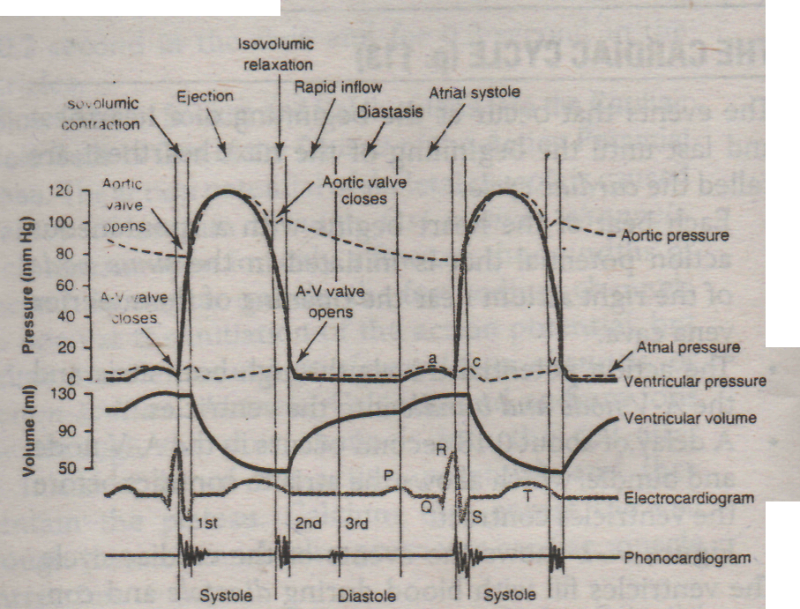
Events of the cardiac cycle for left ventricular function showing changes in left atria! pressure, left ventricular pressure, aortic pressure, ventricular volume, the electrocardiogram, and the phonocardiogram.

Slide 23
The Ventricles Fill With Blood During Diastole. The following events occur just before and during diastole:
During systole, the A-V valves are dosed, and the atria fill with blood.
At the beginning of diastole is the period of isovolu-mic relaxation, caused by ventricular relaxation. When ventricular pressure decreases below that of the atria, the A-V valves open.
During diastole the higher pressure in the atria push­es blood into the ventricles.

Slide 24
The Ventricles Fill With Blood During Diastole. The following events occur just before and during diastole:
The period of rapid filling of the ventricles occurs during the first third of diastole and provides most of the ventricular filling.
Atrial contraction occurs during the last third of di­astole and contributes about 25 percent of the fill­ing of the ventricle. This contraction is commonly known as the "atrial kick."

Slide 25
Outflow of Blood From the Ventricles Occurs During Systole. The following events occur during systole:
At the beginning of systole, ventricular contraction occurs, the A-V valves close, and pressure begins to build up in the ventricle. No outflow of blood occurs during the first 0.2 to 0.3 second of ventricular con­traction (the period of isovolumic contraction). Note that isovolumic means "the same volume" and refers to the ventricular volume.

Slide 26
Outflow of Blood From the Ventricles Occurs During Systole. The following events occur during systole:
When the left ventricular pressure exceeds the aortic pressure of about 80 mm Hg and the right ventricular pressure exceeds the pulmonary artery pressure of 8 mm Hg, the aortic and pulmonary valves open. Ventricular outflow occurs, called the period of ejection.

Slide 27
Outflow of Blood From the Ventricles Occurs During Systole. The following events occur during systole:
Most ejection occurs during the first part of this pe­riod (period of rapid ejection).
The period of rapid ejection is followed by the period of slow ejection. During this period, aortic pressure may slightly exceed the ventricular pressure because the kinetic energy of the blood leaving the ventri­cle is converted to the pressure in the aorta, which slightly increases its pressure.
During the last period of systole, the ventricular pressures fall below the aortic and pulmonary artery pressures, and thus the aortic and pulmonary valves dose at this time.

Slide 28
The Fraction of the End-Diastolic Volume That Is Ejected Is Called the Ejection Fraction.
At the end of diastole, the volume of each ventricle is 110 to 120 milliliters; this-volume is called the end-diastolic volume.
The stroke volume, which has a value of about 70 milliliters, is the amount of blood ejected with each beat
The end-systolic volume is the remaining volume in the ventricle at the end of systole and measures about 40 to 50 milliliters.
The ejection fraction is calculated by dividing the stroke volume by die end-diastolic volume; it has a value of about 60 percent. The stroke volume of the heart can be doubled by increasing die end-diastolic volume and decreasing the end-systolic volume.

Slide 29
Ventricular Ejection Increases Pressure in the Aorta . to 120 mm Hg (Systolic Pressure)
When the ventricular pressure exceeds the diastolic pressure in the aorta, the aortic valve opens and blood is ejected into the aorta. Systolic pressure in the aorta increases to about 120 mm Hg and distends the elastic aorta and other arteries.

Slide 30
Ventricular Ejection Increases Pressure in the Aorta . to 120 mm Hg (Systolic Pressure)
When aortic valve doses at the end of ventricular ejection, a slight backflow of blood occurs, followed by a sudden cessation of flow that causes an incisura, or a slight increase in aortic pressure. During diastole, blood contin­ues to flow into die peripheral circulation and the arterial pressure decreases to 80 mm Hg (diastolic pressure).

Slide 31
The Heart Valves Prevent Backflow of Blood
The A-V valves (i.e., the tricuspid and mitral valves) prevent backflow of blood from die ventrides to the atria during systole. In a similar fashion, die semilunar valves (i.e., die aortic and pulmonary valves) prevent backflow of blood from the aorta and pulmonary artery into the ventricle during disotle.
The A- V valves have papillary muscles attached to them by the chordate tendineae. During systole, the papillary muscles contract to help prevent the valves from bulging back too far into the atria. The arota and pulmonary valves were thicker than the A- valves and do have any papillary muscles attached.

Slide 32
PROPERTIES OF CARDIAC MUSCLE
(1) Functional Syncytium
When a group of cells function as a single unit, it is called functional syncytium. In heart, cardiac muscle fibers are separated from one another by intercalated discs which have low electrical resistance, allowing free diffusion of ions. So, when one muscle fiber is excited, action potential spreads to all cells, exciting whole cardiac muscle. Heart is composed of:

Slide 33
PROPERTIES OF CARDIAC MUSCLE
Atrial syncytium and ventricular syncytium, separated by fibrous tissue and connected functionally by A-V bundle.
(2) Rhythmicity
Contraction of heart at regular intervals without
external stimuli, is called rhythmidty.

Slide 34
CAUSE
Na⁺ ion is leaky to SA nodal fibers that causes
depolarization (action potential) and contraction
at regular intervals.
(3) Refractory Period Period during which an already excited cardiac muscle cannot be re-excited by anormal cardiac impulse, is called refractory period.

Slide 35
TYPES
Two
Absolute Refractory Period
Period during which an already excited cardiac muscle cannot be re-excited even by a very strong cardiac impulse, is called absolute refractory period.
Relative Refractory Period
Period during which an already excited, cardiac muscle can be re-excited by a stronger than normal cardiac impulse, is called relative refractory period.

Slide 36
PROPERTIES OF CARDIAC MUSCLE
(4) Conductivity
Transfer of cardiac impulse from pace-maker (SA node) to all cardiac muscle fibers, is called conductivity.
(5) Contractility
Contraction of cardiac muscle due to intergiditation of actin and myosin filaments in presence of ATP and Ca++, is called Contractility. Mechanism
Action potential over cardiac muscle mem. -)• AP spreads to cardiac muscle fiber thru T-tubules -> (a) Ca⁺⁺ diffuses into cardiac muscle fibers during AP (b) Ca⁺⁺ release from sarcoplasmic reticulum also diffuses into cardiac muscle fibers -> Ca⁺⁺ catalyzes sliding walking along process b/w actin and myosin -> contraction of cardiac muscle.

Slide 37
PROPERTIES OF CARDIAC MUSCLE
(6) Staircase Phenomenon or Treppe
When a quiescent heart is stimulated after prolong rest, first few contractions gradually inc. in size and then become steady; this is called staircase phenomenon or treppe.
(7) Tone
State of partial contraction in cardiac muscle is called tone.
(8) AII-or-Nothlng Principle
Cardiac muscle syncytium (atrial or venffifular) does not contract if stimulus is subthreshold arid it contracts with constant strength if stimulus is at or above threshold in intensity, this is called all-or-nothing principle or all-or-none Jaw.

Slide 38
PROPERTIES OF CARDIAC MUSCLE
(9) Peculiar Action Potential in Cardiac Muscle Consists of
(a) Depolarization caused by rapid Na⁴ influx thru fast Na⁺ channels. ,
(b) Plateau caused by slow Ca⁺⁺- Na⁺ channels
(c) Repolarization caused by rapid K¹ outflux thru K⁺ channles.

