Slide 1
Pakistan and conservation of biodiversity
Genetic resources and conservation
BS Biotechnology (6th Semester)
University of Sargodha

Slide 2
Pakistan
Pakistan is signatory to a large number of international treaties and conventions. These are listed below.
Convention on biological diversity, 1992
Cartagena protocol on Bio Safety, 2001
International Union for Conservation of Nature (IUCN), 1985
CITES, 1973
Ramsar Convention, 1971
Convention on the conservation of migratory species, 1981
UNFCC, 1997

Slide 3
Biodiversity in Pakistan
Pakistan has a great variety of landscapes. Variation in climate has bestowed Pakistan with rich biodiversity and many ecosystems, habitats and species of global significance.
Biodiversity of Pakistan is following
Mammals (195 species, 6 being endemic)
Birds (668 species, 25 being endangered),
Reptiles (177 species, 13 being endemic),
Amphibians (22 species, 9 being endemic),
Fresh water fish (198 species, 29 being endemic)
Invertebrates (5,000 species)
Flowing plants (5,700 species, over 400 being endemic).

Slide 4
Biodiversity in Pakistan
Moreover, Pakistan is rich in indigenous crop diversity with an estimated 3,000 taxa and around 500 wild relatives of crops.
Indian subcontinent was the first to domesticate cattle, water buffalo and chicken.
Pakistan has two breeds of buffalo, eight of cattle, one yak, 25 goat, 28 sheep, one horse, four camels and three poultry breeds.

Slide 5
Threats to biodiversity in Pakistan
Overgrazing and deforestation due to high population pressure and increasing poverty
The diversion of water for irrigation has adversely impacted the ecology of mangrove and riparian ecosystems.
Game birds and animals are heavily hunted
Fisheries from inland and marine ecosystems are harvested to the full limit
agrobiodiversity has suffered serious erosion due to the introduction of higher yielding varieties and the use of agrochemicals.
pollution and disposal of untreated sewage and industrial effluent into the rivers and seas are also major threats to aquatic and marine biodiversity.

Slide 6
Pakistan and CBD
Pakistan is a signatory of CBD.
Pakistan completed a Biodiversity Action Plan (BAP) in the year 2000, which became a de facto biodiversity policy instrument for the country.
The BAP has been a useful document and provided overall guidance and reference material. However, progress on its implementation has been less than satisfactory. Due to lack of resources and colaboration at national and provincial level.
A Biodiversity Working Group was constituted but has only held two meetings. Biodiversity steering committees were constituted in all provinces, but have remained dormant.
Nevertheless, a large number of actions recommended by the BAP have been partially implemented.

Slide 7
Pakistan and 2020 Aichi biodiversity targets
Pakistan has already made reasonable progress towards the achievement of the 2020 Aichi Biodiversity Targets.
Milestones include the
establishment of a protected areas system including almost all major habitats and ecosystems and covering more than 10% of the country’s area (although many of the areas did not meet the international criteria for protected areas)
conservation status of some endangered and threatened species of fauna (ungulates, endemic reptiles, brown bear, black bear) was reported to have improved, largely through the efforts of local communities and conservation NGOs.

Slide 9
Pakistan and Cartagena protocol
A National Biosafety Centre has been established to facilitate implementation of the Cartagena Protocol, along with national biosafety guidelines to regulate genetically modified organisms.
Awareness campaigns have improved the understanding of the importance of biodiversity and have led to broader engagement across society in implementation activities.
Significant progress has been made in the mobilization of national and international financial resources for implementing the Convention.
However, there is no strategic plan for meeting future needs.

Slide 10
Pakistan and IUCN
The IUCN Pakistan country office was established in 1985 and has been an important contributor to environmental work in the country at both policy and community levels, working toward sustainable development.
programmes in Pakistan focus on biodiversity conservation, particularly in the country’s coastal and forest areas, and addressing ongoing challenges to ecosystems and biodiversity preservation, especially in the face of climate change impacts.

Slide 11
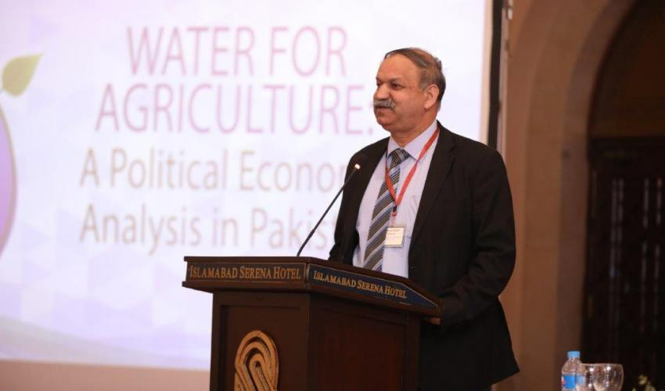
Pakistan and IUCN
Country representative
Mr. Mahmood Akhtar Cheema
Introduction
Bachelor’s degree in Agricultural Engineering from University of Agriculture, Faisalabad, Pakistan
Master of Science in Agriculture Extension from University of Reading, U.K
over 20 years of experience in natural resource management
Address of IUCN country office
1 Bath Island Road, Karachi, Pakistan 75530

Slide 12
Projects of IUCN in Pakistan
Location: Thar
Specie: Vultures
Role of vultures in ecosystem: they eat carcasses of animals
Effect of their decline on ecosystem: Because of the decline in vultures, the food resource available to dogs has increased, causing a significant increase in the number of dogs in the absence of interspecies competition. The increase in the number of feral dogs has led to a rise in the number of dog attacks on humans.
Reasons of decline: 1-use of veterinary drug diclofenac, 2- Habitat loss
Conservation approaches: Captive breeding and conservation in their natural habitat

Slide 13
Projects of IUCN in Pakistan
Location: Indus Delta (Sub Division Ketibunder and Karochann, Thatta District)
Specie: mangrove plants
Objectives of the project:
Protect coastal areas from accelerated sea intrusion and erosion through non-engineered structural measures (such as mangrove plantations)
Protect coastal areas from cyclones and tsunamis
Support community livelihoods by diversifying household income generation options and access to service in ways sustainable to the fragile ecosystem

Slide 14
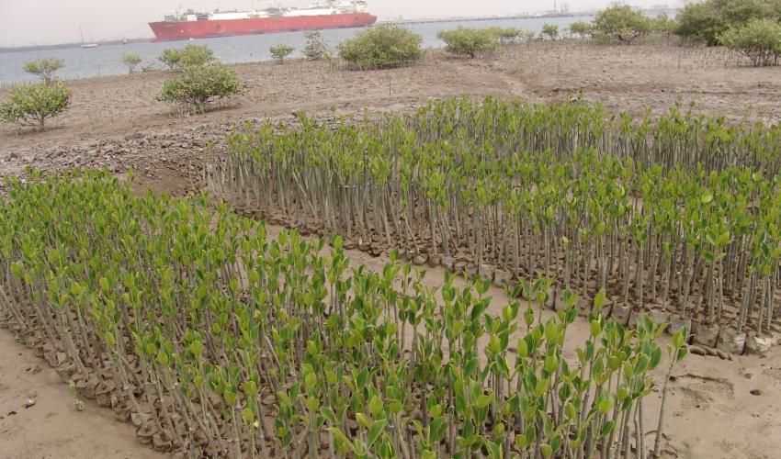
Projects of IUCN in Pakistan
Project title:Restoration of Mangroves Ecosystem in Port Qasim Area
Location:Port Qasim Area, Karachi
Donor: Engro Elengy Terminal Private Limited (EETPL)
Expected outcomes:
Increased mangrove forest cover
Awareness raised among interested corporate sector in making coastal investments
Community is trained on mangrove planting technicalities and are made aware of ecosystem livelihood linkages

Slide 15
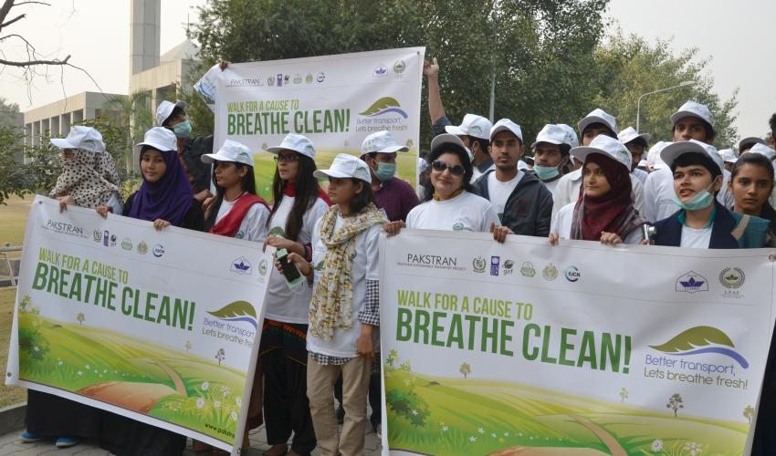
Projects of IUCN in Pakistan
Project title: Pakistan Sustainable Transport Project (PAKSTRAN)
Location: Pakistan
Objectives of the project:
Reduce the growth of energy consumption and related greenhouse gas emissions from Pakistan’s transport sector
Improve the urban environmental conditions and increase Pakistan’s competitiveness
Donor: Global Environment Facility (GEF); and United Nations Development Programme (UNDP)

Slide 16
Projects of IUCN in Pakistan
Project title: Water governance project in Federally Administered Tribal Areas (FATAs): Environment Cell
Location: FATA Agencies and Frontier Regions (FR) of Pakistan
Expected outputs:
FATA Environment Cell established and functional
Stakeholders aware of environmental water protection for improved water governance in all agencies
Enhanced knowledge and skills of stakeholders in environmental water protection for improved governance
Safe water quality standards adapted and identified for drinking and other uses
Donor: Swiss Agency for Development and Cooperation (SDC)

