Slide 1
PHYSICS OF GASEOUS DIFFUSION

Slide 2
GASEOUS MOVEMENT IN RESPIRATORY SYSTEM
After the alveoli are ventilated with fresh air, the next step in the respiratory process is DIFFUSION of various gases.

Slide 3
DIFFUSION OF GASES
The process of diffusion is simply random molecular motion of molecules in both ways through the respiratory membrane.

Slide 4
RATE OF DIFFUSION
The rate of diffusion of gas is directly proportional to the partial pressure of that gas.

Slide 5
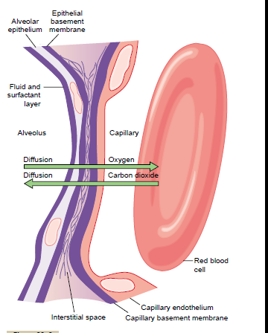

Slide 6
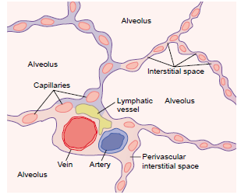

Slide 7
TOTAL PRESSURE OF A GAS
The pressure of a specific gas acting on the surfaces of the respiratory passages and alveoli is proportional to the summated force of impact of all of its molecules.
This means total pressure of a gas is directly proportional to the concentration of the gas molecules.

Slide 8
PRESSURE OF GASES IN WATER & TISSUES
Gases dissolved in water or in the body tissues exert pressure.
The pressure of a dissolved gas in a fluid is determined by the concentration and solubility coefficient.
Pressure= concentration of gas/solubility coefficient of that gas

Slide 9
VAPOUR PRESSURE
The pressure that the water molecules exert to escape through the surface is called VAPOUR PRESSURE of the water.
It is 46mm Hg at normal body temperature of 37degree F.
The vapour pressure depends on the trmperature of water.

Slide 10
PRESSURE DIFFERENCE FOR DIFFUSION
The NET DIFFUSION of gas from the area of high pressure to the area of low pressure is equal to the number of molecules bouncing in this direction minus the number bouncing in the opposite direction & this in turn is proportional to the gas pressure difference between the two areas called PRESSURE DIFFERENCE FOR DIFFUSION.

Slide 11
Net rate of diffusion of fluids depends upon:
1. Pressure difference.
2. Solubility of gas.
3. Diffusion through which gas must diffuse.
4. Cross-sectional area of the fluid.
5. Molecular weight of the gas.
6. Temperature of the fluid.

Slide 12
DIFFERENCE BETWEEN ALVEOLAR AIR & ATMOSPHERIC AIR
1. Alveolar air is only partially replaced by atmospheric air with each breath.
2. Oxygen is constantly being absorbed from the alveolar air.
3. Carbondioxide is constantly diffusing from the pulmonary blood into the alveoli.

Slide 13
RATE AT WHICH ALVEOLAR AIR IS RENEWED BY ATMOSPHERIC AIR
At normal alveolar ventilation approx. half the gas is removed in 17 seconds.

Slide 14
IMPORTANCE OF SLOW REPLACEMENT
This slow replacement is of importance in preventig sudden changes in gaseous concentration of blood.

Slide 15
OXYGEN CONCENTRATION & ITS PARTIAL PRESSURE IN ALVEOLI
1. The more rapidly oxygen is absorbed by blood, the lower becomes its concentration in the alveoli.
2. The oxygen concentration in the alveoli is 10mm Hg & is controlled by---Rate of its absorption into blood AND Rate of entry of new oxygen into lungs.
3. Marked increase in alveolar ventilation can never increase the alveolar PO2 above 149mm Hg as long as person is breathing in normal atmospheric air.

Slide 16
CO2 CONC.& ITS PARTIAL PRESSURE IN ALVEOLI
1. Normal rate of alveolar ventilation for CO2 is 4.2liters/min. CO2 pressure in alveli is 40mm Hg.
2. The alveolar PCO2 increases directly in proportion to the rate of CO2 excretion.
3. Alveolar partial pressure of CO2 decreases in inverse priportion to alveolar ventilation.

Slide 17
DIFFUSION OF GASES THROUGH RESPIRATORY MEMBRANE

Slide 18
THE RESPIRATORY UNIT
It is composed of:
1. Respiratory bronchiole
2. Alveolar ducts
3. Atria
4. Alveoli

Slide 19
RESPIRATORY MEMBRANE
The gaseous exchange between the ALVEOLAR AIR & the PULMONARY BLOOD occurs through membranes of all the termina; portions of lungs. These membranes are known as RESPIRATORY MEMBRANE.

Slide 20
LAYERS OF RESPIRATORY MEMBRANE
1. Fluid layer lining alveoli.
2. The alveolar epithelium.
3. An epithelial basement membrane.
4. A very thin interstitial space between alveolar epithelium & capillary membrane.
5. A capillary basement membrane.
6. The capillary endothelial membrane.

Slide 21
FACTORS AFFECTING DIFFUSION THROUGH THE RESPIRATORY MEMBRANE
The factors that determine how rapidly a gas will pass through the membrane are:
1. Thickness of respiratory membrane.
2. Surface area of respiratory membrane.
3. Diffusion coefficient of the gas.
4. Pressure difference across respiratory membrane.

Slide 22
DIFFUSING CAPACITY OF RESPIRATORY MEMBRANE
It is defined as the volume of a gas that diffuses through the membrane each minute for a pressure difference of 1m Hg.

Slide 23
MEASUREMENT OF DIFFUSING CAPACITY
The oxygen diffusing capacity can be calculated from measurement of:
1. Alveolar PO2.
2. PO2 in pulmonary capillary blood.
3. Rate of oxygen uptake by blood.

Slide 24
VENTILATION PERFUSION RATIO
It is DEFINED as the ratio of alveolar ventilation to blood flow.
FORMULA:
VPR=VA/Q

Slide 25
WHEN VPR IS ZERO
It MEANS VPR is without any alveolar ventilation because the air in the alveolus has come to equilibrium along with the blood oxygen & carbondioxide gas.

Slide 26
WHEN VPR EQUALS INFINITY
It means that there is no capillary blood flow to carry oxygen away or to bring carbondioxide to alveoli. So, the air that is inspired loses no oxygen to blood & it gains no CO2.

Slide 27
WHEN VPR IS NORMAL
This means there is optimal alveolar capillary blood flow & exchange of oxygen and CO2 THROUGH RESPIRATORY MEMBRANE.

Slide 28
PHYSIOLOGICAL SHUNT
When some part of venous blood passing through the pulmonary capillaries does not become OXYGENATED, this is known as SHUNTED BLOOD.
The total amount of shunted blood per minute is known as PHYSIOLOGICAL SHUNT.

Slide 29
How to measure physiological shunt?
It is measured by analysing the concentration of oxygen in both mixed venous blood & arterial blood along with simultaneous measurement of cardiac output.

Slide 30
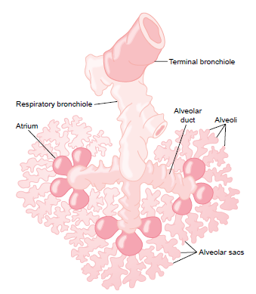

Slide 31
PHYSIOLOGICAL DEAD SPACE

Slide 32
WASTED VENTILATION
When ventilation of some of the alveoli is great BUT alveolar blood flow is low, there is then far more available oxygen in the alveoli than can be transported away by blood. This extra ventilation of alveoli is termed as WASTED VENTILATION.

Slide 33
PHYSIOLOGICAL DEAD SPACE
The sum of alveolar wasted ventilation and ventilation of anatomical dead space areas is termed as PHYSIOLOGICAL DEAD SPACE.

