Slide 1
Root knot diseases

Slide 2
Description:
Root knot of vegetables
Meloidogyne sp.
Attack more than 200 plant species.
Causes up to 75% losses.
Common in warm and hot areas.

Slide 3
Symptoms:
Few, small and pale green leaves.
Infected roots swell at the point of invasion giving root knot appearance.

Slide 4
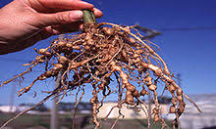
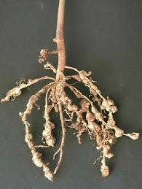
Symptoms:
Knots on roots

Slide 5
Disease cycle:
Host range (potato, tomato, eggplant, chili, okra, carrot, reddish etc)
Female lays 500 eggs in gelatinous substance
2nd stage enters, become sedentary & feed with stylet
Distinguish male & female at 4th stage
Life cycle complete in 25 days at 27°C

Slide 6
Management:
Soil treatment with nematicides
Grow resistant varieties
Cultural practices
Crop rotation
Biological control Bacteria: Pasteuria penetrans, Fungi: Dactylella oviparasitica

