Slide 2
Movement in design

Slide 6
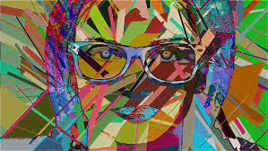

Slide 8
