Slide 1
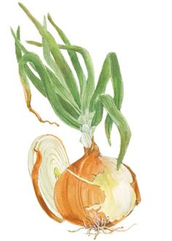
ONION
Technical Name: Allium cepa
Family: Amaryllidaceae
Origin:
Afghanistan
Tajikistan
Uzbekistan
India

Slide 2
Uses
It is known as poor man food
Used when green stage and mature as bulbs
Also used in meat dishes, salad sand witches and soups
Its pungency due to a volatile oil (allyl Propyl disulphide)
Mature buds contain some
starch
Sugar
Protein
Vitamins A,B, C

Slide 3
Climate
It is cool season crop
Length of the day
Day length requirement of different varieties may differ
For bulb formation: high temperature and long photoperiod
Seed stalk: temp more important than day length

Slide 4
Soil:
Fertile soil with rich in humus
Well drained
pH 5.8-6.5
Fertilizer:
Fertilizer vary with
Soil type
Previous fertilizer application
Purpose for which crop grown
FYM: 40-50 t/ha
NPK: 120-60-60 kg/ha

Slide 5
Spacing:
Row to Row: 20 cm
Plant to Plant: 10 cm
Seed Rate:
For nursery
8-10 Kg/ha
Direct sowing:
25 Kg/ha
Bulb
1000-1200 kg/ha
They dibbled 15 cm apart in rows 45 cm apart

Slide 6
Irrigation
A seed bed usually irrigated immediately before transplanting
Irrigation stopped when tops mature and start falling
Varieties
Faisalabad early,
Pindi red
Ghotki
local white
Phulkara
Thanobola khan
Red Nasik
Desi red

Slide 7
Planting time
Seedlings raised between June and September from July to October
In plains of Pakistan for winter crops, seeds sown from middle of October to end of November
In December and January when seedlings reach the age of 8-10 weeks, they are transplanted
In the hills, seeds are sown from march to June

Slide 8
Harvesting
Green bunch onions harvested when diameter of a lead pencil and small bulb has formed
Mature bulbs can be pulled out easily by hand if soil is not hard
Yield
25-30 t/ha

