Slide 1
UNIT NO. 7 APPROACHES TO FARM AND COMMUNITY FORESTRY

Slide 2
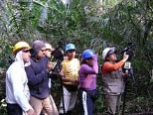
COMMUNITY FORESTRY
Community forestry was initially defined by FAO in 1978
Community forestry refers to a group of objectives, rather than to a single development norm
Community forestry is an evolving branch of forestry where by
the local community plays a significant
role in forest management and land use
decision making by themselves in the
facilitating support of government as well as
change agents

Slide 3
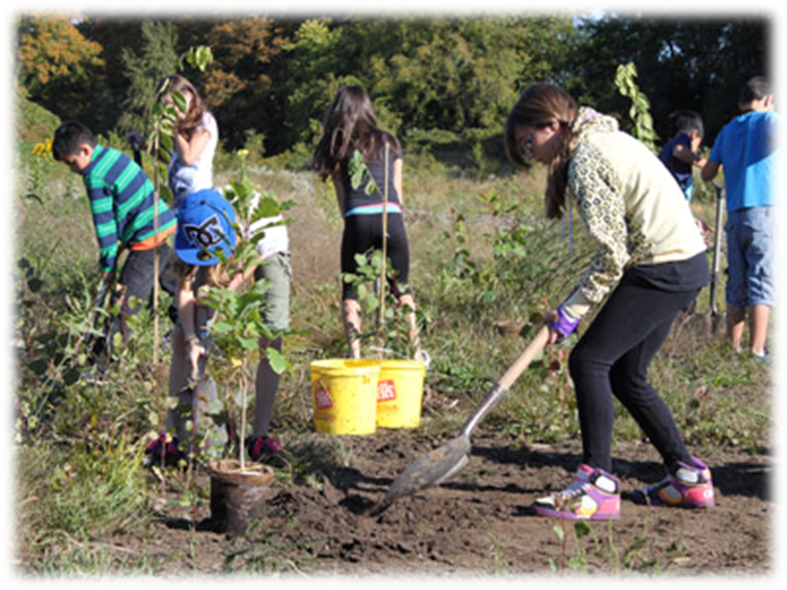
COMMUNITY FORESTRY
Community forestry encompasses:
Broad spectrum of possible linkages
between people and trees
Outputs of trees
People's dependence on existing forests
as with reforestation
Community forestry must be an integral part
of rural development
basic precept that the central purpose of
rural development is to help the poor become self-reliant

Slide 4
ORIGINS OF COMMUNITY FORESTRY
Any situation which intimately involves local people in a forestry activity
In the 1950s and 1960s, government involvement was in favor of industrial forestry
Sudden and intense interest between people and trees was developed in the middle and latter part of the 1970s
In 1975, National Forest Policy was given which contains the people’s participation in the forestry activities as given by NGO.
FAO, with support from SIDA, resulted in a seminal 1978, state-of-knowledge publication “Forestry for Local Community Development”

Slide 5
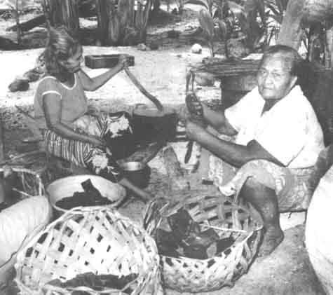
ORIGINS OF COMMUNITY FORESTRY

Slide 6
ORIGINS OF COMMUNITY FORESTRY
FAO and SIDA launched a special action programme:
To heighten awareness of the importance of “community forestry”
To help individual countries initiate or upgrade field programmes in community forestry
1978 Eighth World Forestry Congress, devoted to the theme “Forests for People”, served to give the concept of community forestry rapid and intensive exposure
By 1979, field projects and programmes were initiated
Later on, this was a common components of all policies

Slide 7
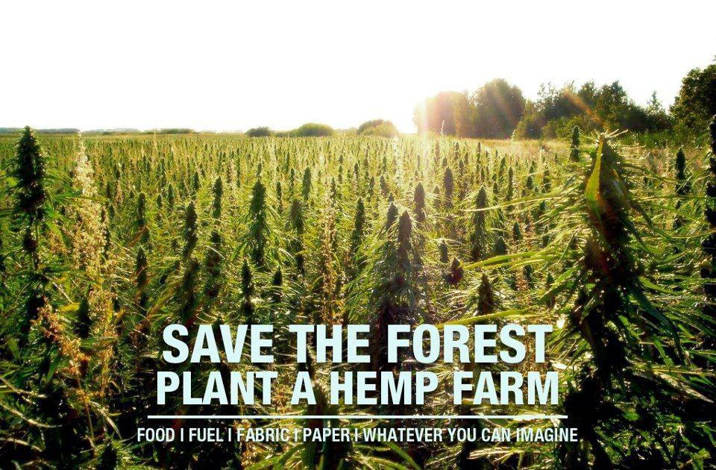
SCOPE OF COMMUNITY FORESTRY
Developing community forests
Establishing better marketing systems
Provide an effective means of helping the poorer members of the community
Seldom managed to meet the expectations
Overburdened with rhetoric and over-ambitious objectives
Do not automatically benefits rather require
painstaking preparation

Slide 8
SCOPE OF COMMUNITY FORESTRY
Complex issues are community management, land and benefit distribution
Focus should be on design and implementation of community forestry programs
Unsatisfactory record not be allowed to obscure the substantial achievements
If the plantation is treated as a purely commercial enterprise, similar to a farm forestry thus will be a net increase in the total biomass production, but the available fodder and fuel wood to the poor may be reduced

Slide 9
IDENTIFYING STRATEGIES FOR COMMUNITY AND FARM FORESTRY
Identifying Program Objectives
Types of Community Forestry Program Strategies
Strategic Approaches

Slide 10
Identifying Program Objectives
Must based on a well-defined and consistent set of objectives
A number of broad aims can be distinguished such as:
Provision of basic necessities
Participation of rural people
Management of degraded and marginal lands
Increasing wood production
Socio-economic development of rural people through:
employment generation
Institution building
Economic growth

Slide 11
Types of Community Forestry Development Strategies
Who are the individuals or institutions with primary management responsibilities?
How is the control, use or ownership of trees and of land resources defined and organized?
Control of tree and land resources belongs either to the community or private groups
Control is defined by legal and institutional arrangements, traditions, cultures etc.
A program’s design will define tree management responsibilities
Responsibility for land management and for tree planting lie with the community and with individuals/households

Slide 12
Strategic Approaches
Community organizations such as schools or cooperatives, establishing nurseries or plant trees on fragmented woodlots
Community strategies, making available state land for communal planting
Developing mechanisms to assure participants the benefits of their labor
Careful development of technical options which fit into the farm production system
Developing market information or credit facilities for market focused forestry

Slide 13
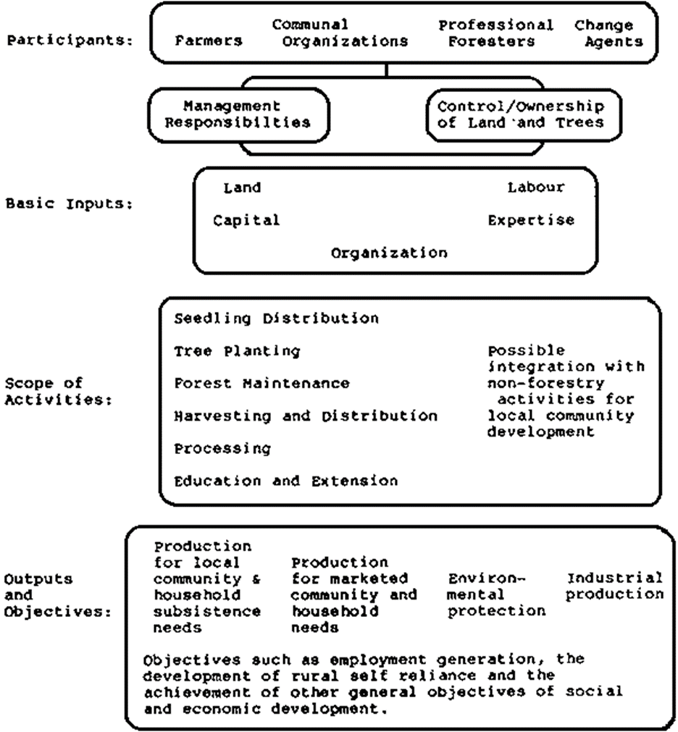
Developing Community Forestry Strategies

Slide 14
PARTICIPATORY LAND USE PLANNING AND FOREST LAND ALLOCATION
Land use planning is a pre-requisite for
Forest land allocation
Sustainable use of allocated lands
Decentralized and participatory approach to land use planning (LUP) and forest land allocation (FLA)
Improving the capacity of local administrations at the district level:
Plan community forestry actions
Implement community forestry actions

Slide 15
FOUNDATIONS FOR THE DEVELOPMENT OF THE METHODOLOGY
Development of approach to land use planning and forest land allocation for:
enhance sustainable management of forest land
Improve livelihood of local populations
Participation of concerned populations

Slide 16
OUTLINE OF THE METHODOLOGY
Organization and Management of the Process
Land Use Planning
Forest Land Allocation

Slide 17
Organization and Management of the Process
The activities related to organization and management of the process include:
Identify stakeholders
Organize working groups, defining roles and responsibilities
Prepare a detailed work plan
Train working group members
Organize monitoring and evaluation

Slide 18
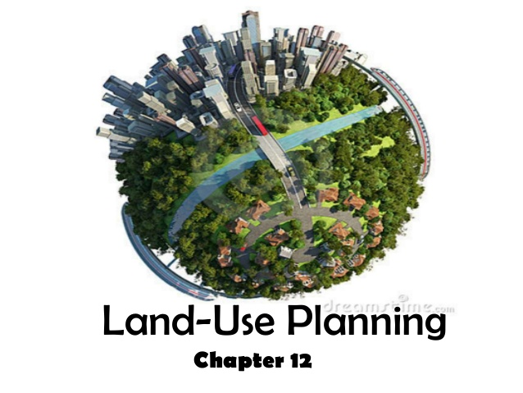
Land Use Planning
Land use planning is carried out at three levels:
Community
Village
Household/Parcels

Slide 19
DIFFERENT LEVELS OF LAND USE PLANNING
 | Community | Village | Household/Parcel
Scope | General | Detailed | Micro-planning
Area Covered | Whole community | Micro-area or equivalent | Individual allocated forest land
Level of Detail | Reconnaissance | Detailed | Very detailed
Sources of Information | Mainly secondary; Extensive field checking | Secondary and primary information from farmers; intensive field checking | Mainly direct field observation
Participation | Indirect and direct, Commune and village meeting | Direct and indirect, Village meeting | Direct participation of household, on site
Mapping Scale | 1:10 000 1:25 000 for communes>25000ha | 1:5 000 | Sketch map 1:1 000

Slide 20
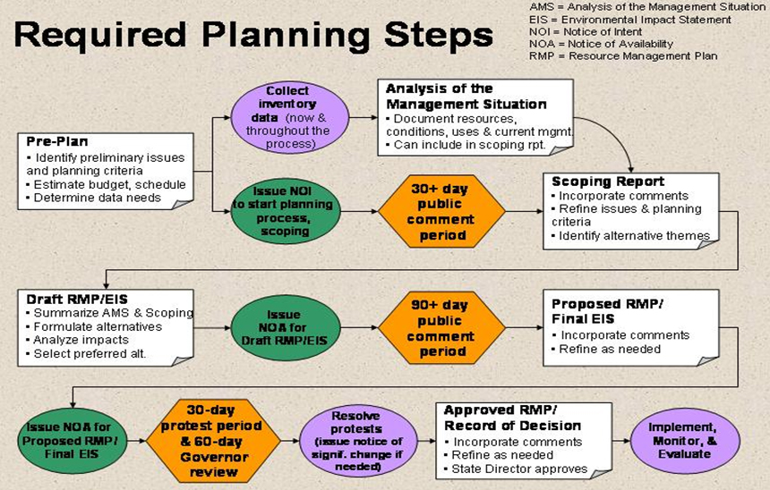

Slide 21
Community Land Use Plan
Ensures sustainable use of the land
Community LUP is a comprehensive and concrete proposal for land use prepared for:
Providing orientations for the use of the land in the future
Identifies what land should be used for agriculture, forestry, conservation etc.
Identifies and addresses local population's needs for forest land
Present use of such lands and capacity to manage them
It includes:
Map showing proposed land uses
Brief report describing the different categories of uses along with recommendations for specific land use practices

Slide 22
How to prepare the Community Land Use Plan (LUP)?
Collect secondary, information related to land and resource use
Update existing information
Analyze information and identify main issues
Identify development goals of the community and specific objectives for forest land allocation
Develop options to address forest land and resource use issues and to meet objectives
Assess options and prepare community land use plan
Discuss community land use plan in commune meetings,
Finalize and obtain formal approval from authorities at district and provincial levels communities

Slide 23
Type of information required to prepare the Community LUP
Socio-economic data, needs, aspirations and know how of commune population
Topographic map, including administrative boundaries, land tenure, occupation
Present land use and vegetation cover
Site conditions and potential/capability

Slide 24
Village Land Use Plan
Provides detailed orientations on land use in a village
Prepared for one of more villages or hamlets, for a specific micro-area or for equivalent areas
Process for the preparation of the village land use plan is the same as for the preparation of commune land use plans but
Much more detailed
Requires a much more direct and intensive participation of concerned populations
More intensive and detailed field work
The village land use plan is normally prepared after the community land use plan has been approved by competent authorities

Slide 25
Land Use Plan for Individual Parcels of Allocated Land
Prepared for each parcel of forest land allocated
Provides guidelines about future use of the allocated forest land
Detailed, micro-planning exercise is done on the land allocated, in cooperation with representatives of the household
Prepared at the time when surveying crews from the community cadastral units go to the field:
To delineate
To measure and sketch/map each individual parcel of land

Slide 26
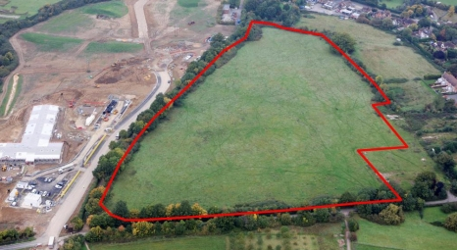
Forest Land Allocation (FLA)
Hold a training session on participatory forest land allocation
Prepare an operational plan for carrying out forest land allocation
Organize commune and village meetings
Assist households in completing application forms for forest land

Slide 27
Forest Land Allocation (FLA)
7. Prepare forest land allocation scheme
Present forest land allocation scheme in village meetings
Delineate and measure allocated parcels in the field
Prepare land use plan for allocated parcel
Prepare cadastral map
Prepare cadastral register
Obtain official approvals for the forest land allocation scheme
Issue Land Tenure Certificates

Slide 28
ISSUES DURING IMPLEMENTATION
Policy Level
Legal Aspects
Land and Forest Classifications
Clarify Objectives
Security of Tenure and Benefits
Impacts
Operational Level
Institutional Aspects
Participation
Local knowledge
Level of Technology
Sustainable Use of Allocated Land

Slide 29
CONCLUSION
The methodology for Participatory Land Use Planning and Forest Land Allocation emphasizes participation of local populations
Multidisciplinary working groups and a level of technology adapted to currently available resources
Provides a general framework and guidelines that need to be adapted to specific situations
Provide a solid basis for forest land allocation on the basis of sound land use planning involving local populations and the sustainable development and use of the allocated lands
Methodology is still being refined so that it should be applied in all situations

