Slide 2
Topics Covered
1.1 Investment and Financing Decisions
1.2 What is a Corporation?
1.3 Who Is the Financial Manager?
1.4 Goals of the Corporation
1.5 Agency Problems, Executive Compensation, and Corporate Governance
1.6 The Ethics of Maximizing Value
1.7 Careers in Finance
1.8 A Preview of Coming Attractions
1.9 Snippets of Financial History
Notes:
3
2
2
2
2
2

Slide 3
Investment and Financing Decisions
Capital Budgeting Decision
Decision to invest in tangible or intangible assets
…also called
the Investment Decision
the Capital Expenditure (CAPEX) decision
Notes:
6
5
5
5
5
5

Slide 4
Investment and Financing Decisions
“Capital Budgeting”
TANGIBLE ASSETS
Southwest Airlines
Purchase new planes
INTANGIBLE ASSETS
GlaxoSmithKline
R&D expenditures
Notes:
6
5
5
5
5
5

Slide 5
Investment and Financing Decisions
Financing Decision
Decision on the sources and amounts of financing
Capital Structure
The mix of long-term debt and equity financing
Notes:
6
5
5
5
5
5

Slide 6
Investment and Financing Decisions
ASSETS
FIRM
Investment Decision
Debt
Equity
Financing Decision
Notes:
6
5
5
5
5
5

Slide 7
Investment and Financing Decisions
Real Assets
Assets used to produce goods and services
Financial Assets
Financial claims to the income generated by the firm’s real assets
Notes:
6
5
5
5
5
5

Slide 8
Investment and Financing Decisions
Are the following capital budgeting or financing decisions?
Intel decides to spend $1 billion to develop a new microprocessor
Volkswagen borrows 350 million euros (€350 million) from Deutsche Bank
Royal Dutch Shell constructs a pipeline to bring natural gas onshore from a production platform in Australia
Avon spends €200 million to launch a new range of cosmetics in European markets
Pfizer issues new shares to buy a small biotech company
Notes:
6
5
5
5
5
5

Slide 9
What Is a Corporation?
Corporation
A business organized as a separate legal entity owned by stockholders
Types of Corporations
Public Companies
Private Corporations
Limited Liability Corporations (LLC)
Notes:
4
3
3
3
3
3

Slide 10
What Is a Corporation?
Types of Business Organizations
Sole Proprietorships
Partnerships
Corporations
Limited Liability Options
Limited Liability Partnerships
Limited Liability Corporations
Professional Corporations
Limited Liability
The owners of a corporation are not personally liable for its obligations
Notes:
4
3
3
3
3
3

Slide 11
What Is a Corporation?
 | Sole Proprietorship | Partnership | Corporation
Who owns the business? | The manager | Partners | Stockholders
Are managers and owners separate? | No | No | Usually
What is the owner’s liability? | Unlimited | Unlimited | Limited
Are the owner and business taxed separately? | No | No | Yes
Notes:
5
4
4
4
4
4

Slide 12
What Is a Corporation?
Sole Proprietorships
Unlimited Liability
Personal tax on profits
Partnerships
Limited Liability
Corporate tax on profits + personal tax on dividends
Corporations

Slide 13
Who Is the Financial Manager?
Chief Financial Officer
Treasurer
Cash Management
Raising capital
Banking relationship
Controller
Preparation of Financial Statement
Accounting
Taxes
Notes:
19

Slide 14
Who Is the Financial Manager?
Chief Financial Officer (CFO)
Supervises all financial functions and sets overall financial strategy
Treasurer
Responsible for financing, cash management, and relationships with banks and other financial institutions
Controller
Responsible for budgeting, accounting, and taxes
Notes:
4
3
3
3
3
3

Slide 15
Who Is the Financial Manager?
(2)
Financial
Manager
(1)
Firm’s Operations
Investors
(4a)
(3)
(4b)
Real assets
Financial assets
Notes:
11
10
6
6
6
6

Slide 16
Goals of the Corporation
Shareholders desire wealth maximization
Profit maximization
Maximize profits? Which year’s profits?
Earning manipulation
Opportunity cost of capital
The minimum acceptable rate of return on capital investment is set by the investment opportunities available to shareholders in financial markets
Notes:
17

Slide 17
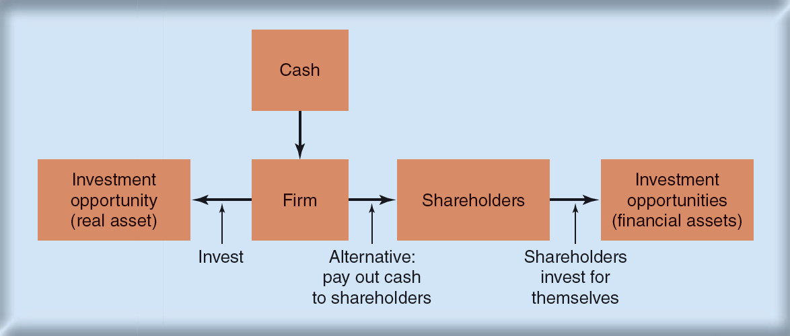
Goals of the Corporation
The Investment Trade-Off
Notes:
17

Slide 18
Agency Problem
Do managers maximize shareholder wealth or manager wealth?
Mangers have many constituencies “stakeholders”
Stakeholder
Anyone with a financial interest in the corporation
Notes:
17

Slide 19
Agency Problem
Agency problem
Managers are agents for stockholders and are tempted to act in their own interests rather than maximizing value
Agency cost
Value lost from agency problems or from the cost of mitigating agency problems
Notes:
17

Slide 20
Agency Problem
Ownership vs. Management
Difference in Information
Stock prices vs. returns
Dilution of ownership
Dividend policy
Financing decisions
Different Objectives
Managers vs. stockholders
Top managers vs. lower managers
Stockholders vs. banks and lenders

Slide 21
Agency Problem
Corporate governance
The laws, regulations, institutions, and corporate practices that protect shareholders and other investors
Notes:
18

Slide 22
Agency Problem
Elements of good corporate governance
Legal requirements
Board of directors
Activist shareholders
Takeovers
Information for shareholders
Notes:
18

Slide 23
Ethics of Maximizing Value
“It is not from the benevolence of the butcher, the brewer, or the baker, that we expect our dinner, but from their regard to their own interest. We address ourselves, not to their humanity but to their self-love, and never talk to them of our own necessities but of their advantages.” –Adam Smith, 1776
Does value maximization justify unethical behavior?
Charles Ponzi
Bernard Madoff
Tyco
Is it ethical?
Short selling
Corporate raiders
Tax avoidance
Notes:
18

Slide 24
Preview of Coming Attractions
How do I calculate the value of a stream of future cash flows?
How do I measure risk?
Where does financing come from?
How do I ensure that the firm’s financial decisions add up to a sensible whole?
What about some of those other responsibilities of the financial manager that you mentioned earlier?
Notes:
18

